Slide 1
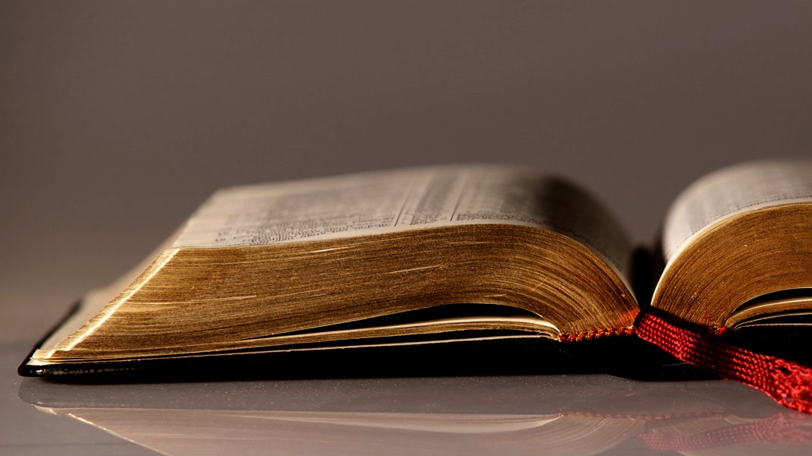
Welcome to
Our Sunday School
We’ll start at 9:07
visit OurSundaySchool.com for more about our class

Slide 2
Today’s class (pages 90-93)
Philippians 4:4-5

Slide 3
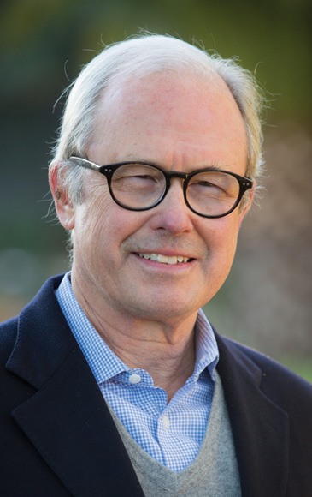
Dr. G. Walter Hansen A time of suffering is a time when rejoicing in the Lord is the only way to survive.

Slide 4
Today’s class (pages 90-93)
Philippians 4:4-5

Slide 5
The chiasm in Philippians 4:4
Χαίρετε ἐν κυρίῳ πάντοτε πάλιν ἐρῶ χαίρετε
Rejoice in the Lord always again I say Rejoice

Slide 6
Today’s class (pages 90-93)
Philippians 4:4-5

Slide 7
BDAG on epieikes (ep-ee-ahh-CASE) not insisting on every right or letter of law or custom; yielding, gentle, kind, courteous, tolerant

Slide 8
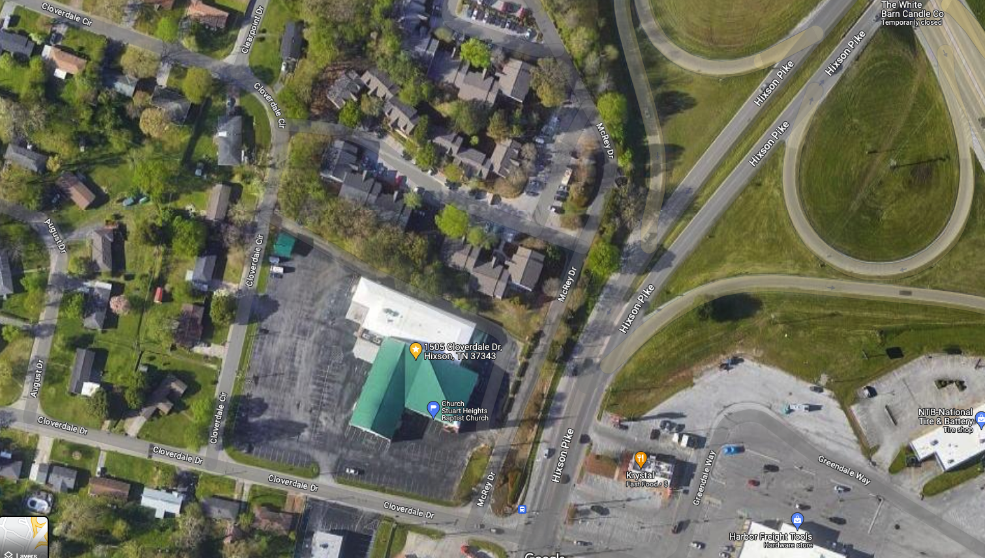

Slide 9
Prayer Time
Write down your prayer requests (on the Weekly Update or in the comments)
Lean in, engage, and pray for someone not with you
Go worship

Slide 10
Today’s class (page 16)
Preparing for Philippians 1:1-30
Pray with others
Hear with others
Think with others
Study with others In class, as a table
Share with others
Invite others After class
In class, as a class

Slide 11
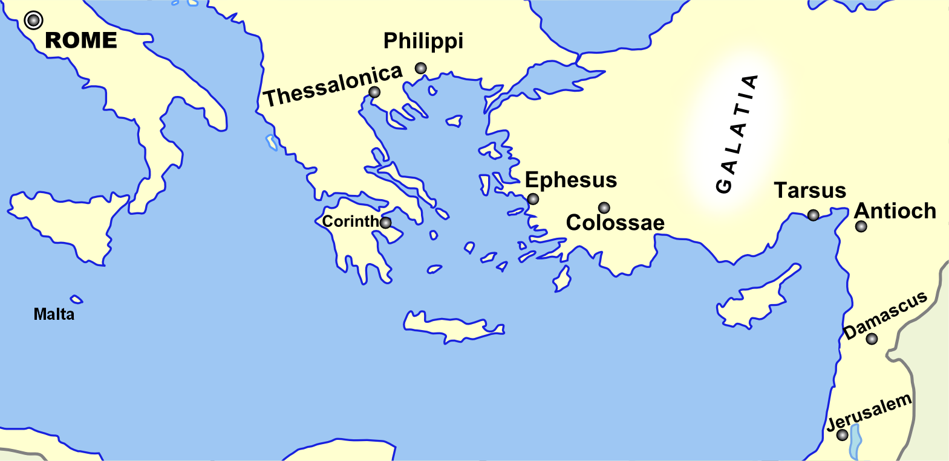
Monozigote. (2012). Broad Overview of Geography Relevant to Paul of Tarsus [Map]. Wikipedia.

Slide 12
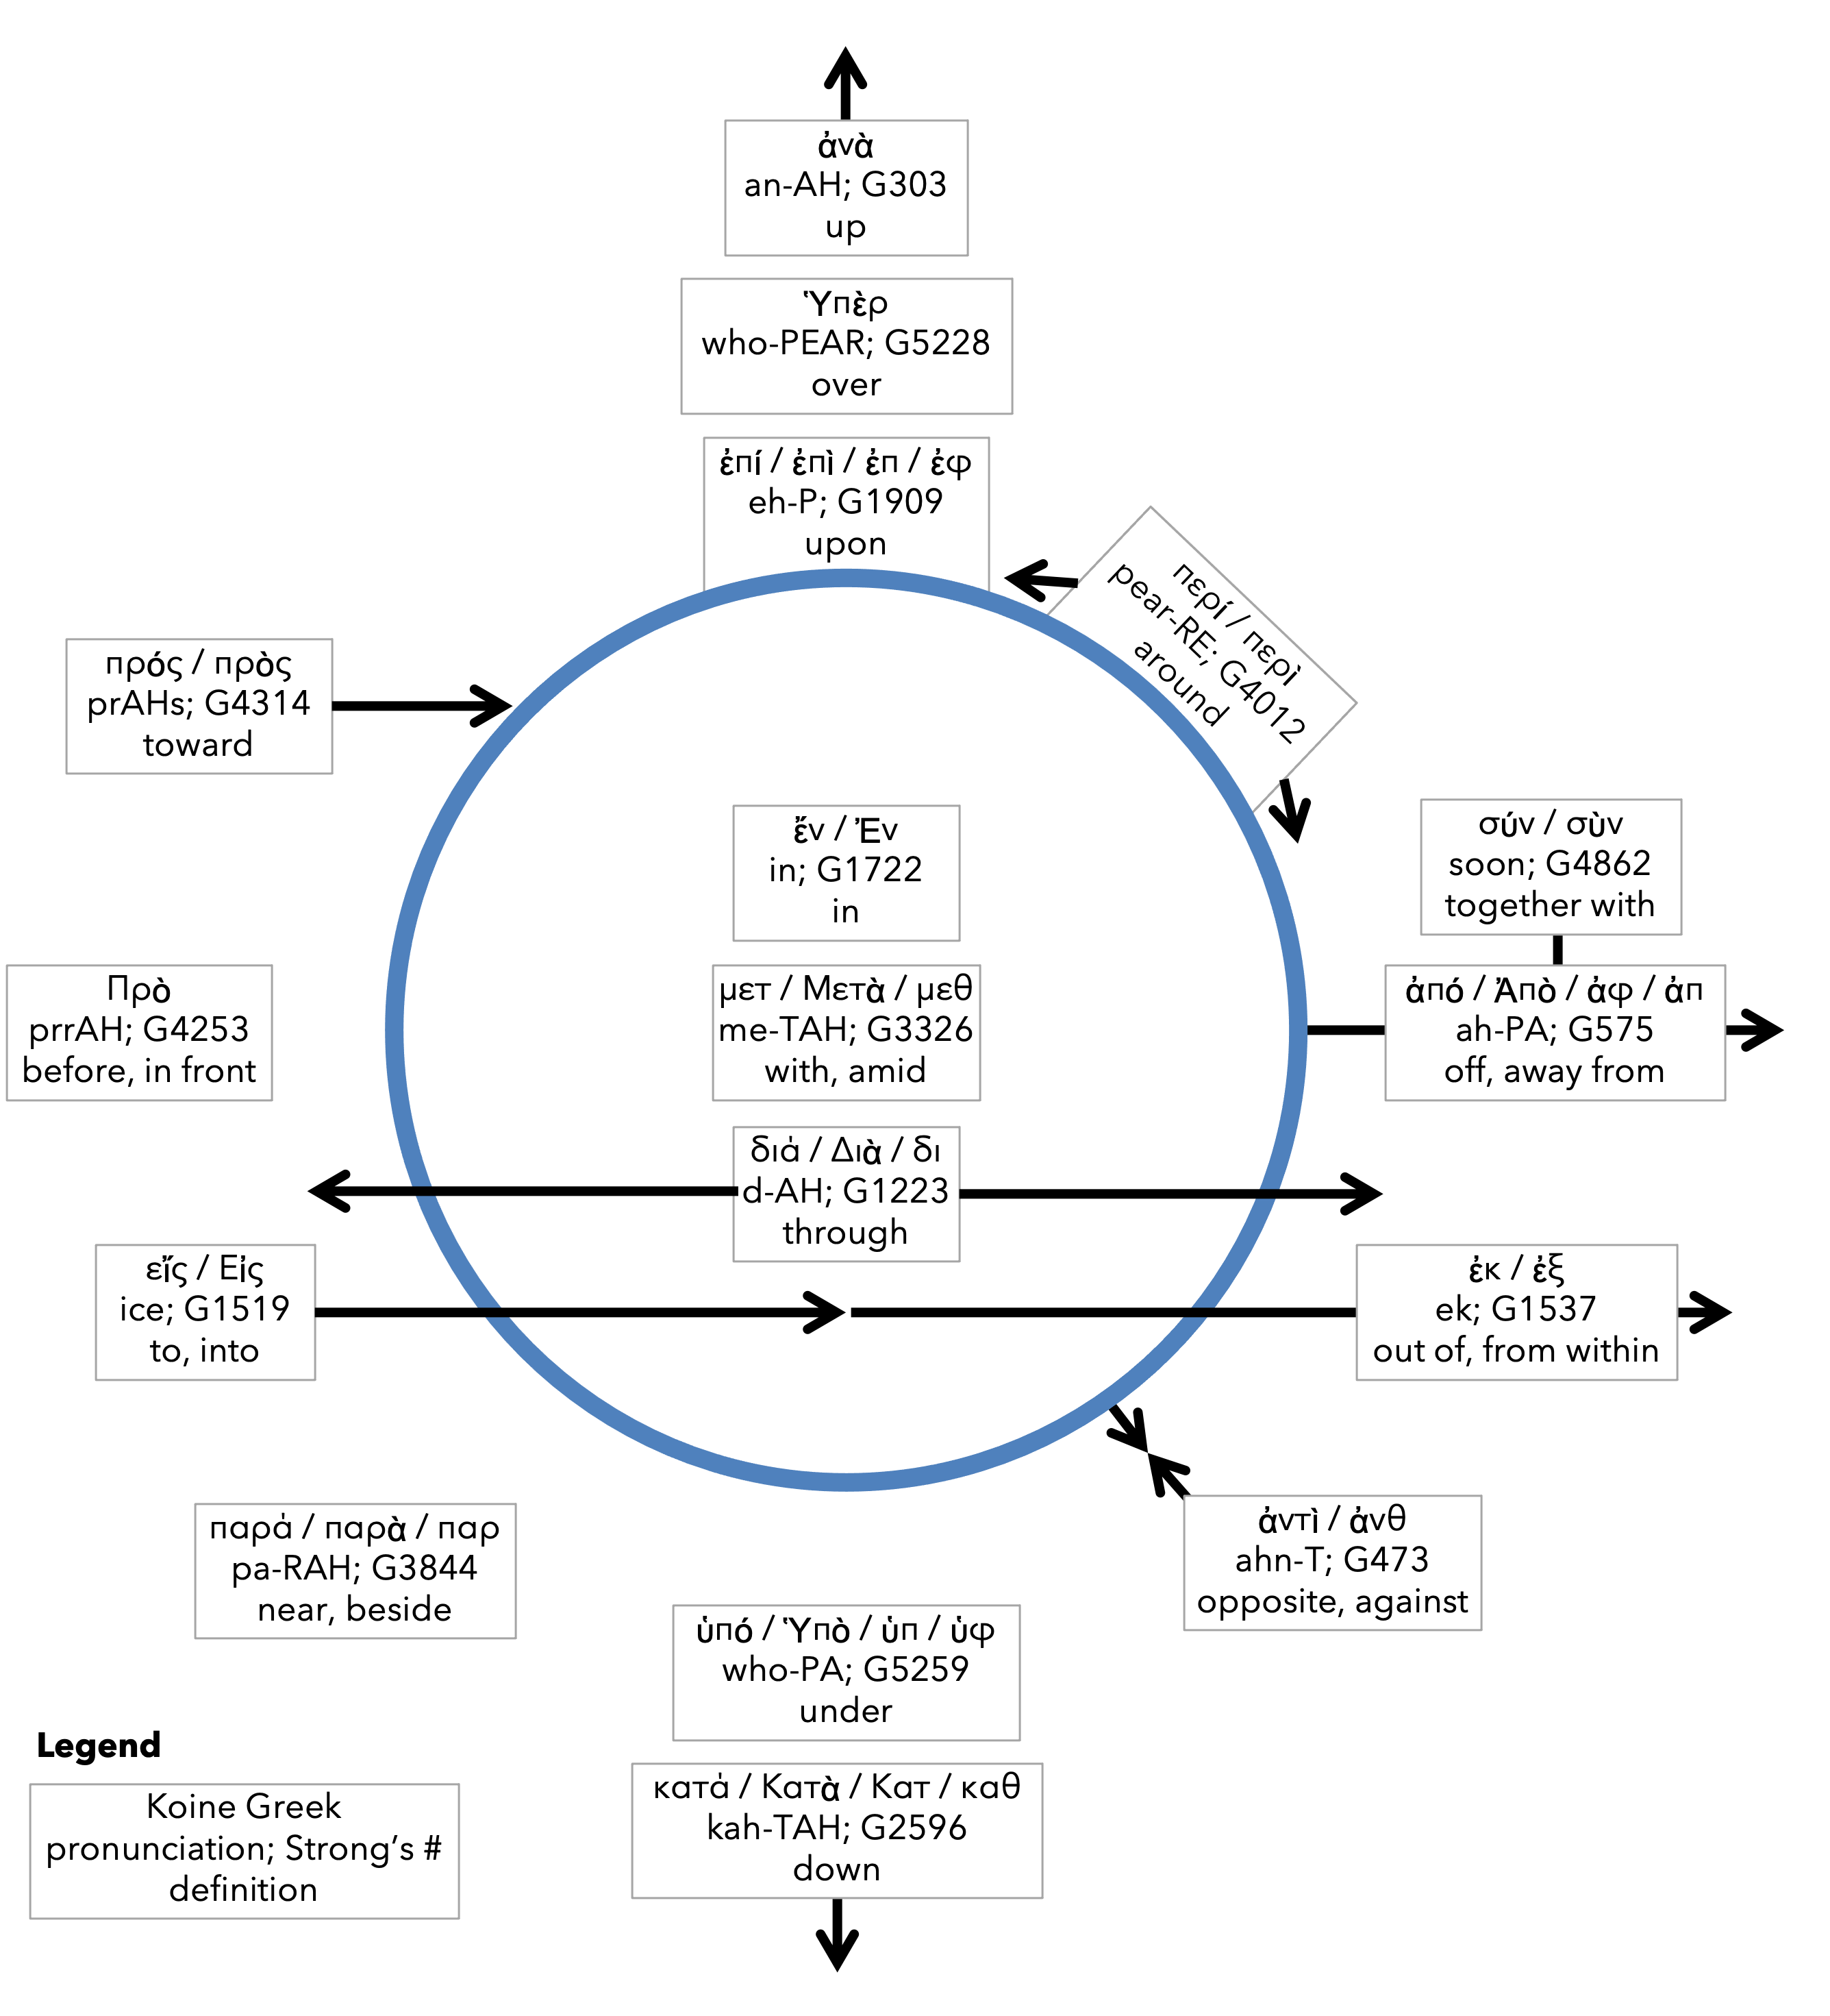
Preposition circle (page 13)

Slide 13
BDAG on morphe (mor-FAY) form, outward appearance, shape

Slide 14
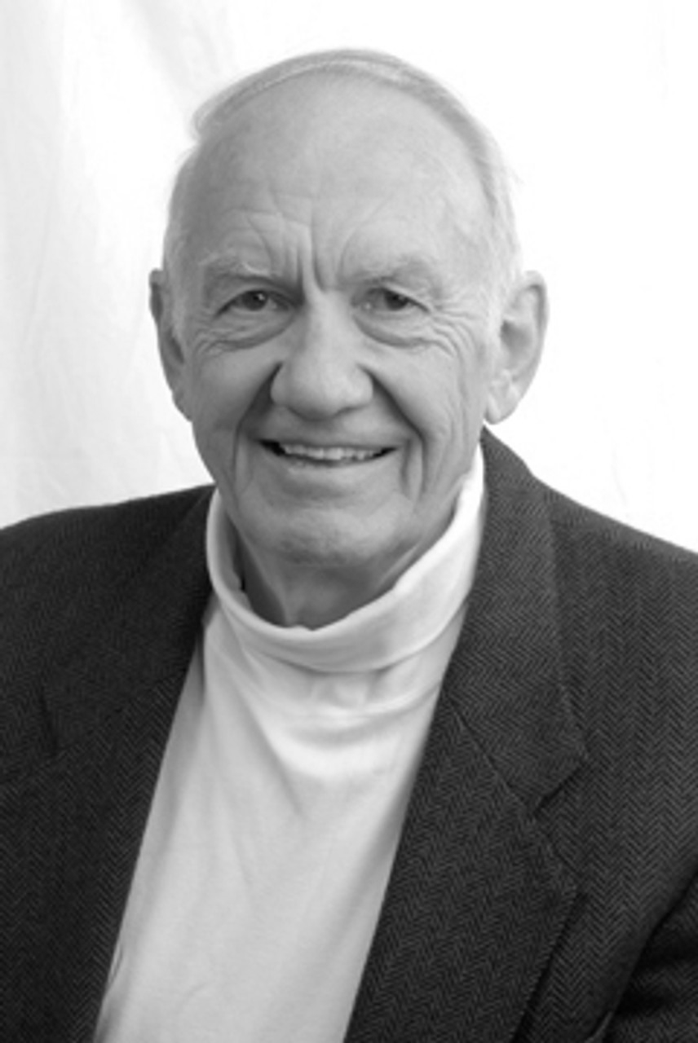
Dr. Gordon Fee Quote

Slide 15
Dr. G. Walter Hansen Quote

Slide 16
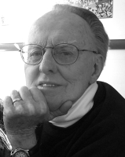
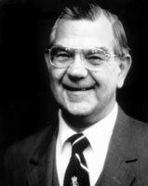
Dr. G. F. Hawthorne & Dr. Ralph P. Martin Quote

Slide 17
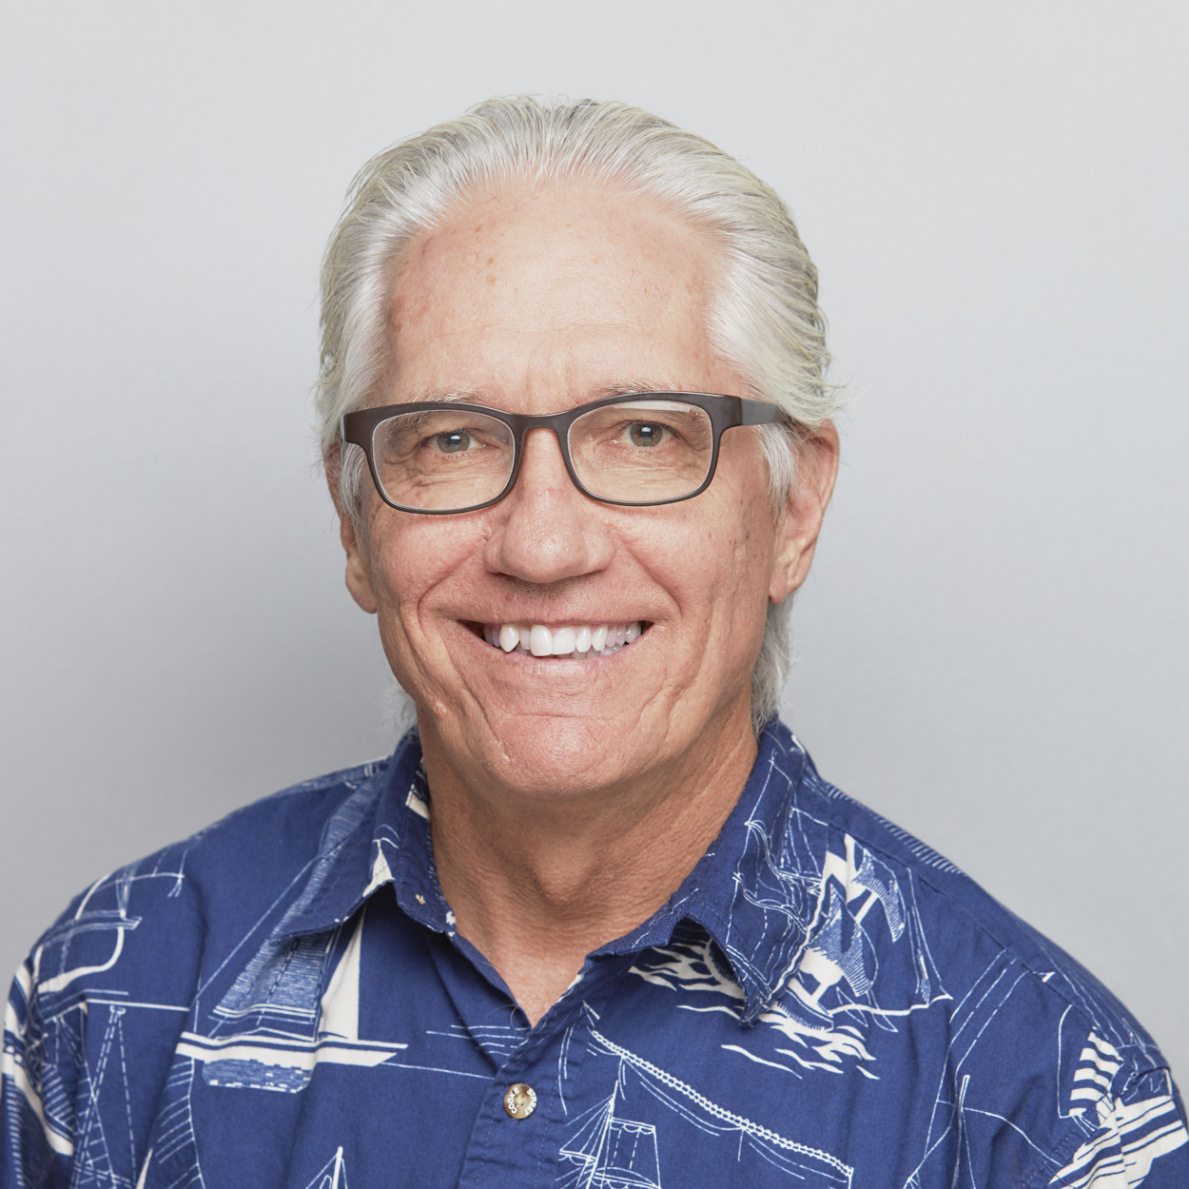
Dr. Joe Hellerman Quote

Slide 18
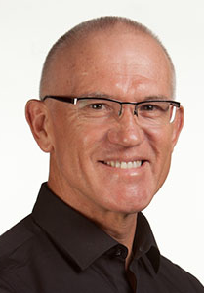
Dr. Mark Keown Quote

Slide 19
Dr. Ralph P. Martin Quote

Slide 20
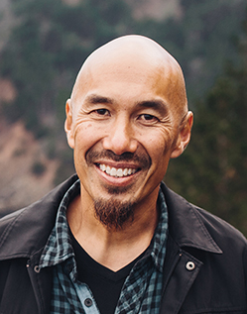
Dr. Tony Merida & Frances Chan Quote

Slide 21
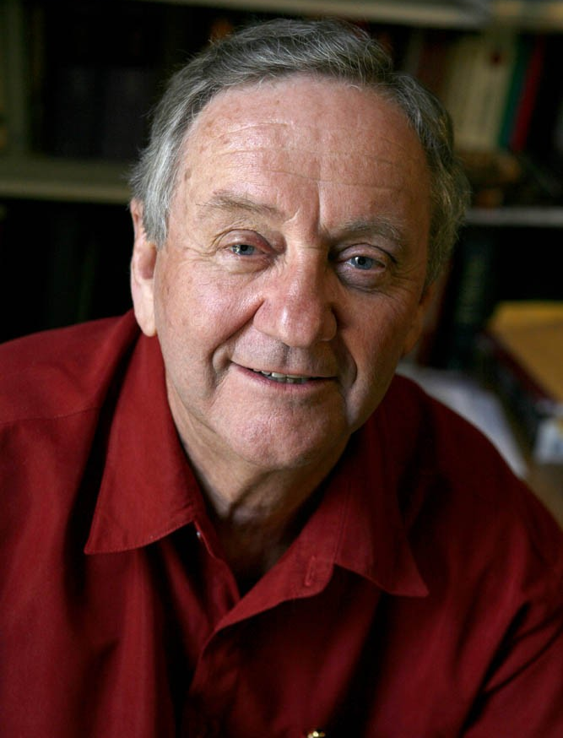
Dr. Peter T. O’Brien Quote

Slide 22
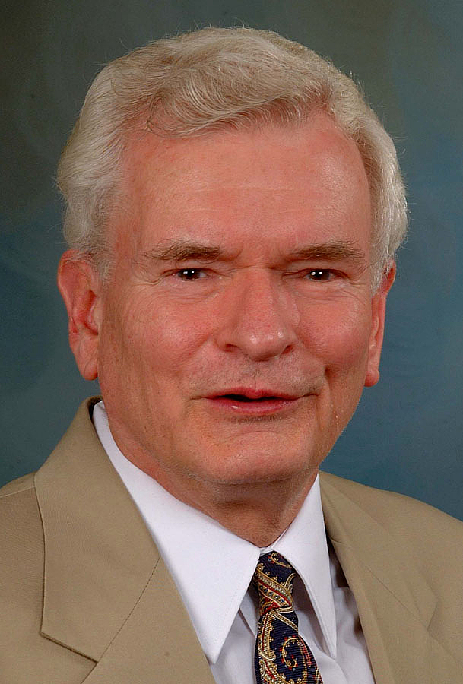
Dr. John Reumann Quote

Slide 23
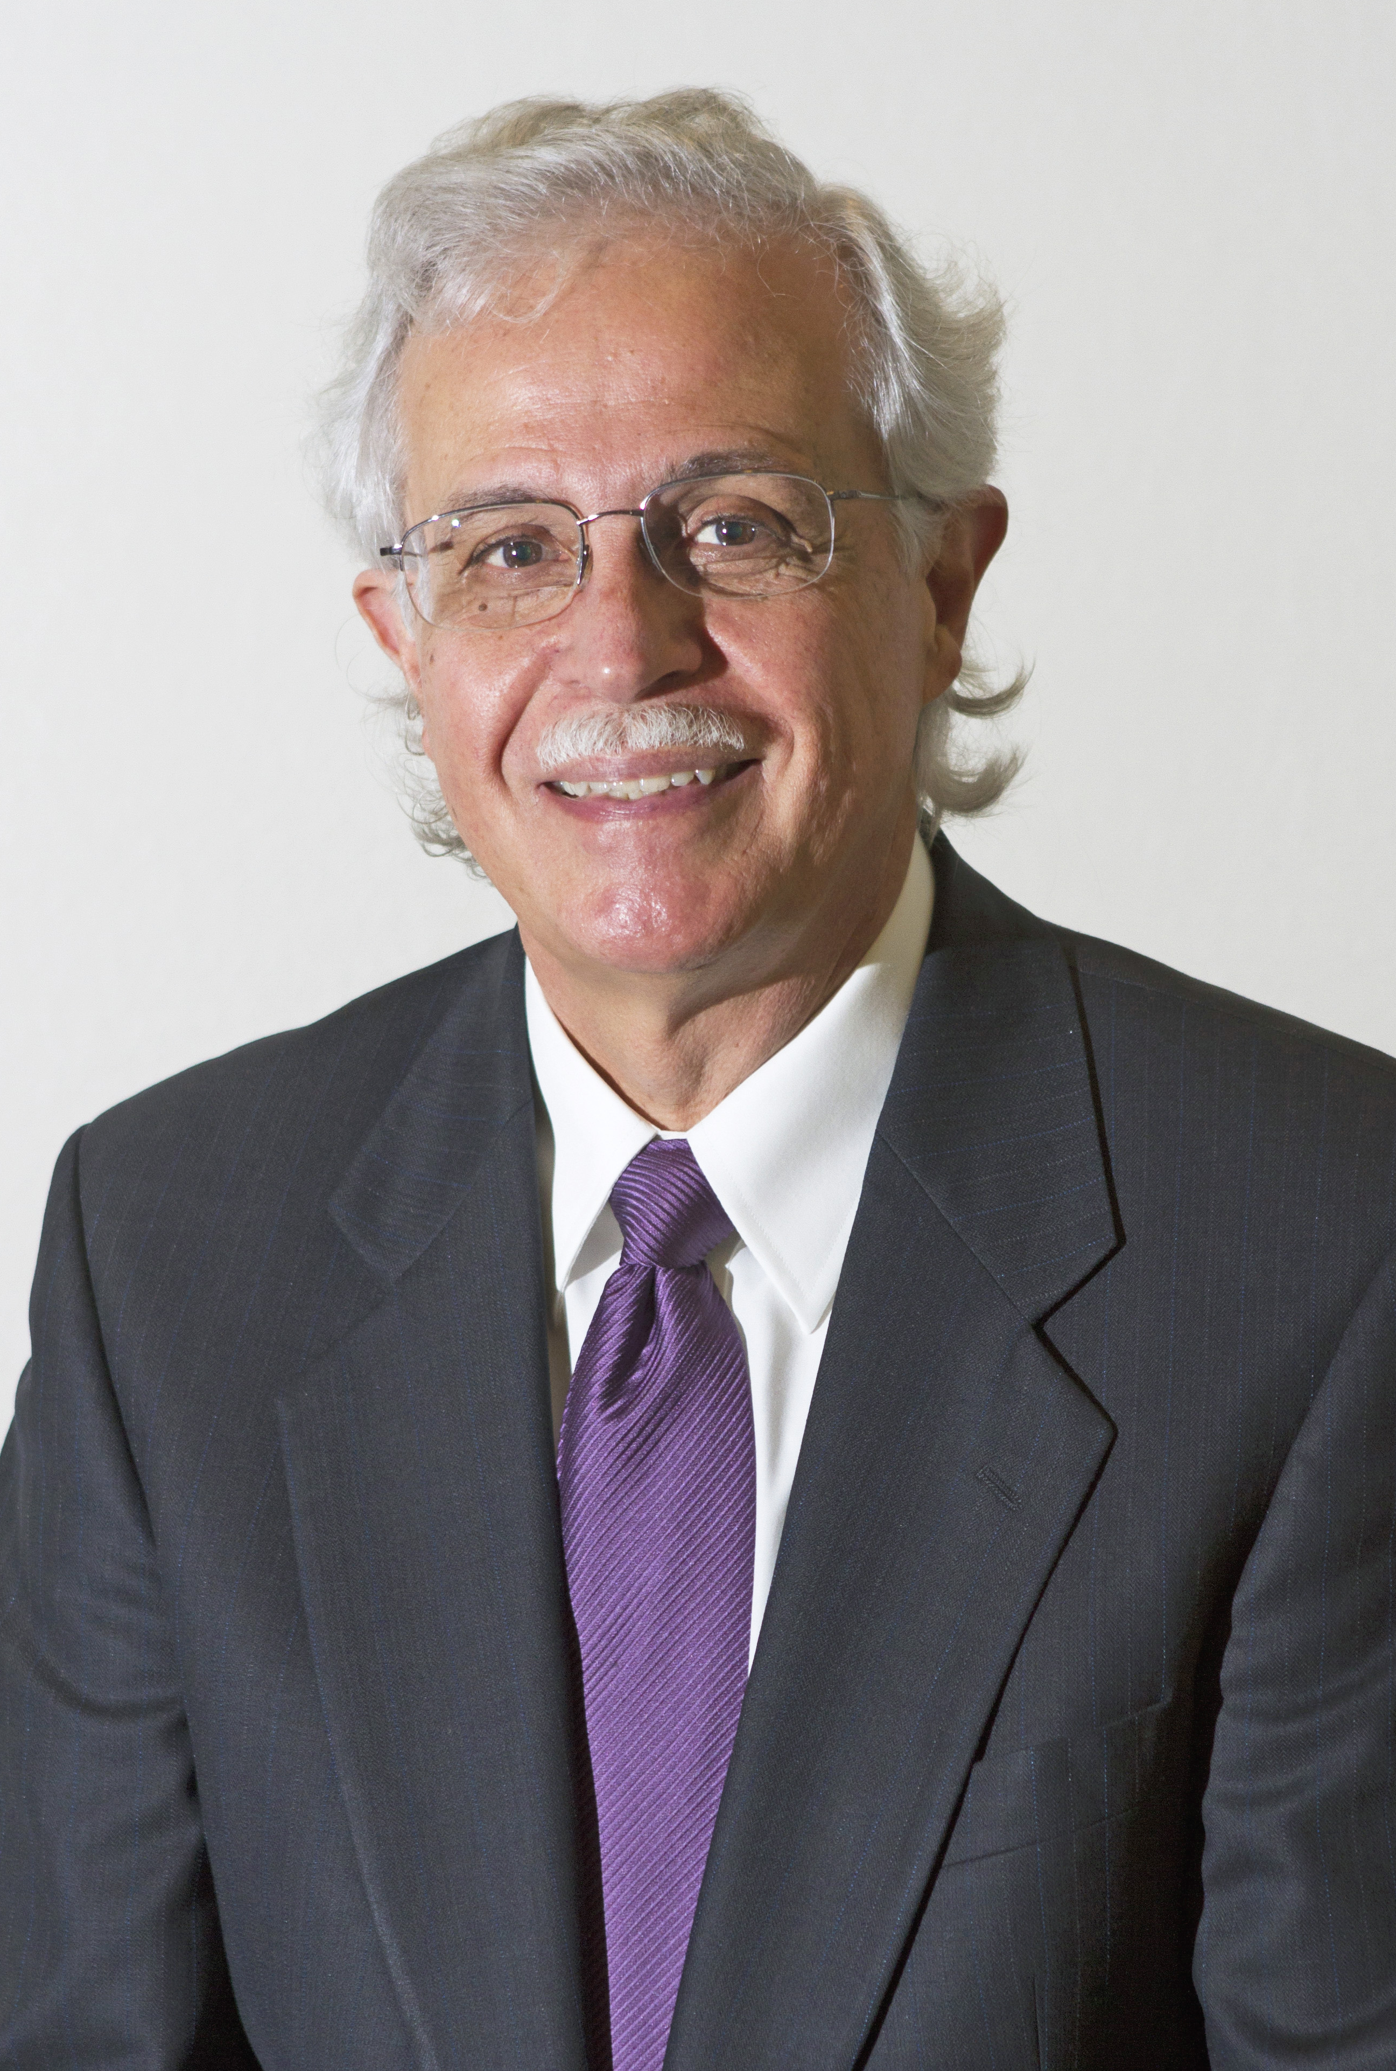
Dr. Moises Silva Quote

Slide 24
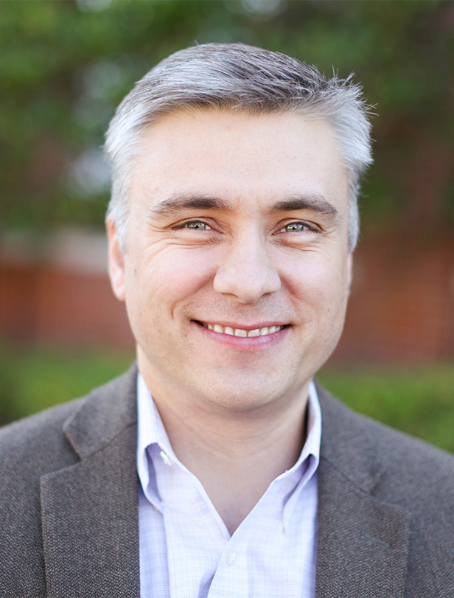
Dr. David T. A. Strain Quote

Slide 25
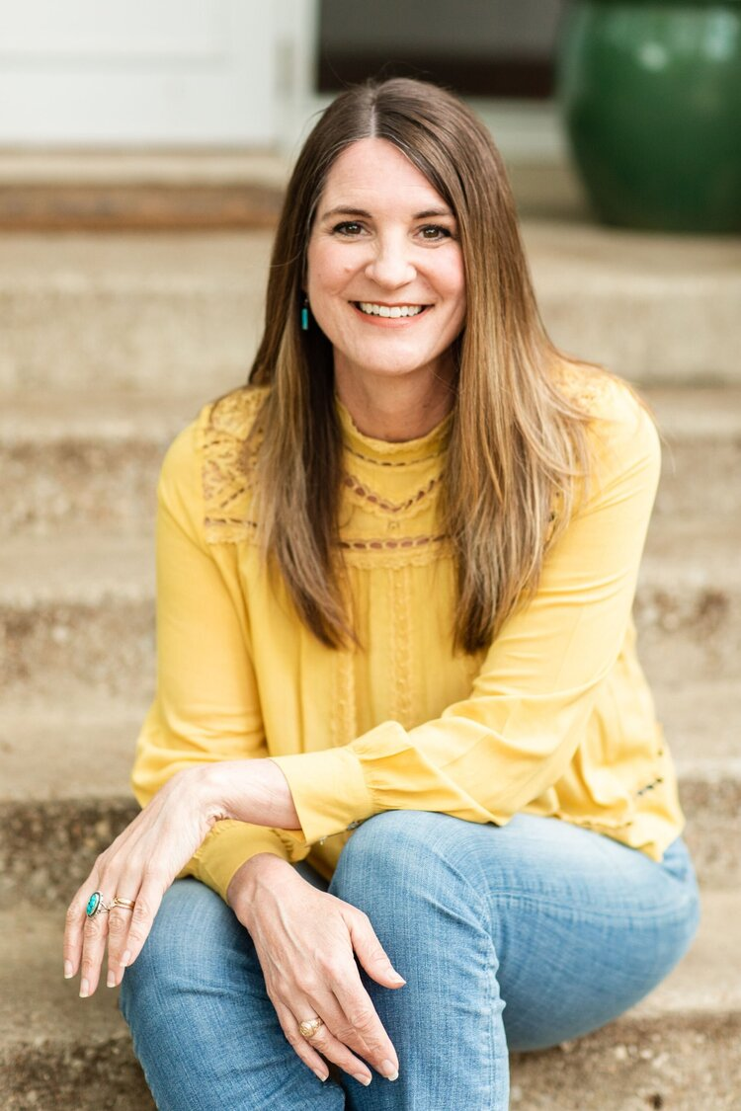
Jen Wilkin Quote

