Slide 1
Welcome to
Our Sunday School
We’ll start at 9:07
visit OurSundaySchool.com for more about our class

Slide 2
Today’s class (pages 83-90)
Philippians 4:2-3

Slide 3
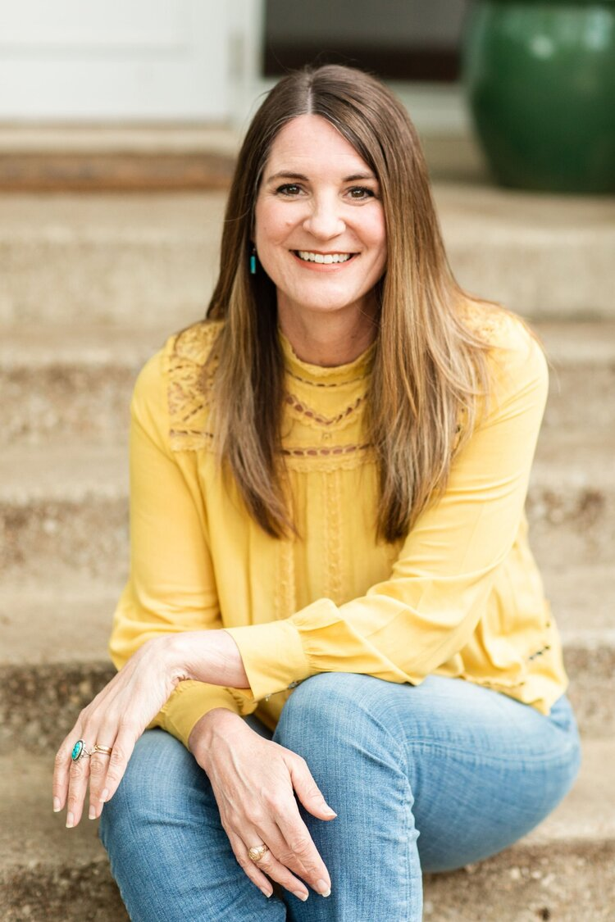
Jen Wilkin The heart cannot worship what the mind does not know.

Slide 4
Today’s class (pages 83-90)
Philippians 4:2-3

Slide 5
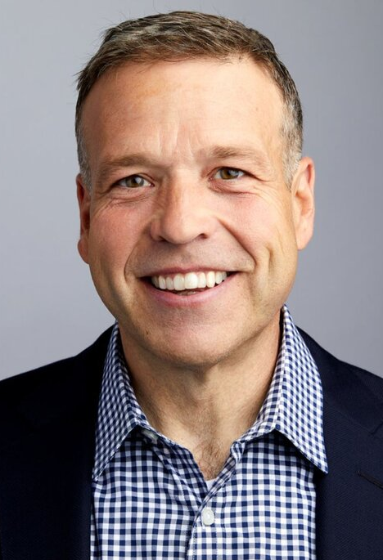
Don Miller We are called to hold our hands against the wounds of a broken world, to stop the bleeding

Slide 6
Today’s class (pages 83-90)
Philippians 4:2-3

Slide 7
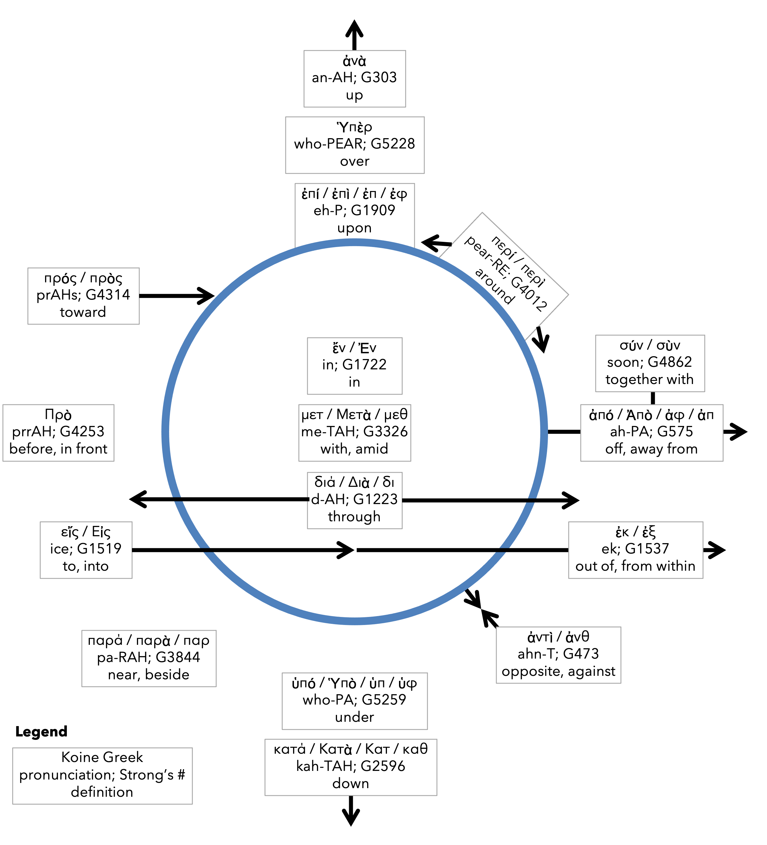
Preposition circle (page 13)

Slide 8
Today’s class (pages 83-90)
Philippians 4:2-3

Slide 9
Prayer Time
Write down your prayer requests (on the Weekly Update or in the comments)
Lean in, engage, and pray for someone not with you
Go worship

Slide 10
Today’s class (page 16)
Preparing for Philippians 1:1-30
Pray with others
Hear with others
Think with others
Study with others In class, as a table
Share with others
Invite others After class
In class, as a class

Slide 11
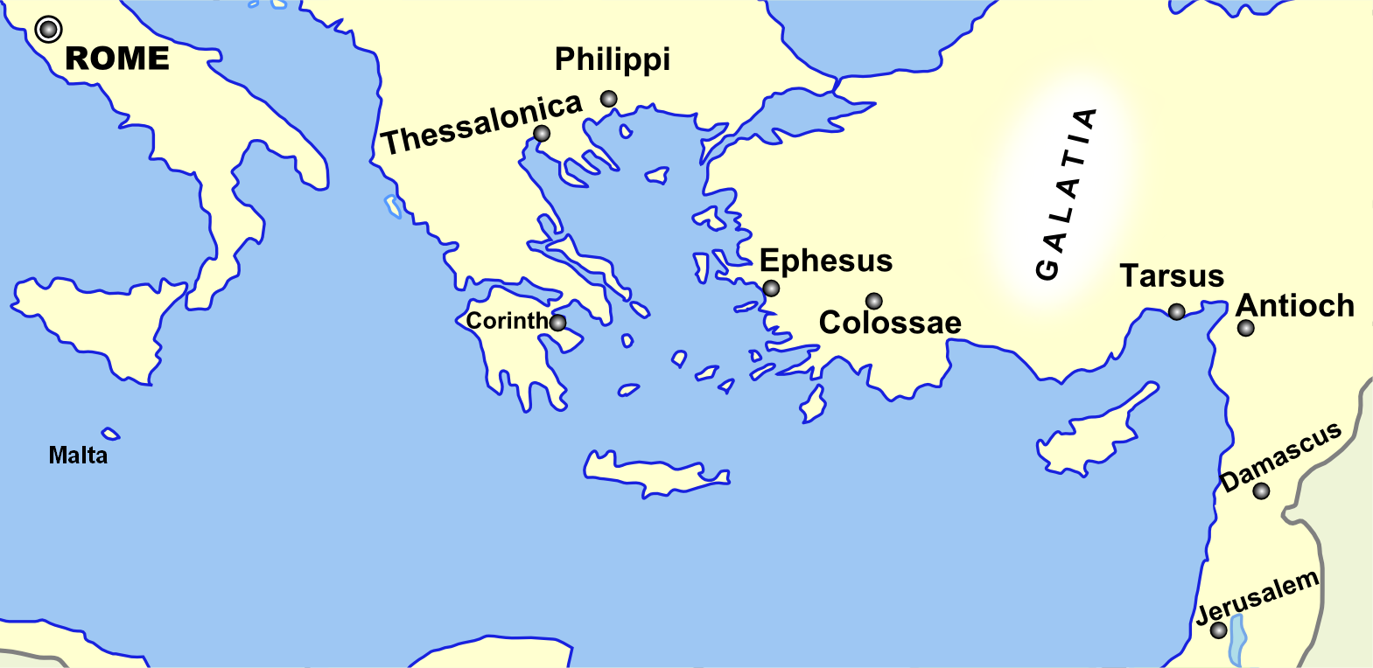
Monozigote. (2012). Broad Overview of Geography Relevant to Paul of Tarsus [Map]. Wikipedia.

Slide 12
Preposition circle (page 13)

Slide 13
BDAG on morphe (mor-FAY) form, outward appearance, shape

Slide 14
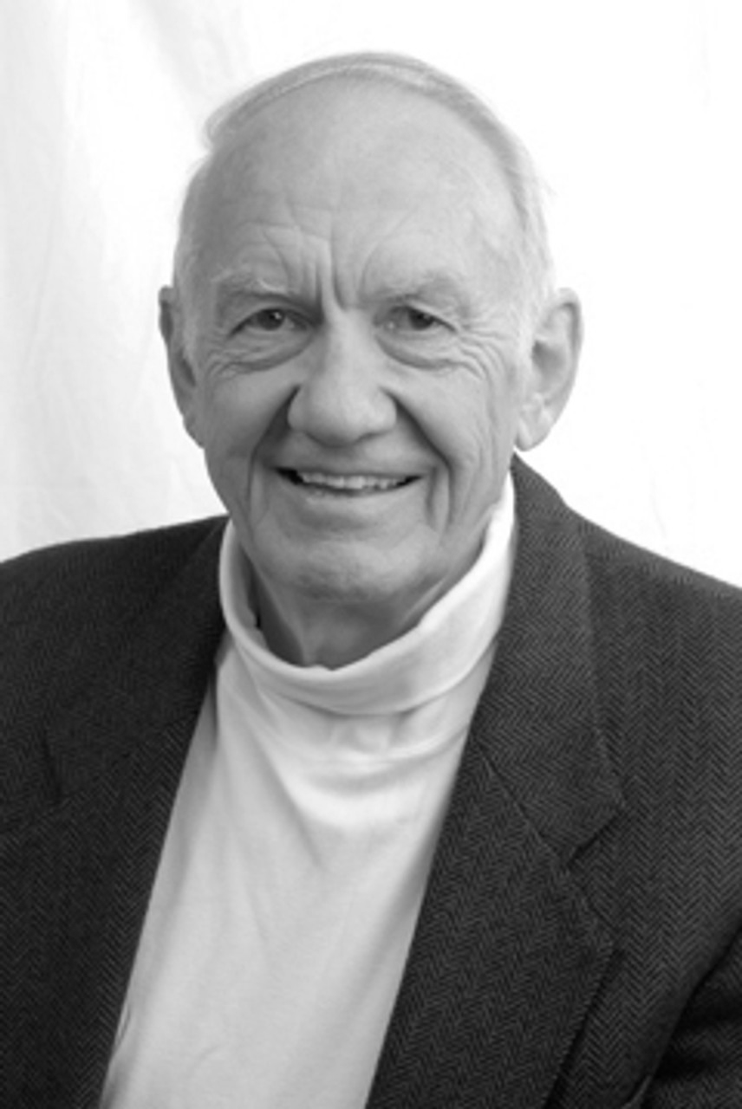
Dr. Gordon Fee Quote

Slide 15
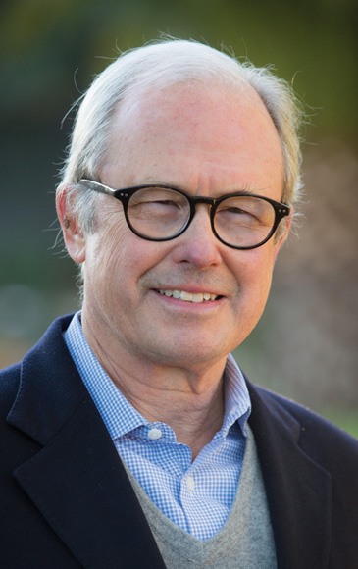
Dr. G. Walter Hansen Quote

Slide 16
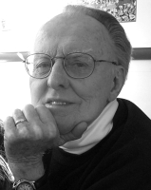
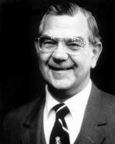
Dr. G. F. Hawthorne & Dr. Ralph P. Martin Quote

Slide 17
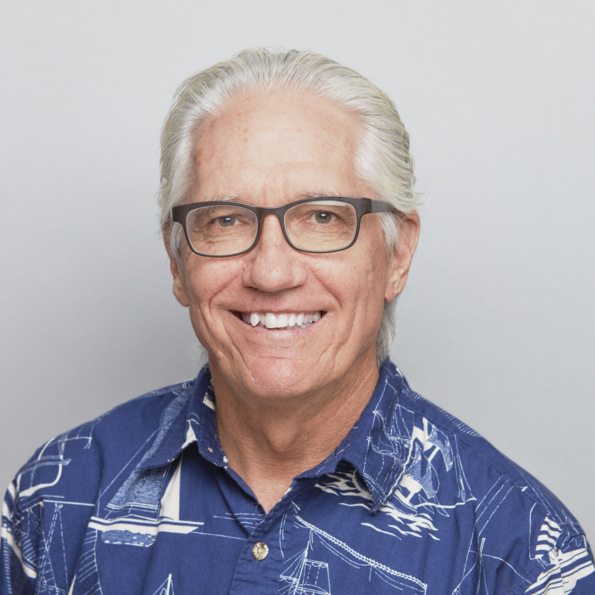
Dr. Joe Hellerman Quote

Slide 18
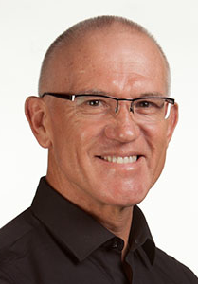
Dr. Mark Keown Quote

Slide 19
Dr. Ralph P. Martin Quote

Slide 20
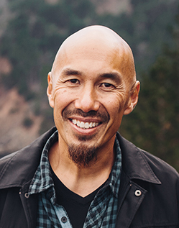
Dr. Tony Merida & Frances Chan Quote

Slide 21
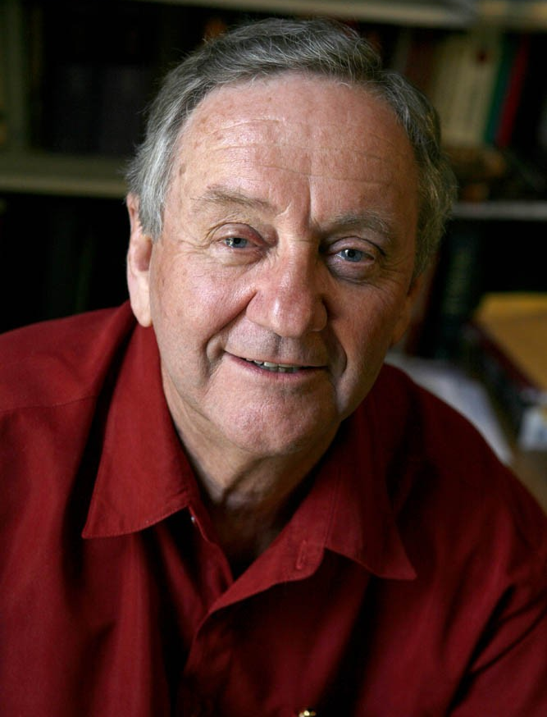
Dr. Peter T. O’Brien Quote

Slide 22
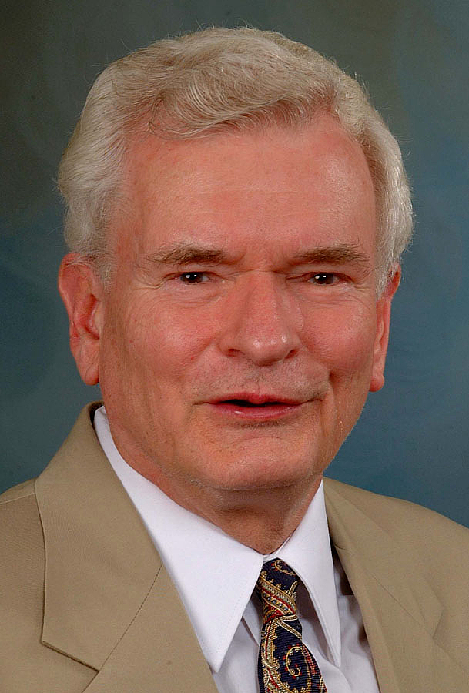
Dr. John Reumann Quote

Slide 23
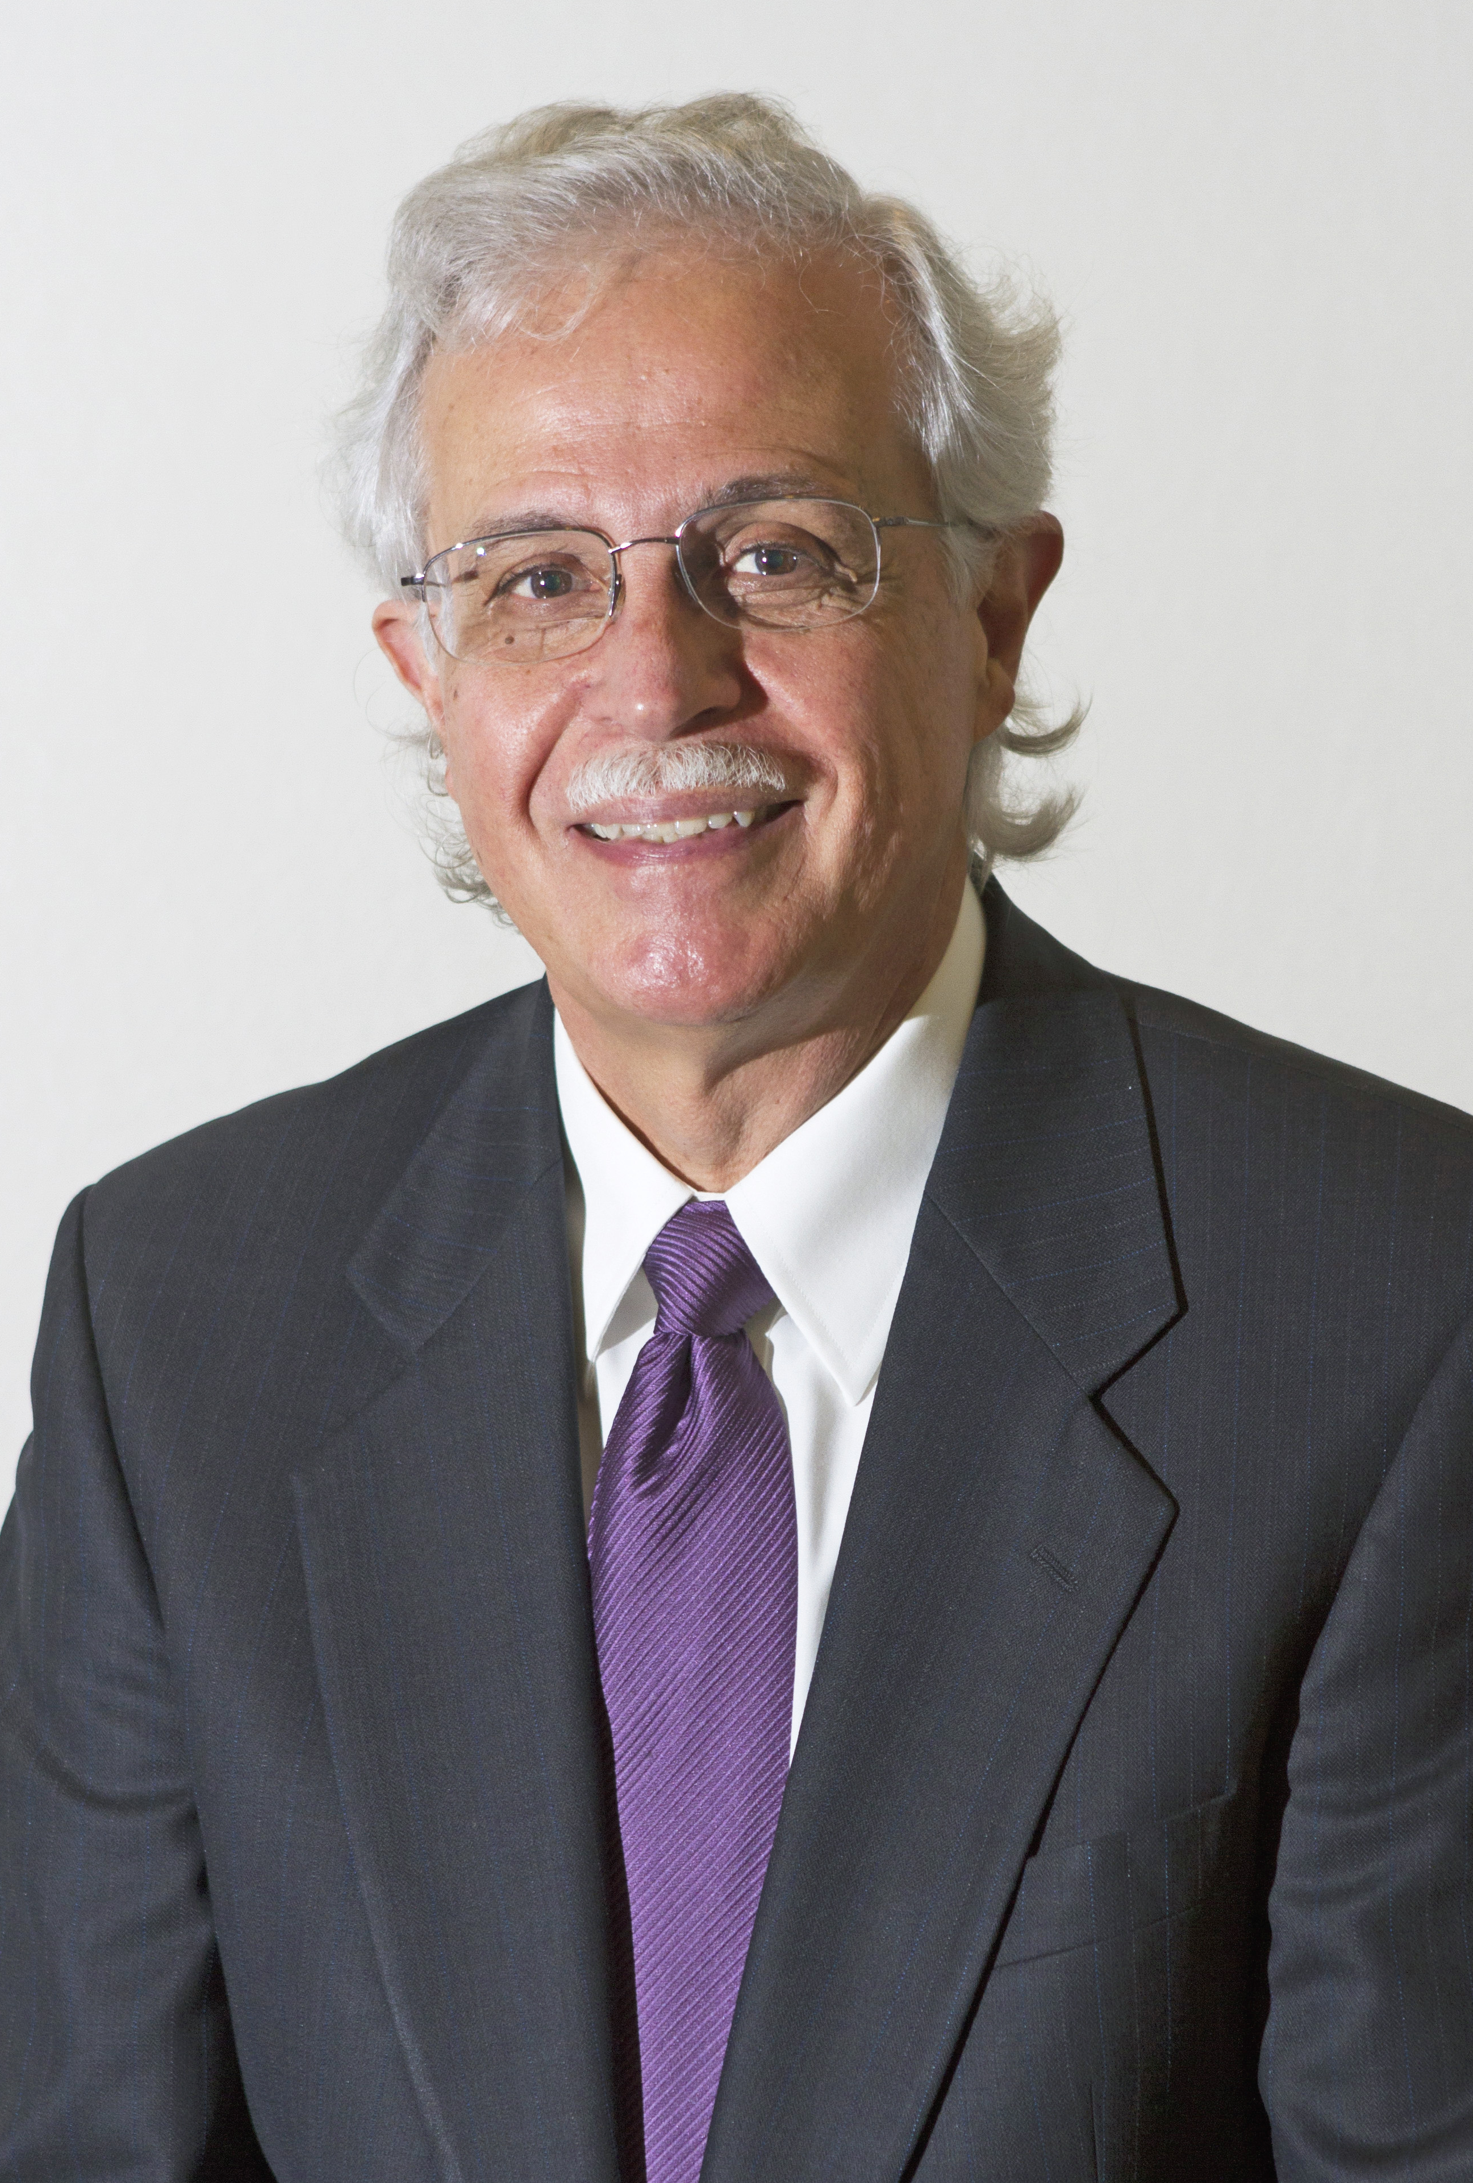
Dr. Moises Silva Quote

Slide 24
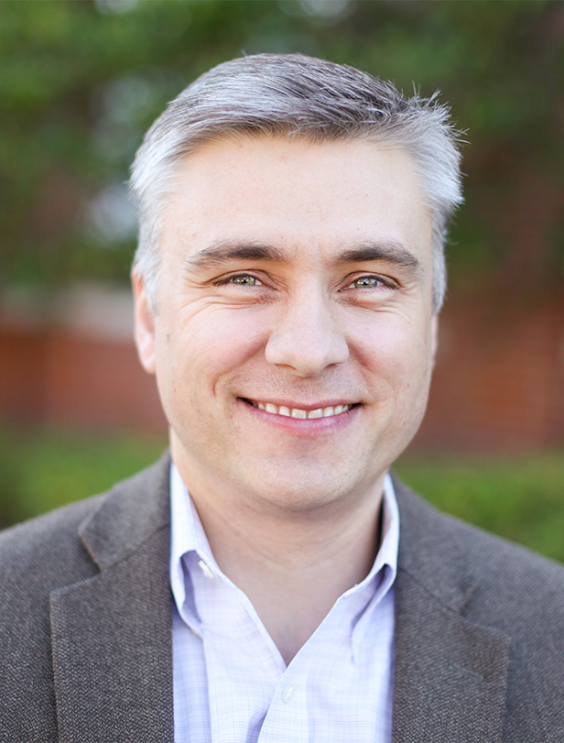
Dr. David T. A. Strain Quote

Slide 25
Jen Wilkin Quote

