Slide 1
Welcome to
Our Sunday School
We’ll start at 9:07
visit OurSundaySchool.com for more about our class

Slide 2
Today’s class (pages 72-80)
Philippians 3:20-4:1

Slide 3
Structure of 3:19-21
Enemies of the Cross
Their destiny is destruction
Their god is their stomach
Their glory is their shame
Their mind is on the Earth
Followers of Christ
We are citizens of Heaven
Humble body will be transformed
Covered in glory of Christ
Mind is on Christ’s return

Slide 4
Today’s class (pages 72-80)
Philippians 3:20-4:1

Slide 5
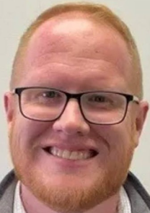

Slide 6
Today’s class (pages 72-80)
Philippians 3:20-4:1

Slide 7
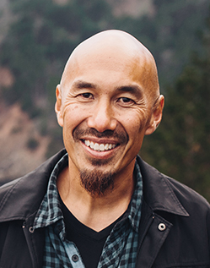
Dr. Tony Merida & Frances Chan Christ-Centered Exposition

Slide 8
Today’s class (pages 72-80)
Philippians 3:20-4:1

Slide 9
Prayer Time
Write down your prayer requests (on the Weekly Update or in the comments)
Lean in, engage, and pray for someone not with you
Go worship

