Slide 1
Welcome to
Our Sunday School
We’ll start at 9:07
visit OurSundaySchool.com for more about our class

Slide 2
Today’s class (pages 50-60)
Philippians 3:12-14

Slide 3
BDAG on epekteinomai (ep-ek-TIE-no-my) to exert oneself to the uttermost, stretch out, strain

Slide 4
Today’s class (pages 50-60)
Philippians 3:12-14

Slide 5
Prayer Time
Write down your prayer requests (on the Weekly Update or in the comments)
Lean in, engage, and pray for someone not with you
Go worship

Slide 6
Today’s class (page 16)
Preparing for Philippians 1:1-30
Pray with others
Hear with others
Think with others
Study with others In class, as a table
Share with others
Invite others After class
In class, as a class

Slide 7
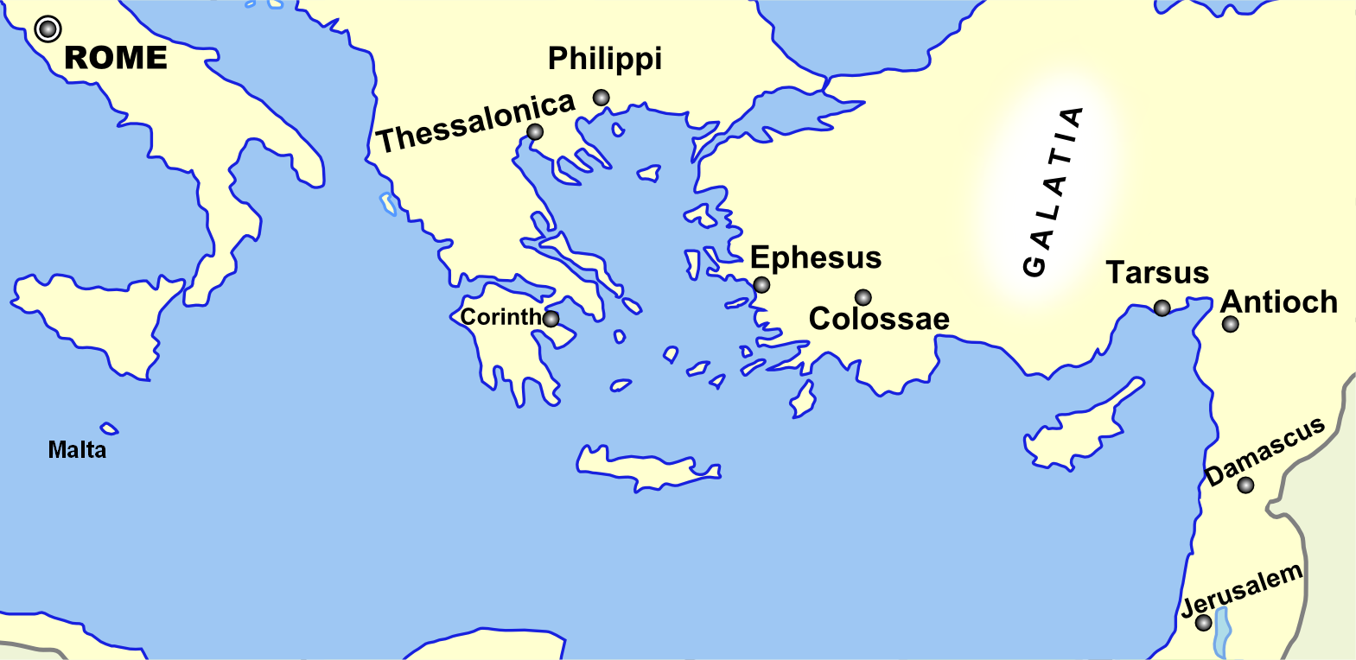
Monozigote. (2012). Broad Overview of Geography Relevant to Paul of Tarsus [Map]. Wikipedia.

Slide 8
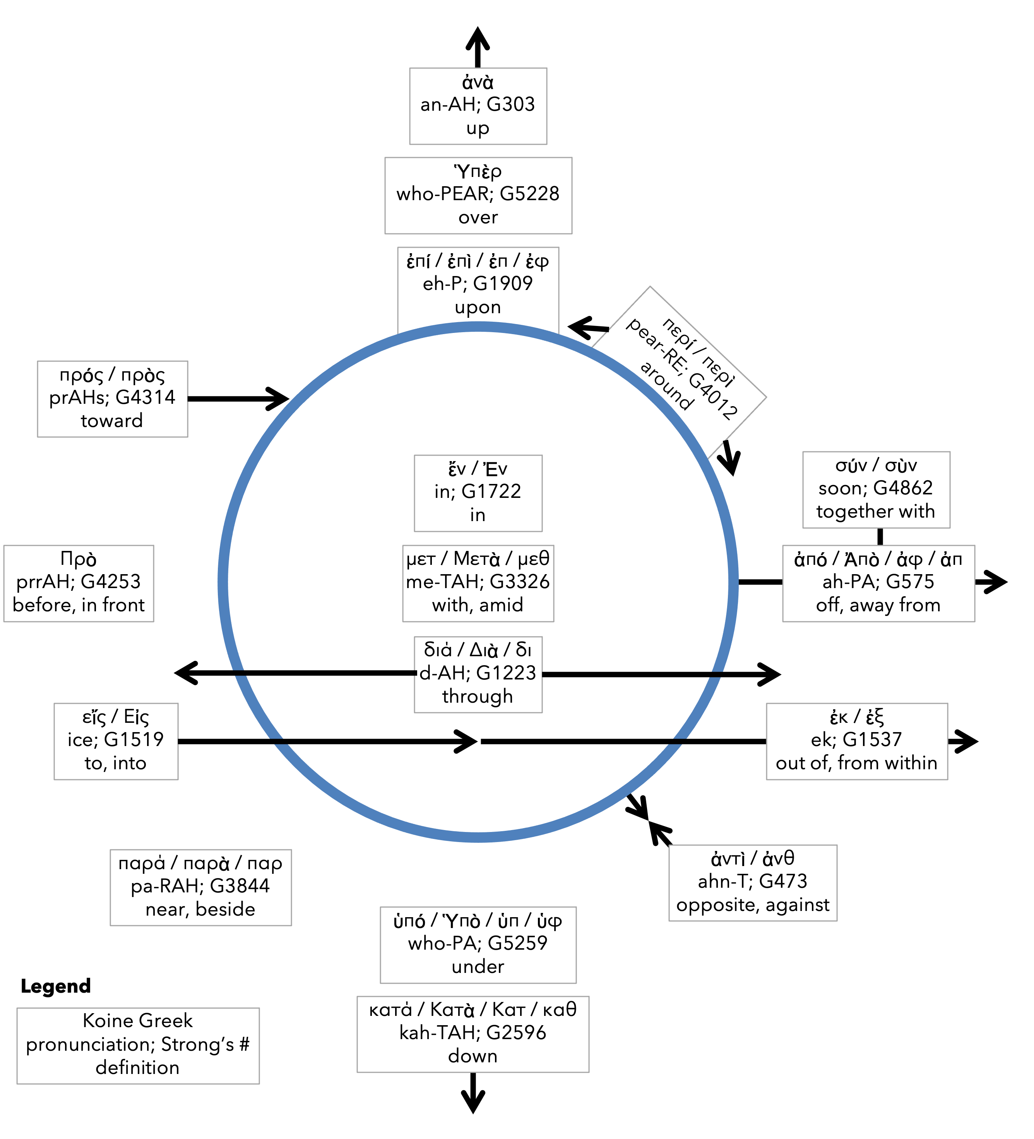
Preposition circle (page 11)

Slide 9
BDAG on morphe (mor-FAY) form, outward appearance, shape

Slide 10
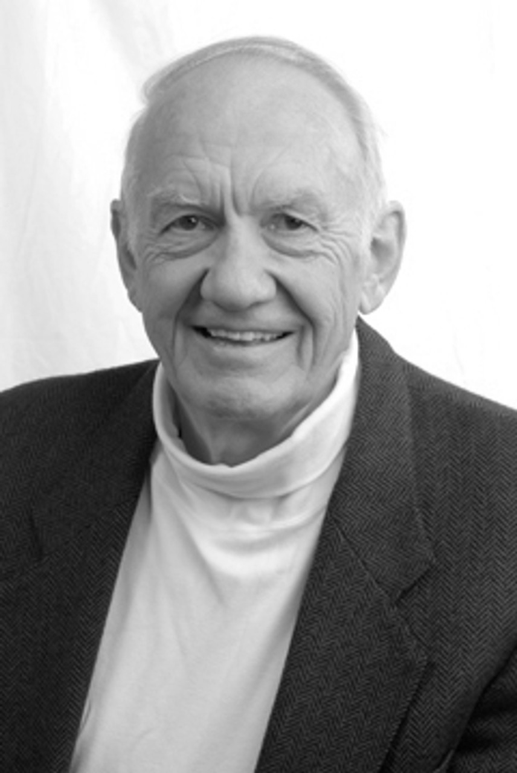
Dr. Gordon Fee Quote

Slide 11
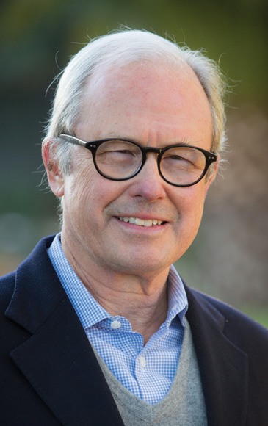
Dr. G. Walter Hansen Quote

Slide 12
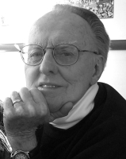
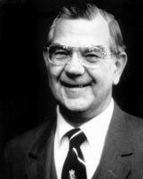
Dr. G. F. Hawthorne & Dr. Ralph P. Martin Quote

Slide 13
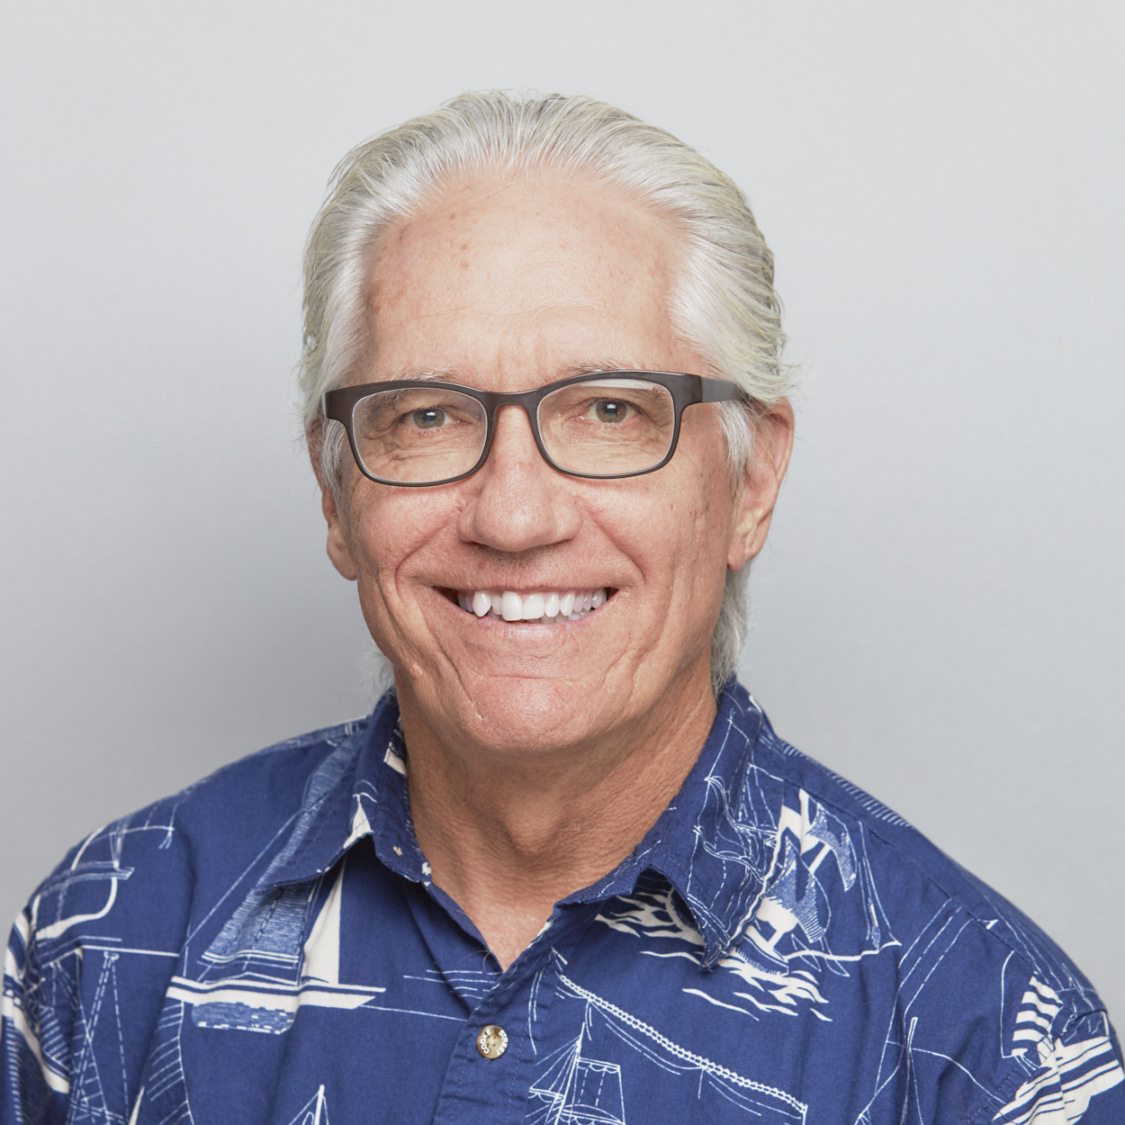
Dr. Joe Hellerman Quote

Slide 14
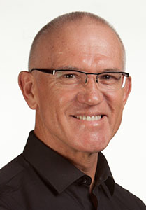
Dr. Mark Keown Quote

Slide 15
Dr. Ralph P. Martin Quote

Slide 16
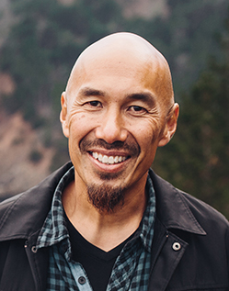
Dr. Tony Merida & Frances Chan Quote

Slide 17
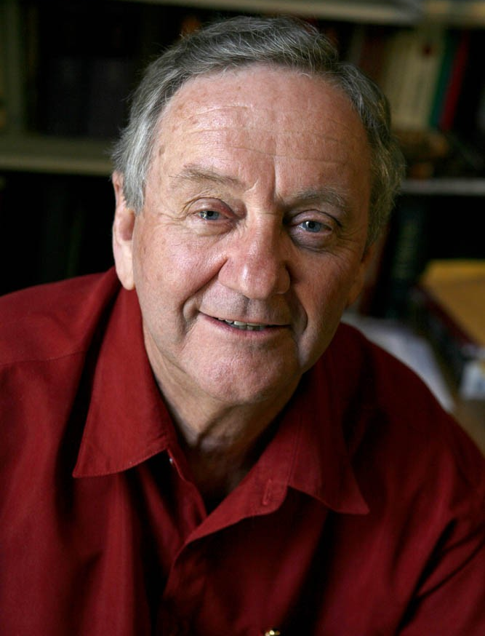
Dr. Peter T. O’Brien Quote

Slide 18
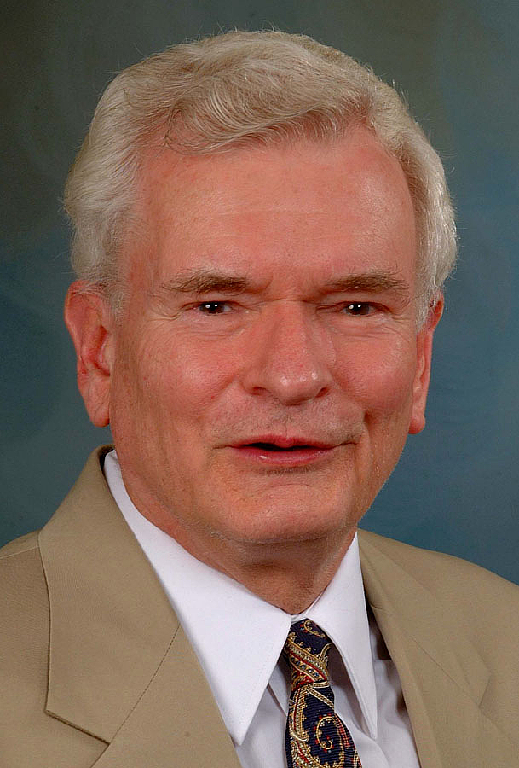
Dr. John Reumann Quote

Slide 19
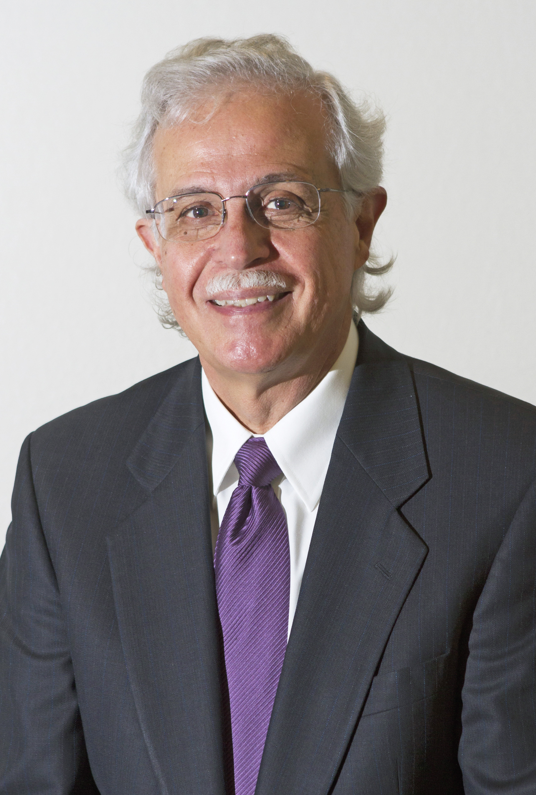
Dr. Moises Silva Quote

Slide 20
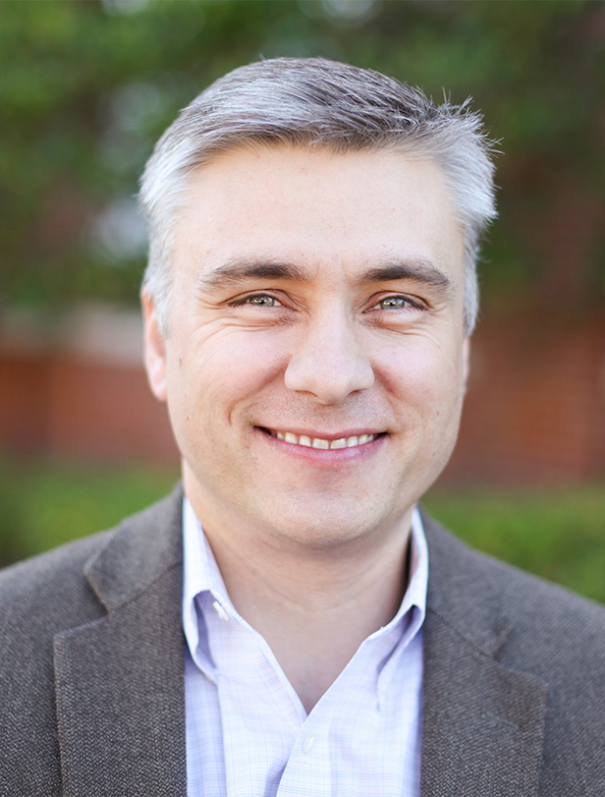
Dr. David T. A. Strain Quote

Slide 21
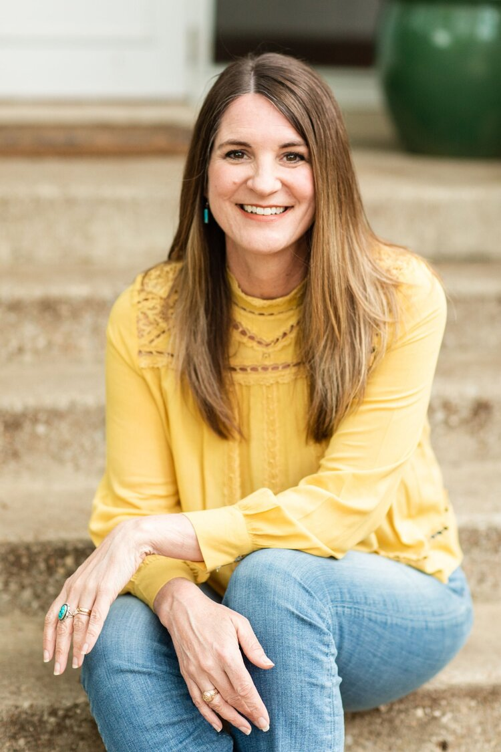
Jen Wilkin Quote

