Slide 1
Welcome to
Our Sunday School
We’ll start at 9:07
visit OurSundaySchool.com for more about our class

Slide 2
Colossians: week 27 (pages 171-180)

Slide 3
Colossians 2:20-23
If you died with Christ to the elements of this world, why do you live as if you still belonged to the world? Why do you submit to regulations: “Don’t handle, don’t taste, don’t touch”? All these regulations refer to what is destined to perish by being used up; they are human commands and doctrines. Although these have a reputation for wisdom by promoting self-made religion, false humility, and severe treatment of the body, they are not of any value in curbing self-indulgence.
If you died with Christ to the elements of this world, why do you live as if you still belonged to the world? Why do you submit to regulations: “Don’t handle, don’t taste, don’t touch”? All these regulations refer to what is destined to perish by being used up; they are human commands and doctrines. Although these have a reputation for wisdom by promoting self-made religion, false humility, and severe treatment of the body, they are not of any value in curbing self-indulgence.

Slide 4
Colossians: week 27 (pages 171-180)

Slide 5
BDAG on dogmatizo (dag-ma-TEED-zo) to put under obligation by rules or ordinances obligate

Slide 6
Colossians: week 27 (pages 171-180)

Slide 7
Romans 14:13-23
v. 20: “Everything is clean”

Slide 8
Colossians: week 27 (pages 171-180)

Slide 9
Prayer time
Write down your prayer requests (on the Weekly Update or in the comments
Lean in, engage, and pray for someone not with you
Be out of this room by 9:50
Go worship

Slide 10
Today’s class (page 17)
Preparing for Colossians 1:1-2:3 Pray with others Hear with others Think with others Study with others Share with others Invite others
In class, as a class
In class, as tables
After class

Slide 11
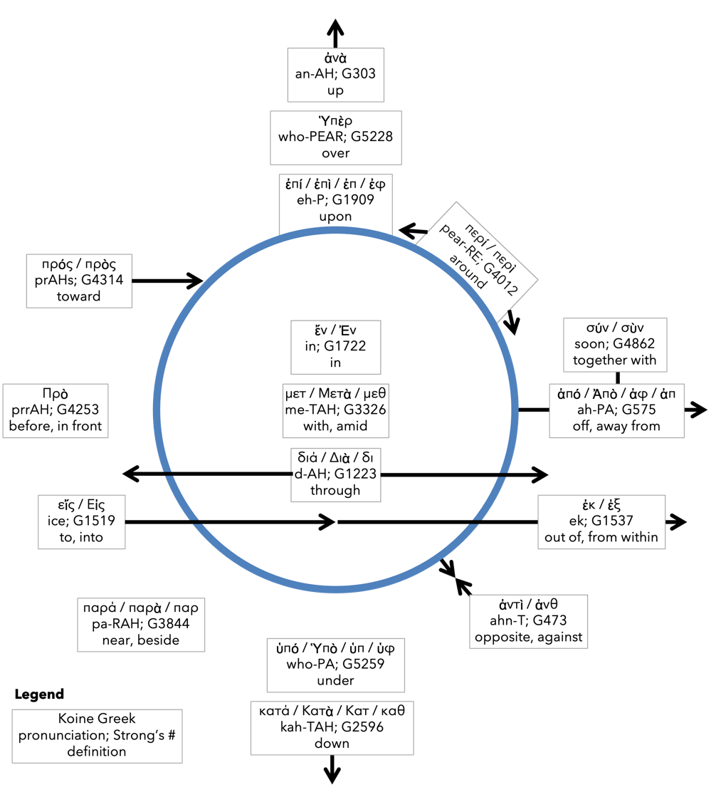
Preposition circle (page 12)

Slide 12
BDAG on morphe (mor-FAY) definition

Slide 13
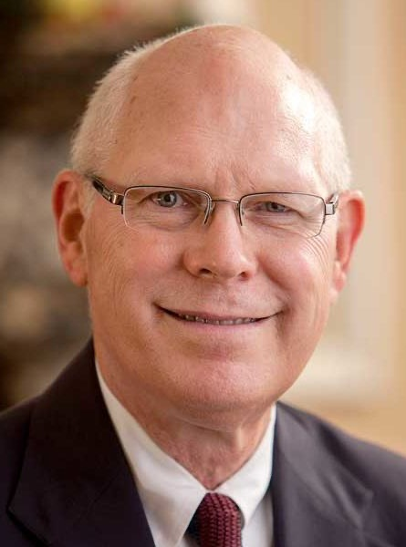
Dr. Gregory K. Beale Quote

Slide 14
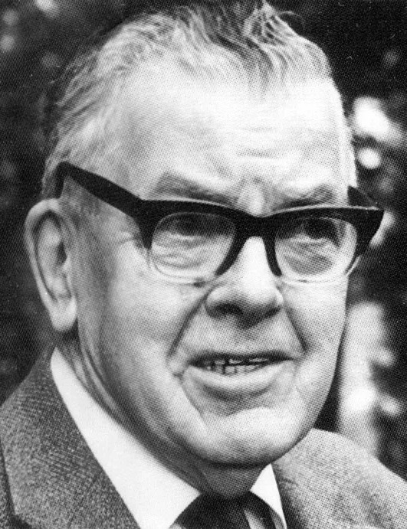
F. F. Bruce Quote

Slide 15
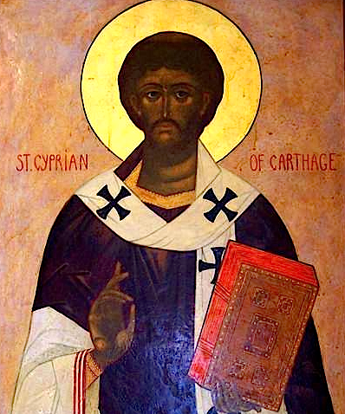
Cyprian Quote

Slide 16
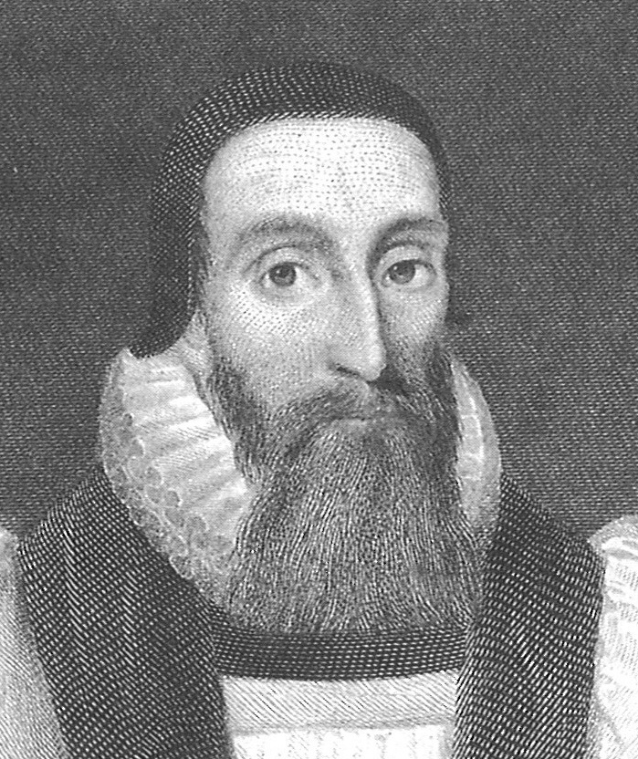
Dr. John Davenant Quote

Slide 17
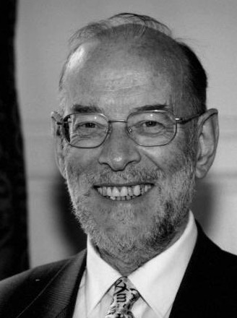
Dr. James D. G. Dunn Quote

Slide 18
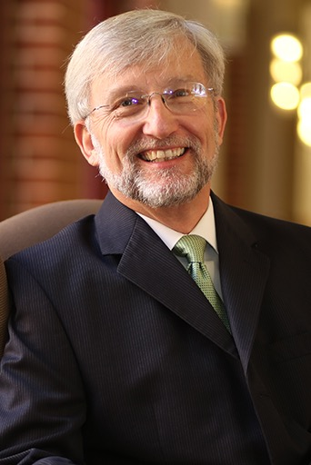
Dr. David Garland Quote

Slide 19
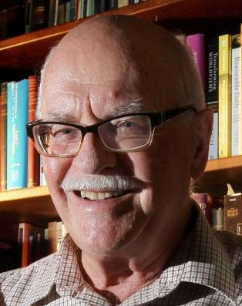
Dr. Murray J. Harris Quote

Slide 20
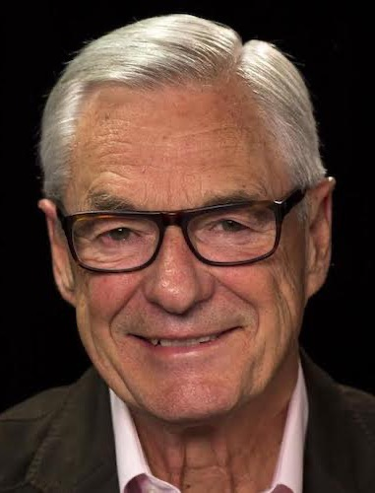
Dr. R. Kent Hughes Quote

Slide 21
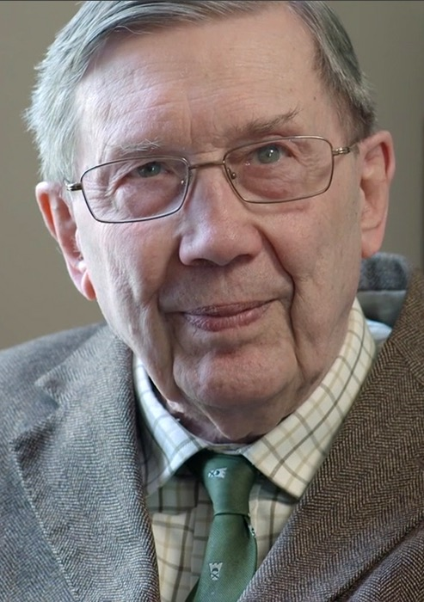
R. C. Lucas Quote

Slide 22
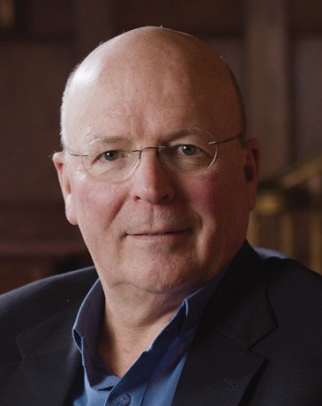
Dr. Scot McKnight Quote

Slide 23
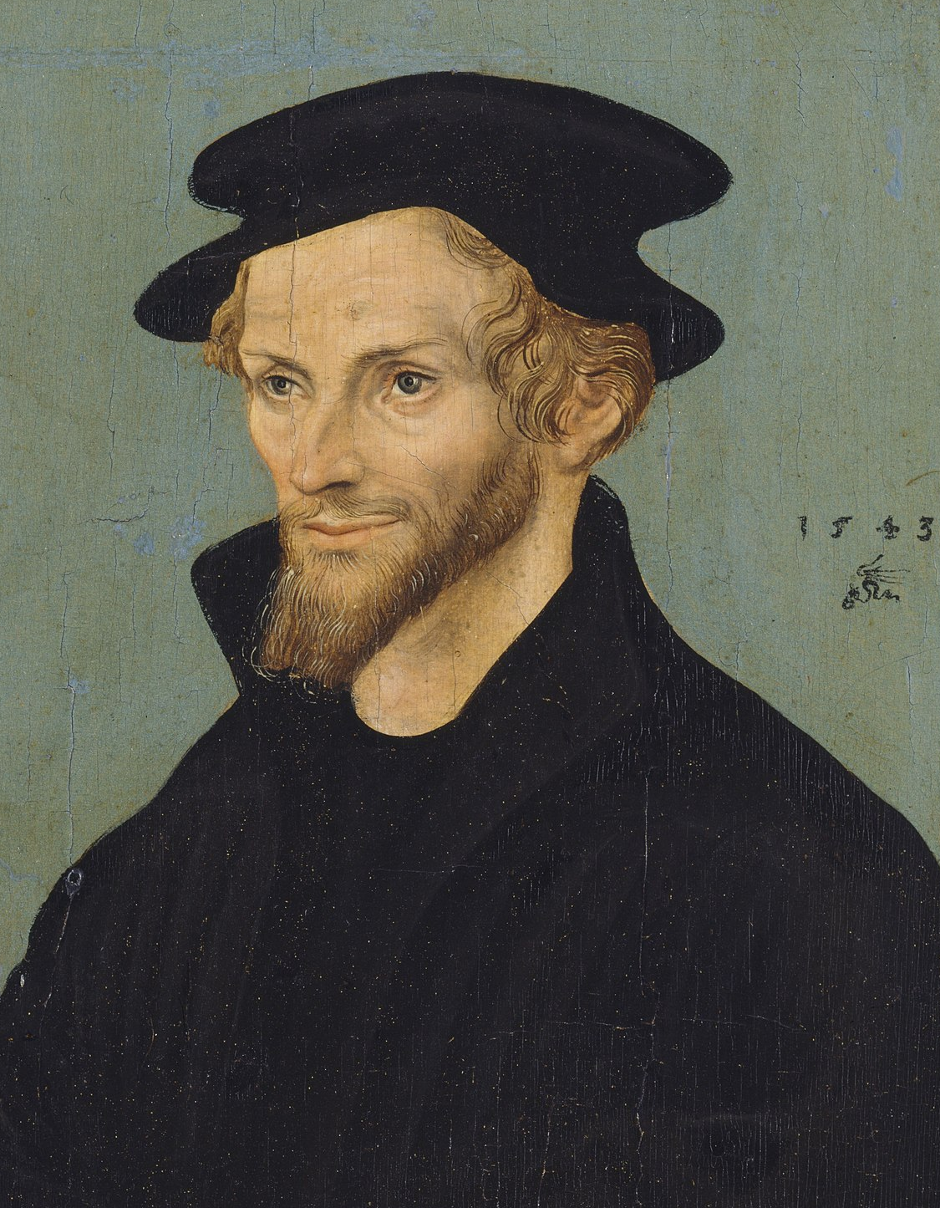
Philip Melanchthon Quote

Slide 24
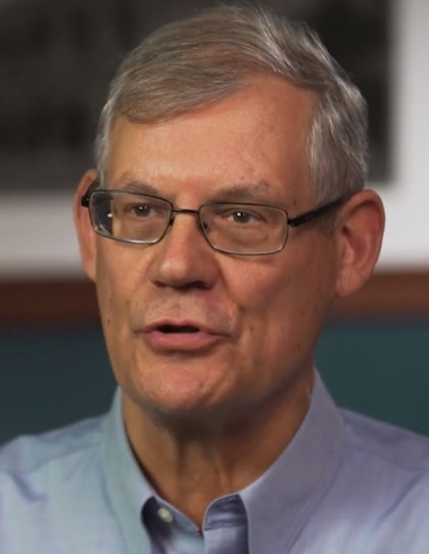
Dr. Douglas J. Moo Quote

Slide 25
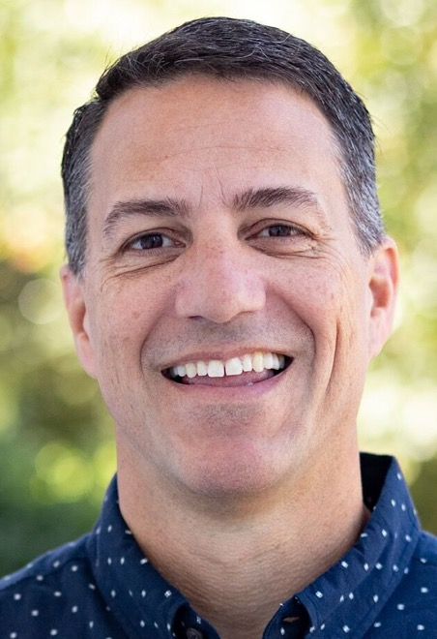
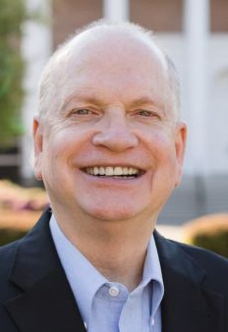
Dr. R. Scott Pace & Dr. Daniel L. Akin Quote

Slide 26
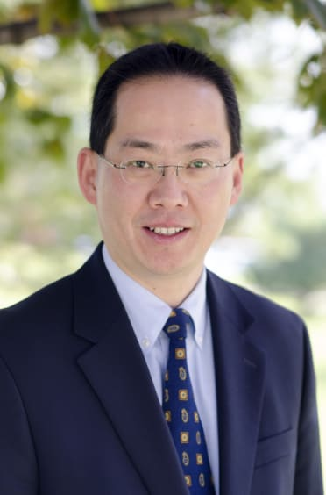
Dr. David W. Pao Quote

Slide 27
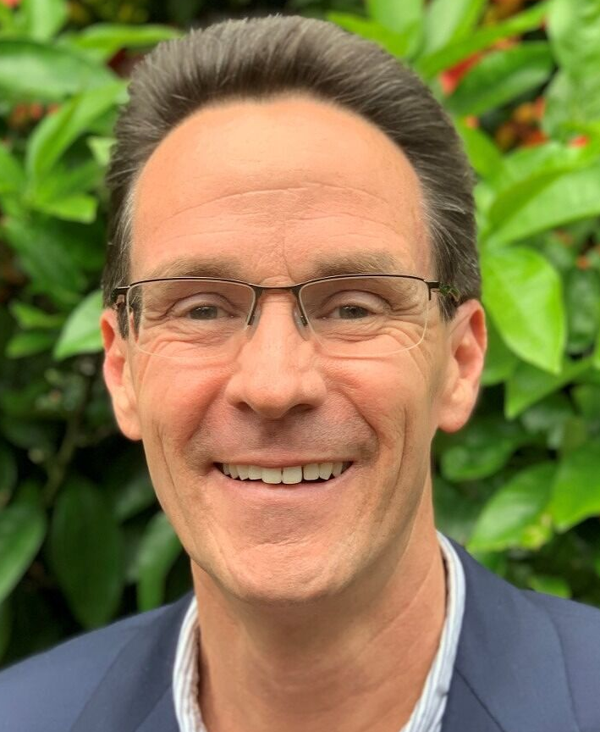
Dr. Alan Thompson Quote

Slide 28
Jen Wilkin Quote

Slide 29
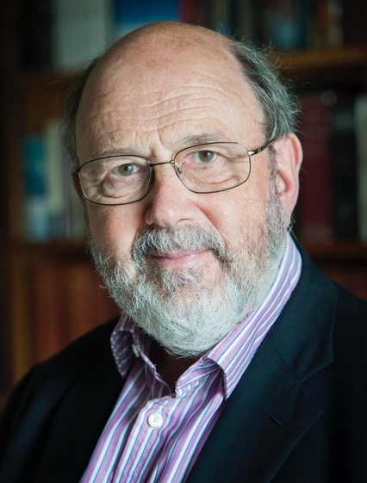
Dr. N. T. Wright Quote

