Slide 1
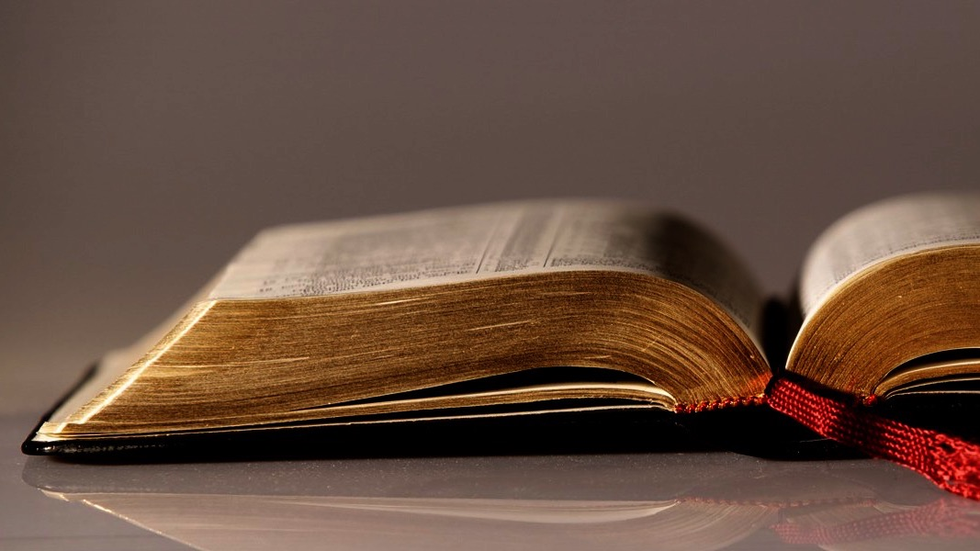
Welcome to
Our Sunday School
We’ll start at 9:07
visit OurSundaySchool.com for more about our class

Slide 2
Colossians: week 24 (pages 151-159)

Slide 3
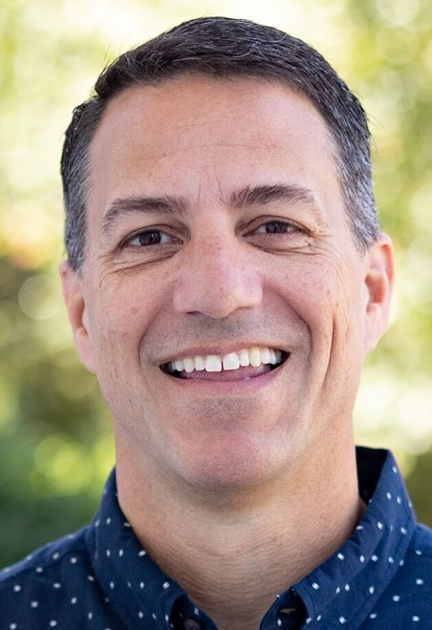
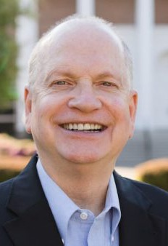
Dr. R. Scott Pace
& Dr. Daniel L. Akin
It is through his substitutionary atonement that our hearts have been circumcised in order that we [may be] God’s people….

Slide 4
Dr. R. Scott Pace
& Dr. Daniel L. Akin
…. through the sacrifice of Christ's entire body, not simply the removal of a piece of flesh, our hearts are spiritually circumcised and converted.

Slide 5
Colossians 2:13-15
And when you were dead in trespasses and in the uncircumcision of your flesh, he made you alive with him and forgave us all our trespasses. He erased the certificate of debt, with its obligations, that was against us and opposed to us, and has taken it away by nailing it to the cross. He disarmed the rulers and authorities and disgraced them publicly; he triumphed over them in him.

Slide 6
Colossians: week 24 (pages 151-159)

Slide 7
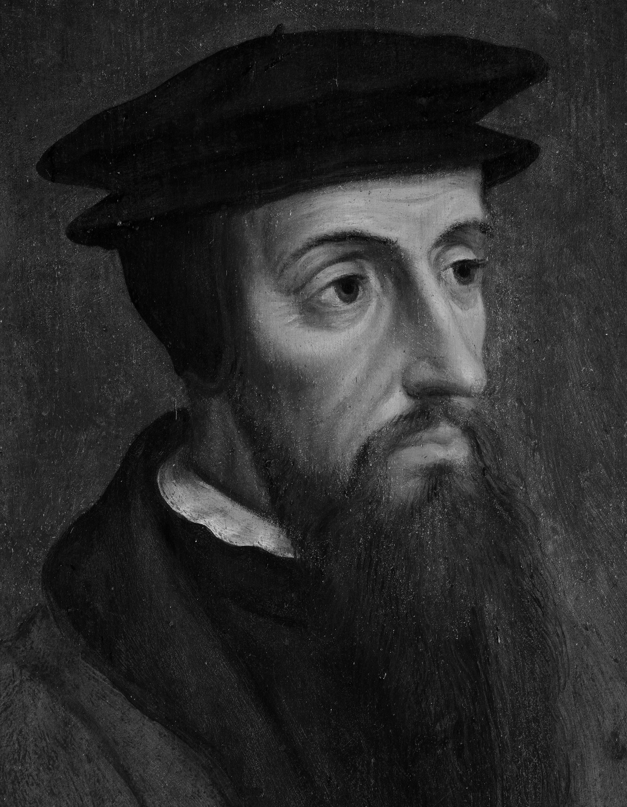
John Calvin
The Son of God has not only by his death delivered us from the condemnation of death, but in order that absolution might be made more certain,

Slide 8
John Calvin he abrogated those ceremonies, so that no reminder of obligation would remain. This is full freedom:

Slide 9
John Calvin that Christ by his blood has not only blotted out our sins, but every document which might testify against as guilty before the judgment of God.

Slide 10
Colossians: week 24 (pages 151-159)

Slide 11
Dr. R. Scott Pace
& Dr. Daniel L. Akin
Through Christ’s physical and visible resurrection and ascension, Jesus put on public display his victory and his enemies’ defeat.

Slide 12
Colossians: week 24 (pages 151-159)

Slide 13
Dr. R. Scott Pace
& Dr. Daniel L. Akin
Ultimately, our walk with Christ must also overcome the temptations to find our identity in what we know, what we can do, or what we have.

Slide 14
Dr. R. Scott Pace
& Dr. Daniel L. Akin
Our identity as believers is determined by who we know, what he has done, and all that he offers.

Slide 15
Dr. R. Scott Pace
& Dr. Daniel L. Akin
Through his death, burial, and resurrection, Christ has adopted us into his family, he has purchased our salvation,

Slide 16
Dr. R. Scott Pace
& Dr. Daniel L. Akin and he has given us new life with the power to walk in the victory that he has secured on our behalf!

Slide 17
Prayer time
Write down your prayer requests (on the Weekly Update or in the comments
Lean in, engage, and pray for someone not with you
Be out of this room by 9:50
Go worship

Slide 18
Today’s class (page 17)
Preparing for Colossians 1:1-2:3
Pray with others
Hear with others
Think with others
Study with others
Share with others
Invite others
  In class, as a class
  In class, as tables
  After class

Slide 19
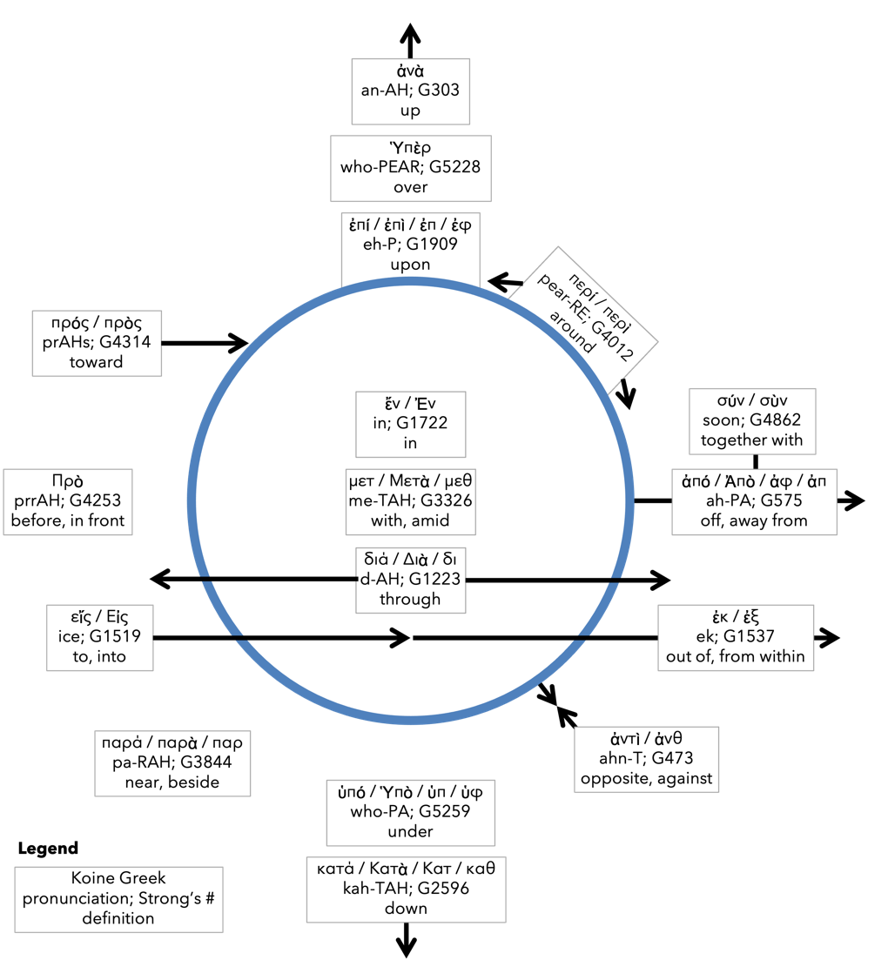
Preposition circle (page 12)

Slide 20
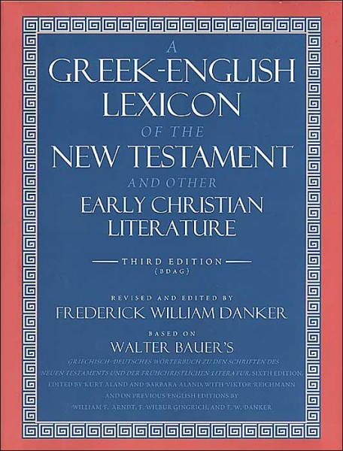
BDAG on morphe
(mor-FAY) definition

Slide 21
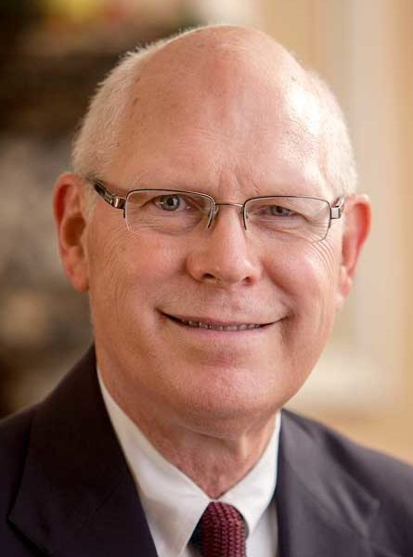
Dr. Gregory K. Beale
Quote

Slide 22
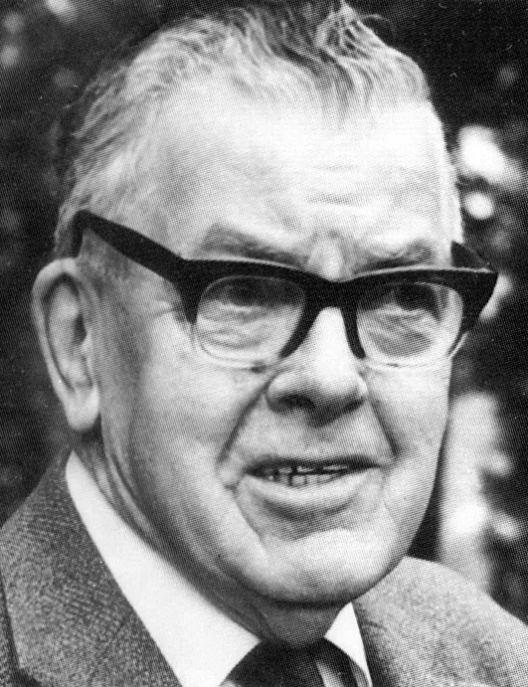
F. F. Bruce
Quote

Slide 23
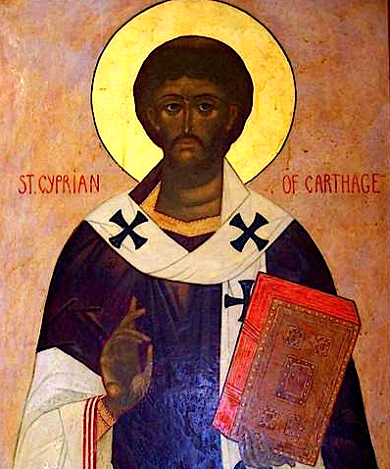
Cyprian
Quote

Slide 24
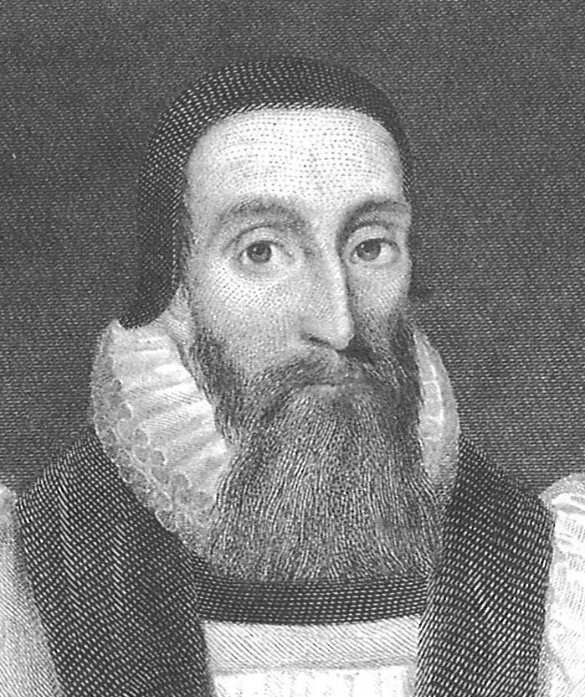
Dr. John Davenant
Quote

Slide 25
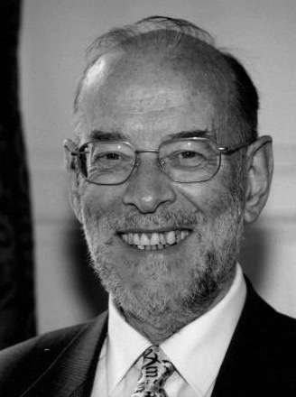
Dr. James D. G. Dunn
Quote

Slide 26
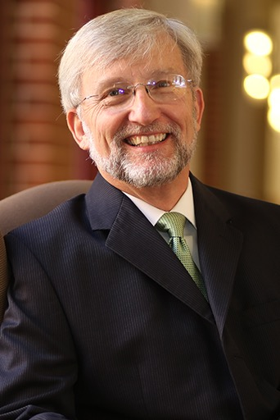
Dr. David Garland
Quote

Slide 27
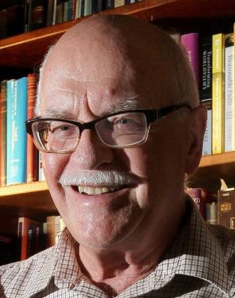
Dr. Murray J. Harris
Quote

Slide 28
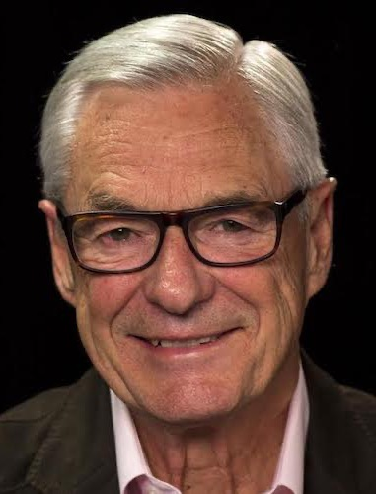
Dr. R. Kent Hughes
Quote

Slide 29
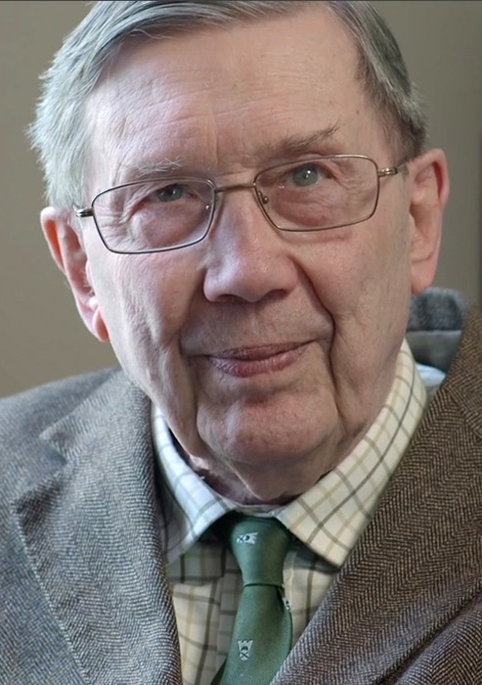
R. C. Lucas
Quote

Slide 30
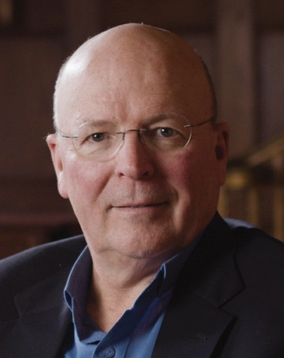
Dr. Scot McKnight
Quote

Slide 31
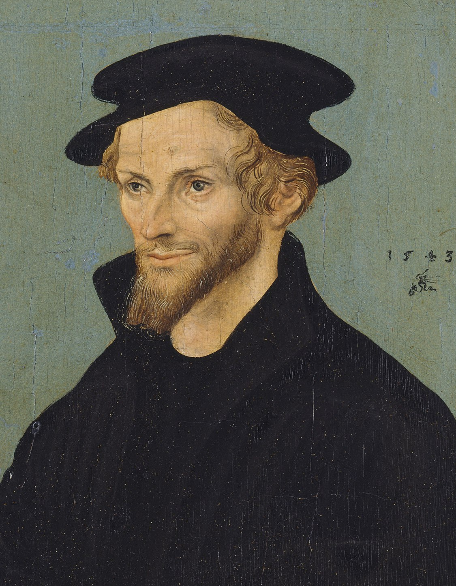
Philip Melanchthon
Quote

Slide 32
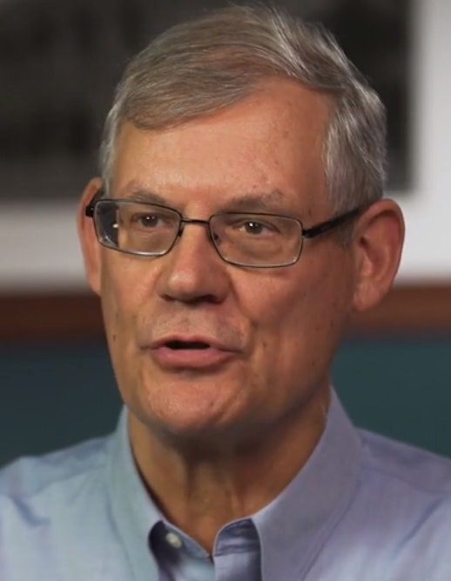
Dr. Douglas J. Moo
Quote

Slide 33
Dr. R. Scott Pace
& Dr. Daniel L. Akin
Quote

Slide 34
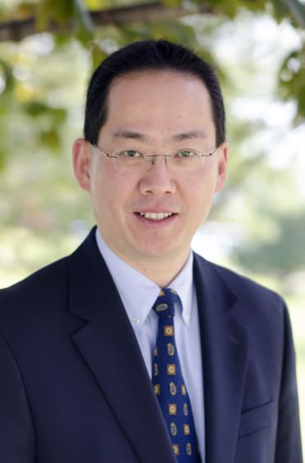
Dr. David W. Pao
Quote

Slide 35
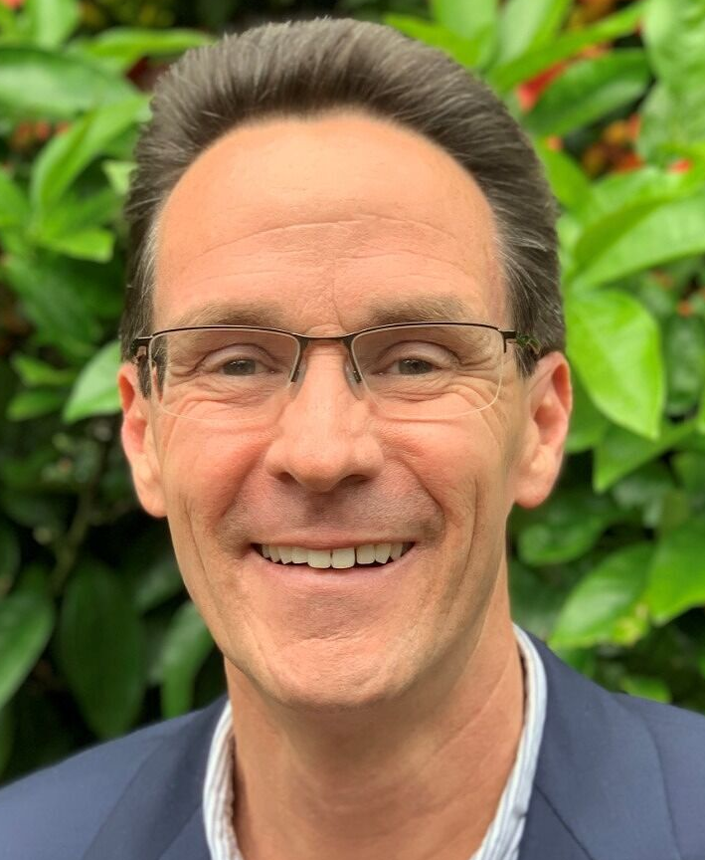
Dr. Alan Thompson
Quote

Slide 36
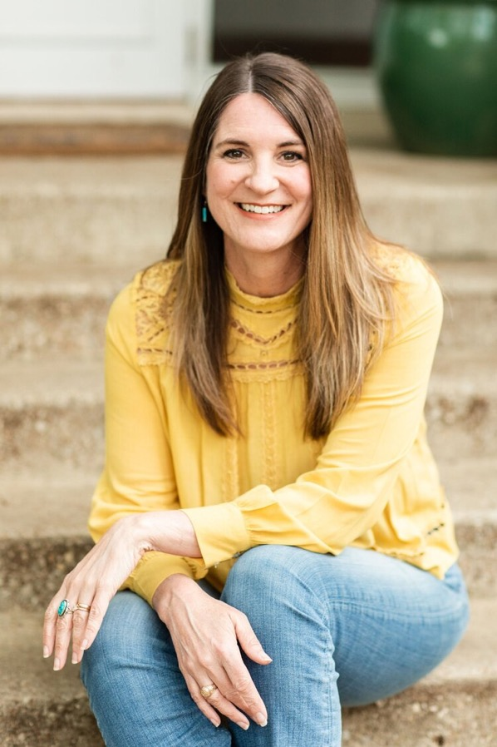
Jen Wilkin
Quote

Slide 37
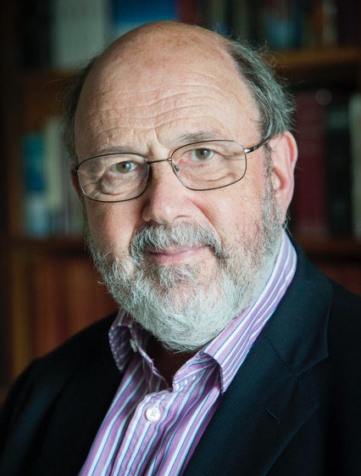
Dr. N. T. Wright
Quote

