Slide 1
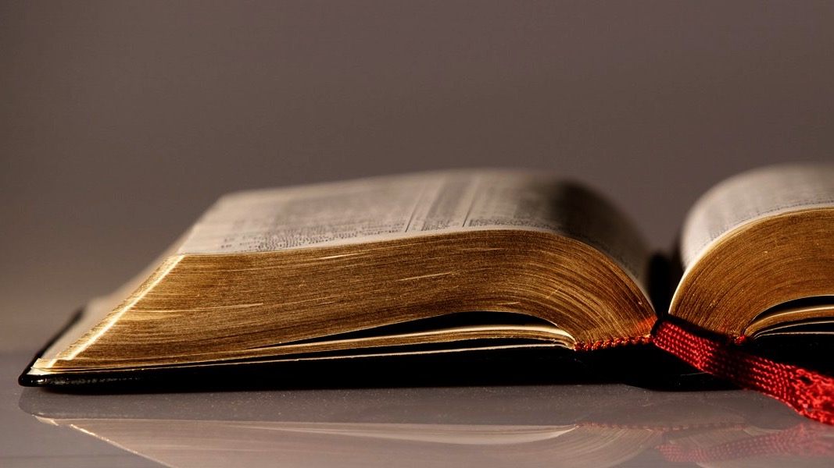
Welcome to
Our Sunday School
We’ll start at 9:07
visit OurSundaySchool.com for more about our class

Slide 2
Colossians: week 21 (pages 134-138)

Slide 3
Colossians 2:6-7
So then, just as you have received Christ Jesus as Lord, continue to walk in him, being rooted and built up in him and established in the faith, just as you were taught, and overflowing with gratitude.

Slide 4
Colossians: week 21 (pages 134-138)

Slide 5
“Overflowing with gratitude”
Read through your prayer request page
Make any updates that need to be made
Share new requests
Praise God for what he has done

Slide 6
“Overflowing with gratitude”
Read through your prayer request page
Make any updates that need to be made
Share new requests
Praise God for what he has done

Slide 7
“Overflowing with gratitude”
Read through your prayer request page
Make any updates that need to be made
Share new requests
Praise God for what he has done

Slide 8
“Overflowing with gratitude”
Read through your prayer request page
Make any updates that need to be made
Share new requests
Praise God for what he has done

Slide 9
Class is dismissed
Be out of this room by 9:50
Go worship

Slide 10
Today’s class (page 17)
Preparing for Colossians 1:1-2:3 Pray with others Hear with others Think with others Study with others Share with others Invite others
In class, as a class
In class, as tables
After class

Slide 11
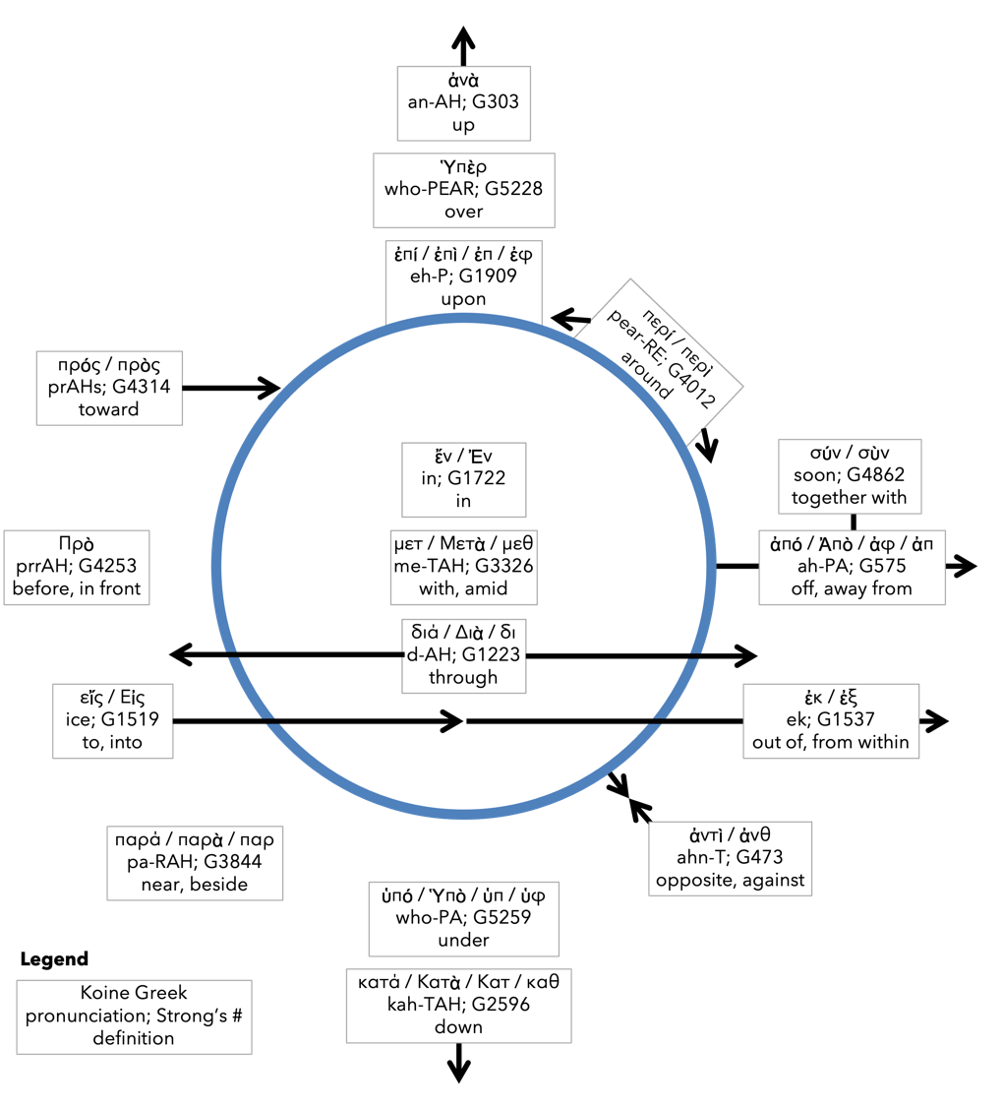
Preposition circle (page 12)

Slide 12
BDAG on morphe (mor-FAY) definition

Slide 13
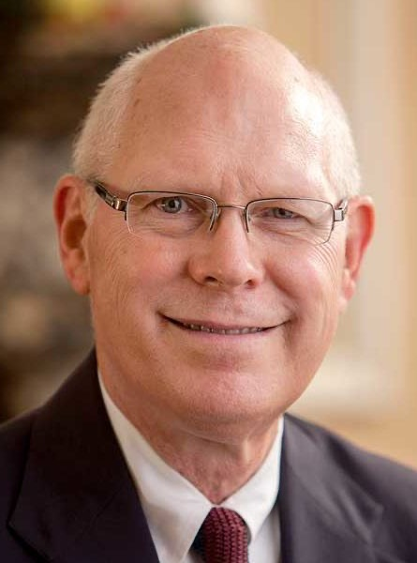
Dr. Gregory K. Beale Quote

Slide 14
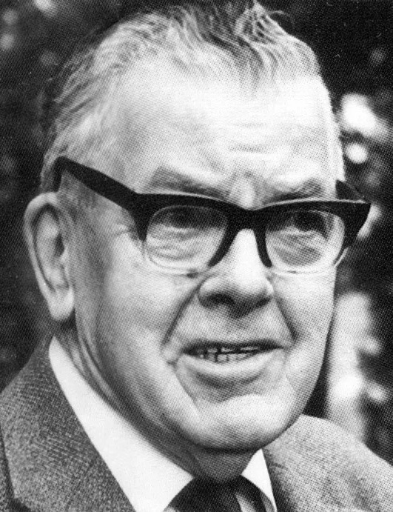
F. F. Bruce Quote

Slide 15
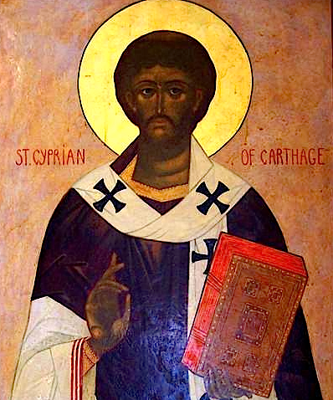
Cyprian Quote

Slide 16
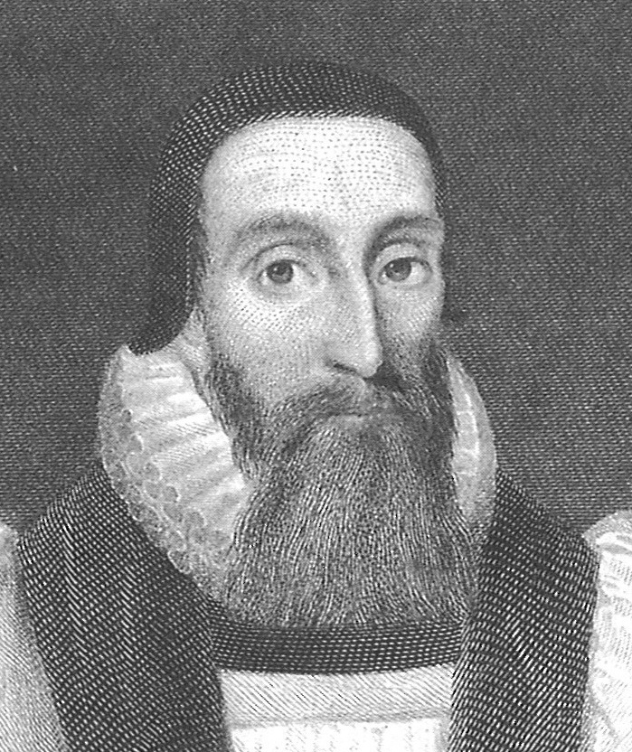
Dr. John Davenant Quote

Slide 17
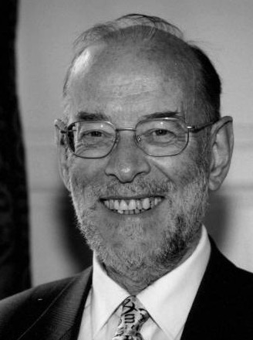
Dr. James D. G. Dunn Quote

Slide 18
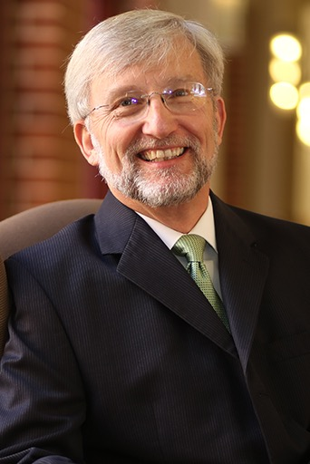
Dr. David Garland Quote

Slide 19
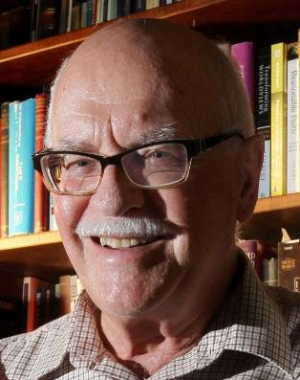
Dr. Murray J. Harris Quote

Slide 20
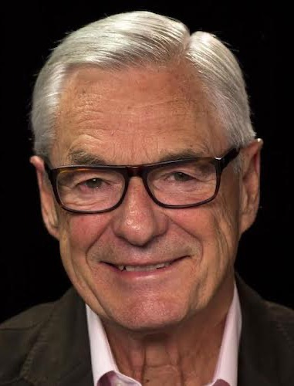
Dr. R. Kent Hughes Quote

Slide 21
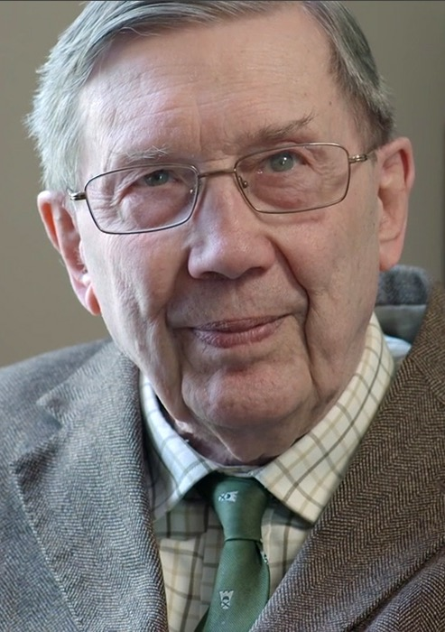
R. C. Lucas Quote

Slide 22
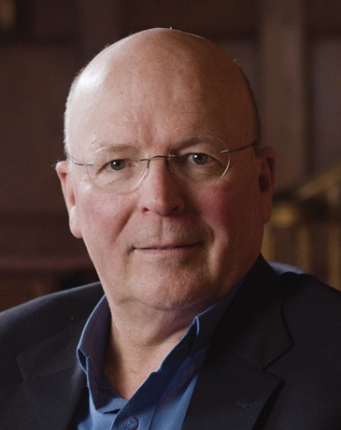
Dr. Scot McKnight Quote

Slide 23
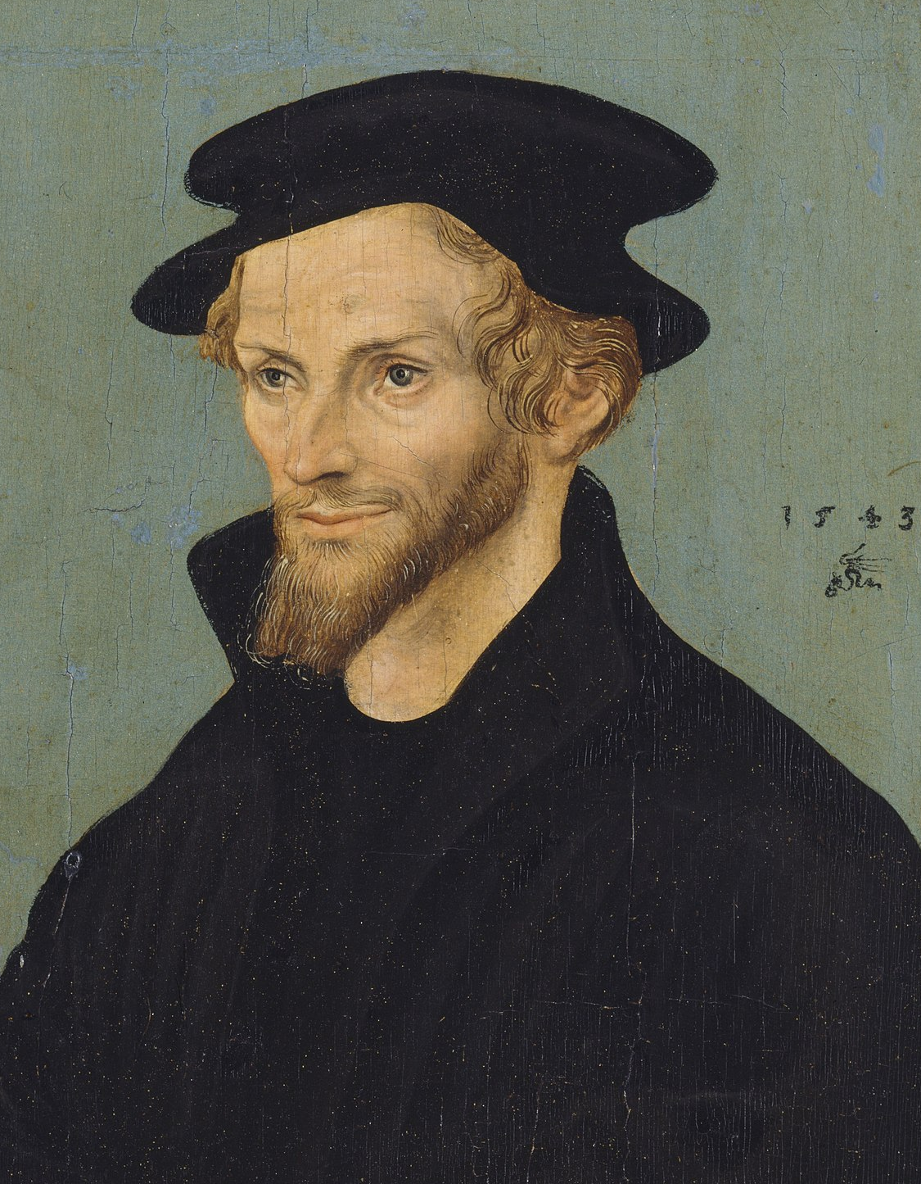
Philip Melanchthon Quote

Slide 24
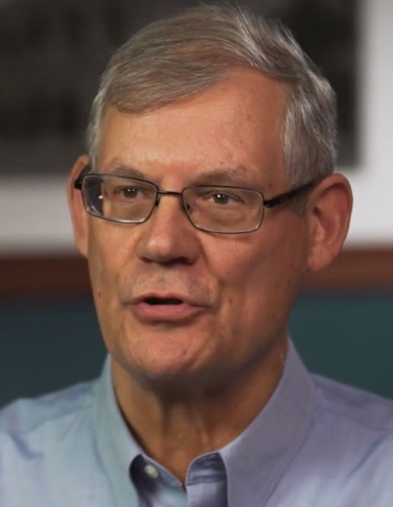
Dr. Douglas J. Moo Quote

Slide 25
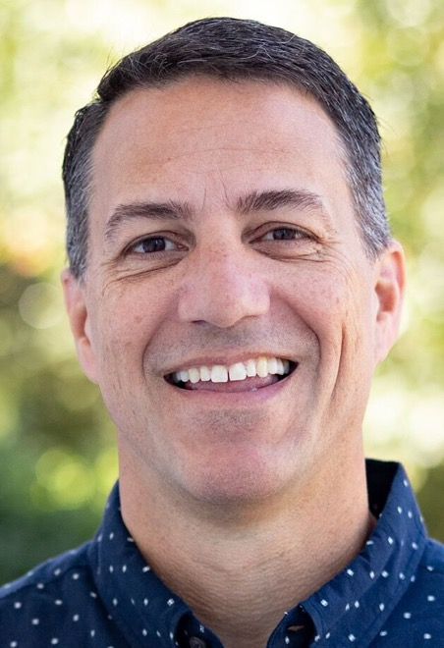
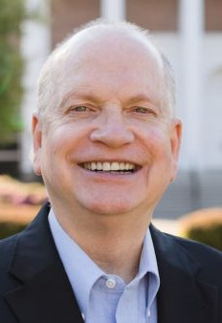
Dr. R. Scott Pace & Dr. Daniel L. Akin Quote

Slide 26
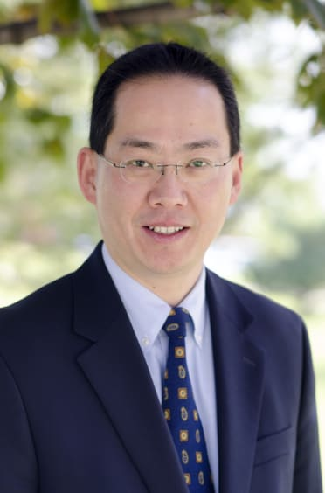
Dr. David W. Pao Quote

Slide 27
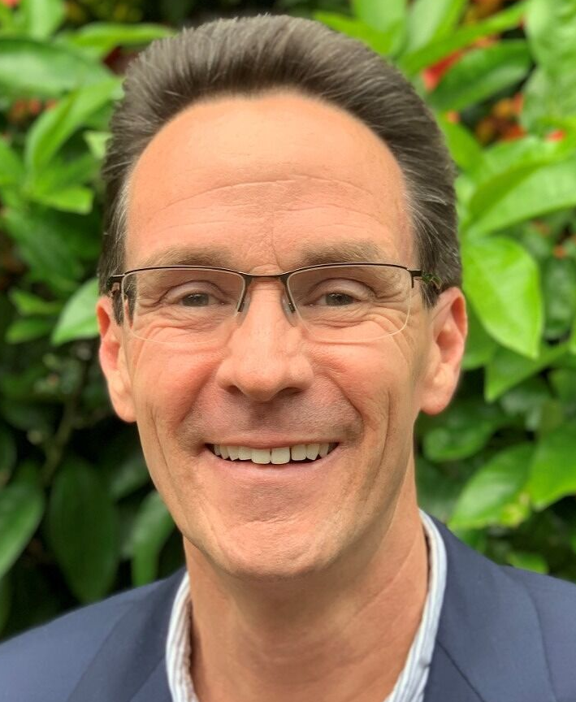
Dr. Alan Thompson Quote

Slide 28
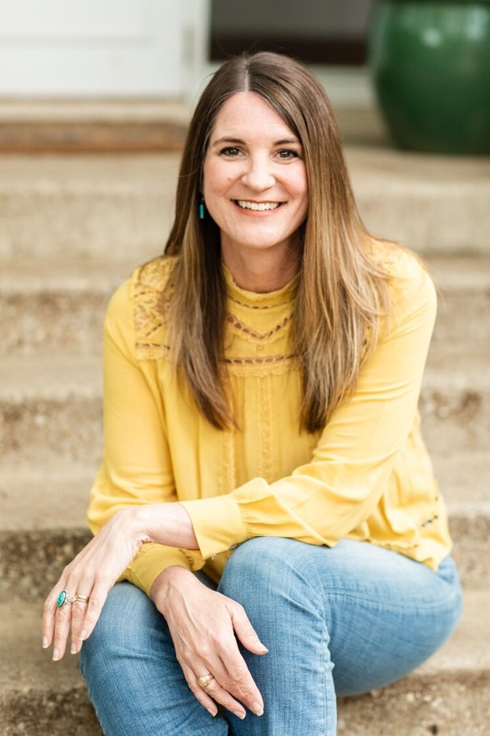
Jen Wilkin Quote

Slide 29
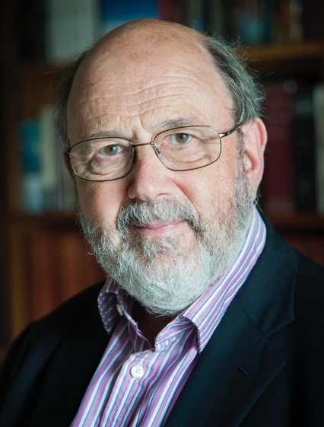
Dr. N. T. Wright Quote

