Slide 1
Welcome to
Our Sunday School
We’ll start at 9:07
visit OurSundaySchool.com for more about our class

Slide 2
Colossians: week 20 (pages 124-134)

Slide 3
Colossians 2:4-5
I am saying this so that no one will deceive you with arguments that sound reasonable. For I may be absent in body, but I am with you in spirit, rejoicing to see how well ordered you are and the strength of your faith in Christ.

Slide 4
Colossians: week 20 (pages 124-134)

Slide 5
BDAG on taxis (TOX-is) 1: an arrangement of things in sequence Luke 1:8

Slide 6
BDAG on taxis (TOX-is) 2: a state of good order 1 Corinthians 14:40 Colossians 2:5

Slide 7
BDAG on taxis (TOX-is) 3: an assigned station or rank not used in the NT

Slide 8
BDAG on taxis (TOX-is) 4: an arrangement in which someone or something functions Hebrews 5-7

Slide 9
BDAG on taxis (TOX-is) 2: a state of good order 1 Corinthians 14:40 Colossians 2:5

Slide 10
Colossians: week 20 (pages 124-134)

Slide 11
Prayer time
Write down your prayer requests (on the Weekly Update or in the comments
Lean in, engage, and pray for someone not with you
Be out of this room by 9:50
Go worship

Slide 12
Today’s class (page 17)
Preparing for Colossians 1:1-2:3 Pray with others Hear with others Think with others Study with others Share with others Invite others
In class, as a class
In class, as tables
After class

Slide 13
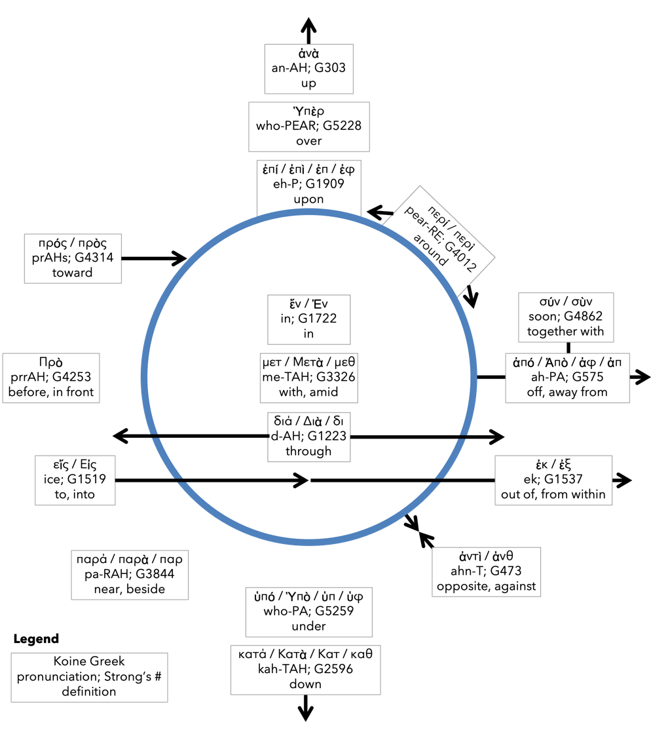
Preposition circle (page 12)

Slide 14
BDAG on morphe (mor-FAY) definition

Slide 15
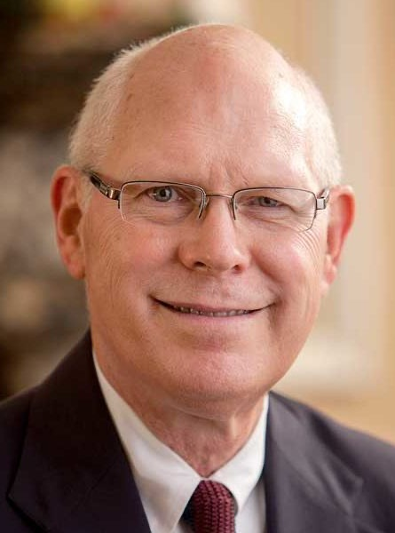
Dr. Gregory K. Beale Quote

Slide 16
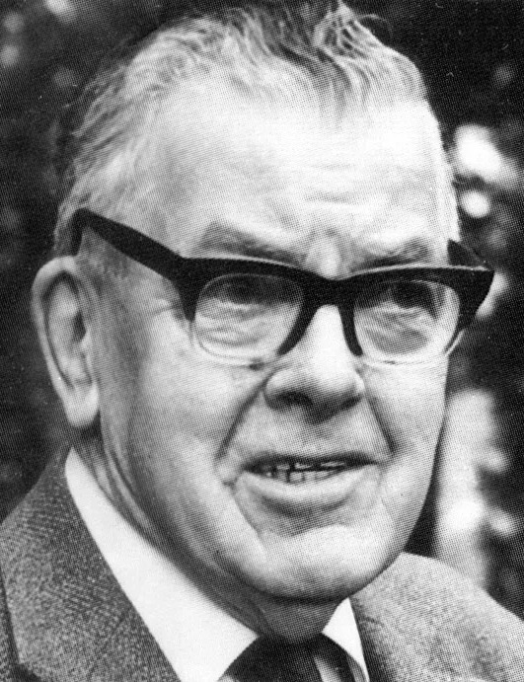
F. F. Bruce Quote

Slide 17
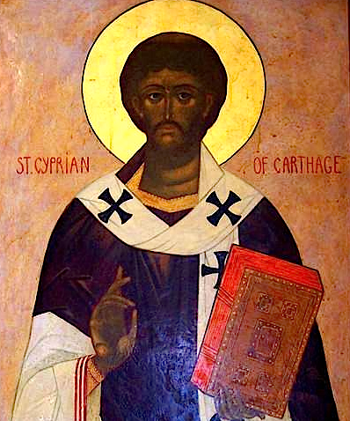
Cyprian Quote

Slide 18
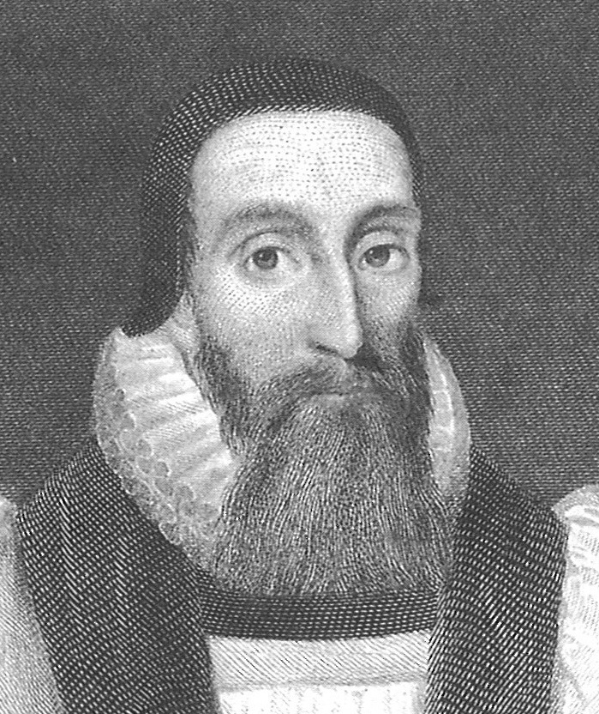
Dr. John Davenant Quote

Slide 19
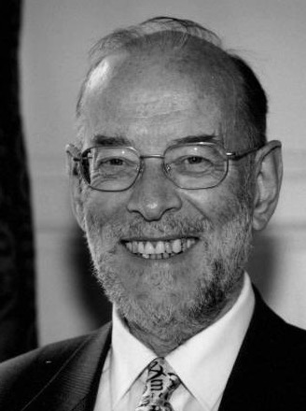
Dr. James D. G. Dunn Quote

Slide 20
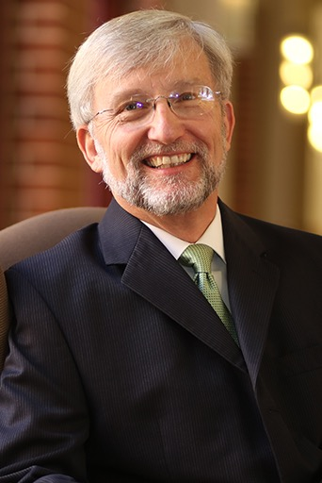
Dr. David Garland Quote

Slide 21
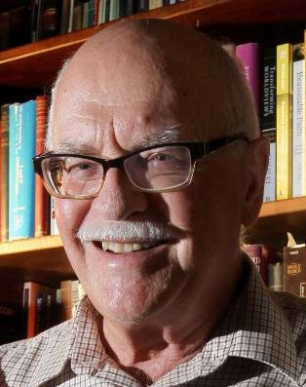
Dr. Murray J. Harris Quote

Slide 22
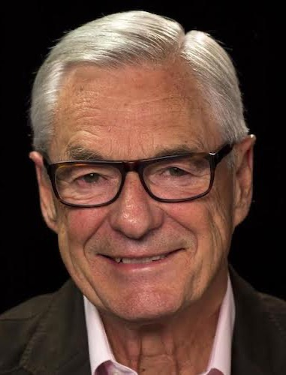
Dr. R. Kent Hughes Quote

Slide 23
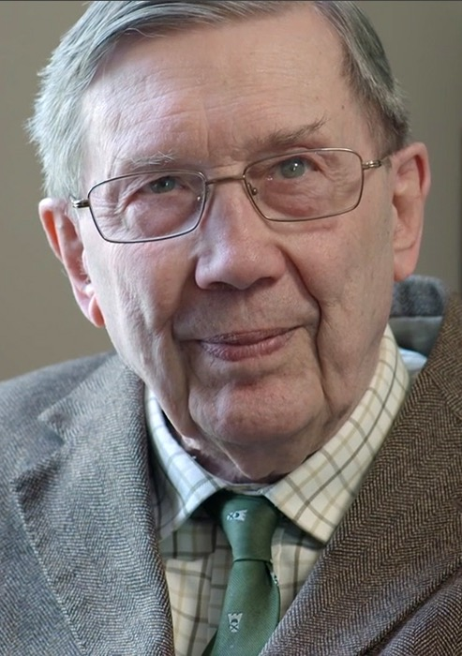
R. C. Lucas Quote

Slide 24
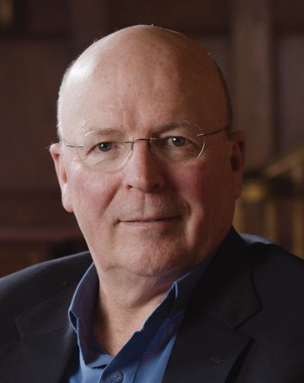
Dr. Scot McKnight Quote

Slide 25
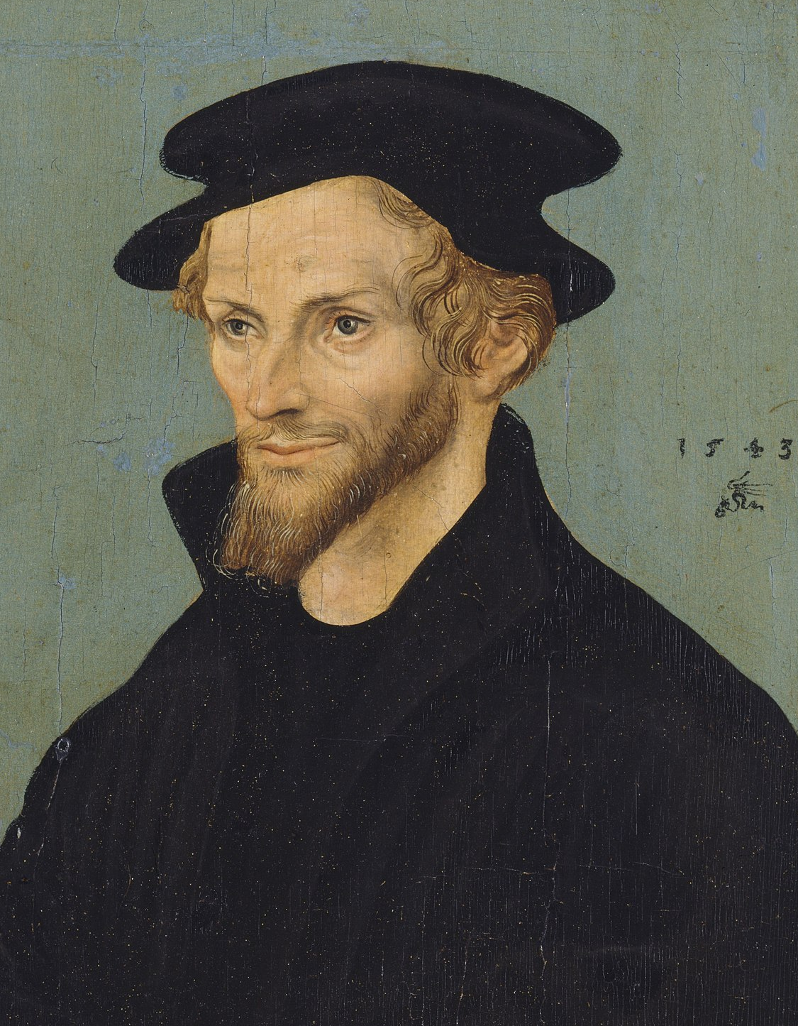
Philip Melanchthon Quote

Slide 26
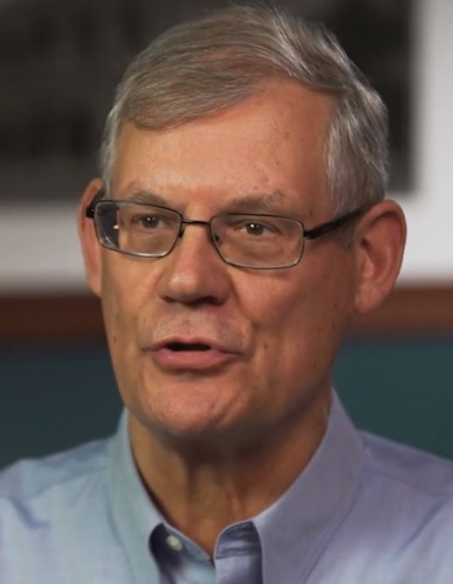
Dr. Douglas J. Moo Quote

Slide 27
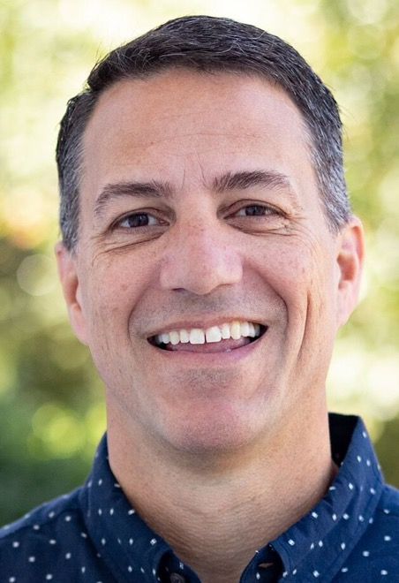
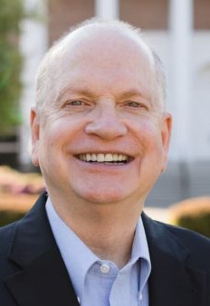
Dr. R. Scott Pace & Dr. Daniel L. Akin Quote

Slide 28
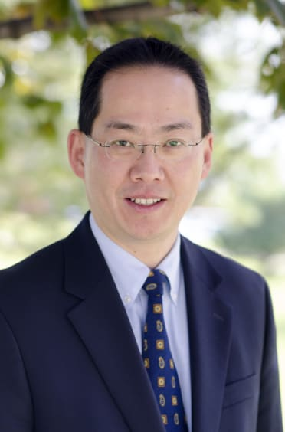
Dr. David W. Pao Quote

Slide 29
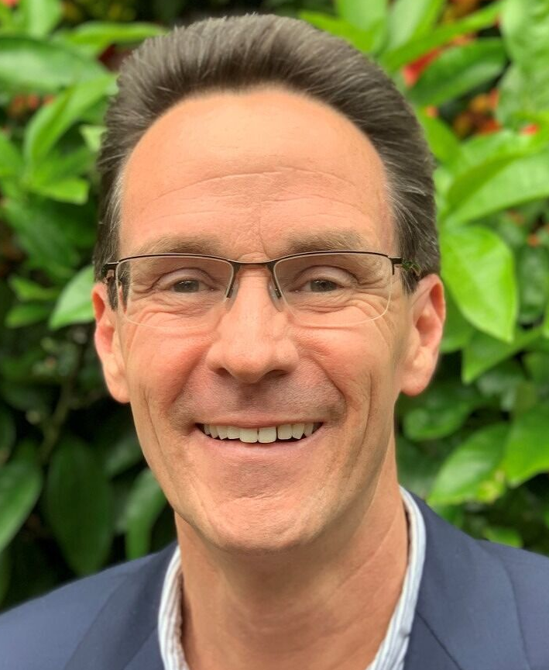
Dr. Alan Thompson Quote

Slide 30
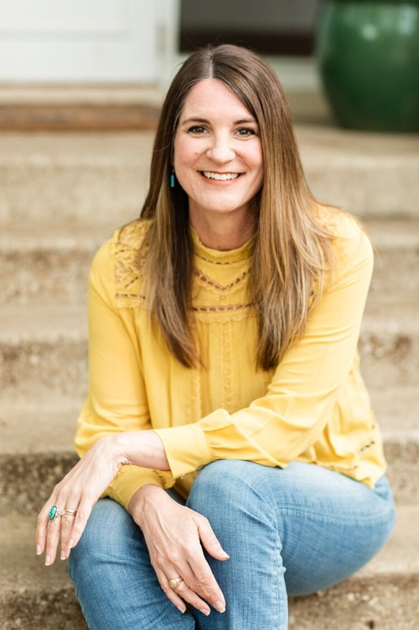
Jen Wilkin Quote

Slide 31
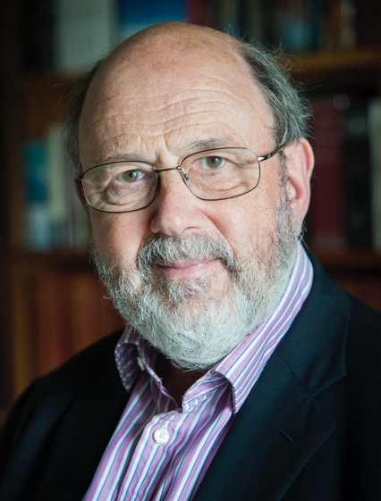
Dr. N. T. Wright Quote

