Slide 1
Welcome to
Our Sunday School
We’ll start at 9:07
visit OurSundaySchool.com for more about our class

Slide 2
Colossians: week 18 (pages 116-121)

Slide 3
Colossians 2:2-3
I want their hearts to be encouraged and joined together in love, so that they may have all the riches of complete understanding and have the knowledge of God’s mystery—Christ. In him are hidden all the treasures of wisdom and knowledge.

Slide 4
Colossians: week 18 (pages 116-121)

Slide 5
so that their hearts may be encouraged, having been held together in love, even unto all the wealth of the full assurance of understanding, unto the full knowledge of God’s mystery, that is, Christ Himself,
Legacy
Standard Bible
Colossians 2:2

Slide 6
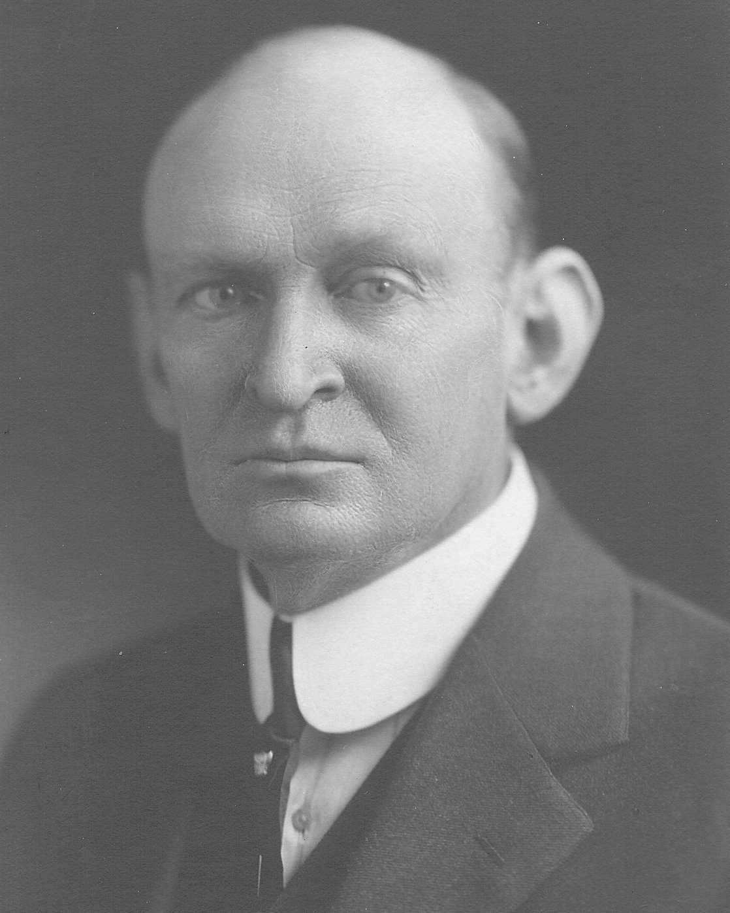
Dr. A. T. Robertson Paul desires the full use of the intellect in grasping the great mystery of Christ and it calls for the full and balanced exercise of all one’s mental powers

Slide 7
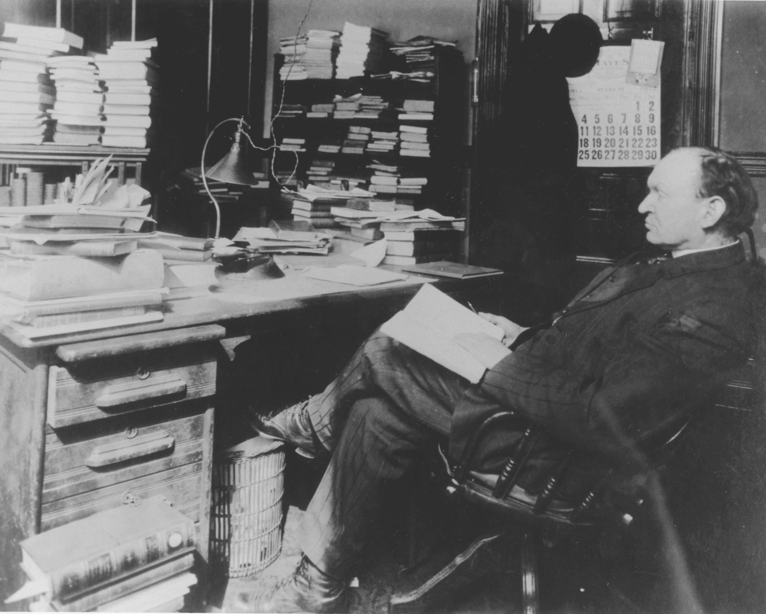
Dr. A. T. Robertson 1863-1924
image from SBTS.edu

Slide 8
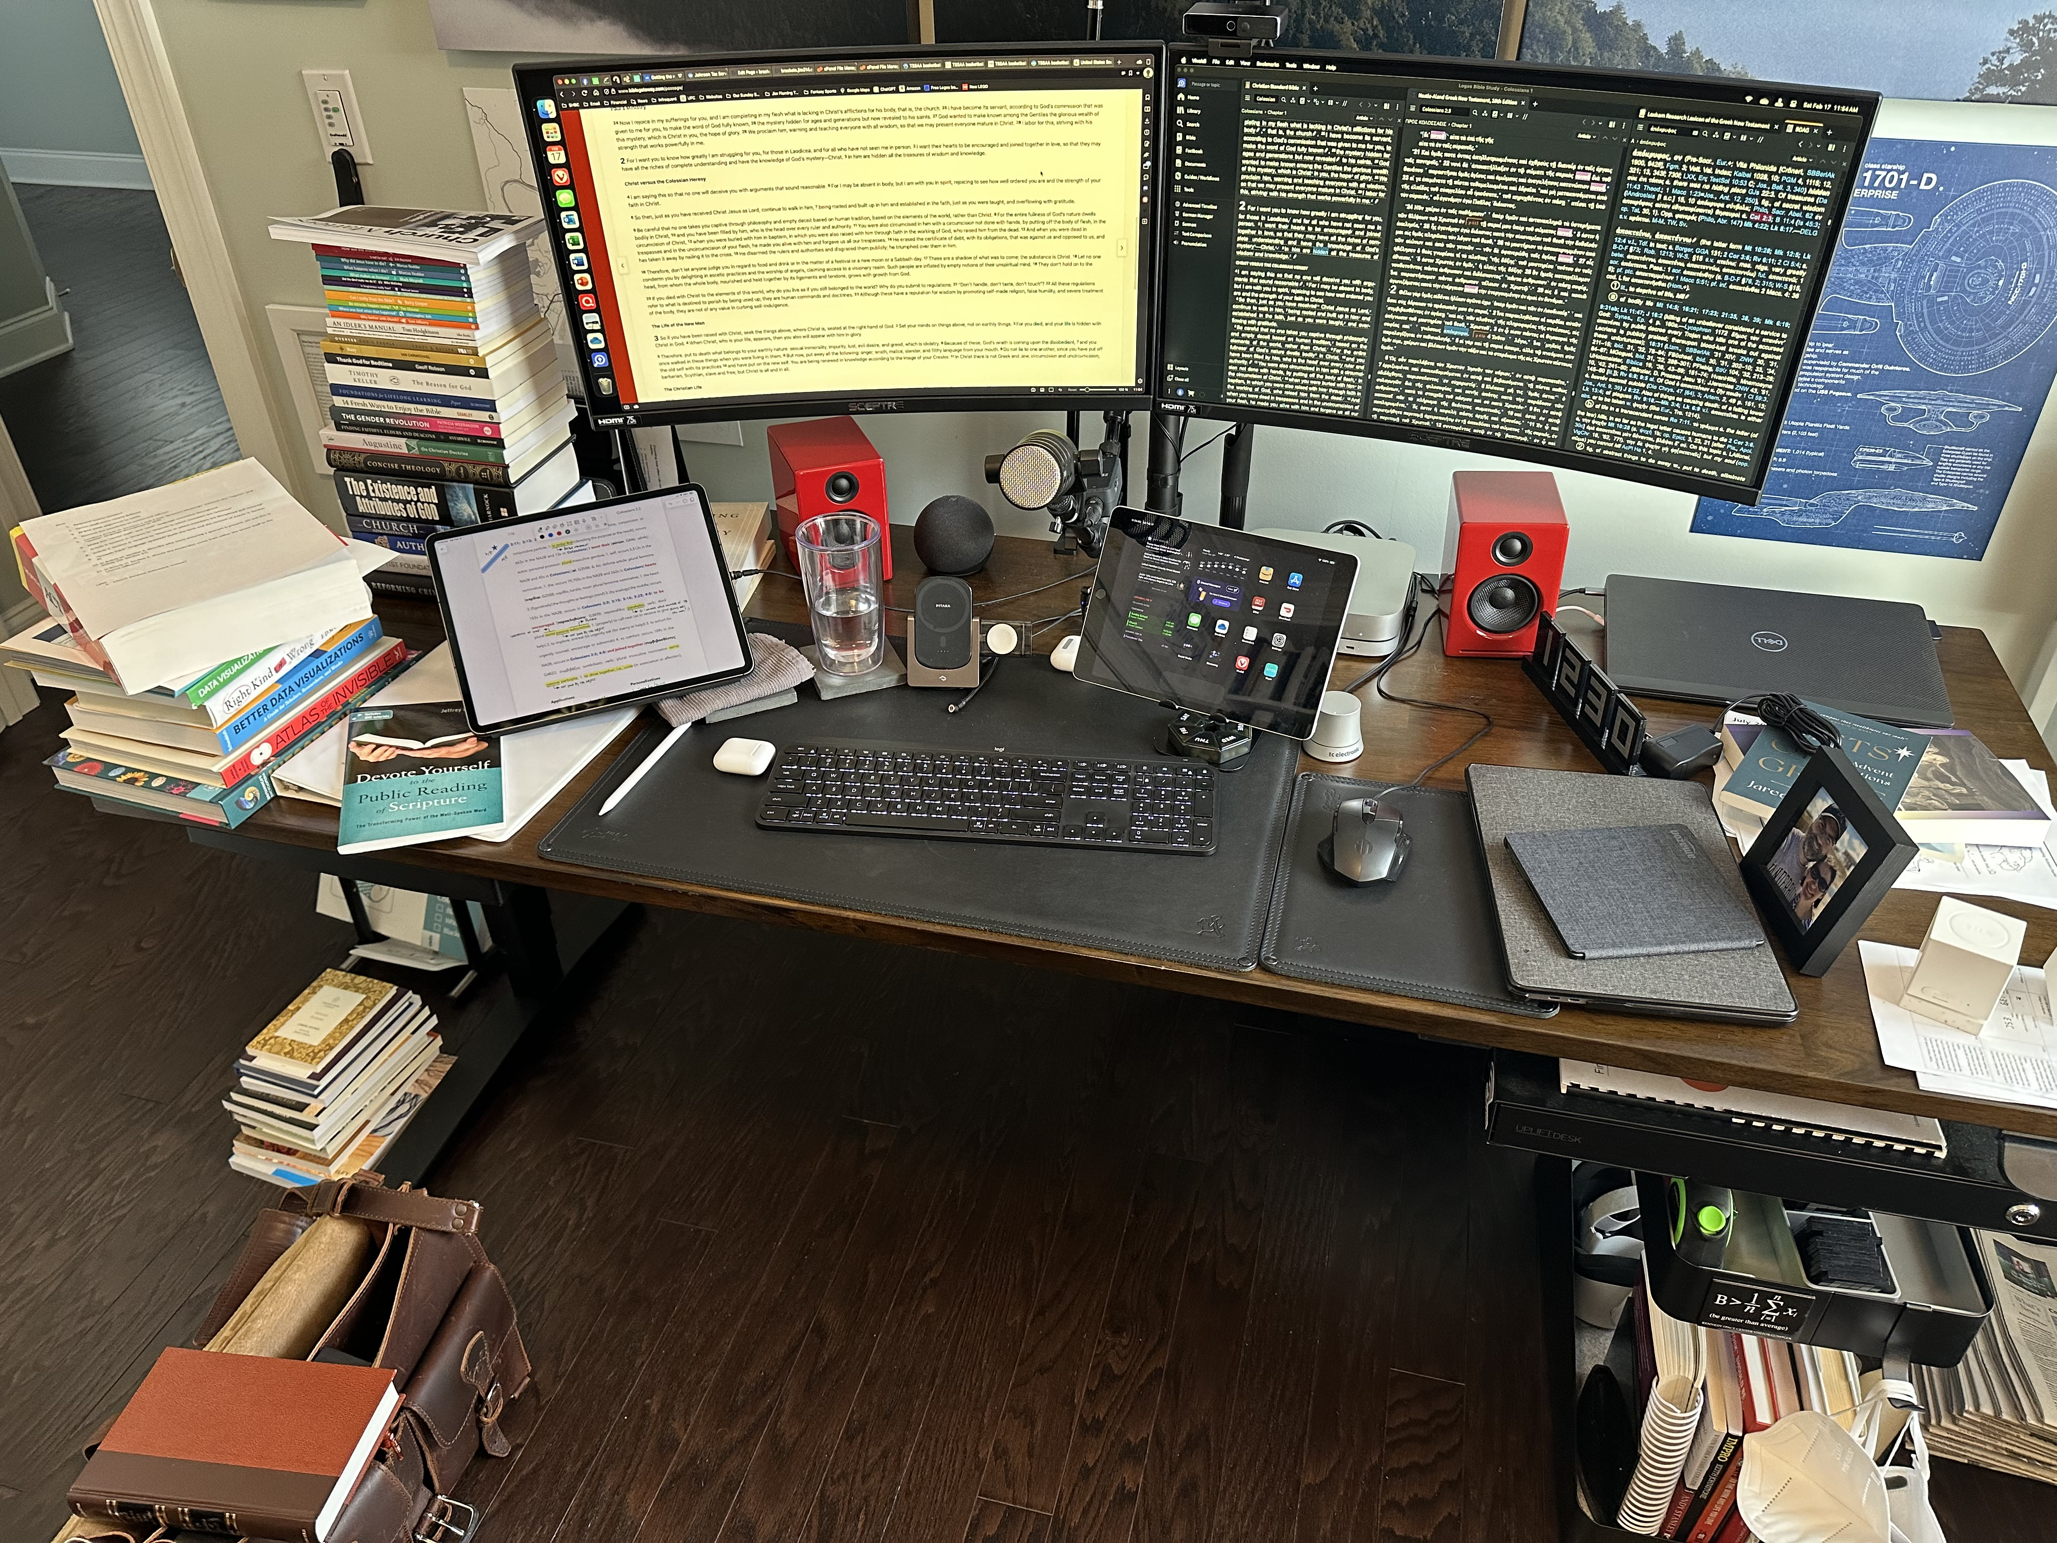

Slide 9
Dr. A. T. Robertson The Greek New Testament is the New Testament. All else is translation.
image from SBTS.edu

Slide 10
Dr. A. T. Robertson The greatest proof that the Bible is inspired is that it has stood so much bad preaching
image from SBTS.edu

Slide 11
Colossians: week 18 (pages 116-121)

Slide 12
Taxonomies
Bloom’s (modified cognitive domain)
Proverbs
Wisdom
Discernment
Understanding
Knowledge
Fear of the Lord
Create Evaluate Analyze Apply Understand Remember

Slide 13
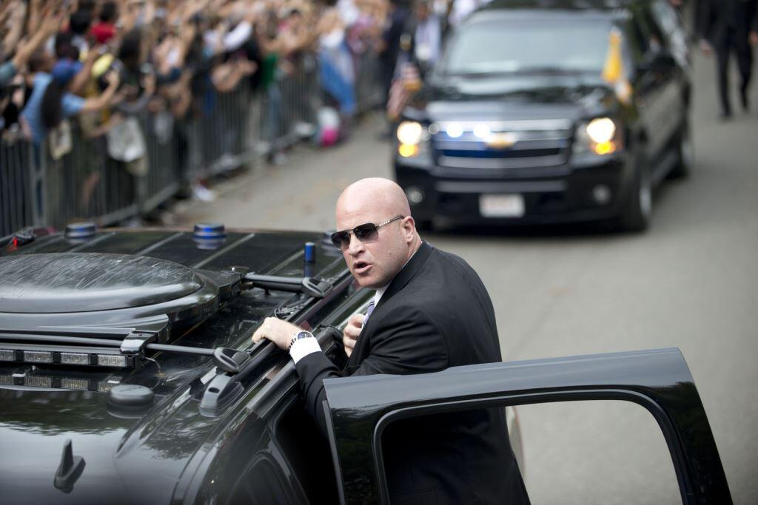
image from SecretService.gov

Slide 14
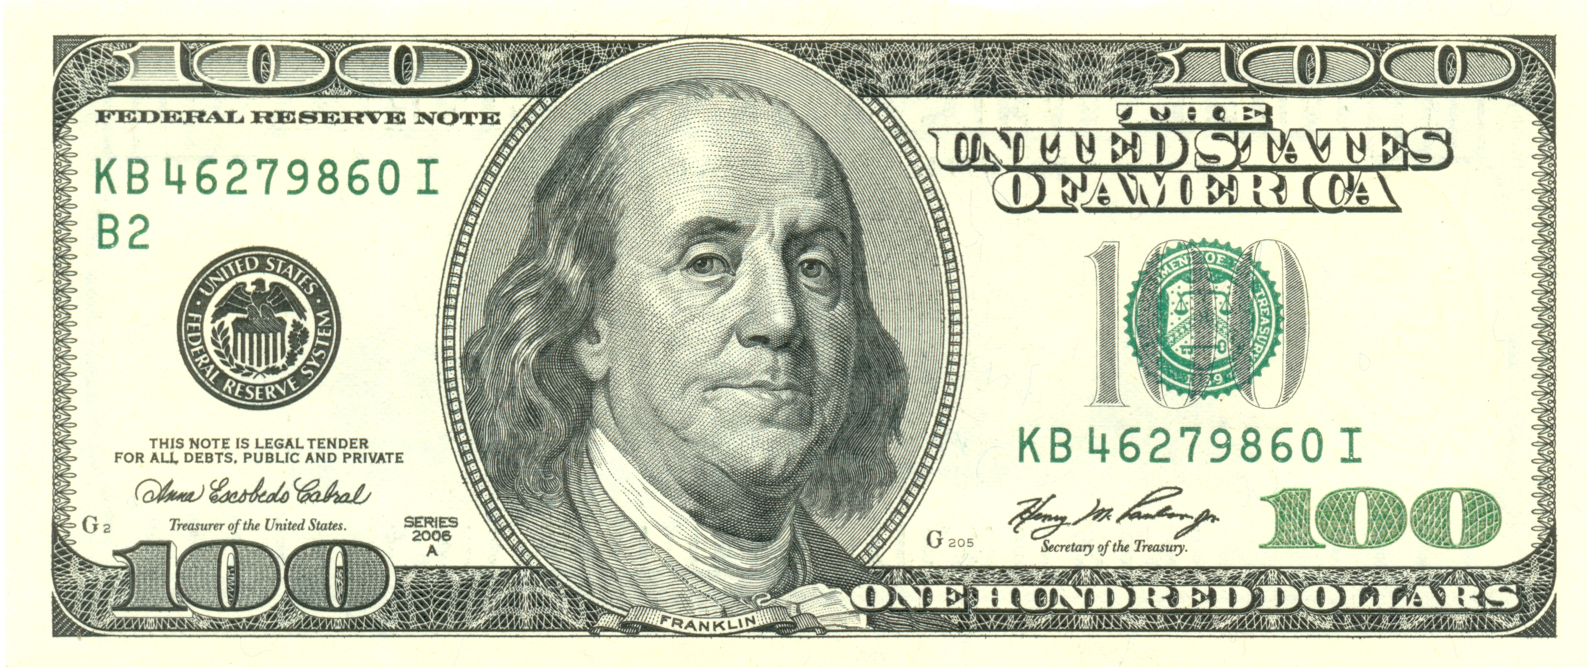

Slide 17
Prayer time
Write down your prayer requests (on the Weekly Update or in the comments
Lean in, engage, and pray for someone not with you
Be out of this room by 9:50
Go worship

Slide 18
Today’s class (page 17)
Preparing for Colossians 1:1-2:3 Pray with others Hear with others Think with others Study with others Share with others Invite others
In class, as a class
In class, as tables
After class

Slide 19
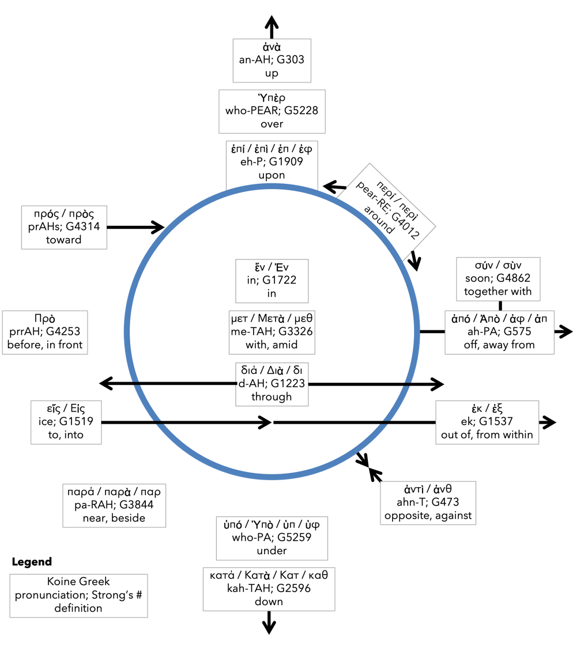
Preposition circle (page 12)

Slide 20
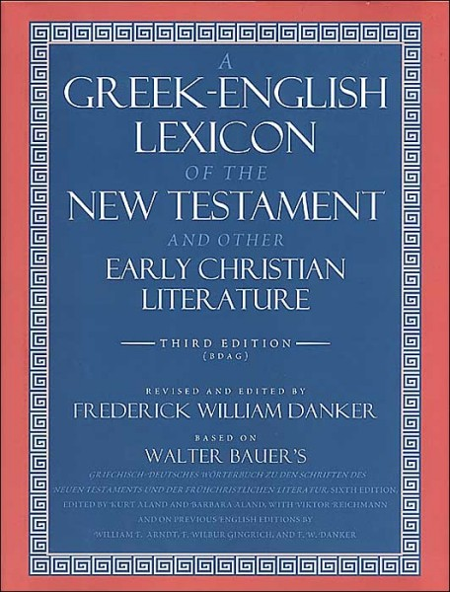
BDAG on morphe (mor-FAY) definition

Slide 21
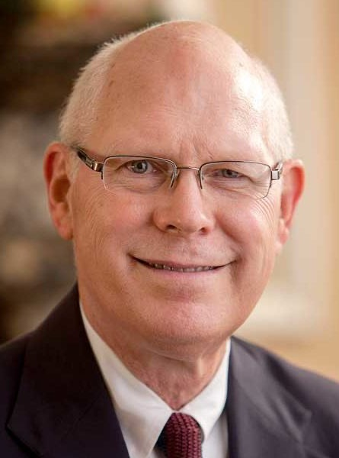
Dr. Gregory K. Beale Quote

Slide 22
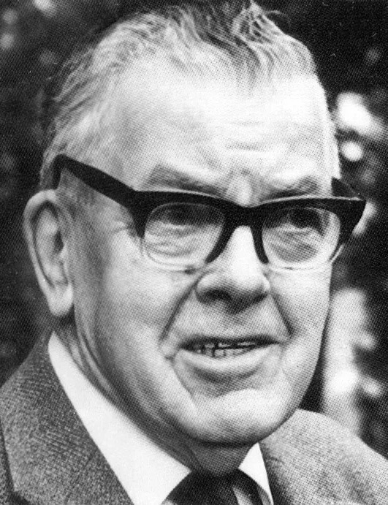
F. F. Bruce Quote

Slide 23
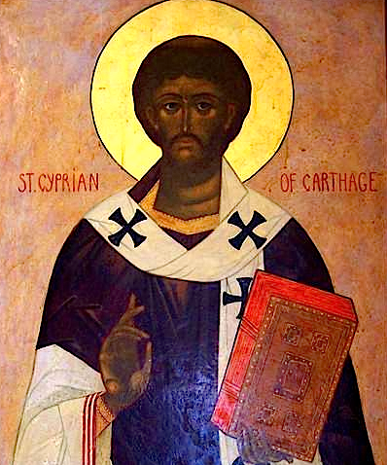
Cyprian Quote

Slide 24
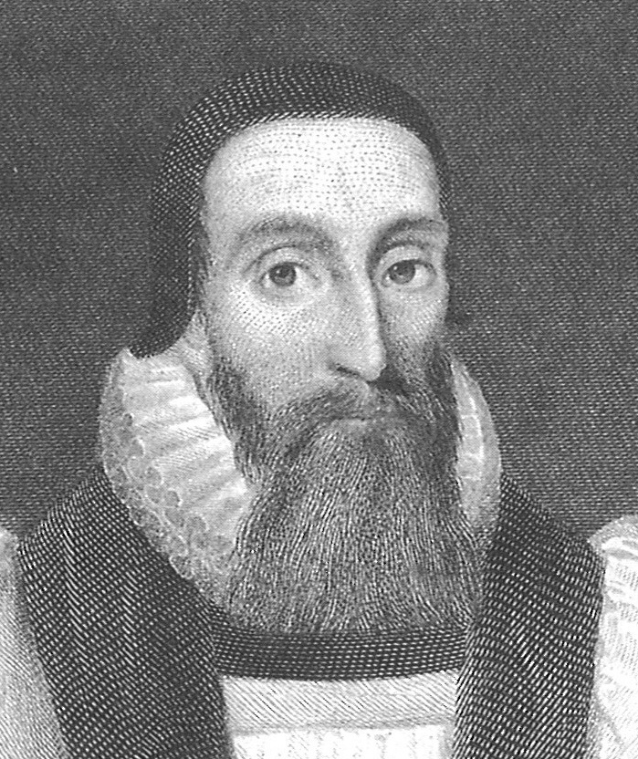
Dr. John Davenant Quote

Slide 25
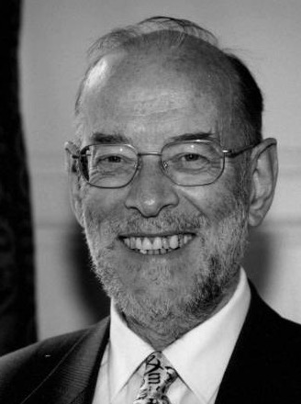
Dr. James D. G. Dunn Quote

Slide 26
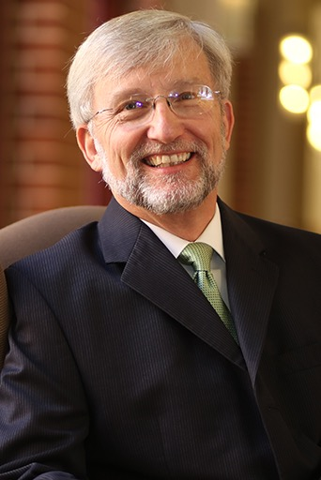
Dr. David Garland Quote

Slide 27
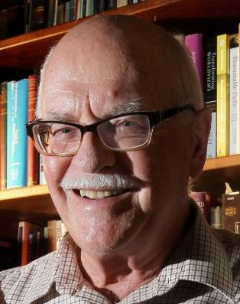
Dr. Murray J. Harris Quote

Slide 28
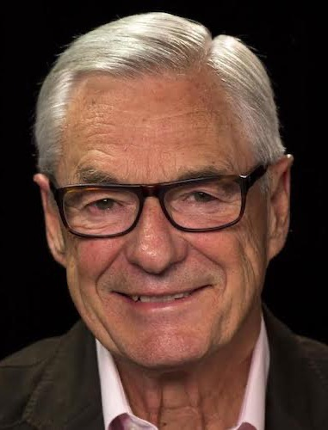
Dr. R. Kent Hughes Quote

Slide 29
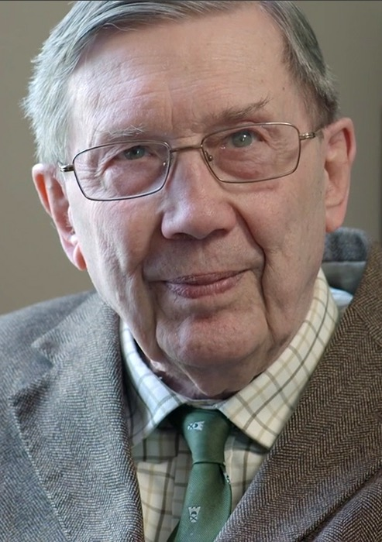
R. C. Lucas Quote

Slide 30
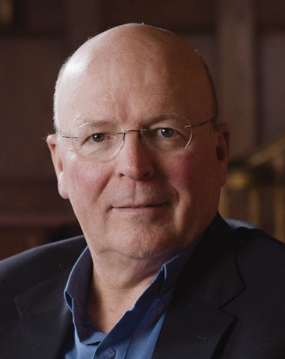
Dr. Scot McKnight Quote

Slide 31
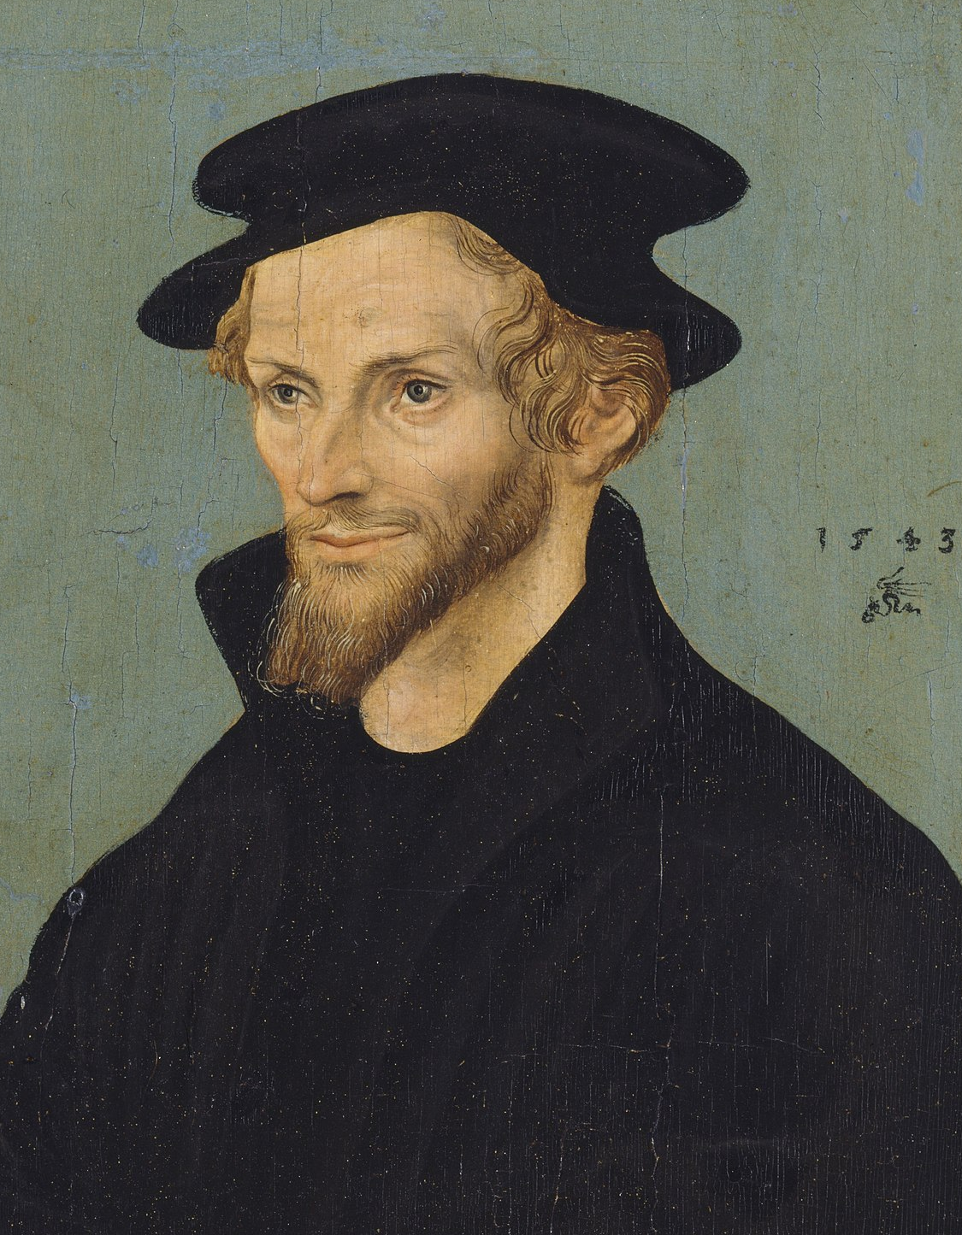
Philip Melanchthon Quote

Slide 32
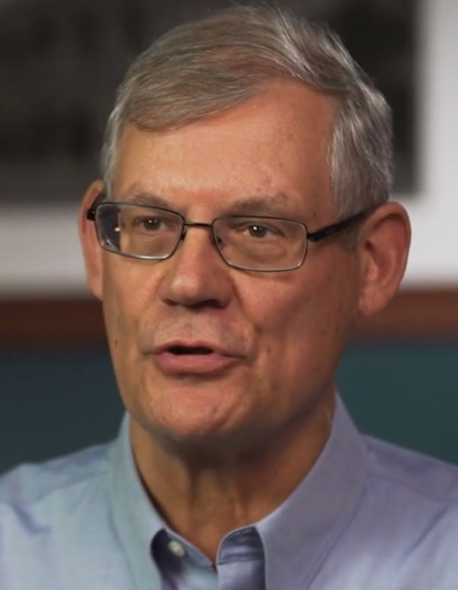
Dr. Douglas J. Moo Quote

Slide 33
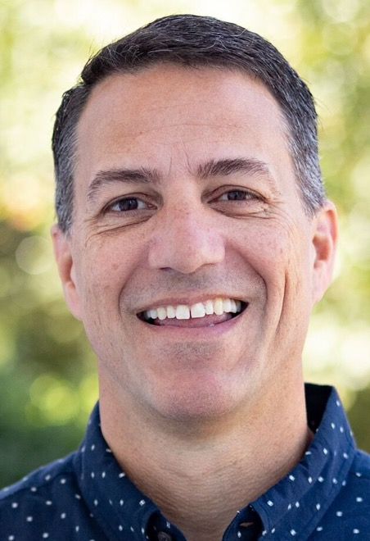
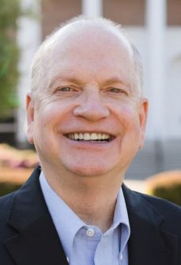
Dr. R. Scott Pace & Dr. Daniel L. Akin Quote

Slide 34
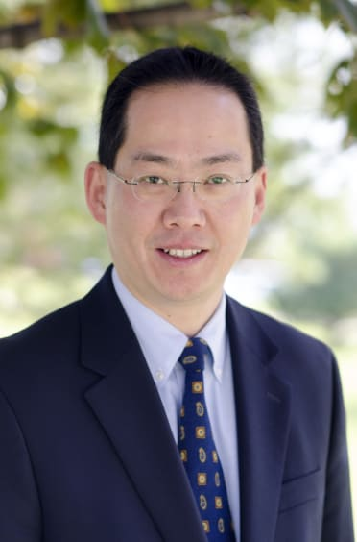
Dr. David W. Pao Quote

Slide 35
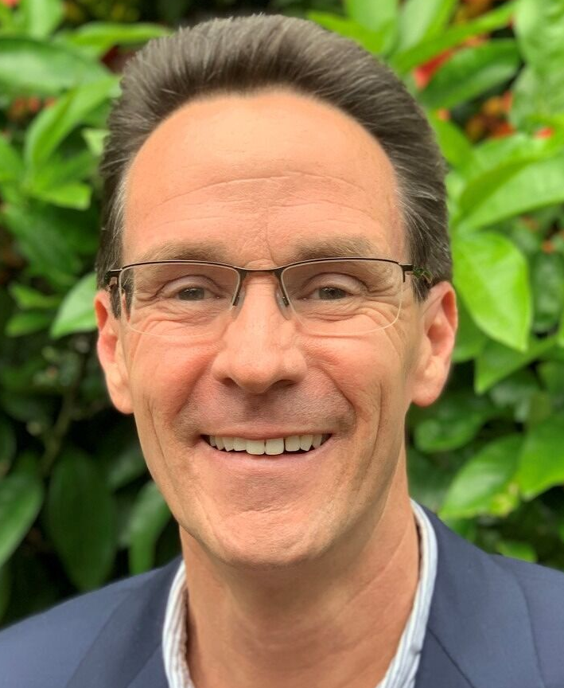
Dr. Alan Thompson Quote

Slide 36
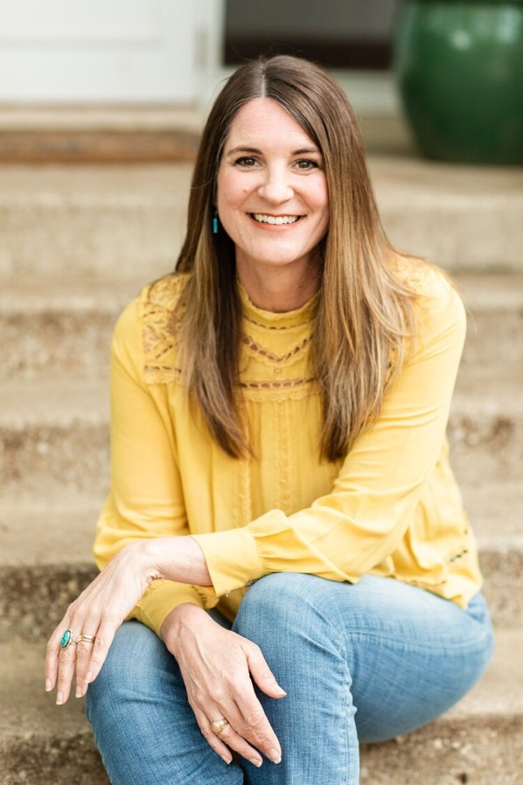
Jen Wilkin Quote

Slide 37
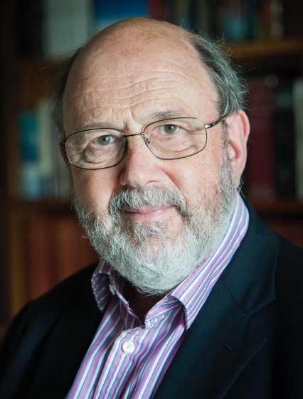
Dr. N. T. Wright Quote

