Slide 1
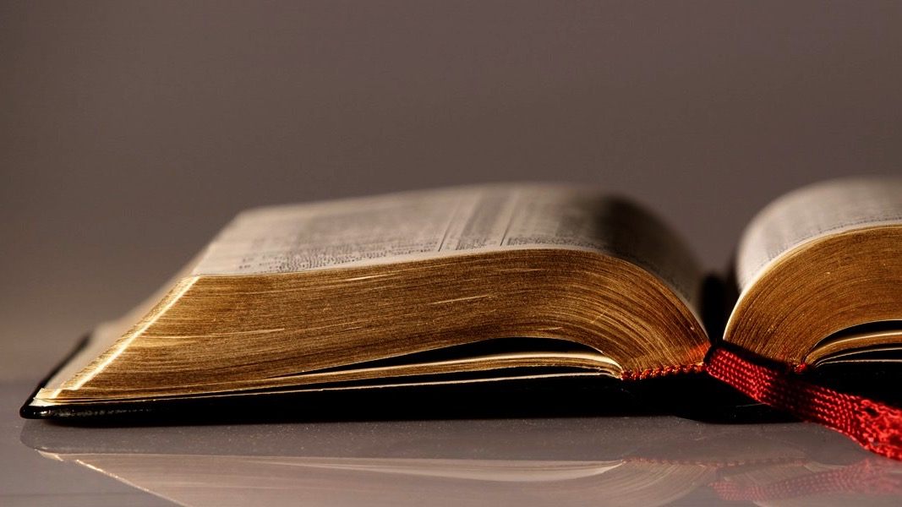
Welcome to
Our Sunday School
We’ll start at 9:07
visit OurSundaySchool.com for more about our class

Slide 2
Colossians: week 16 (pages 110-112)

Slide 3
Colossians 1:29
I labor for this, striving with his strength that works powerfully in me.

Slide 4
Colossians: week 16 (pages 110-112)

Slide 5
What physically exhausts you?

Slide 6
Colossians: week 16 (pages 110-112)

Slide 7
What does “this” refer to?

Slide 8
Colossians: week 16 (pages 110-112)

Slide 9
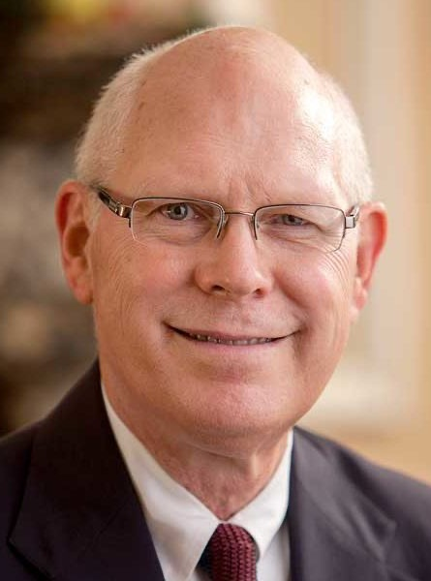
Dr. Gregory K. Beale Christians should strive for maturity, not by keeping earthly legalistic laws but by faithfully seeking the heavenly Christ

Slide 10
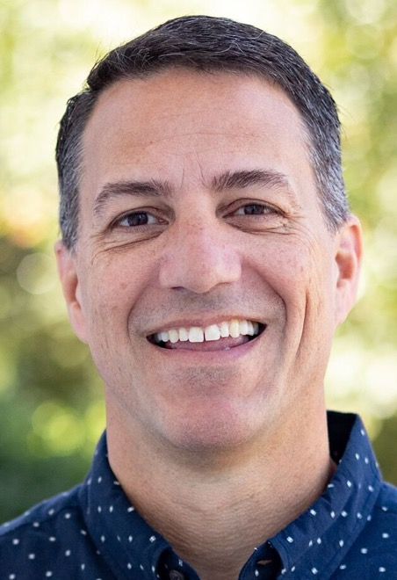
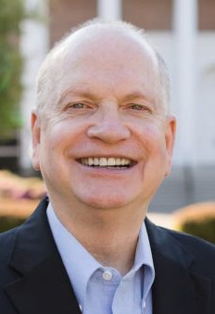
Dr. R. Scott Pace & Dr. Daniel L. Akin The strategy and audience of the mission culminate in its ultimate goal, to “present everyone mature in Christ”

Slide 11
Colossians: week 16 (pages 110-112)

Slide 12
What is a deponent?

Slide 13
What is a deponent? (see p. 10)

Slide 14
Colossians: week 16 (pages 110-112)

Slide 15
Prayer time
Write down your prayer requests (on the Weekly Update or in the comments
Lean in, engage, and pray for someone not with you
Be out of this room by 9:50
Go worship

Slide 16
Today’s class (page 17)
Preparing for Colossians 1:1-2:3 Pray with others Hear with others Think with others Study with others Share with others Invite others
In class, as a class
In class, as tables
After class

Slide 17
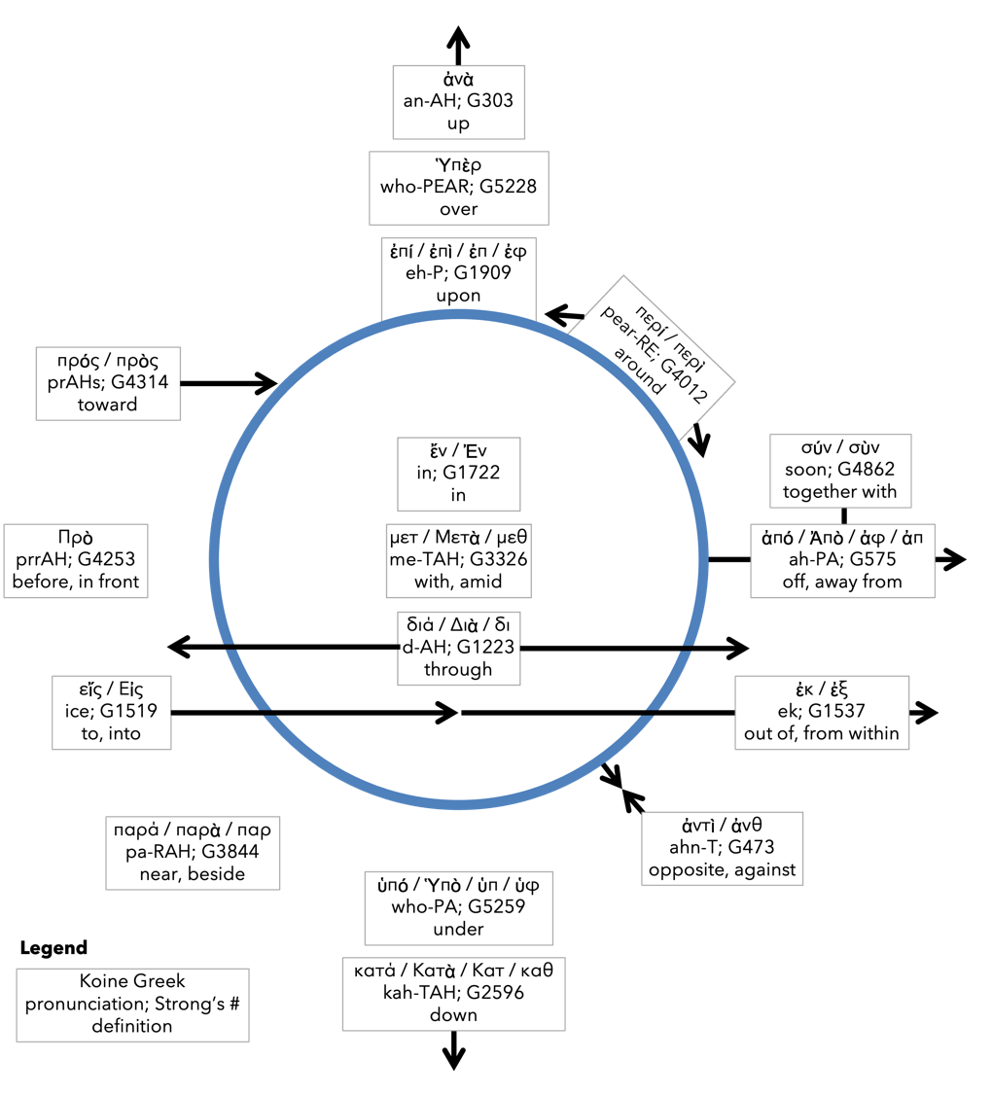
Preposition circle (page 12)

Slide 18
BDAG on morphe (mor-FAY) definition

Slide 19
Dr. Gregory K. Beale Quote

Slide 20
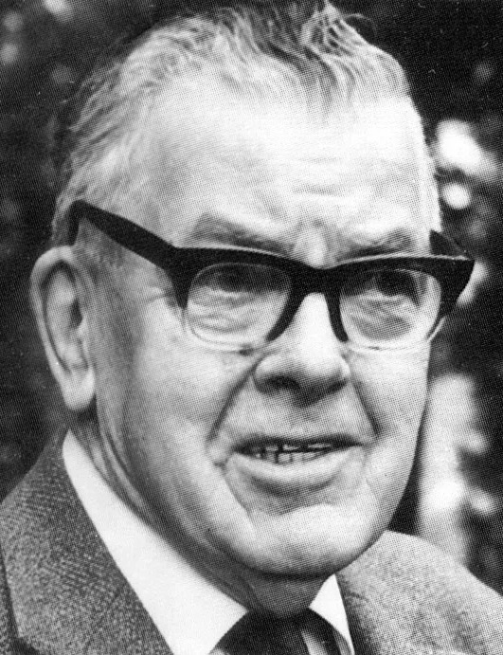
F. F. Bruce Quote

Slide 21
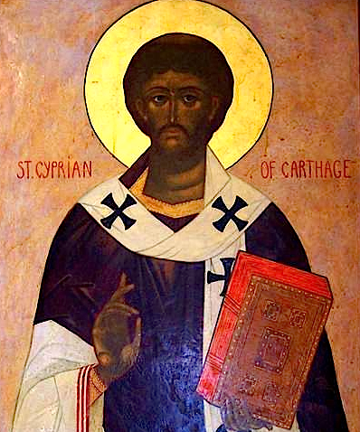
Cyprian Quote

Slide 22
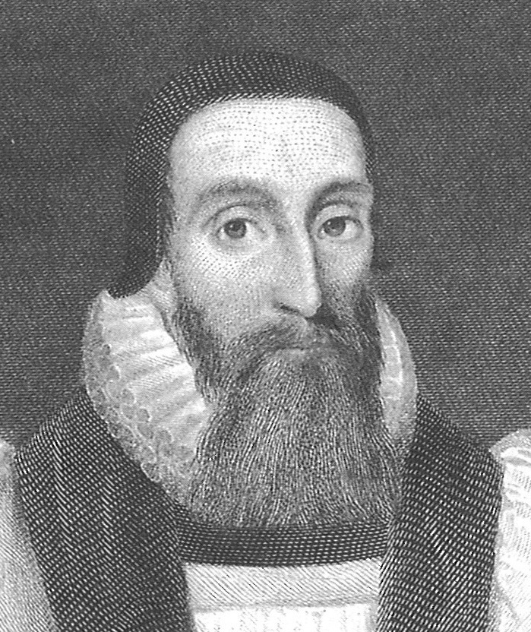
Dr. John Davenant Quote

Slide 23
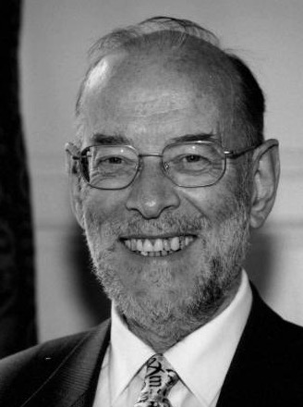
Dr. James D. G. Dunn Quote

Slide 24
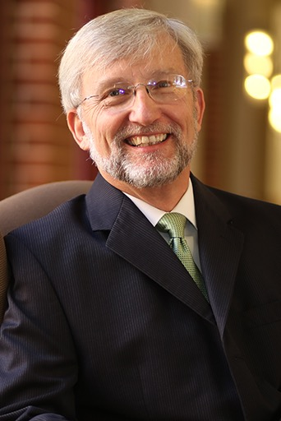
Dr. David Garland Quote

Slide 25
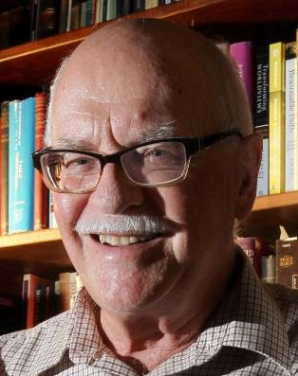
Dr. Murray J. Harris Quote

Slide 26
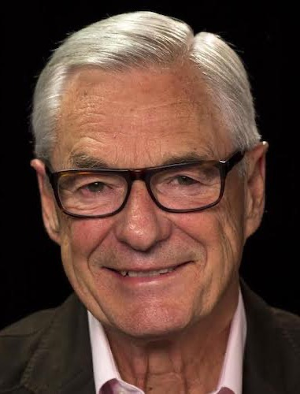
Dr. R. Kent Hughes Quote

Slide 27
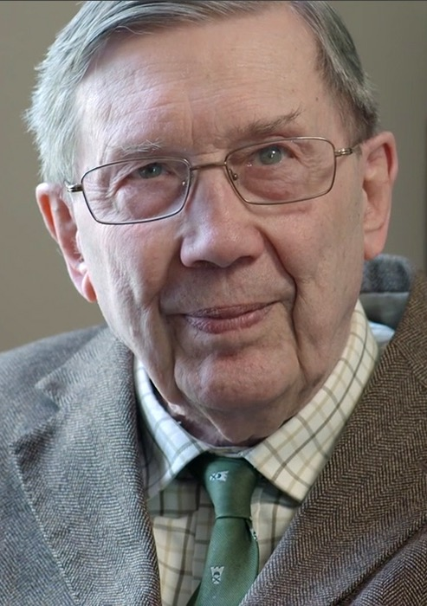
R. C. Lucas Quote

Slide 28
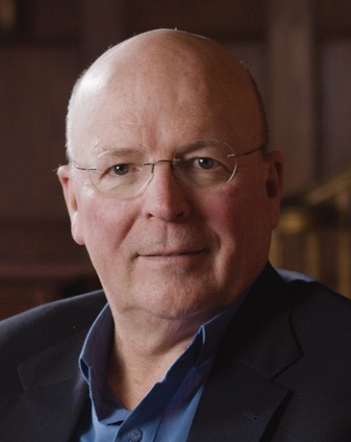
Dr. Scot McKnight Quote

Slide 29
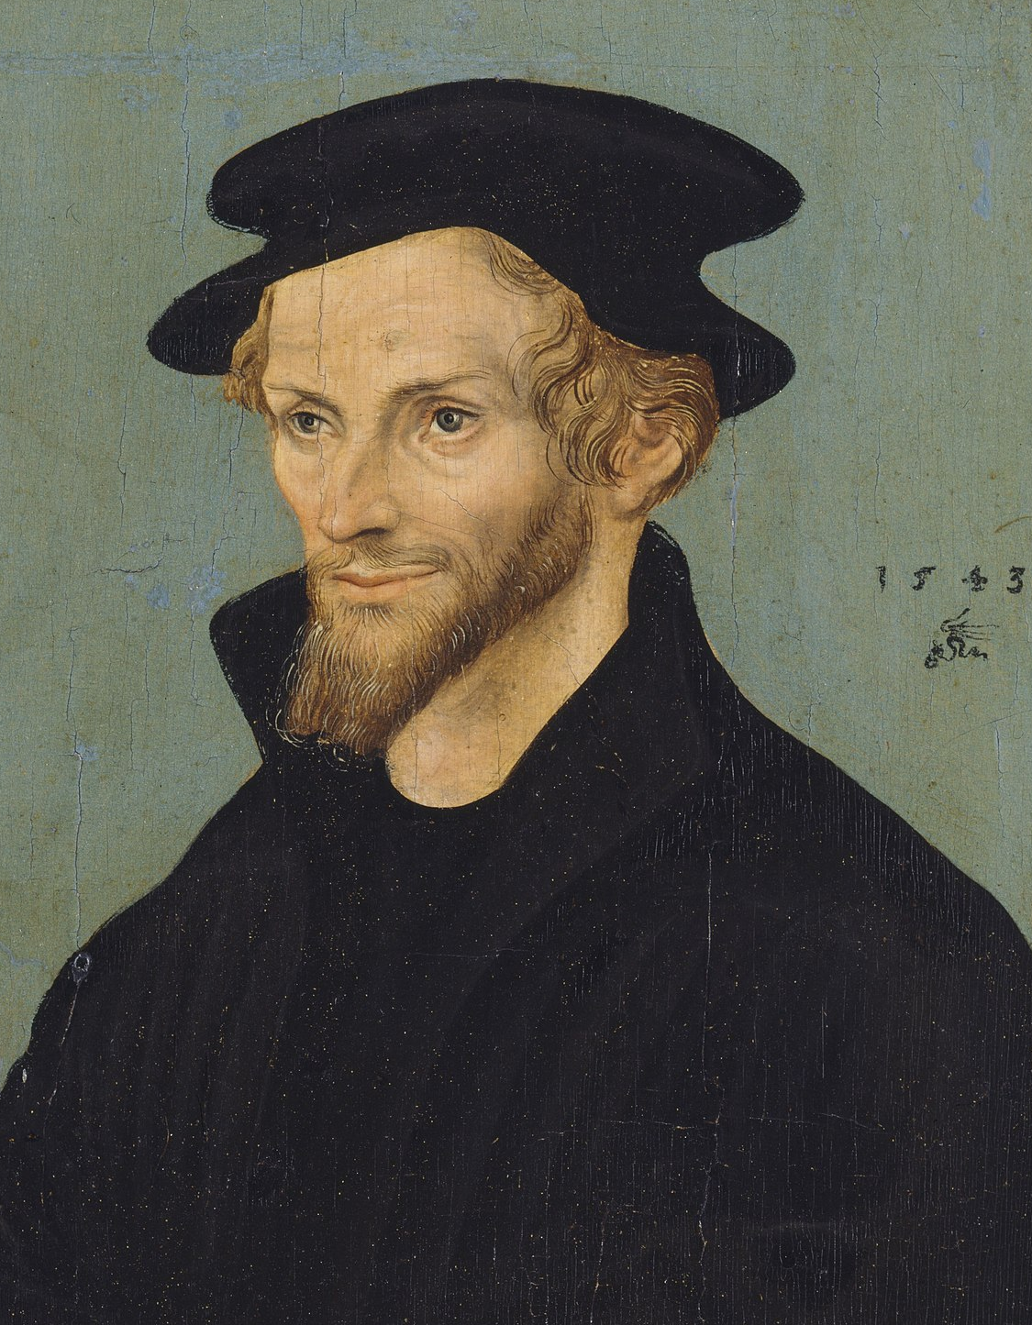
Philip Melanchthon Quote

Slide 30
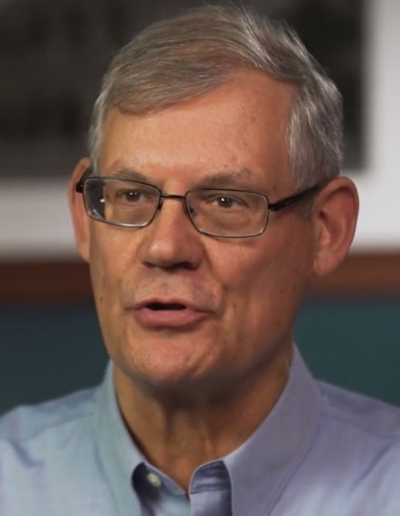
Dr. Douglas J. Moo Quote

Slide 31
Dr. R. Scott Pace & Dr. Daniel L. Akin Quote

Slide 32
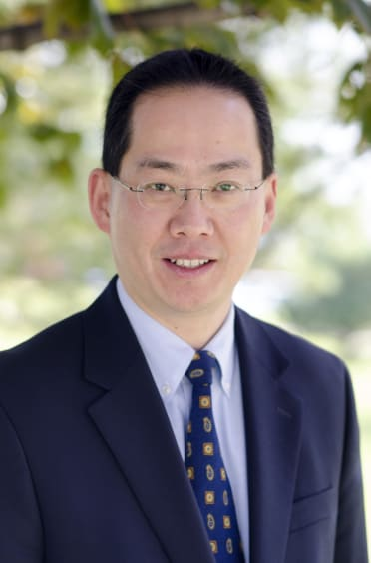
Dr. David W. Pao Quote

Slide 33
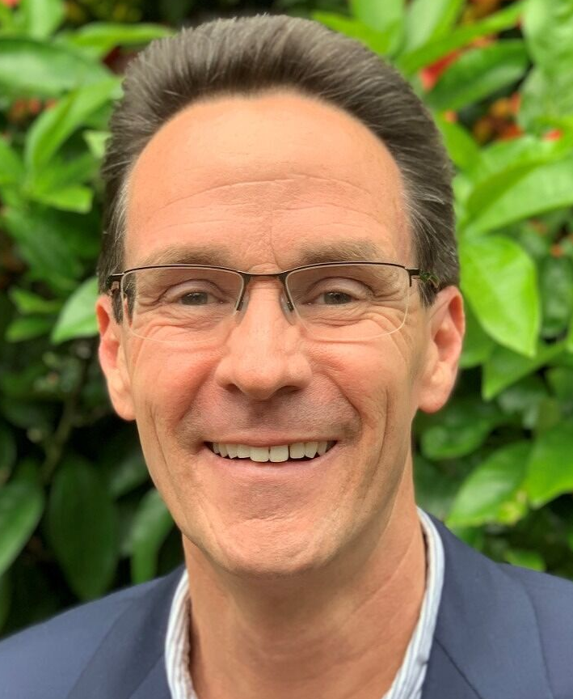
Dr. Alan Thompson Quote

Slide 34
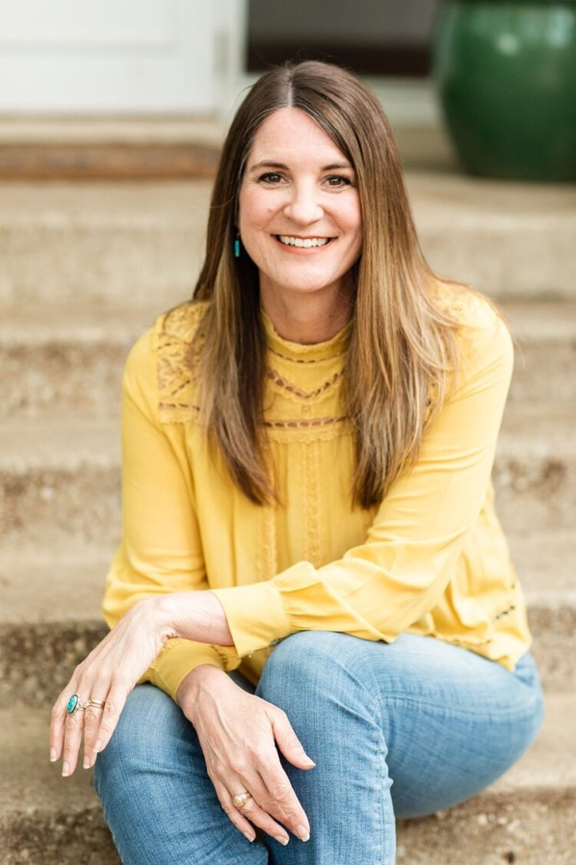
Jen Wilkin Quote

Slide 35
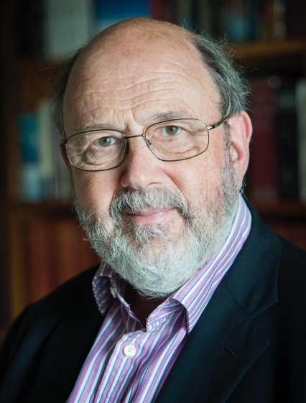
Dr. N. T. Wright Quote

