Slide 1
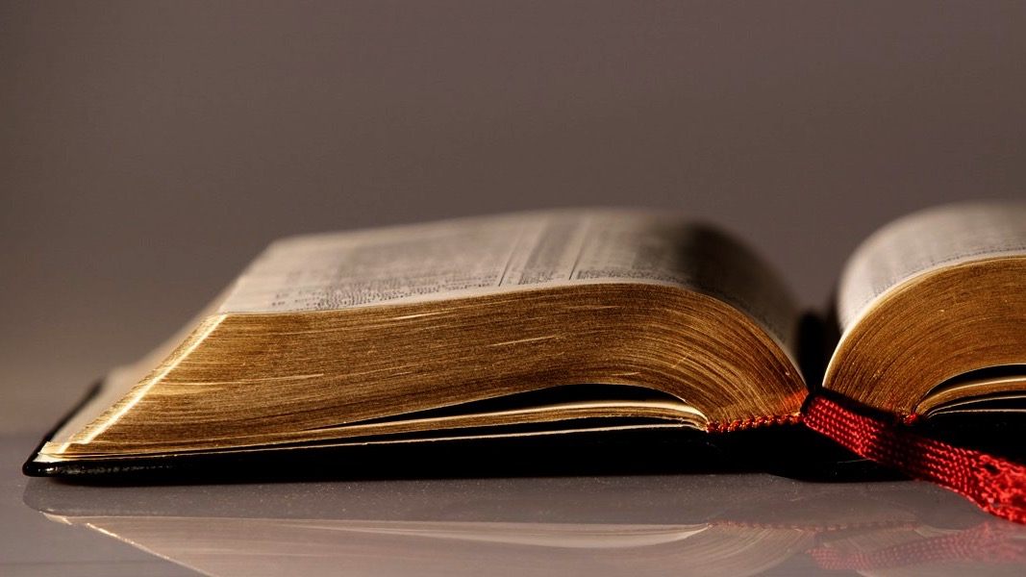
Welcome to
Our Sunday School
We’ll start at 9:07
visit OurSundaySchool.com for more about our class

Slide 2
Colossians: week 15 (pages 106-112)

Slide 3
A review of applications (1:1-2) (what is the point of the text)
Paul wrote Colossians
Paul has authority to speak for God
Our Lord Jesus Christ picked Paul
Paul was not alone
All people in all places need a clear picture of our Lord Jesus Christ

Slide 4
A review of applications (1:1-2) (what is the point of the text)
Faith in our Lord Jesus Christ produces faithful brothers and sisters
Paul fills the format with our Lord Jesus Christ
God’s children are family

Slide 5
A review of applications (1:3-8) (what is the point of the text)
Thankfulness for what God is doing is normal
God is the object of our thanks
God is our Father and our Lord Jesus Christ is our brother
Jesus Christ is our Lord

Slide 6
A review of applications (1:3-8) (what is the point of the text)
Repeated thankfulness for what God is doing is normal
Christians share good news
Our faith is in our Lord Jesus Christ
Faith is visible in our actions
Christians love all Christians

Slide 7
A review of applications (1:3-8) (what is the point of the text)
Faith, love, and hope work together
Reward awaits
The gospel is true
Christians need the gospel daily
The gospel bears fruit when sown
The gospel produces new life

Slide 8
A review of applications (1:3-8) (what is the point of the text)
God causes growth
The gospel is for the whole world
The gospel is for believers
Hearing comes before recognition
The gospel is evidence of God’s grace
The gospel should not be changed

Slide 9
A review of applications (1:3-8) (what is the point of the text)
Evangelism works
Ministers should be loved
Ministers should be faithful
Ministers are servants
Minsters are servants for their churches
Ministers share good news about their churches

Slide 10
A review of applications (1:3-8) (what is the point of the text)
Love is a fruit of the Spirit
The Trinity is actively involved

Slide 11
A review of applications (1:9-14) (what is the point of the text)
Love in the Spirit is the reason for repeated prayer
Repeated prayer is the result of love in the Spirit
Prayer has a purpose
God fills with knowledge

Slide 12
A review of applications (1:9-14) (what is the point of the text)
God has a will
God’s will can be known

Slide 13
A review of applications (1:9-14) (what is the point of the text)
Filling has a purpose #1 walking worthy #2 desiring to please #3 bearing fruit #4 growing in knowledge #5 being strengthened #6 having endurance and patience #7 joyfully giving thanks

Slide 14
A review of applications (1:9-14) (what is the point of the text)
The Father qualifies
The Father shares
The Father rescued
The Father transferred
The Father loves

Slide 15
A review of applications (1:9-14) (what is the point of the text)
Our Lord Jesus Christ redeems his own
Christians sinned and are forgiven

Slide 16
A review of applications (1:15-23) (what is the point of the text)
Our Lord Jesus Christ is God’s icon
Our Lord Jesus Christ is unique
Our Lord Jesus Christ is the Father’s first son
Our Lord Jesus Christ is over all

Slide 17
A review of applications (1:15-23) (what is the point of the text)
Our Lord Jesus Christ created all (heaven/earth)
Our Lord Jesus Christ created all (visible/invisible)
Our Lord Jesus Christ created all (thrones/dominions)
Our Lord Jesus Christ created all (rulers/authorities)

Slide 18
A review of applications (1:15-23) (what is the point of the text)
Everything was created through our Lord Jesus Christ
Everything was created for our Lord Jesus Christ
Our Lord Jesus Christ is before all
Our Lord Jesus Christ enabled all existence to exist

Slide 19
A review of applications (1:15-23) (what is the point of the text)
Our Lord Jesus Christ leads the church
The church is a body
Our Lord Jesus Christ is the first to resurrect and never die again
Our Lord Jesus Christ has first place in all
Our Lord Jesus Christ is worthy

Slide 20
A review of applications (1:15-23) (what is the point of the text)
All the Father’s fullness actively dwells in our Lord Jesus Christ
All reconciliation goes through our Lord Jesus Christ
The scope of our Lord Jesus Christ’s reconciliation is total

Slide 21
A review of applications (1:15-23) (what is the point of the text)
Our Lord Jesus Christ’s blood causes peace with the Father, with believers, and with creation
The cross is central for peace

Slide 22
A review of applications (1:15-23) (what is the point of the text)
Pre-reconciliation, estrangement was normal
Pre-reconciliation, hostility of thought was normal
Pre-reconciliation, hostility of action was normal
Reconciliation is our Lord Jesus Christ’s work

Slide 23
A review of applications (1:15-23) (what is the point of the text)
Our Lord Jesus Christ’s physical body died
Our Lord Jesus Christ puts on an exhibit of his holy and blameless work: his own
Christians are holy, faultless, and blameless before the Father

Slide 24
A review of applications (1:15-23) (what is the point of the text)
The believer’s role is to remain grounded and steadfast in the faith
Hope can shift
The gospel and hope are connected
The gospel must be heard
The gospel must be proclaimed
The gospel need is universal

Slide 25
A review of applications (1:15-23) (what is the point of the text)
The gospel is personal
Christians are servants to the gospel

Slide 26
A review of applications (1:24-27) (what is the point of the text)
Rejoicing and suffering can coexist
The church is our Lord Jesus Christ’s body
Christians are servants to the church
Apostles were commissioned by God
Christians make God’s word known

Slide 27
A review of applications (1:24-27) (what is the point of the text)
The mystery is a who
God revealed his mystery
The mystery is also for the Gentiles
The mystery is in God’s people

Slide 28
Colossians: week 15 (pages 106-112)

Slide 29
Colossians 1:28-29
We proclaim him, warning and teaching everyone with all wisdom, so that we may present everyone mature in Christ. I labor for this, striving with his strength that works powerfully in me.

Slide 30
Colossians: week 15 (pages 106-112)

Slide 31
Options for “all”

Slide 32
Options for “all”
All people everywhere

Slide 33
Options for “all”
All people everywhere
All Christians

Slide 34
Options for “all”
All people everywhere
All Christians
All Christians in a specific local church

Slide 35
Colossians: week 15 (pages 106-112)

Slide 36
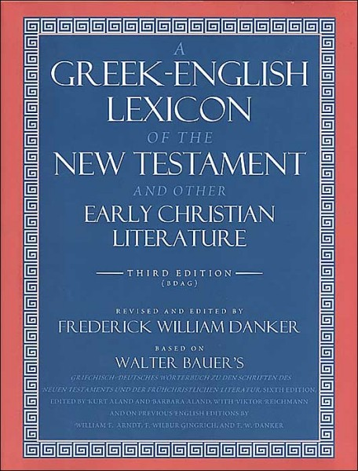
BDAG on sophia (sof-EE-uh) the capacity to understand and function accordingly

Slide 37
Taxonomies
Bloom’s (modified cognitive domain)
Proverbs
Wisdom
Discernment
Understanding
Knowledge
Fear of the Lord
Create Evaluate Analyze Apply Understand Remember

Slide 38
Hot stove example
Proverbs
What it looks like

Slide 39
Hot stove example
Proverbs
What it looks like
Fear of the Lord

Slide 40
Hot stove example
Proverbs
What it looks like
Fear of the Lord
God has rules

Slide 41
Hot stove example
Proverbs
What it looks like
Knowledge
Fear of the Lord
God has rules

Slide 42
Hot stove example
Proverbs
What it looks like
Knowledge
Fear of the Lord
the stove is hot
God has rules

Slide 43
Hot stove example
Proverbs
What it looks like
Understanding
Knowledge
Fear of the Lord
the stove is hot
God has rules

Slide 44
Hot stove example
Proverbs
What it looks like
Understanding
Knowledge
Fear of the Lord
the stove will burn me
the stove is hot
God has rules

Slide 45
Hot stove example
Proverbs
What it looks like
Discernment
Understanding
Knowledge
Fear of the Lord
the stove will burn me
the stove is hot
God has rules

Slide 46
Hot stove example
Proverbs
What it looks like
Discernment
Understanding
Knowledge
Fear of the Lord
that is bad for me
the stove will burn me
the stove is hot
God has rules

Slide 47
Hot stove example
Proverbs
What it looks like
Wisdom
Discernment
Understanding
Knowledge
Fear of the Lord
that is bad for me
the stove will burn me
the stove is hot
God has rules

Slide 48
Hot stove example
Proverbs
What it looks like
Wisdom
Discernment
Understanding
Knowledge
Fear of the Lord
I don’t touch the stove
that is bad for me
the stove will burn me
the stove is hot
God has rules

Slide 49
BDAG on sophia (sof-EE-uh) the capacity to understand and function accordingly

Slide 50
Colossians: week 15 (pages 106-112)

Slide 51
Prayer time
Write down your prayer requests (on the Weekly Update or in the comments
Lean in, engage, and pray for someone not with you
Be out of this room by 9:50
Go worship

Slide 52
Today’s class (page 17)
Preparing for Colossians 1:1-2:3 Pray with others Hear with others Think with others Study with others Share with others Invite others
In class, as a class
In class, as tables
After class

Slide 53
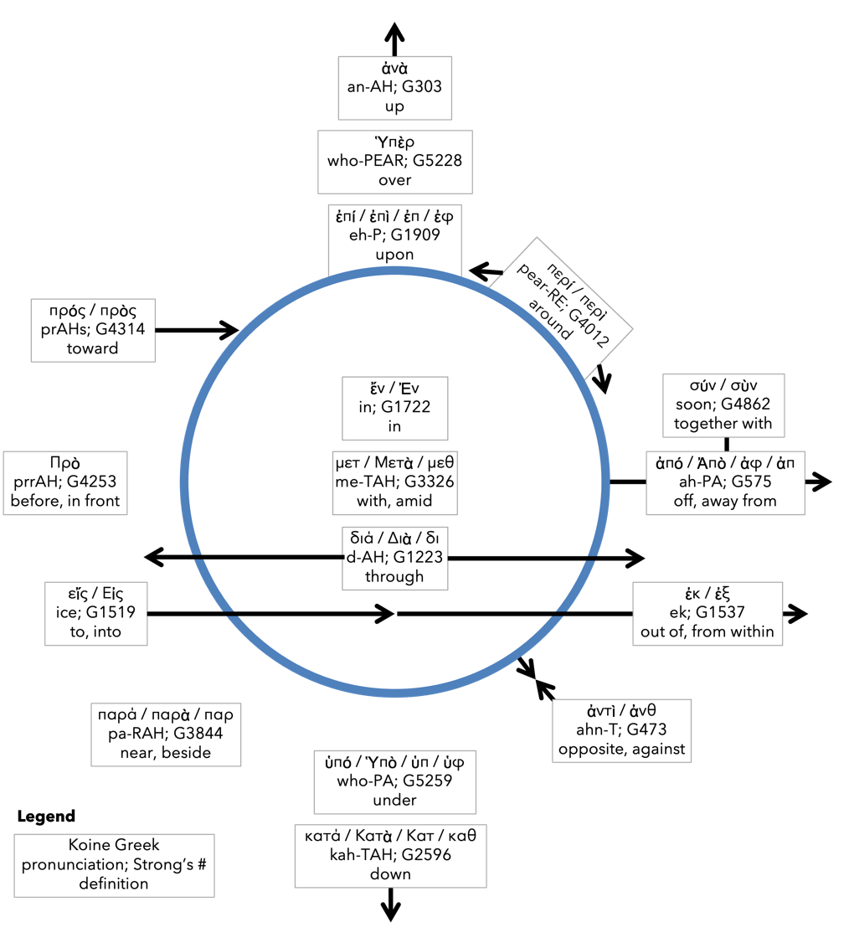
Preposition circle (page 12)

Slide 54
BDAG on morphe (mor-FAY) definition

Slide 55
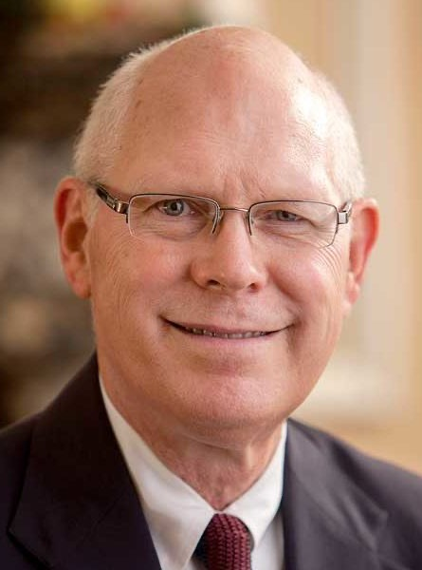
Dr. Gregory K. Beale Quote

Slide 56
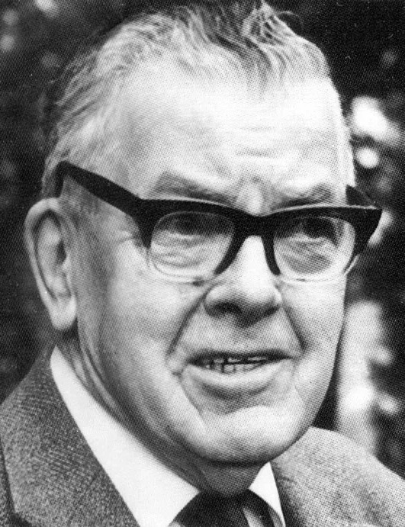
F. F. Bruce Quote

Slide 57
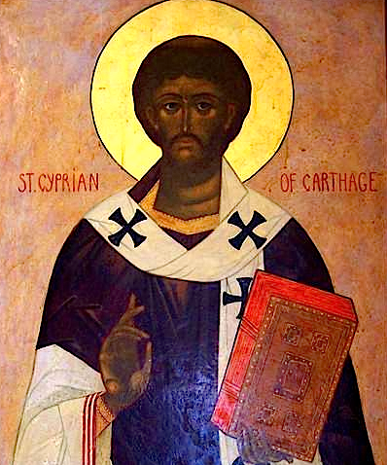
Cyprian Quote

Slide 58
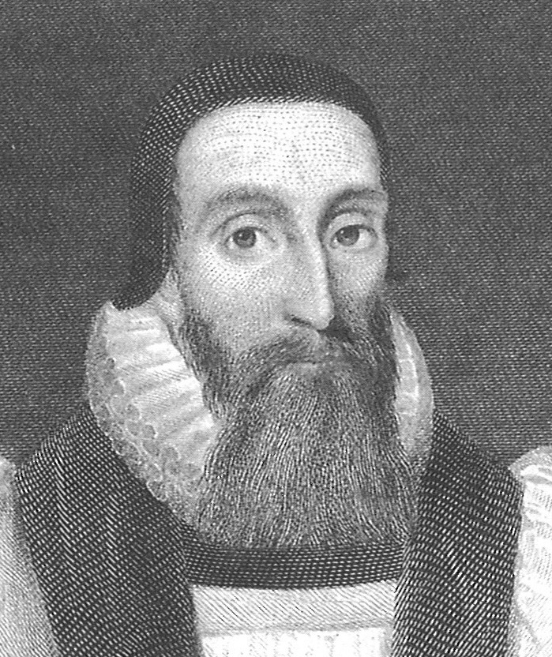
Dr. John Davenant Quote

Slide 59
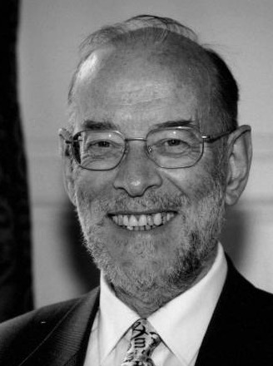
Dr. James D. G. Dunn Quote

Slide 60
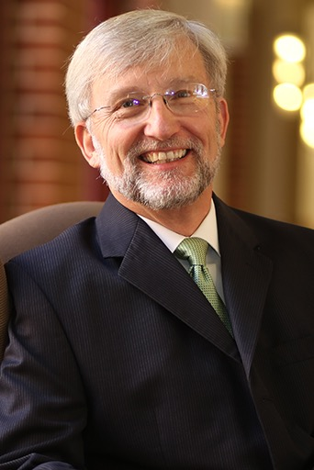
Dr. David Garland Quote

Slide 61
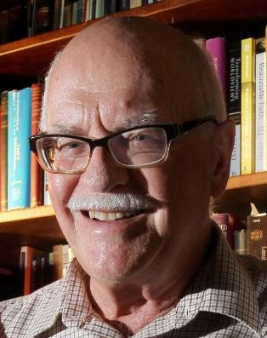
Dr. Murray J. Harris Quote

Slide 62
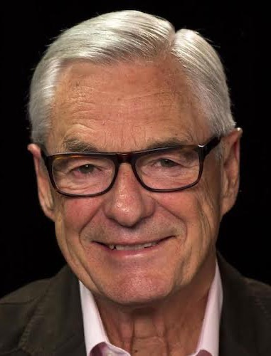
Dr. R. Kent Hughes Quote

Slide 63
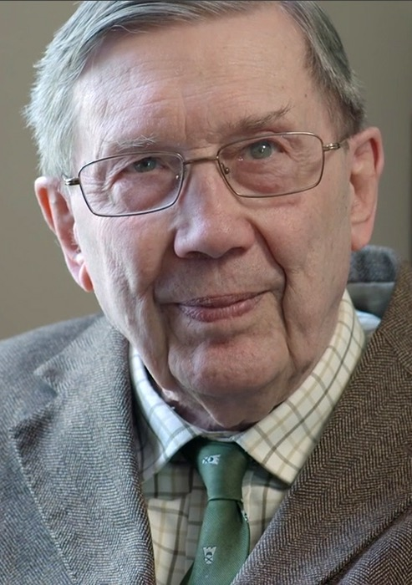
R. C. Lucas Quote

Slide 64
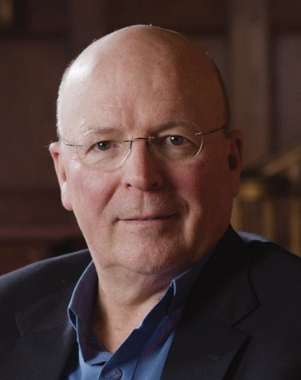
Dr. Scot McKnight Quote

Slide 65
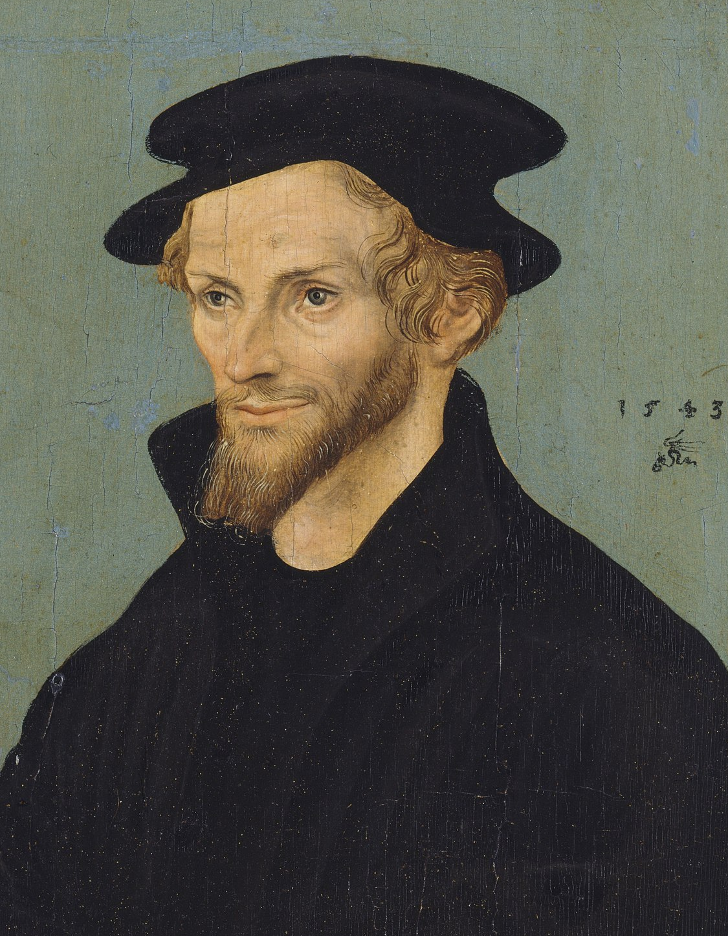
Philip Melanchthon Quote

Slide 66
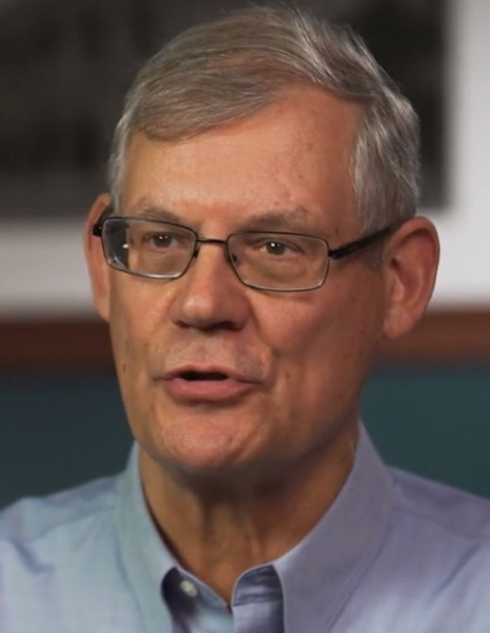
Dr. Douglas J. Moo Quote

Slide 67
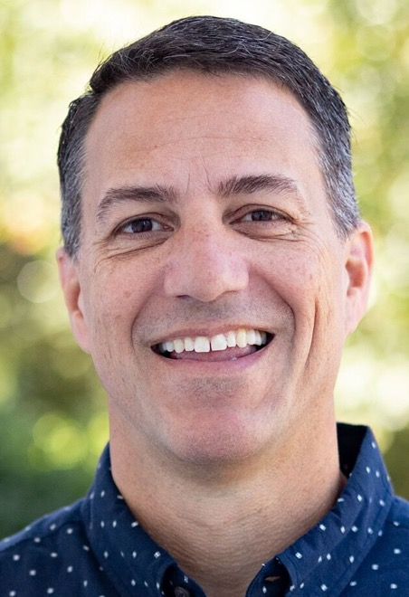
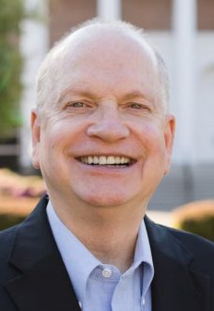
Dr. R. Scott Pace & Dr. Daniel L. Akin Quote

Slide 68
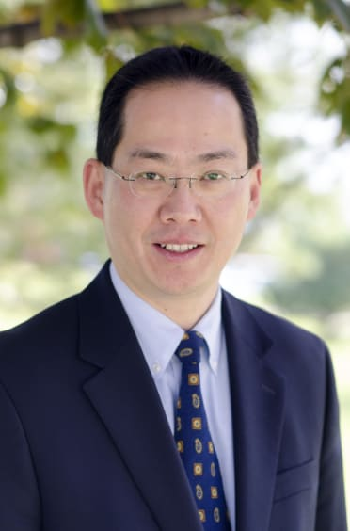
Dr. David W. Pao Quote

Slide 69
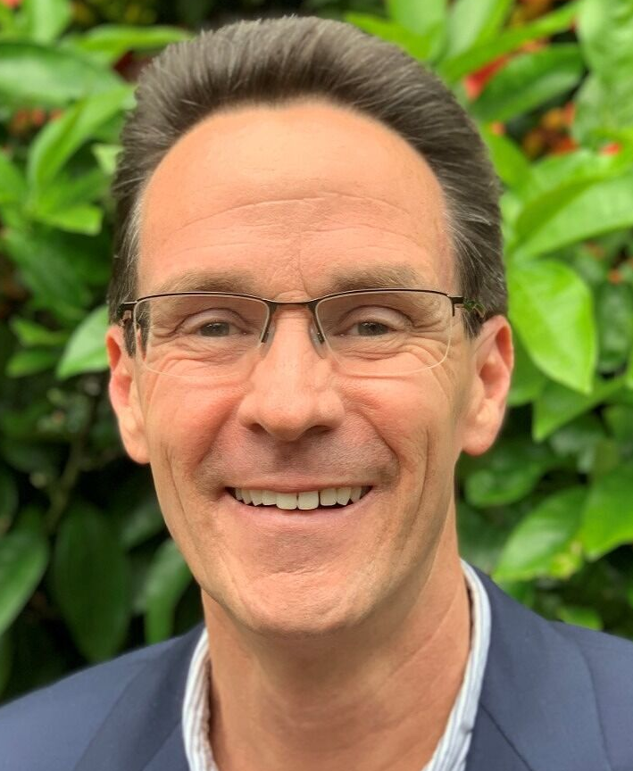
Dr. Alan Thompson Quote

Slide 70
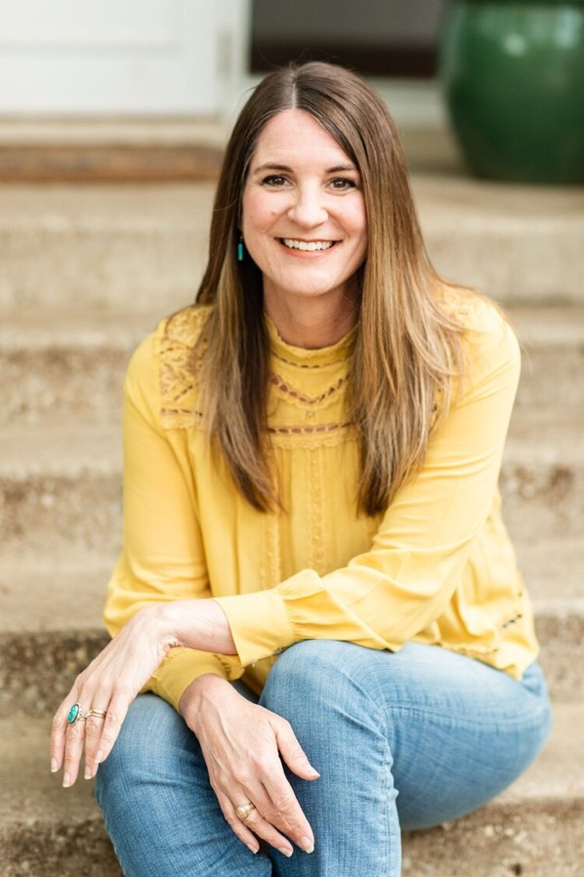
Jen Wilkin Quote

Slide 71
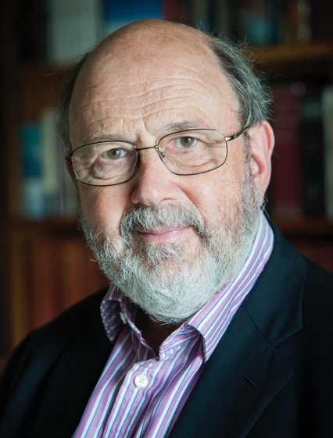
Dr. N. T. Wright Quote

