Slide 1
Welcome to
Our Sunday School
We’ll start at 9:07
visit OurSundaySchool.com for more about our class

Slide 2
Colossians: week 14 (pages 91-106)

Slide 3
Colossians 1:24-27
Now I rejoice in my sufferings for you, and I am completing in my flesh what is lacking in Christ’s afflictions for his body, that is, the church. I have become its servant, according to God’s commission that was given to me for you, to make the word of God fully known, the mystery hidden for ages and generations but now revealed to his saints. God wanted to make known among the Gentiles the glorious wealth of this mystery, which is Christ in you, the hope of glory.

Slide 4
Colossians: week 14 (pages 91-106)

Slide 5
BDAG on husterema (who-STARE-ee-ma) the lack of what is needed or desirable, frequently in contrast to abundance need, want, deficiency

Slide 6
Colossians: week 14 (pages 91-106)

Slide 7
BDAG on thlipsis (th-LEAP-sis) trouble that inflicts distress oppression, affliction, tribulation

Slide 8
Colossians: week 14 (pages 91-106)

Slide 9
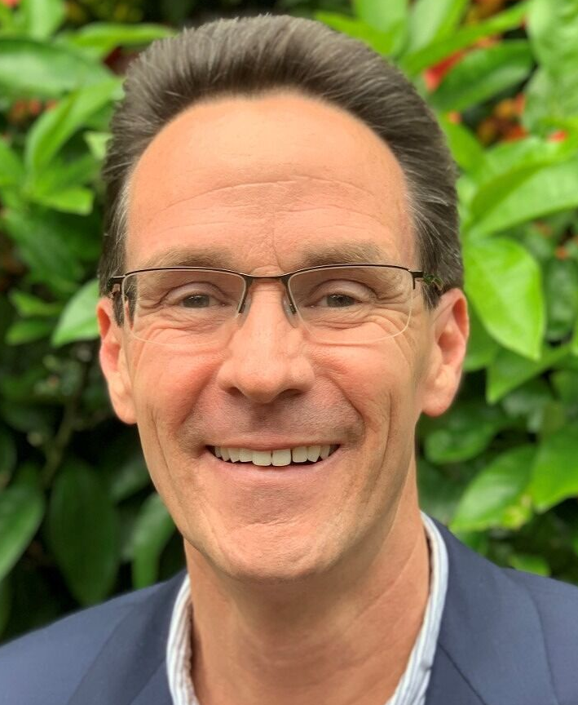
Dr. Alan Thompson There is no hint of any deficiency in Christ’s death or any indication that Paul or anyone else needs to, or is somehow able to, supplement what the cross accomplished in God’s saving activity

Slide 10
Colossians: week 14 (pages 91-106)

Slide 11
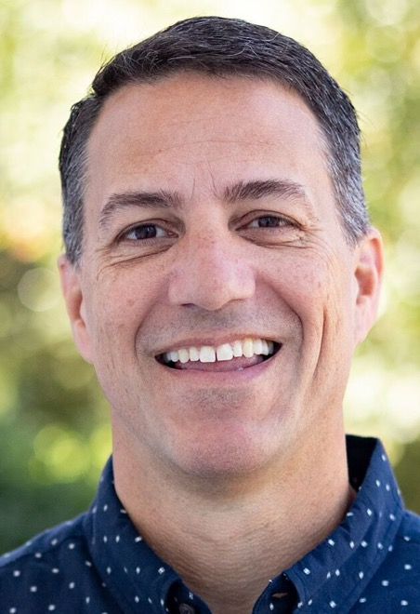
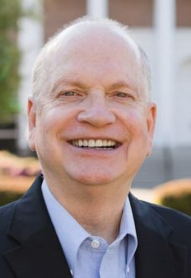
Dr. R. Scott Pace & Dr. Daniel L. Akin Paul’s suffering in order to fulfill his personal calling was in service to the Colossian congregation and the church as a whole

Slide 12
Colossians: week 14 (pages 91-106)

Slide 13
Dr. R. Scott Pace & Dr. Daniel L. Akin Paul’s stewardship of God's message, to make it “fully known,” included both the explanation of the gospel’s fulfillment in Christ

Slide 14
Dr. R. Scott Pace & Dr. Daniel L. Akin and the expansion of the gospel’s impact throughout the world

Slide 15
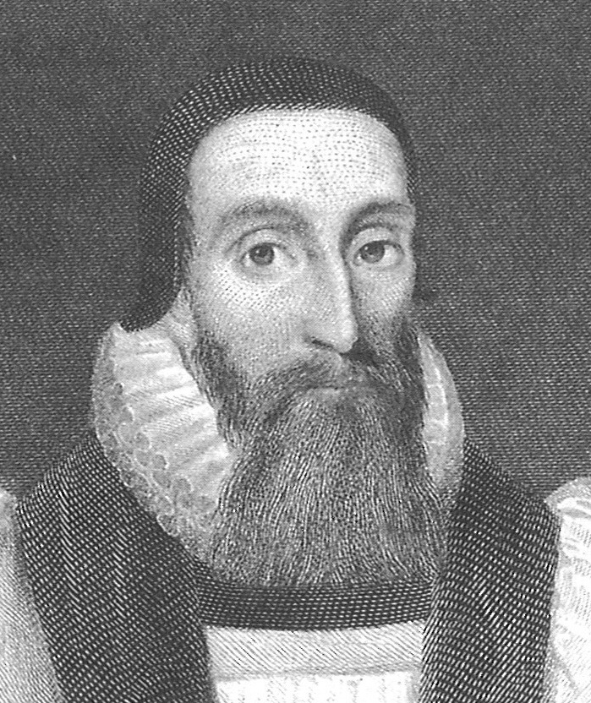
Dr. John Davenant God not only decreed by his eternal counsel what sufferings Christ on his part should undergo in his body for the redemption of the church,

Slide 16
Dr. John Davenant but also what each member of the church should be subject to in his body for the name of Christ

Slide 17
2 Corinthians 1:5-7
For just as the sufferings of Christ overflow to us, so also through Christ our comfort overflows. If we are afflicted, it is for your comfort and salvation. If we are comforted, it is for your comfort, which produces in you patient endurance of the same sufferings that we suffer. And our hope for you is firm, because we know that as you share in the sufferings, so you will also share in the comfort.

Slide 18
Philippians 1:29-30
For it has been granted to you on Christ’s behalf not only to believe in him, but also to suffer for him, since you are engaged in the same struggle that you saw I had and now hear that I have.

Slide 19
Philippians 3:10-11
My goal is to know him and the power of his resurrection and the fellowship of his sufferings, being conformed to his death, assuming that I will somehow reach the resurrection from among the dead.

Slide 20
1 Peter 2:21
For you were called to this, because Christ also suffered for you, leaving you an example, that you should follow in his steps.

Slide 21
Lancelot Ridley So as pertaining to our redemption, justification and salvation, nothing remains that was not fulfilled in the passion of Christ,

Slide 22
Lancelot Ridley but as touching the suffering of Christ in his members, this remains to be fulfilled in every one of them.

Slide 23
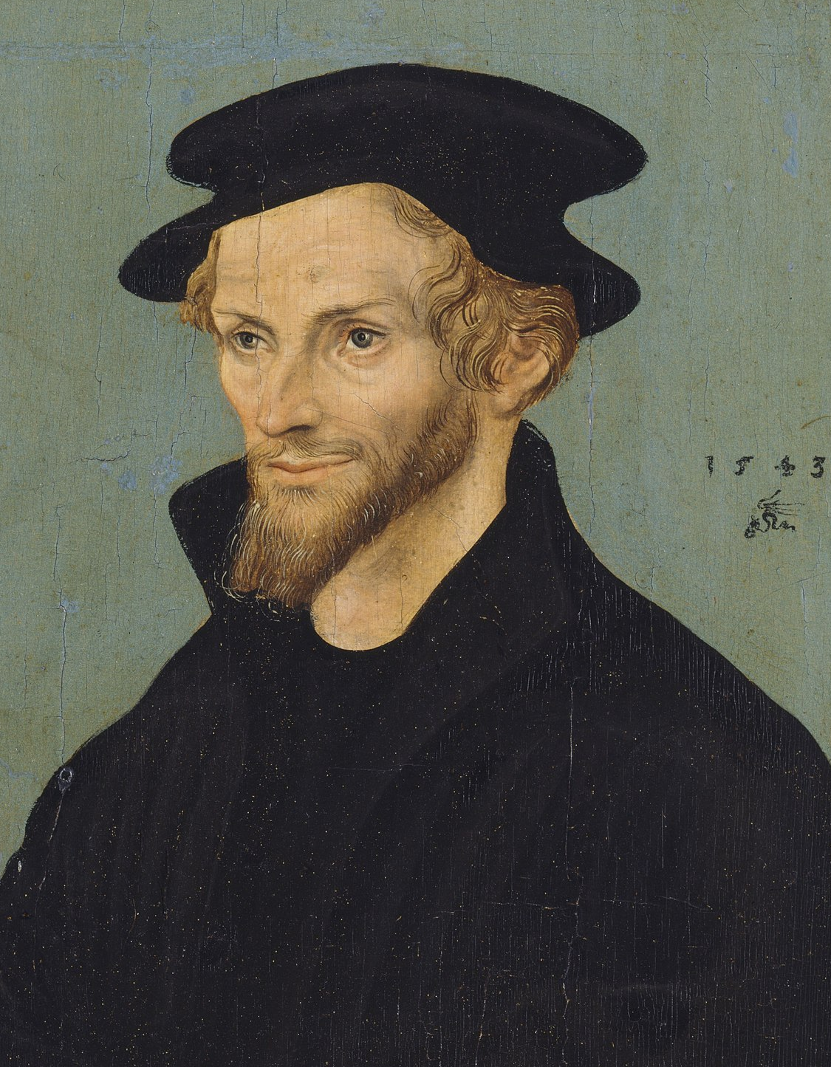
Philip Melanchthon The sufferings of the saints are Christ’s sufferings. Therefore, there lacks something to the sufferings of Christ, so long as there remain people who suffer.

Slide 24
Colossians: week 14 (pages 91-106)

Slide 25
Prayer time
Write down your prayer requests (on the Weekly Update or in the comments
Lean in, engage, and pray for someone not with you
Go worship

Slide 26
Today’s class (page 17)
Preparing for Colossians 1:1-2:3 Pray with others Hear with others Think with others Study with others Share with others Invite others
In class, as a class
In class, as tables
After class

Slide 27
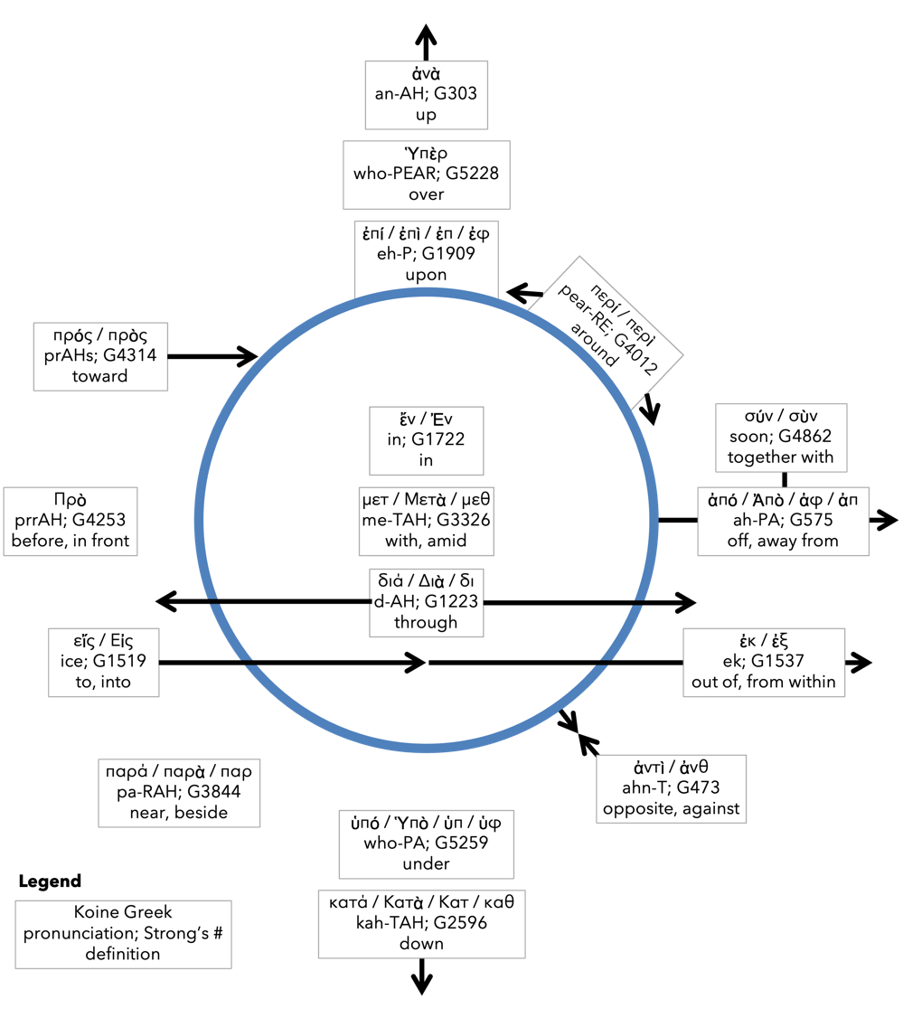
Preposition circle (page 12)

Slide 28
BDAG on morphe (mor-FAY) definition

Slide 29
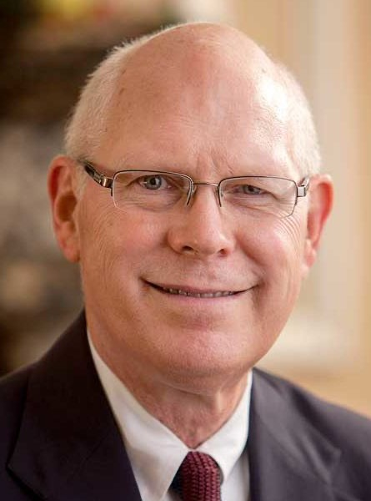
Dr. Gregory K. Beale Quote

Slide 30
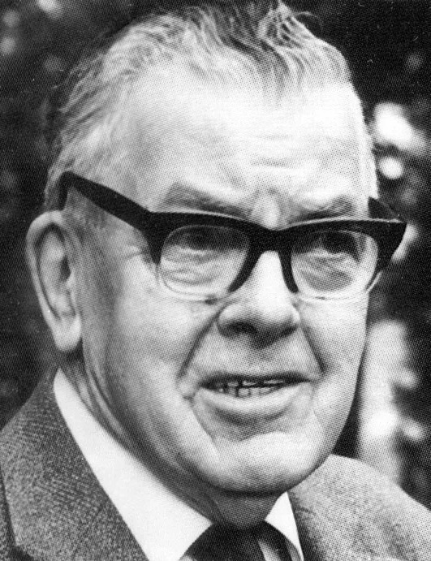
F. F. Bruce Quote

Slide 31
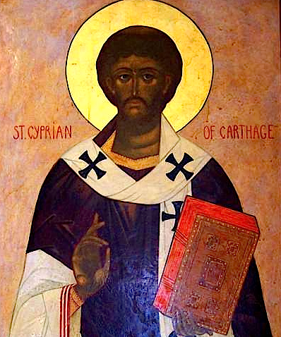
Cyprian Quote

Slide 32
Dr. John Davenant Quote

Slide 33
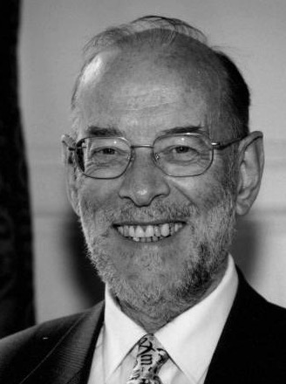
Dr. James D. G. Dunn Quote

Slide 34
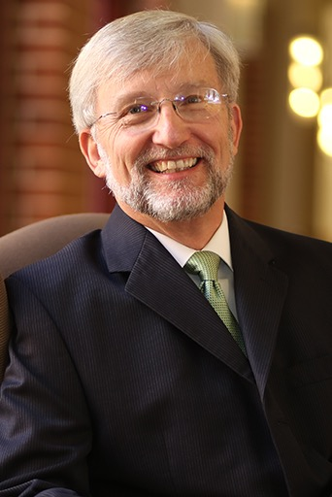
Dr. David Garland Quote

Slide 35
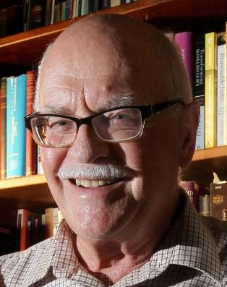
Dr. Murray J. Harris Quote

Slide 36
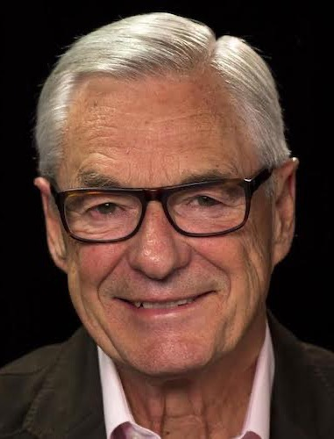
Dr. R. Kent Hughes Quote

Slide 37
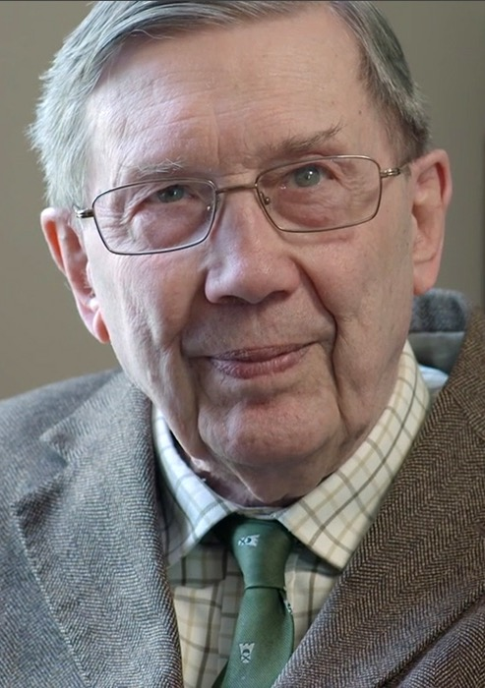
R. C. Lucas Quote

Slide 38
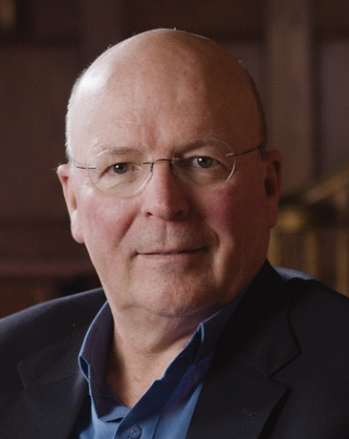
Dr. Scot McKnight Quote

Slide 39
Philip Melanchthon Quote

Slide 40
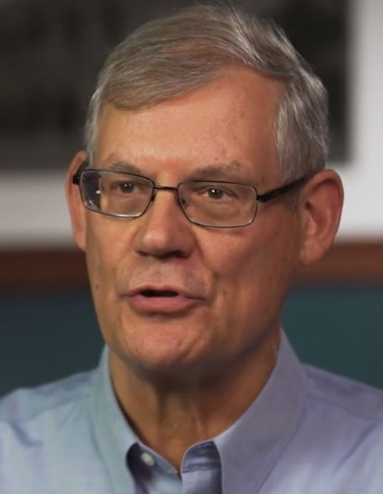
Dr. Douglas J. Moo Quote

Slide 41
Dr. R. Scott Pace & Dr. Daniel L. Akin Quote

Slide 42
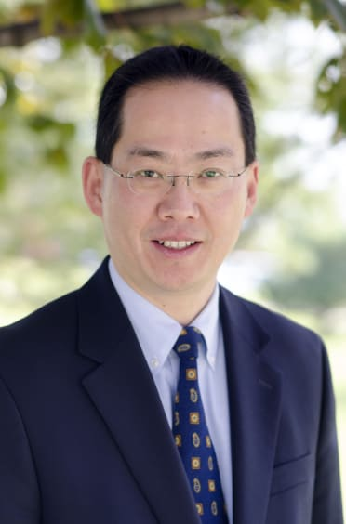
Dr. David W. Pao Quote

Slide 43
Dr. Alan Thompson Quote

Slide 44
Jen Wilkin Quote

Slide 45
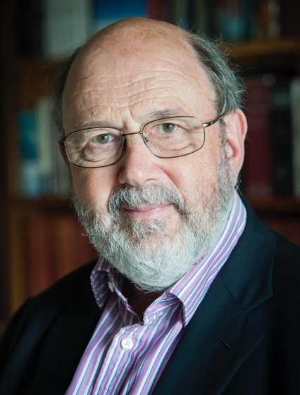
Dr. N. T. Wright Quote

