Slide 1
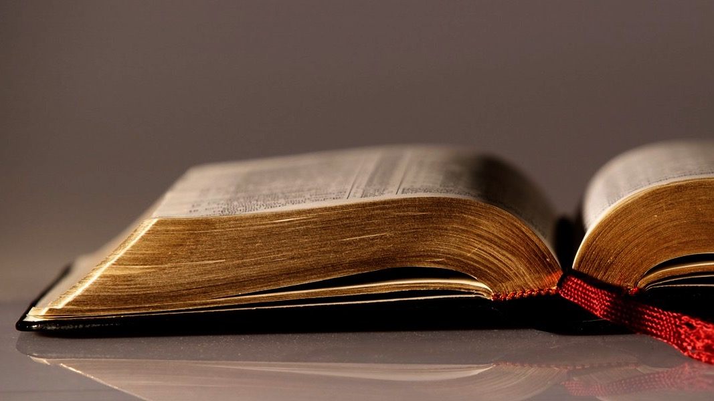
Welcome to
Our Sunday School
We’ll start at 9:07
visit OurSundaySchool.com for more about our class

Slide 2
Colossians: week 13 (pages 85-90)

Slide 3
Colossians 1:23
if indeed you remain grounded and steadfast in the faith and are not shifted away from the hope of the gospel that you heard. This gospel has been proclaimed in all creation under heaven, and I, Paul, have become a servant of it.

Slide 4
Colossians: week 13 (pages 85-90)

Slide 5
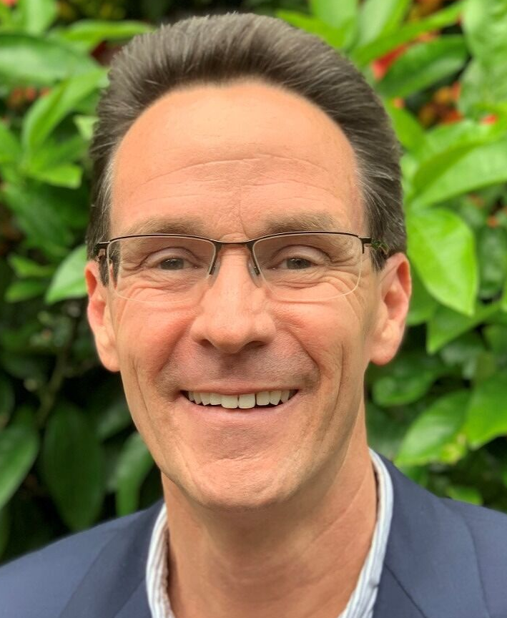
Dr. Alan Thompson This will be a judgment scene in which there is no judgment or guilty verdict.

Slide 6
Colossians: week 13 (pages 85-90)

Slide 7
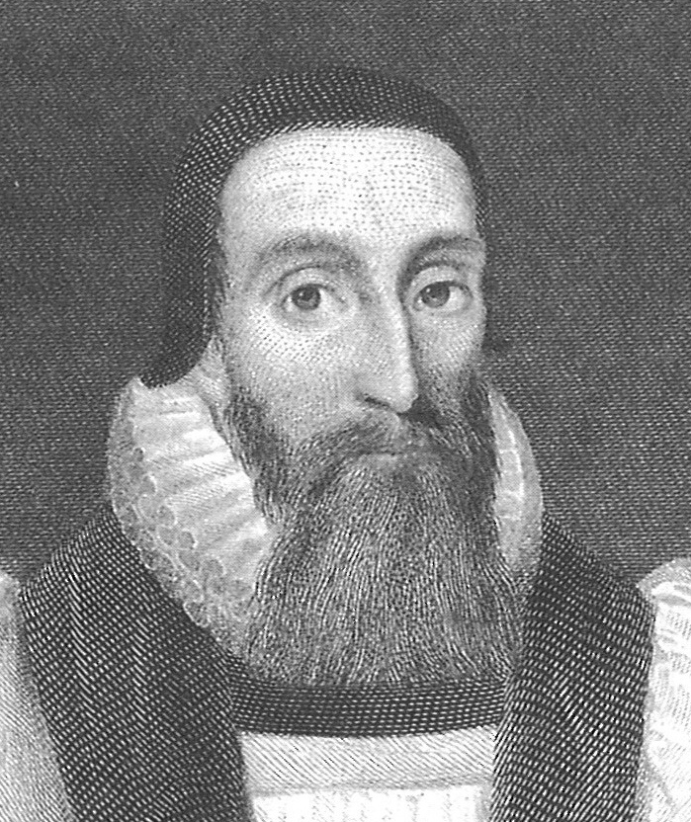
Dr. John Davenant True faith always looks to Christ Jesus

Slide 8
Colossians: week 13 (pages 85-90)

Slide 9
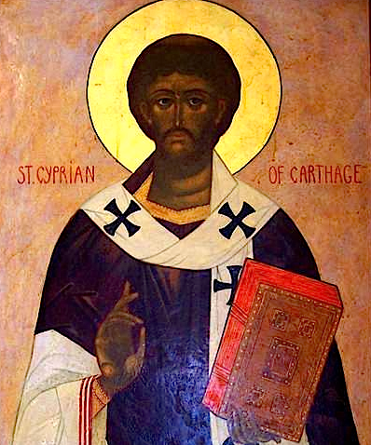
Cyprian That we are Christians is the substance of faith and hope

Slide 10
Colossians: week 13 (pages 85-90)

Slide 11
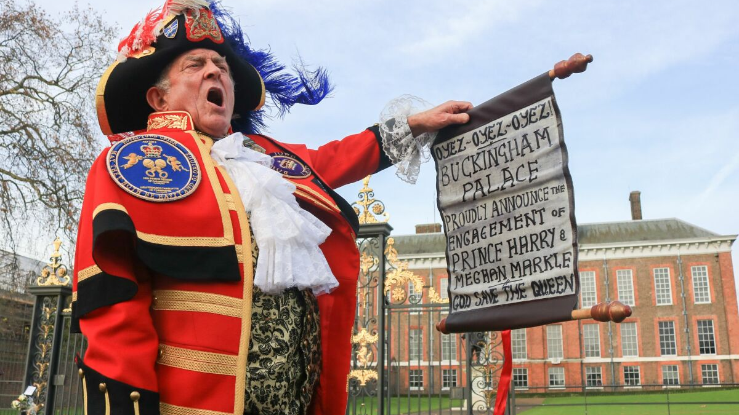

Slide 12
Colossians: week 13 (pages 85-90)

Slide 13
Prayer time
Write down your prayer requests (on the Weekly Update or in the comments
Lean in, engage, and pray for someone not with you
Go worship

Slide 14
Today’s class (page 17)
Preparing for Colossians 1:1-2:3 Pray with others Hear with others Think with others Study with others Share with others Invite others
In class, as a class
In class, as tables
After class

Slide 15
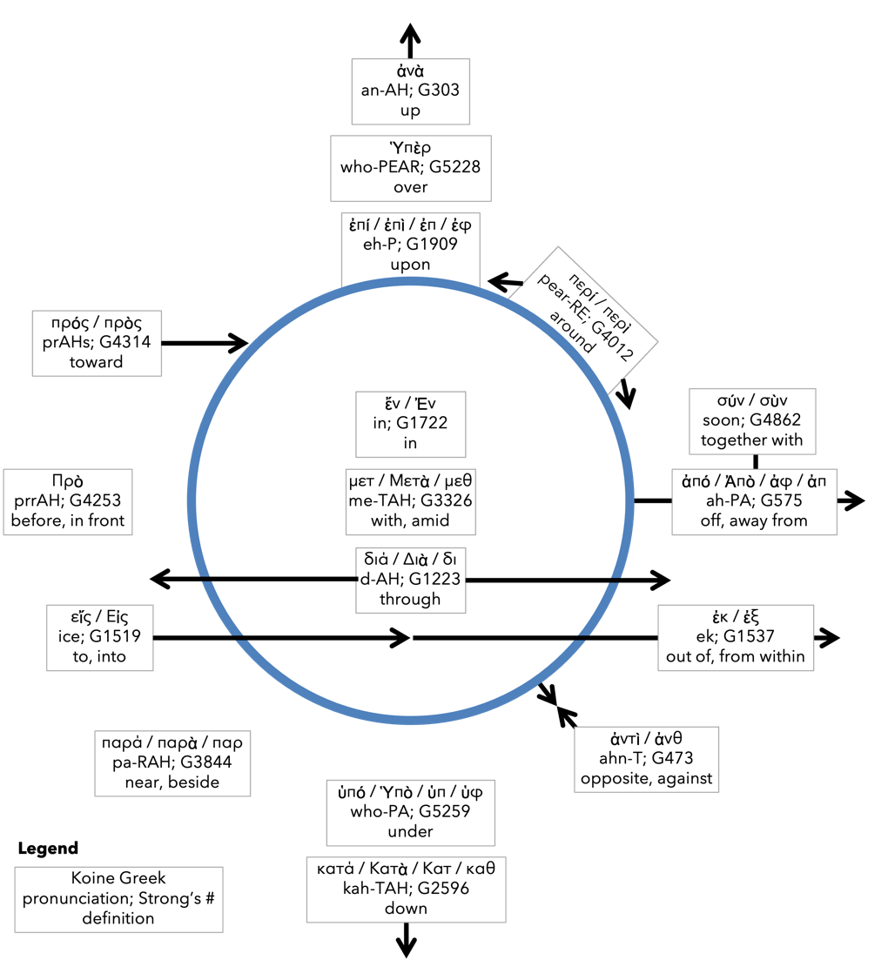
Preposition circle (page 12)

Slide 16
BDAG on morphe (mor-FAY) definition

Slide 17
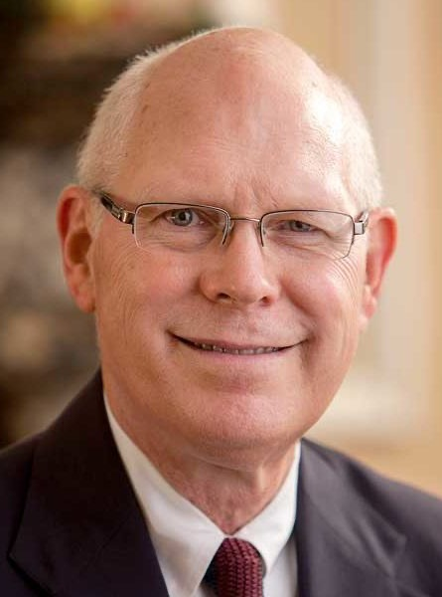
Dr. Gregory K. Beale Quote

Slide 18
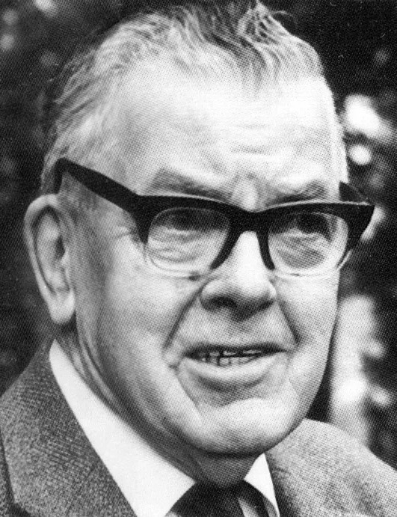
F. F. Bruce Quote

Slide 19
Dr. John Davenant Quote

Slide 20
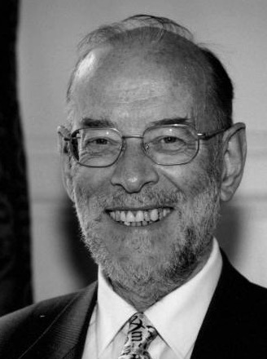
Dr. James D. G. Dunn Quote

Slide 21
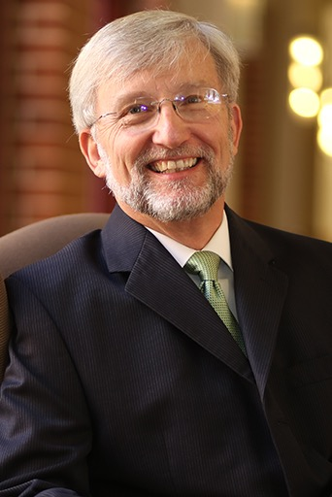
Dr. David Garland Quote

Slide 22
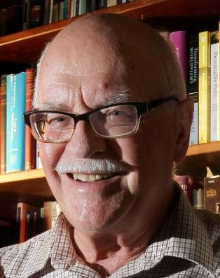
Dr. Murray J. Harris Quote

Slide 23
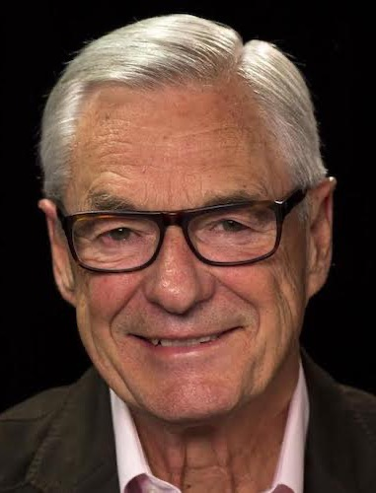
Dr. R. Kent Hughes Quote

Slide 24
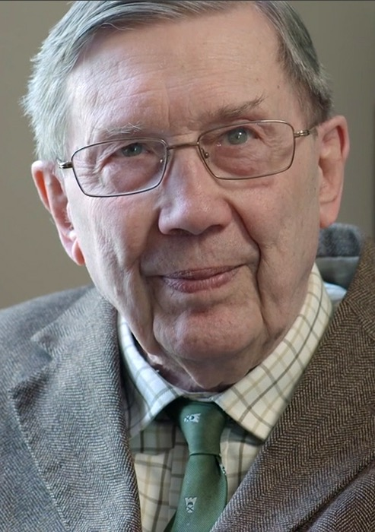
R. C. Lucas Quote

Slide 25
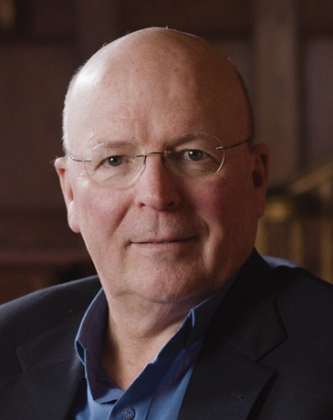
Dr. Scot McKnight Quote

Slide 26
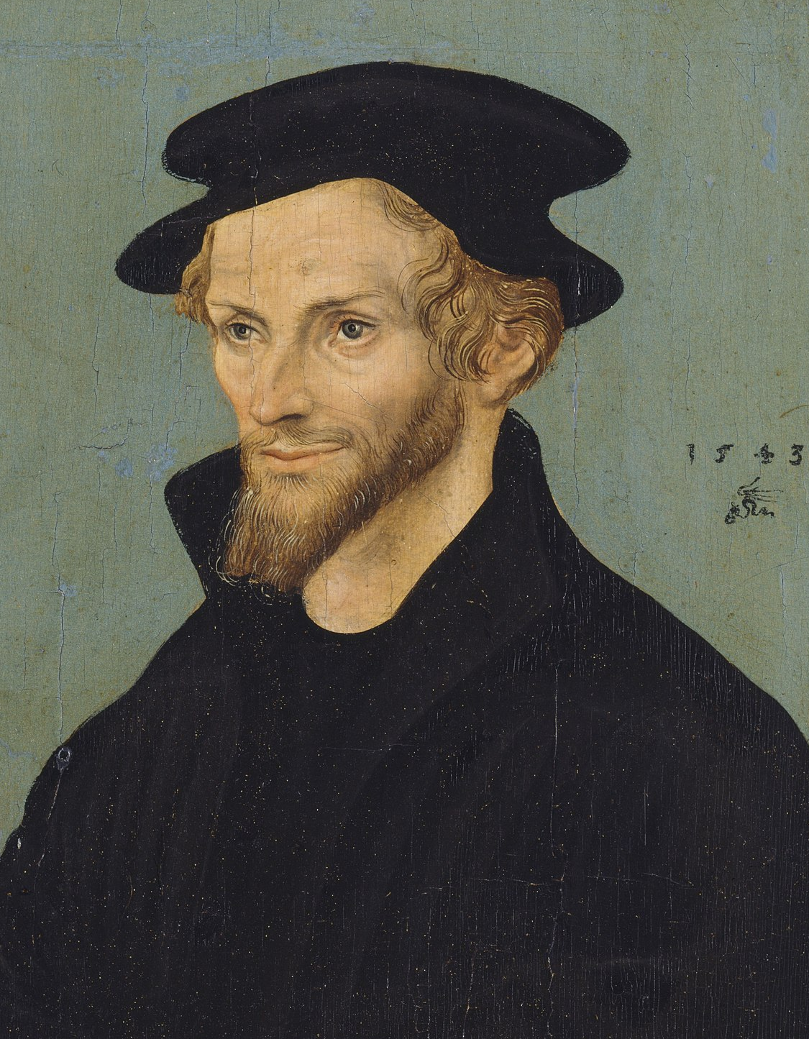
Philip Melanchthon Quote

Slide 27
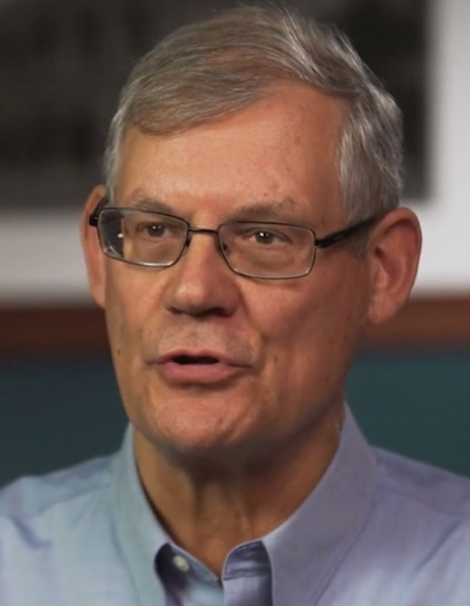
Dr. Douglas J. Moo Quote

Slide 28
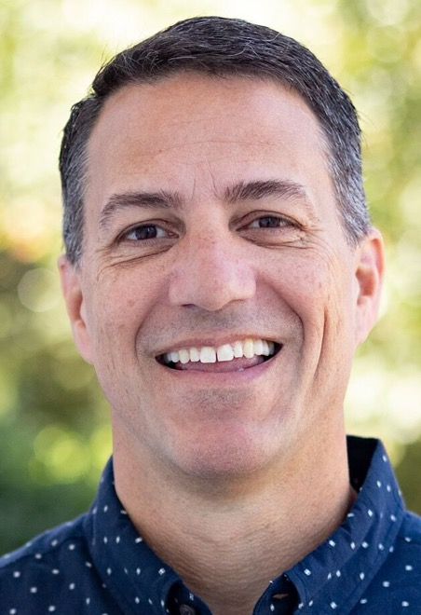
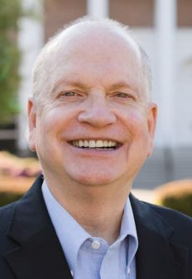
Dr. R. Scott Pace & Dr. Daniel L. Akin Quote

Slide 29
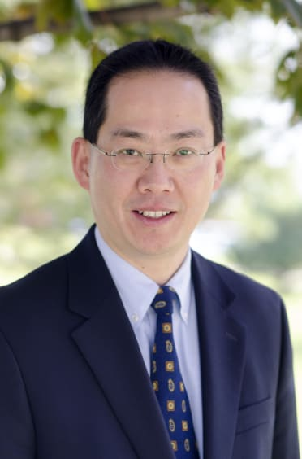
Dr. David W. Pao Quote

Slide 30
Dr. Alan Thompson Quote

Slide 31
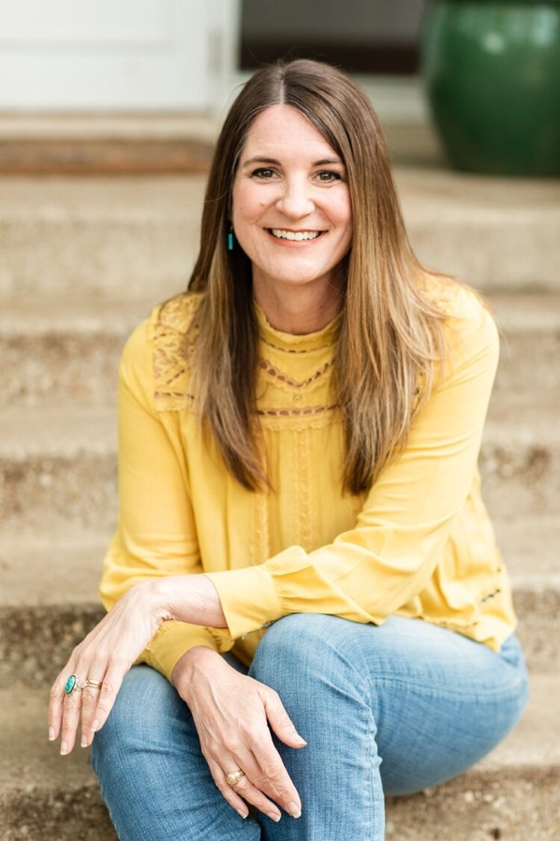
Jen Wilkin Quote

Slide 32
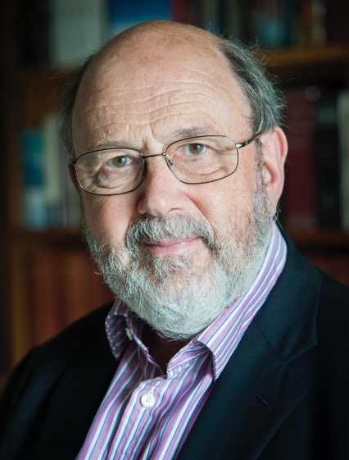
Dr. N. T. Wright Quote

