Slide 1
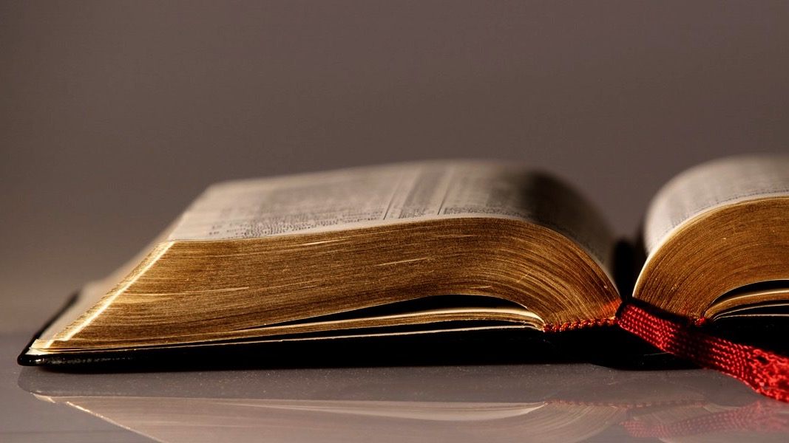
Welcome to
Our Sunday School
We’ll start at 9:07
visit OurSundaySchool.com for more about our class

Slide 2
Colossians: week 10 (pages 75-76)

Slide 3
Colossians 1:19
For God was pleased to have
all his fullness dwell in him

Slide 4
Colossians: week 10 (pages 75-76)

Slide 5
BDAG on eudokeo (you-dak-EH-o) to consider something as good and therefore worthy of choice consent, determine, resolve

Slide 6
Colossians: week 10 (pages 75-76)

Slide 7
Prayer time
Write down your prayer requests (on the Weekly Update or in the comments
Lean in, engage, and pray for someone not with you
Go worship

Slide 8
Today’s class (page 17)
Preparing for Colossians 1:1-2:3 Pray with others Hear with others Think with others Study with others Share with others Invite others
In class, as a class
In class, as tables
After class

Slide 9
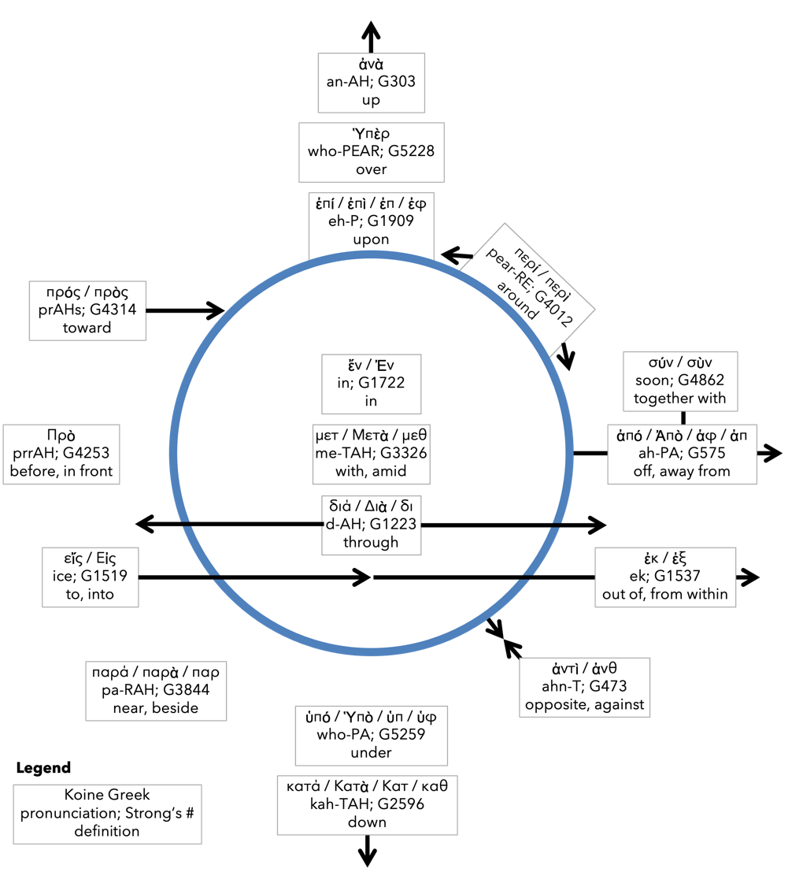
Preposition circle (page 12)

Slide 10
BDAG on morphe (mor-FAY) form, outward appearance, shape

Slide 11
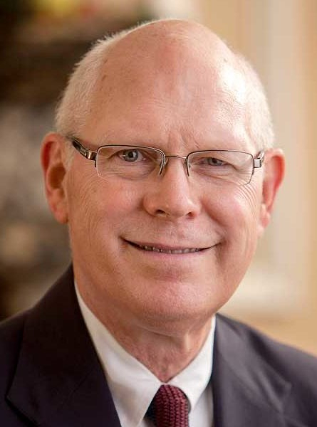
Dr. Gregory K. Beale Quote

Slide 12
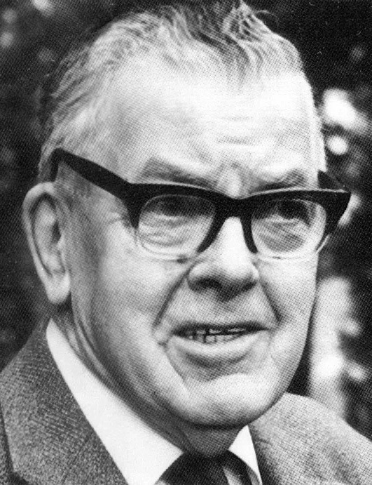
F. F. Bruce Quote

Slide 13
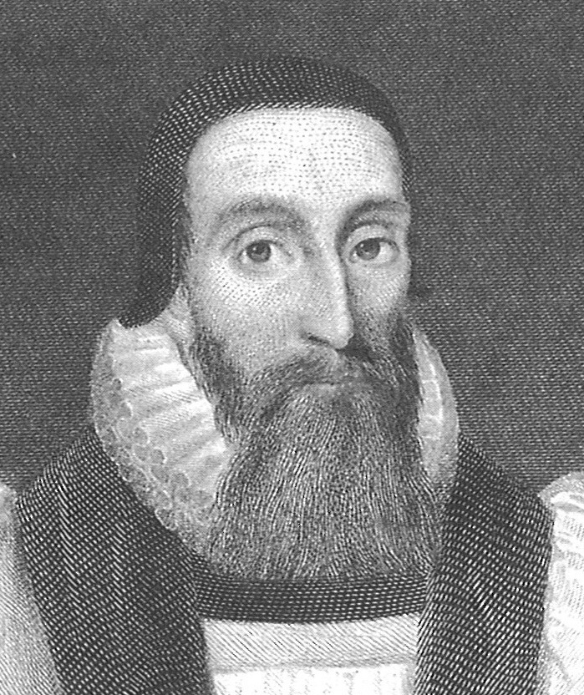
Dr. John Davenant Quote

Slide 14
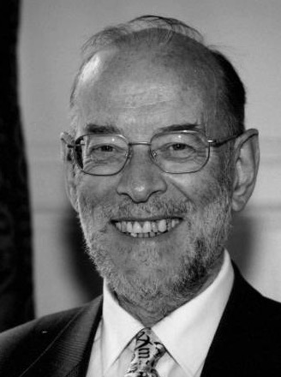
Dr. James D. G. Dunn Quote

Slide 15
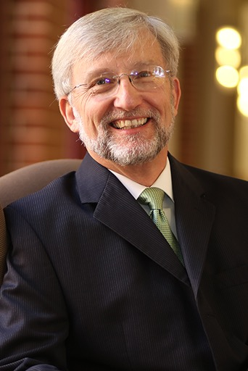
Dr. David Garland Quote

Slide 16
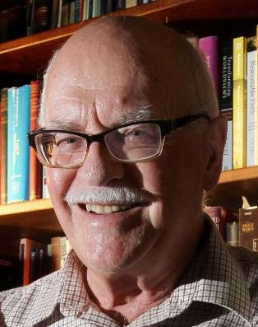
Dr. Murray J. Harris Quote

Slide 17
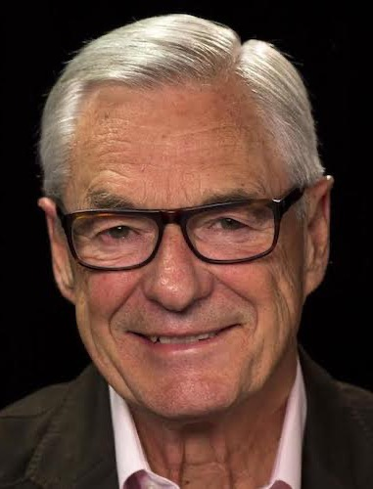
Dr. R. Kent Hughes Quote

Slide 18
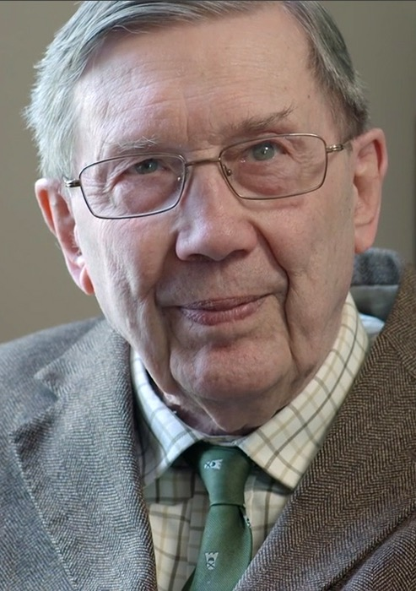
R. C. Lucas Quote

Slide 19
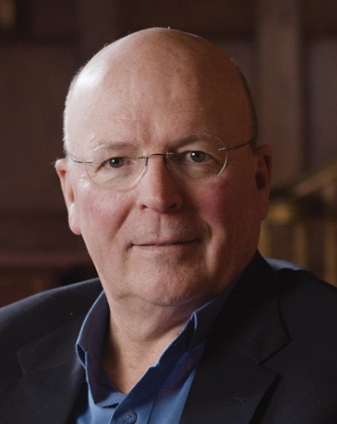
Dr. Scot McKnight Quote

Slide 20
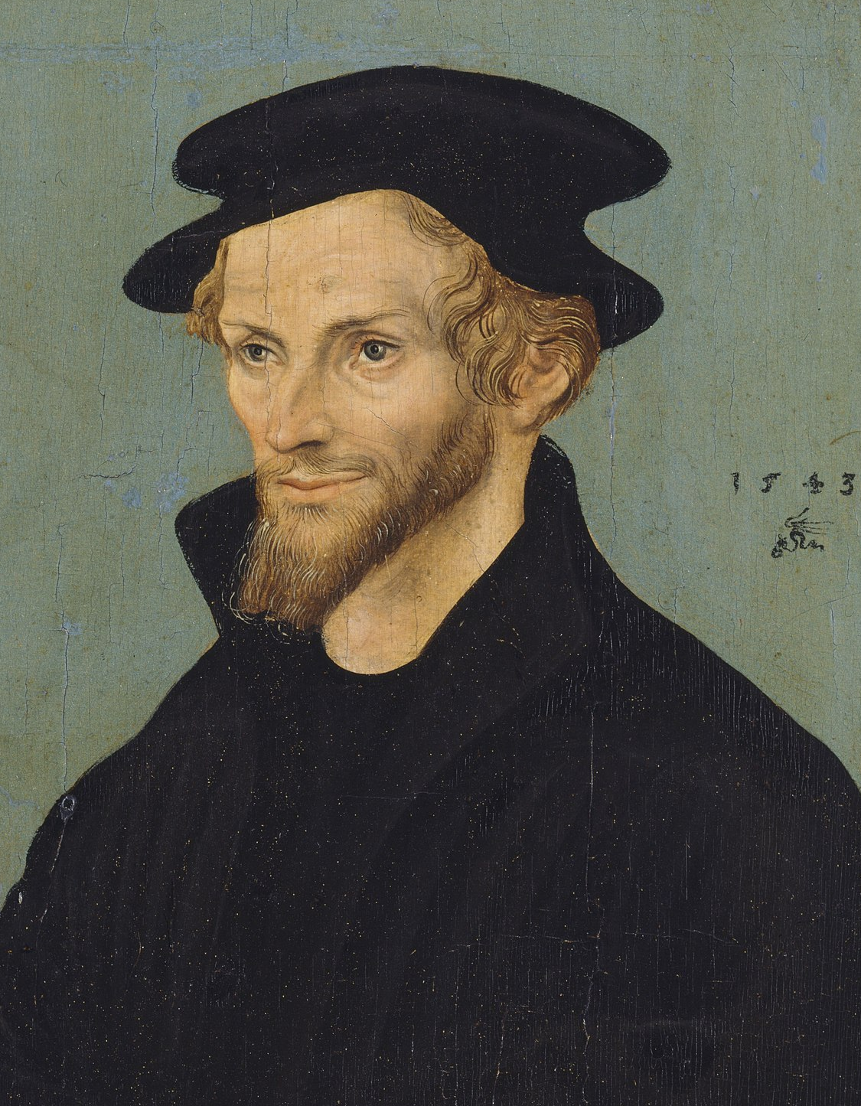
Philip Melanchthon Quote

Slide 21
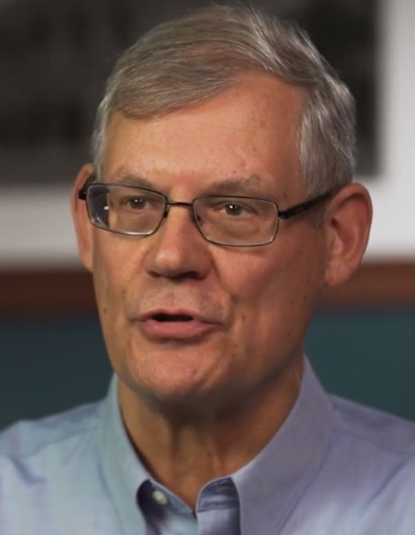
Dr. Douglas J. Moo Quote

Slide 22
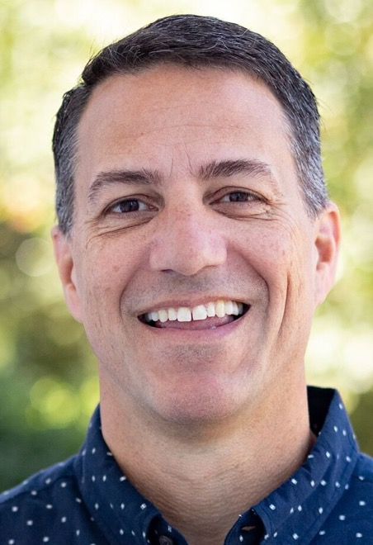
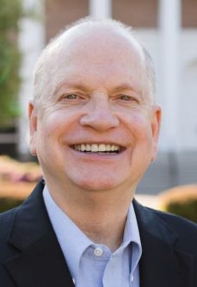
Dr. R. Scott Pace & Dr. Daniel L. Akin Quote

Slide 23
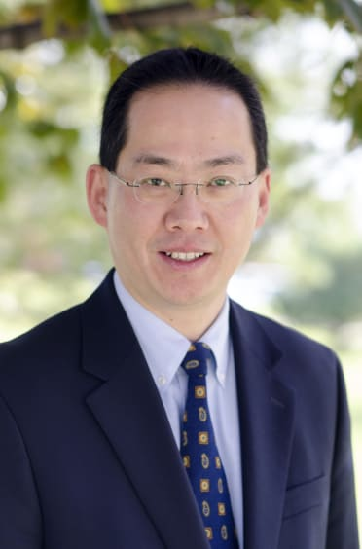
Dr. David W. Pao Quote

Slide 24
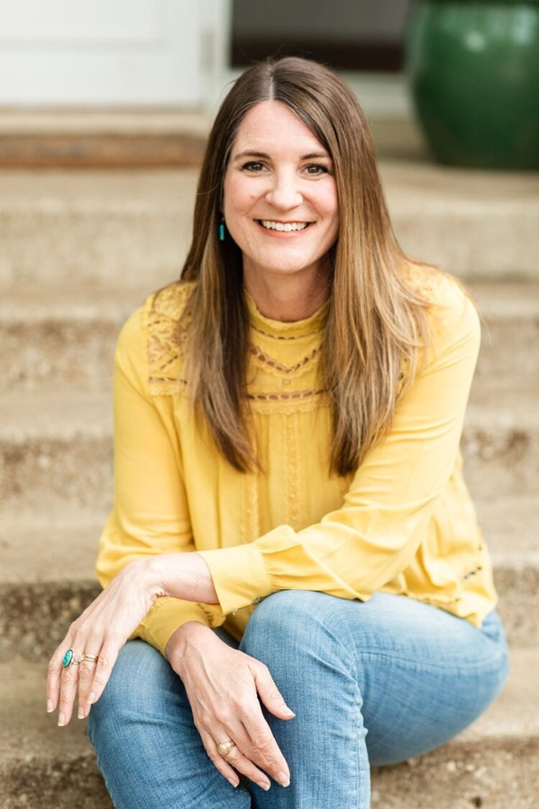
Jen Wilkin Quote

Slide 25
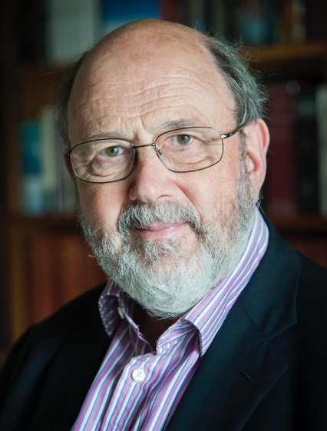
Dr. N. T. Wright Quote

