Slide 1
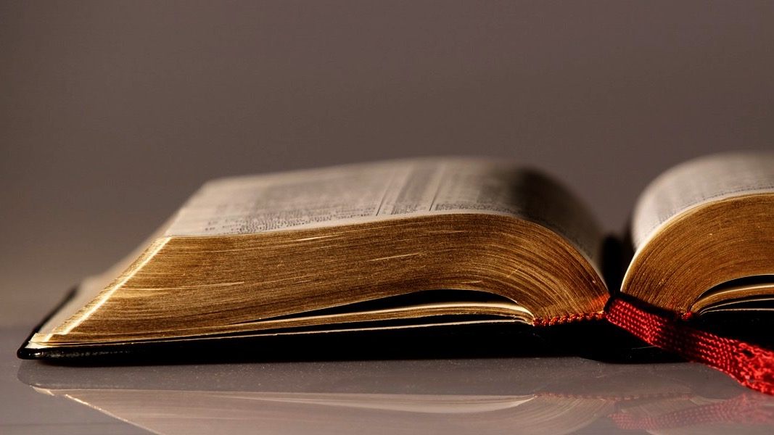
Welcome to
Our Sunday School
We’ll start at 9:07
visit OurSundaySchool.com for more about our class

Slide 2
Colossians: week 9 (pages 70-75)

Slide 3
Colossians 1:17-18
He is before all things,
and by him all things hold together.
He is also the head of the body, the church;
he is the beginning,
the firstborn from the dead,
so that he might come to have
first place in everything.

Slide 4
Colossians: week 9 (pages 70-75)

Slide 5
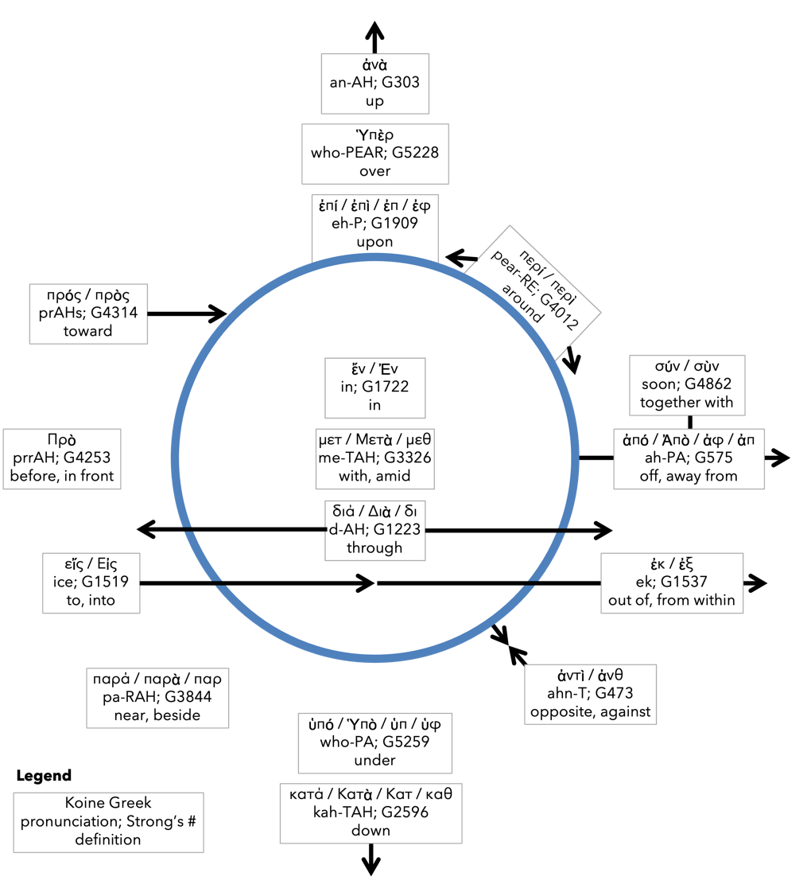
Preposition circle (page 12)

Slide 6
Colossians: week 9 (pages 70-75)

Slide 7
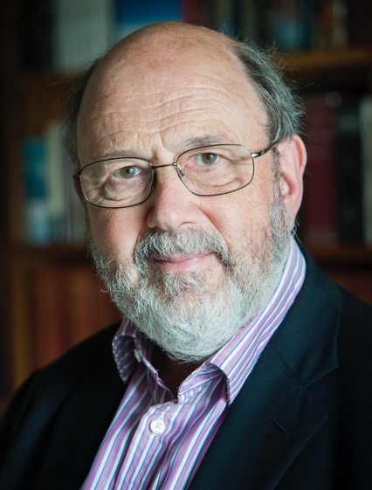
Dr. N. T. Wright The verb, again, is in the perfect, indicating that ‘everything’ has held together in him and continues to do so.

Slide 8
BDAG on sunistao (soon-EIS-tay-me) to come to be in a condition of coherence continue, endure, exist, hold together

Slide 9
Dr. N. T. Wright Through him the world is sustained, prevented from falling into chaos.

Slide 10
Colossians: week 9 (pages 70-75)

Slide 11
Jared Wilson American evangelicals are prone to panic about the waning faith in our nation. But we forget America is not the center of Christianity.

Slide 12
Jared Wilson The center of Christianity is seated at the right hand of the Father, and of his kingdom there will be no end.

Slide 13
Colossians: week 9 (pages 70-75)

Slide 14
BDAG on prototokos (pro-TOT-ock-oss) (1) firstborn (2) having special status associated with a firstborn

Slide 15
Colossians: week 9 (pages 70-75)

Slide 16
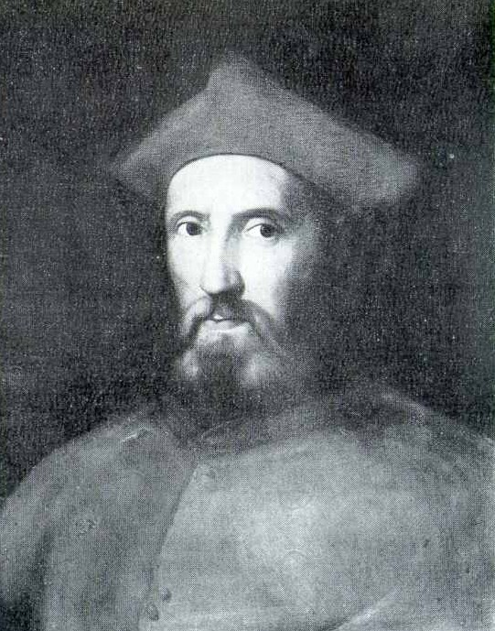
Gasparo Contarini 1483-1542

Slide 17
Gasparo Contarini Many rose from the dead prior to Christ…. But they all rose to a mortal life, and they would all die again.

Slide 18
Gasparo Contarini Christ alone was raised to an immortal life over which death has no dominion.

Slide 19
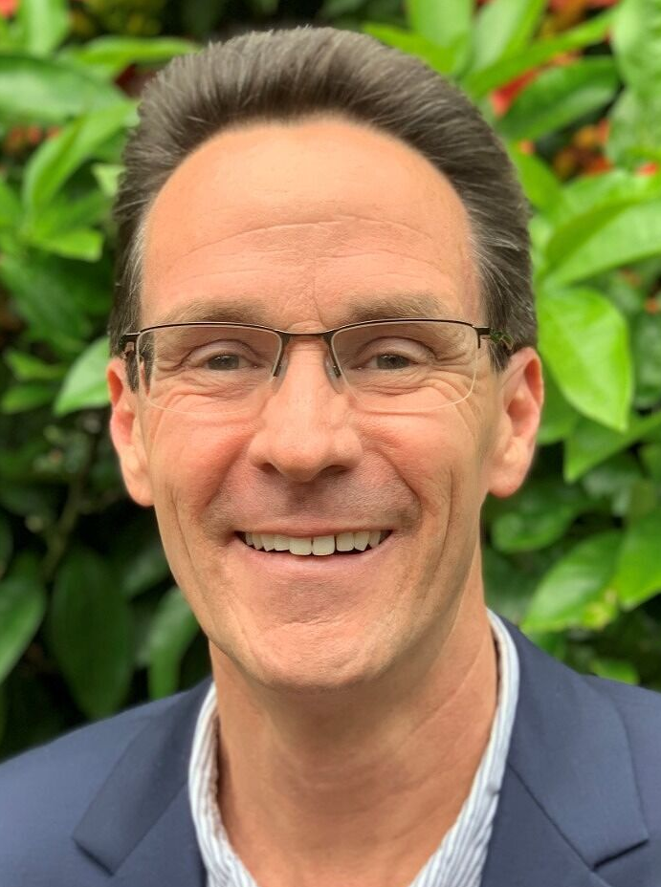
Dr. Alan Thompson Not only did all creation have its origin through Christ, Christ is also the end goal of all creation.

Slide 20
Dr. Alan Thompson Christ himself is the means by which the end goal is reached. Christ is the assurance that all things will reach that future goal.

Slide 21
Colossians: week 9 (pages 70-75)

Slide 22
Prayer time
Write down your prayer requests (on the Weekly Update or in the comments
Lean in, engage, and pray for someone not with you
Go worship

Slide 23
Today’s class (page 17)
Preparing for Colossians 1:1-2:3 Pray with others Hear with others Think with others Study with others Share with others Invite others
In class, as a class
In class, as tables
After class

Slide 24
Preposition circle (page 12)

Slide 25
BDAG on morphe (mor-FAY) form, outward appearance, shape

Slide 26
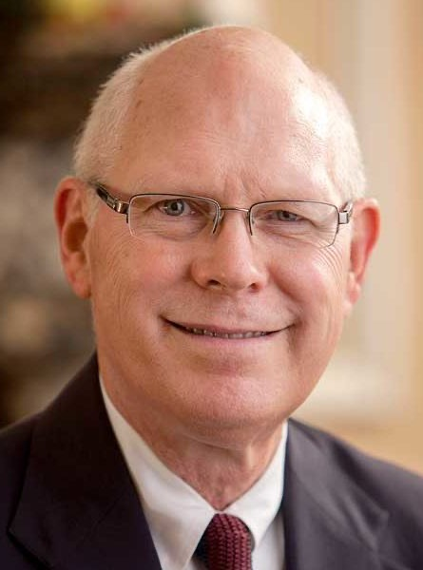
Dr. Gregory K. Beale Quote

Slide 27
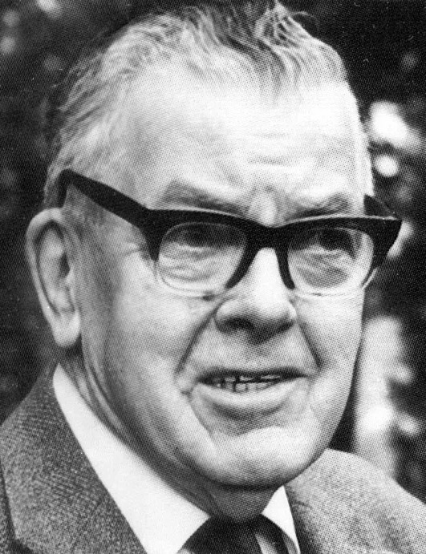
F. F. Bruce Quote

Slide 28
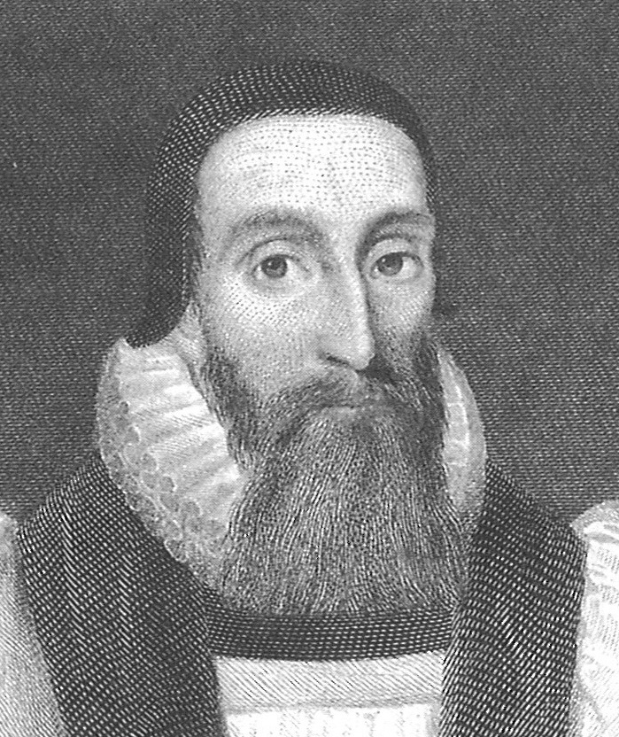
Dr. John Davenant Quote

Slide 29
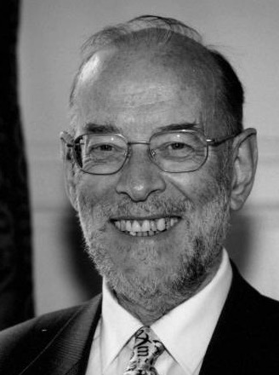
Dr. James D. G. Dunn Quote

Slide 30
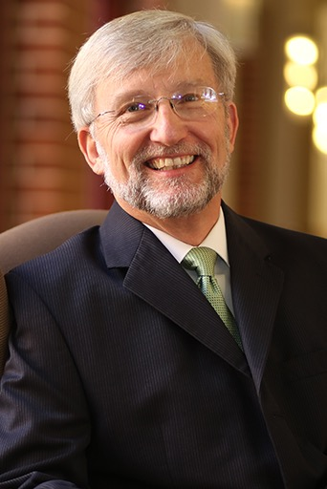
Dr. David Garland Quote

Slide 31
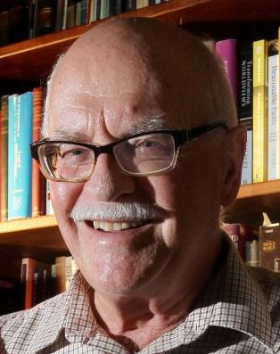
Dr. Murray J. Harris Quote

Slide 32
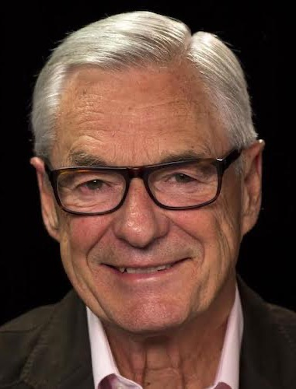
Dr. R. Kent Hughes Quote

Slide 33
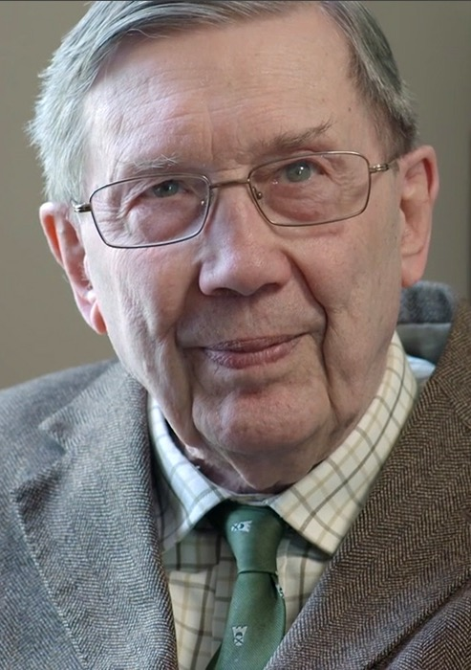
R. C. Lucas Quote

Slide 34
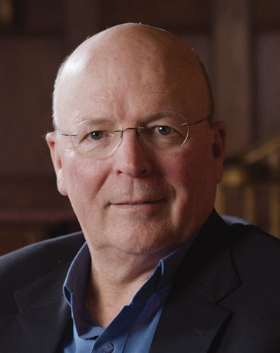
Dr. Scot McKnight Quote

Slide 35
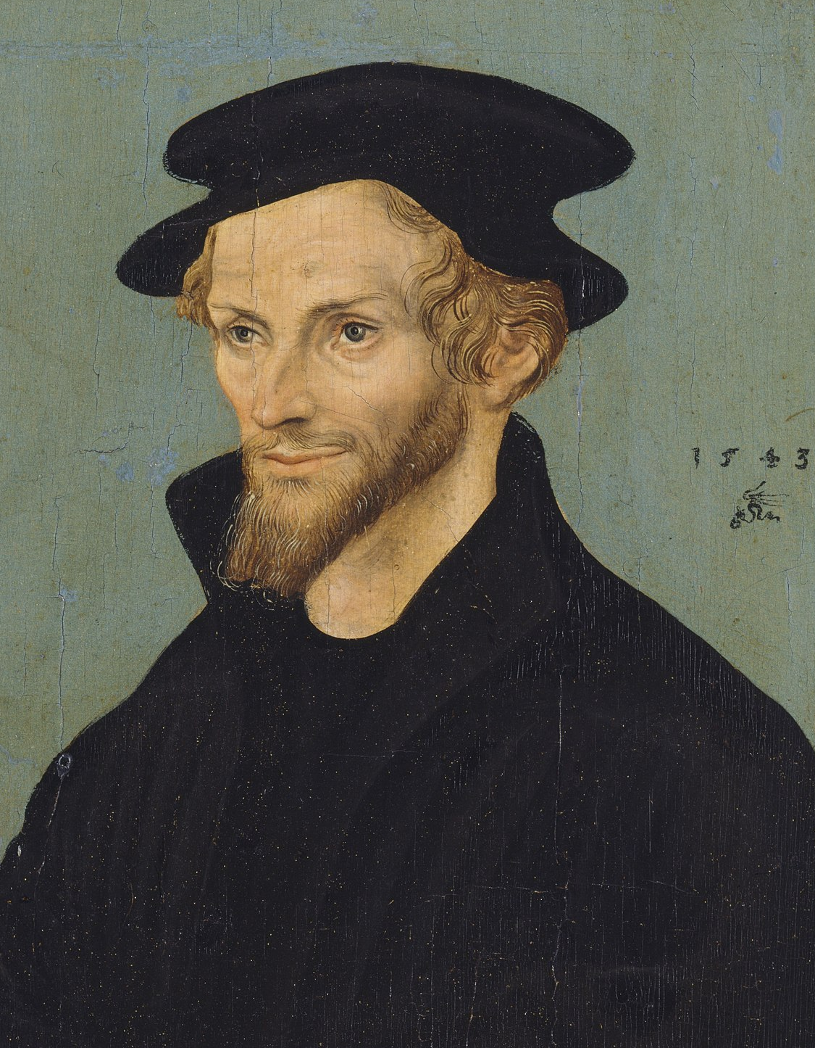
Philip Melanchthon Quote

Slide 36
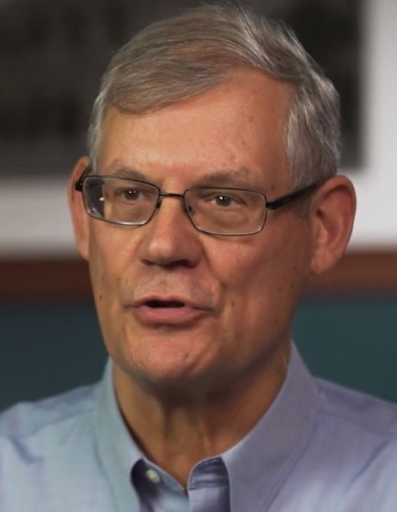
Dr. Douglas J. Moo Quote

Slide 37
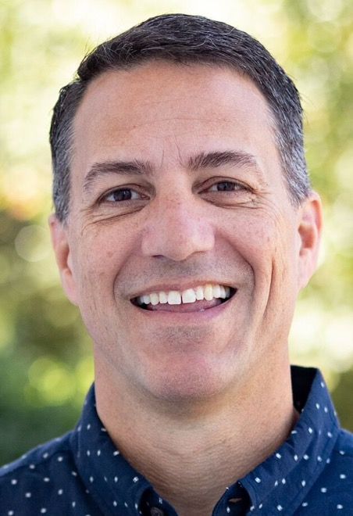
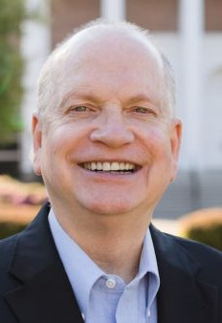
Dr. R. Scott Pace & Dr. Daniel L. Akin Quote

Slide 38
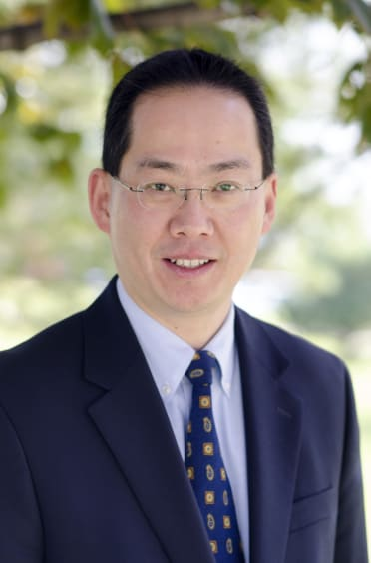
Dr. David W. Pao Quote

Slide 39
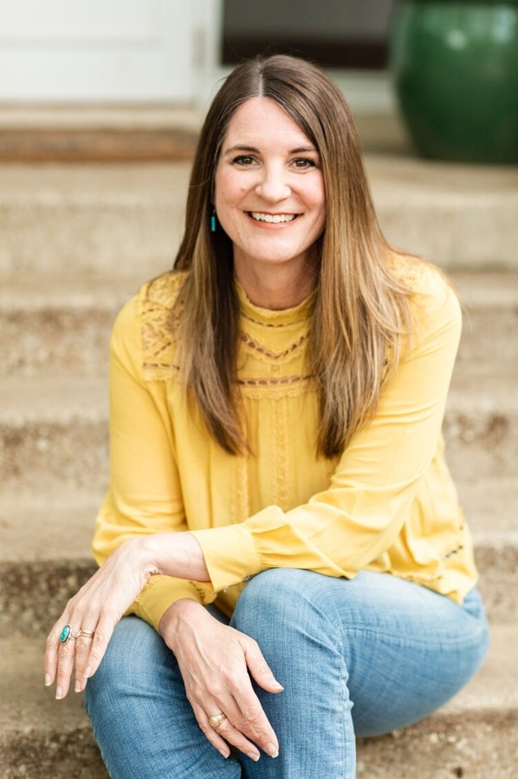
Jen Wilkin Quote

Slide 40
Dr. N. T. Wright Quote

