Slide 1
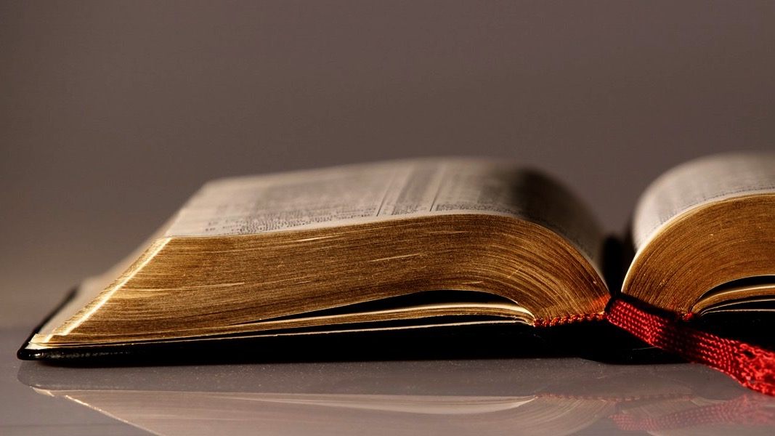
Welcome to
Our Sunday School
We’ll start at 9:07
visit OurSundaySchool.com for more about our class

Slide 2
Colossians: week 7 (pages 53-59)

Slide 3
Colossians 1:12b-14
who has enabled you to share in the saints’ inheritance in the light. He has rescued us from the domain of darkness and transferred us into the kingdom of the Son he loves. In him we have redemption, the forgiveness of sins.

Slide 4
Colossians: week 7 (pages 53-59)

Slide 5
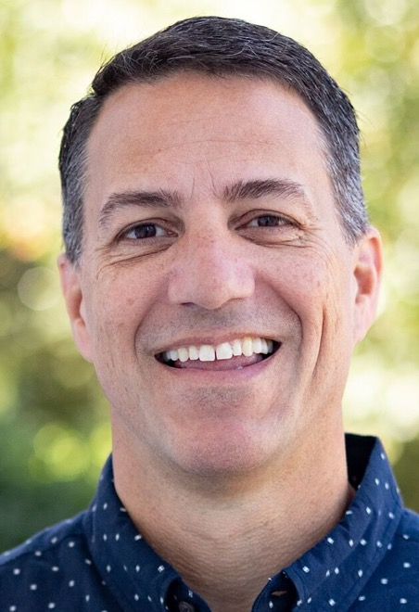
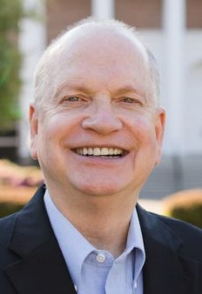
Dr. R. Scott Pace & Dr. Daniel L. Akin Thanksgiving is not simply a sentimental attitude of reflection but an intentional action of obedience.

Slide 6
Colossians: week 7 (pages 53-59)

Slide 9
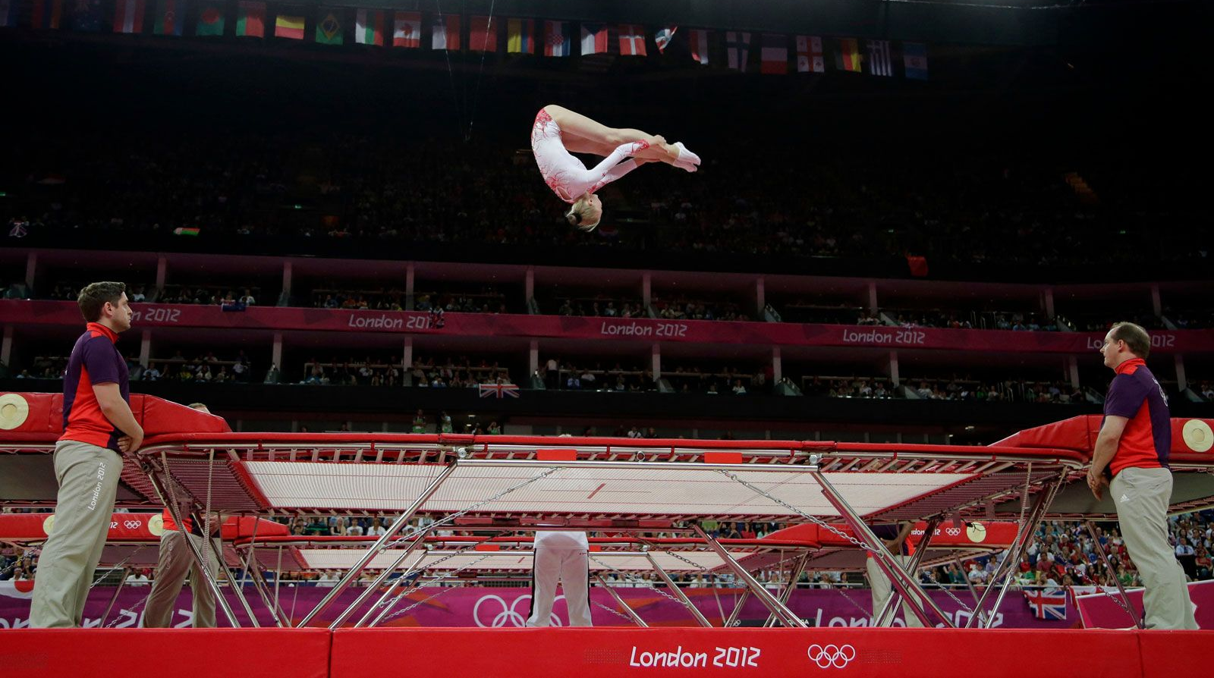
Photo by Gregory Bull, AP

Slide 10
Olympic trampoline qualification process
World Championships (November 2023)
Individual World Cup Series (February 2023 - April 2024)
Continental Championships

Slide 11
BDAG on hikanoo (heek-uh-NA-oh) to cause to be adequate, make sufficient, supply

Slide 12
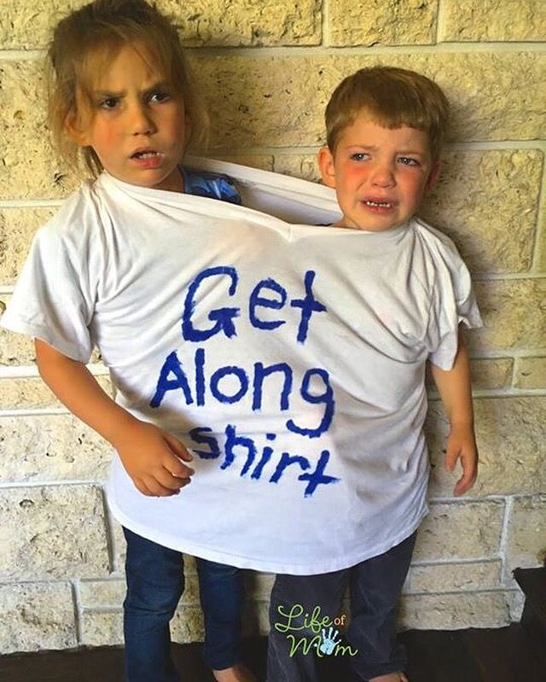
“enabled you to share”

Slide 13
Colossians: week 7 (pages 53-59)

Slide 14
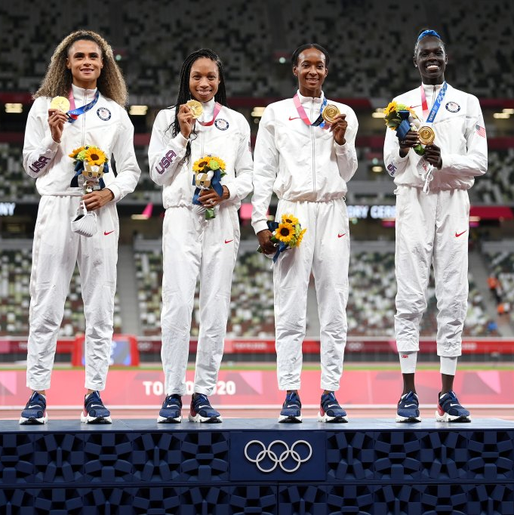
“enabled you to share”

Slide 15
Colossians: week 7 (pages 53-59)

Slide 16
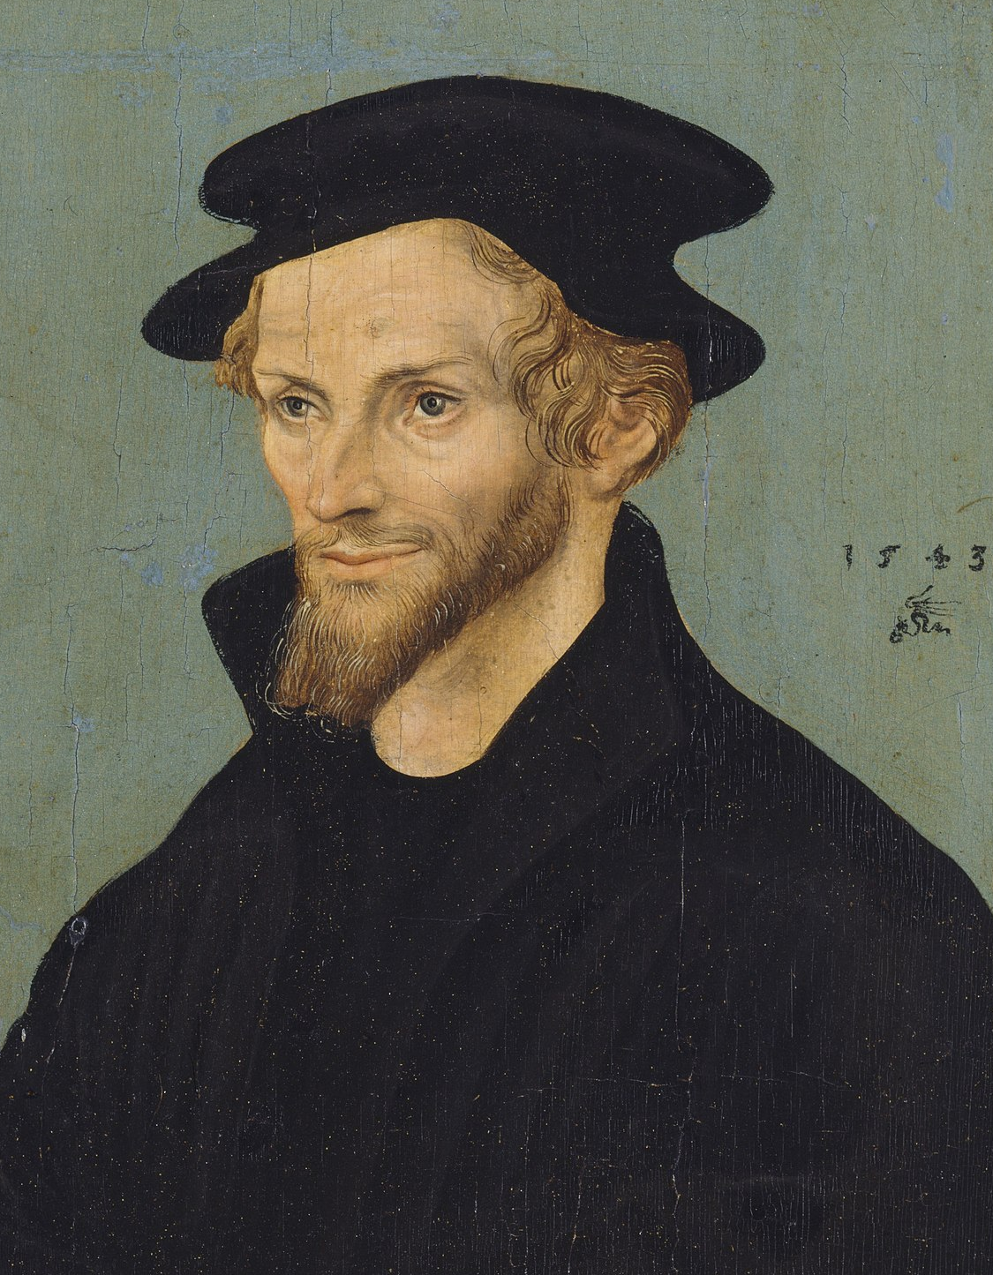
Philip Melanchthon 1497-1560

Slide 17
Desiring God

Slide 18
Philip Melanchthon If somebody who had been shipwrecked knew for sure that he could swim to safety, he would not fear for his life but would be cheerful.

Slide 19
Colossians: week 7 (pages 53-59)

Slide 20
Philip Melanchthon Paul does not say that we are delivered from darkness, but from the power of darkness.

Slide 21
Colossians: week 7 (pages 53-59)

Slide 22
Delighting in the Trinity by Michael Reeves

Slide 23
Colossians: week 7 (pages 53-59)

Slide 24
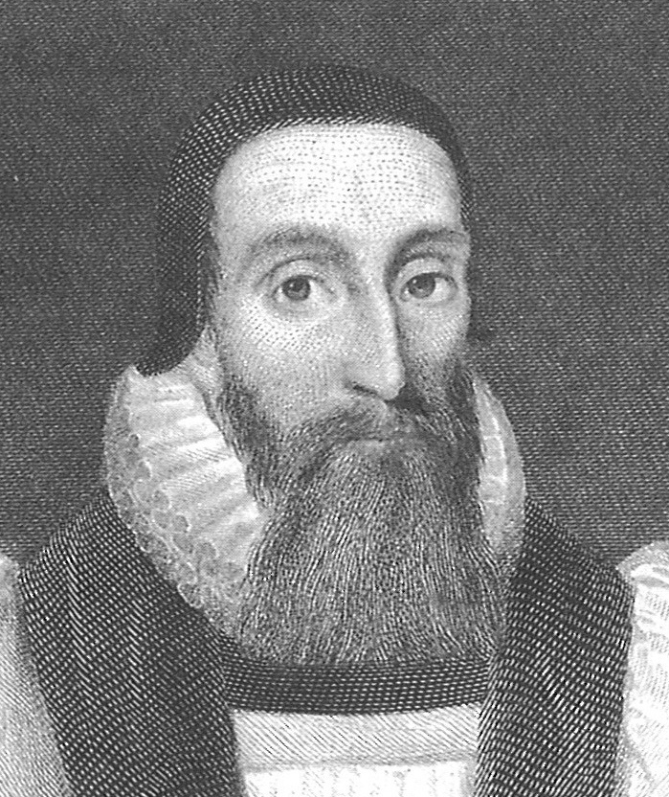
Dr. John Davenant Although the devil held us captives, the price of our redemption… was offered as a satisfaction to God, not to the devil.

Slide 25
Dr. John Davenant It rested with God either to condemn or to absolve…. God is abundantly satisfied in the death of Christ for the sins of the whole world.

Slide 26
Colossians: week 7 (pages 53-59)

Slide 27
Prayer time
Write down your prayer requests (on the Weekly Update or in the comments
Lean in, engage, and pray for someone not with you
Go worship

Slide 28
Today’s class (page 17)
Preparing for Colossians 1:1-2:3 Pray with others Hear with others Think with others Study with others Share with others Invite others
In class, as a class
In class, as tables
After class

Slide 29
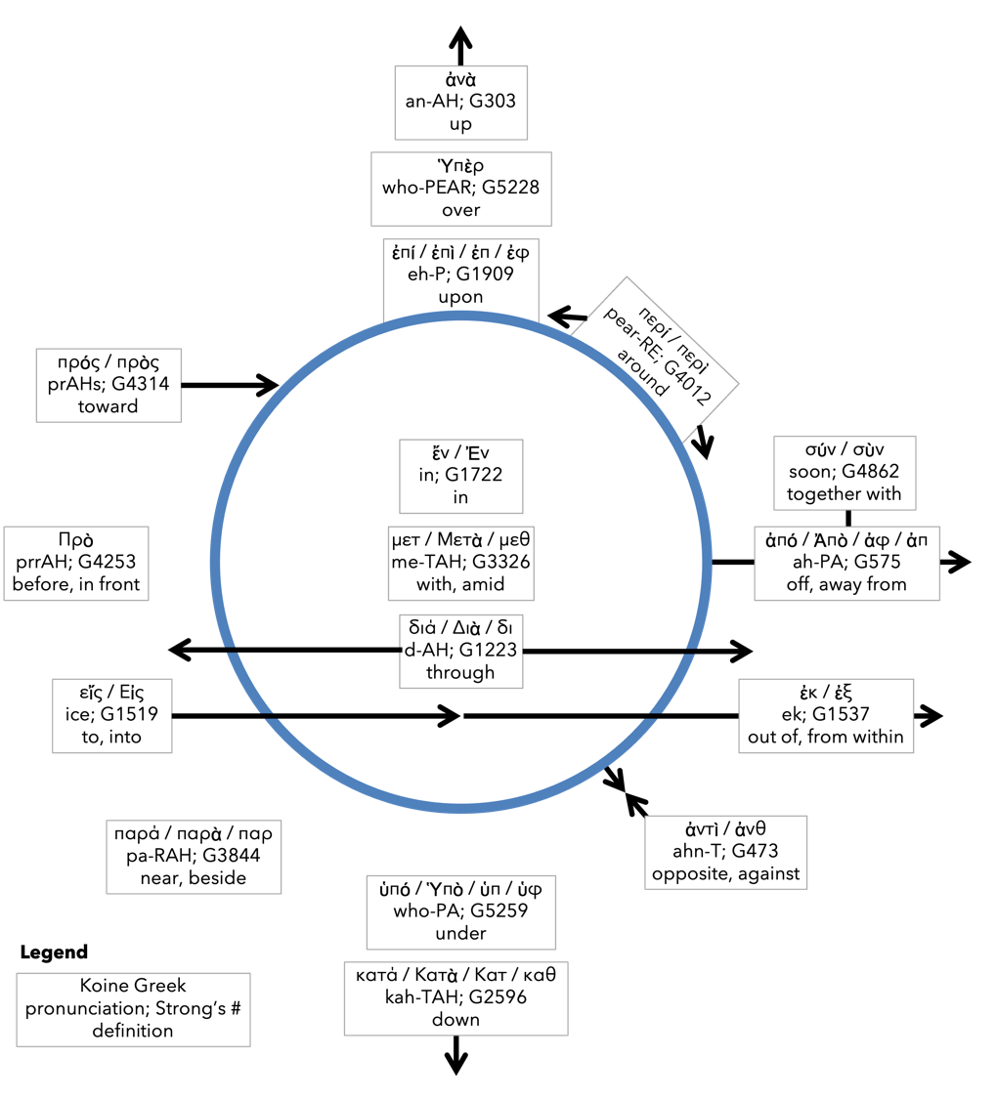
Preposition circle (page 12)

Slide 30
BDAG on morphe (mor-FAY) form, outward appearance, shape

Slide 31
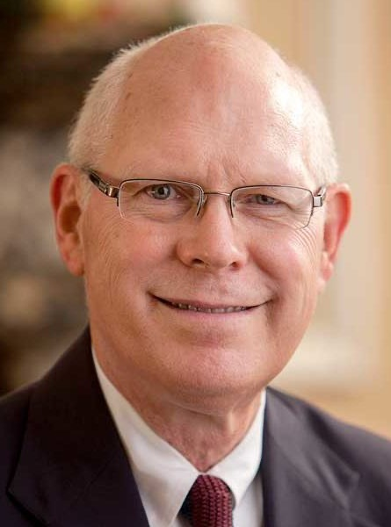
Dr. Gregory K. Beale Quote

Slide 32
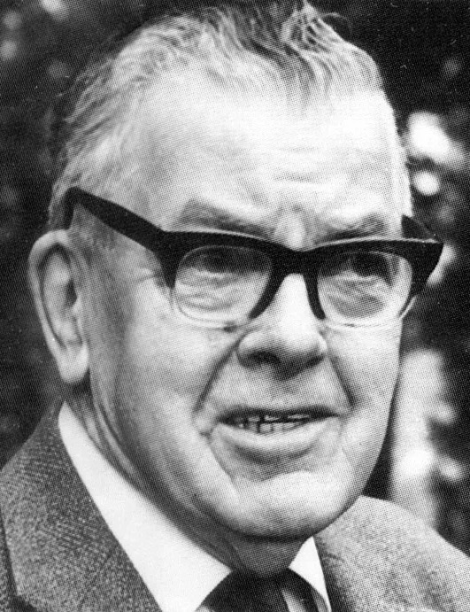
F. F. Bruce Quote

Slide 33
Dr. John Davenant Quote

Slide 34
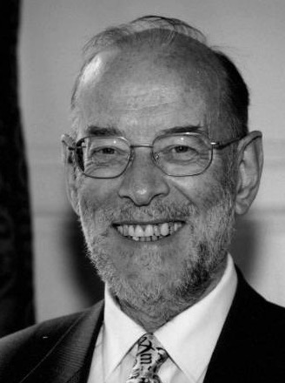
Dr. James D. G. Dunn Quote

Slide 35
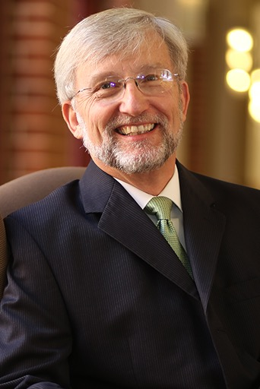
Dr. David Garland Quote

Slide 36
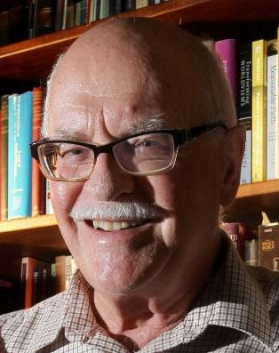
Dr. Murray J. Harris Quote

Slide 37
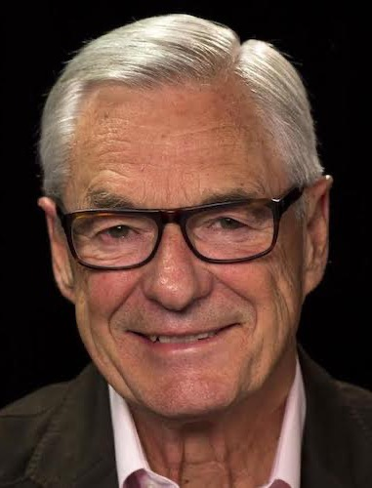
Dr. R. Kent Hughes Quote

Slide 38
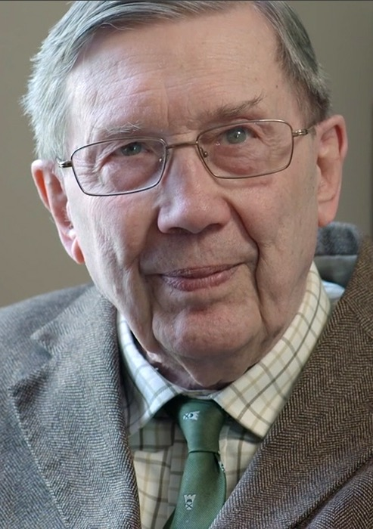
R. C. Lucas Quote

Slide 39
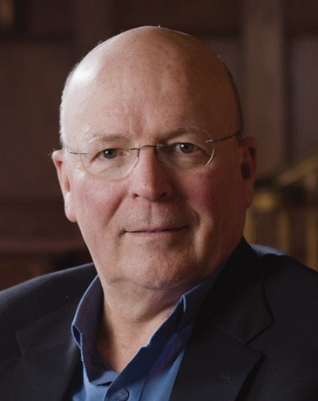
Dr. Scot McKnight Quote

Slide 40
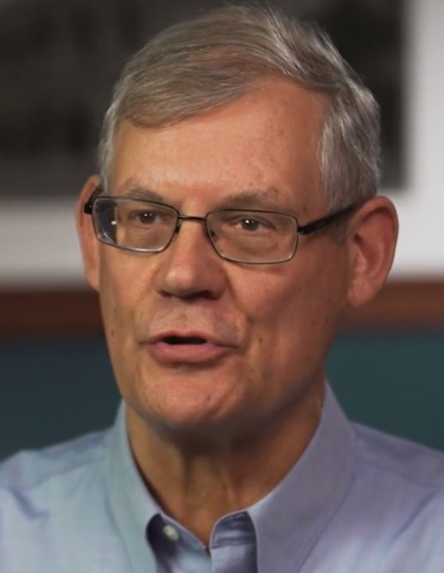
Dr. Douglas J. Moo Quote

Slide 41
Dr. R. Scott Pace & Dr. Daniel L. Akin Quote

Slide 42
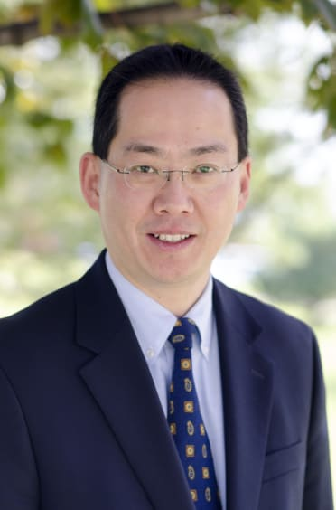
Dr. David W. Pao Quote

Slide 43
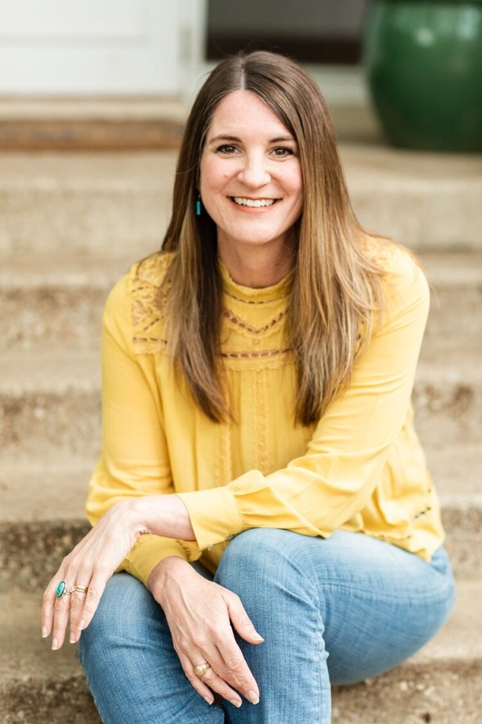
Jen Wilkin Quote

Slide 44
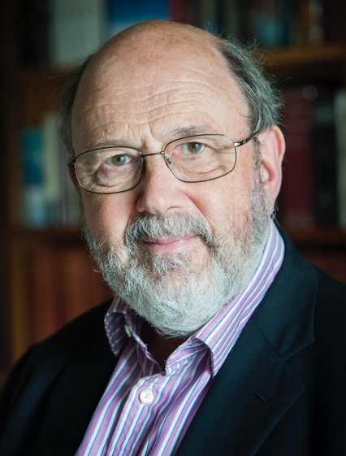
Dr. N. T. Wright Quote

Slide 45
Philip Melanchthon Quote

