Slide 1
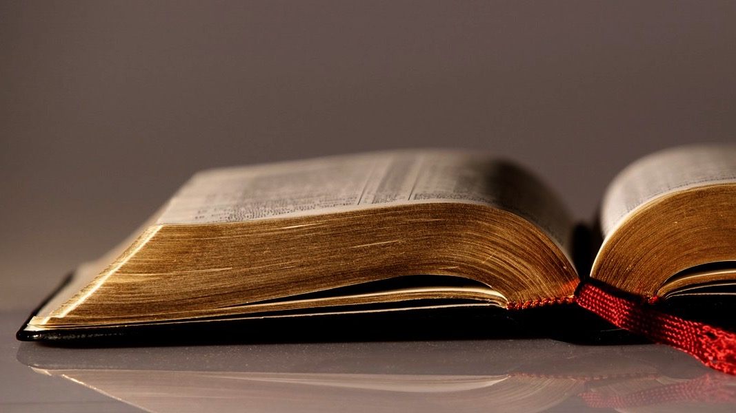
Welcome to
Our Sunday School
We’ll start at 9:07
visit OurSundaySchool.com for more about our class

Slide 2
Colossians: week 6 (pages 42-55)

Slide 3
Colossians 1:9-10
For this reason also, since the day we heard this, we haven’t stopped praying for you. We are asking that you may be filled with the knowledge of his will in all wisdom and spiritual understanding, so that you may walk worthy of the Lord, fully pleasing to him: bearing fruit in every good work and growing in the knowledge of God,

Slide 4
Colossians 1:11-12
being strengthened with all power, according to his glorious might, so that you may have great endurance and patience, joyfully giving thanks to the Father, who has enabled you to share in the saints’ inheritance in the light.

Slide 5
Colossians: week 6 (pages 42-55)

Slide 6
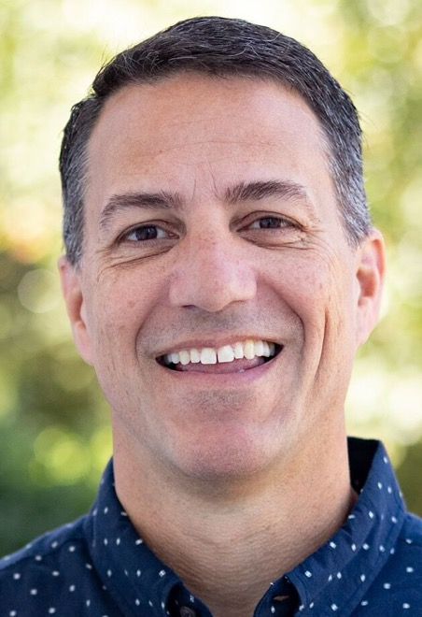
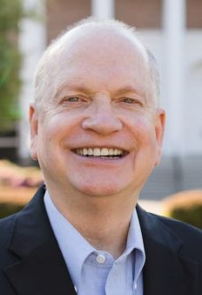
Dr. R. Scott Pace & Dr. Daniel L. Akin We are all in constant need of intercessory prayer that is not occasional or based on impending circumstances.

Slide 7
Colossians: week 6 (pages 42-55)

Slide 8
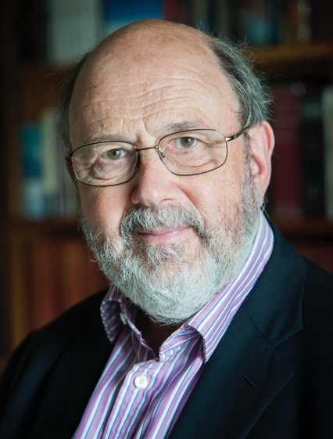
Dr. N. T. Wright God is at work, therefore his people are at work.

Slide 9
Colossians: week 6 (pages 42-55)

Slide 10
Dr. N. T. Wright Understanding will fuel holiness; holiness will deepen understanding.

Slide 11
Colossians: week 6 (pages 42-55)

Slide 12
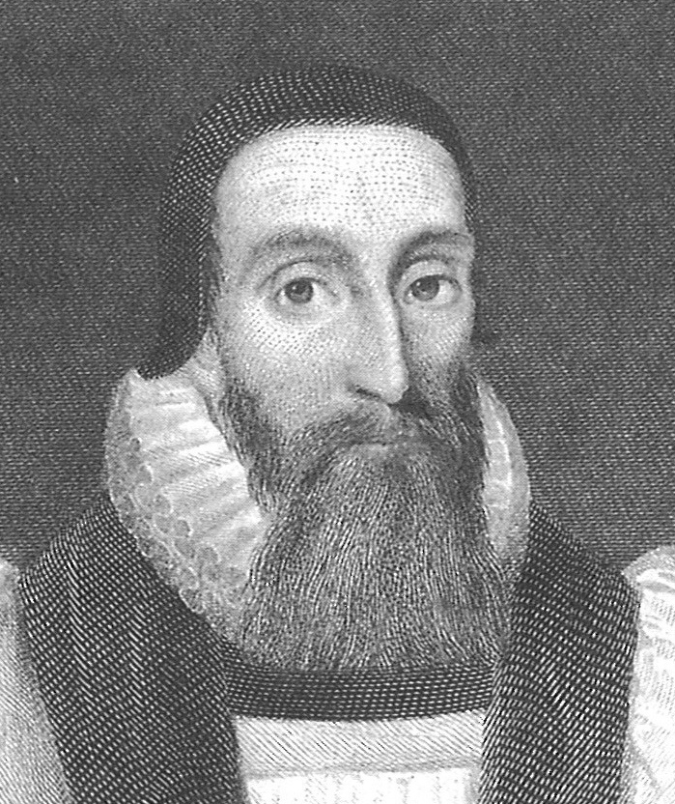
Dr. John Davenant Patience causes all its enemies to serve itself

Slide 13
Colossians: week 6 (pages 42-55)

Slide 14
Dr. R. Scott Pace & Dr. Daniel L. Akin Thanksgiving is not simply a sentimental attitude of reflection but an intentional action of obedience.

Slide 15
Colossians: week 6 (pages 42-55)

Slide 16
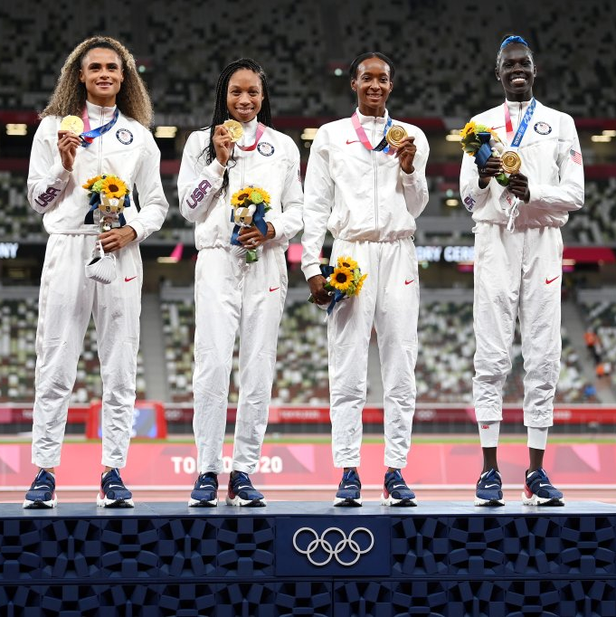
“enabled you to share”

Slide 17
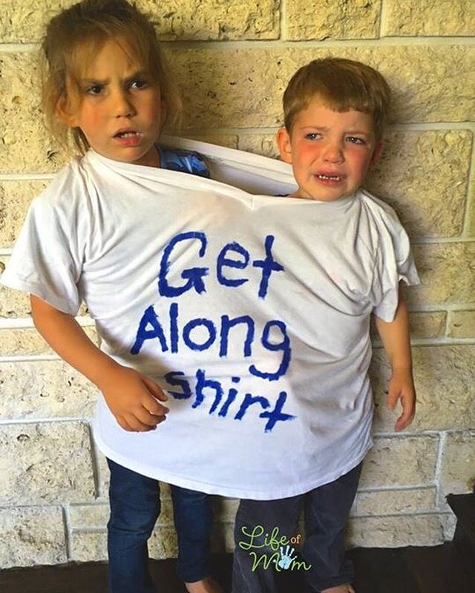
“enabled you to share”

Slide 18
“enabled you to share”

Slide 19
Colossians: week 6 (pages 42-55)

Slide 20
Prayer time
Write down your prayer requests (on the Weekly Update or in the comments
Lean in, engage, and pray for someone not with you
Go worship

Slide 21
Today’s class (page 17)
Preparing for Colossians 1:1-2:3 Pray with others Hear with others Think with others Study with others Share with others Invite others
In class, as a class
In class, as tables
After class

Slide 22
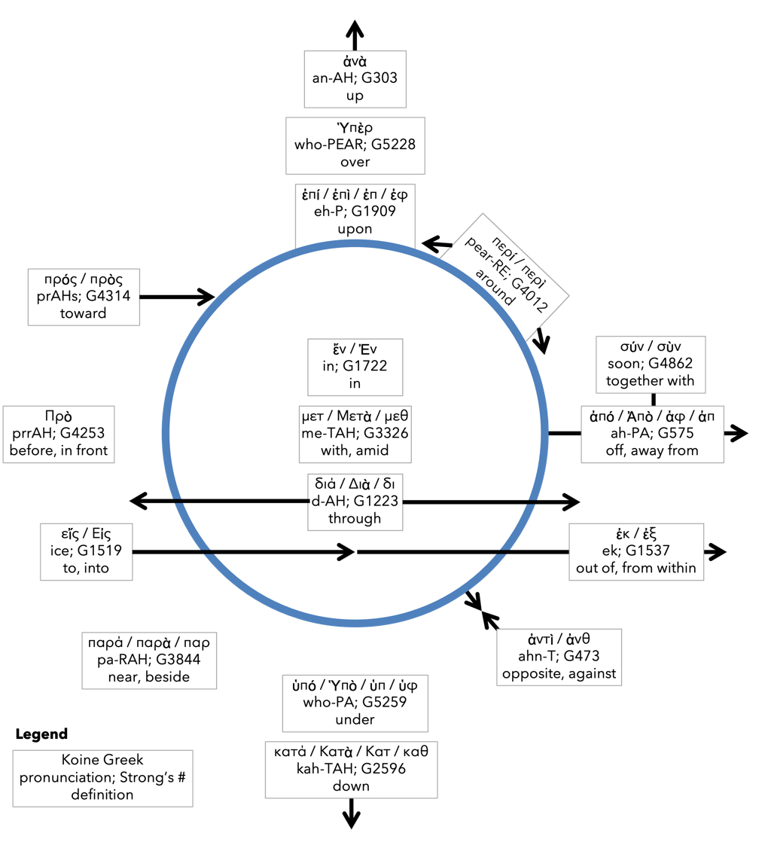
Preposition circle (page 12)

Slide 23
BDAG on morphe (mor-FAY) form, outward appearance, shape

Slide 24
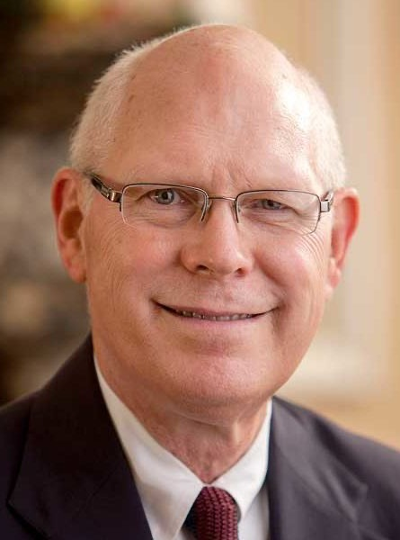
Dr. Gregory K. Beale Quote

Slide 25
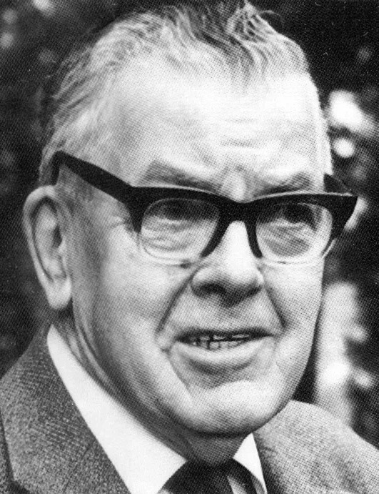
F. F. Bruce Quote

Slide 26
Dr. John Davenant Quote

Slide 27
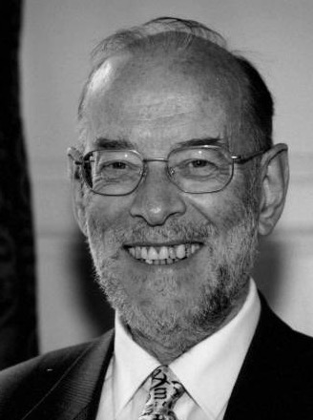
Dr. James D. G. Dunn Quote

Slide 28
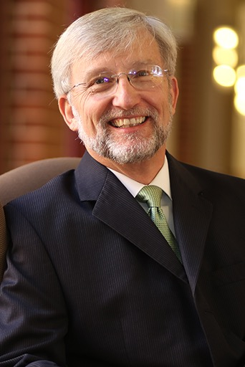
Dr. David Garland Quote

Slide 29
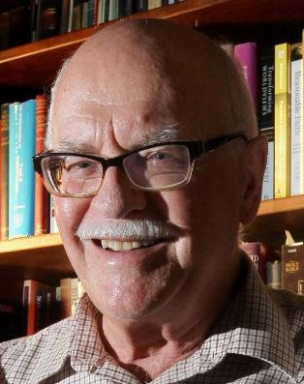
Dr. Murray J. Harris Quote

Slide 30
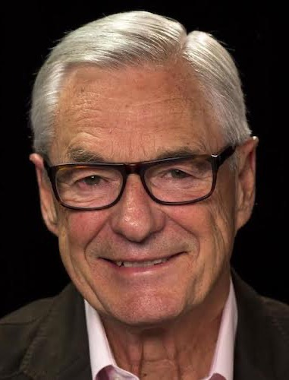
Dr. R. Kent Hughes Quote

Slide 31
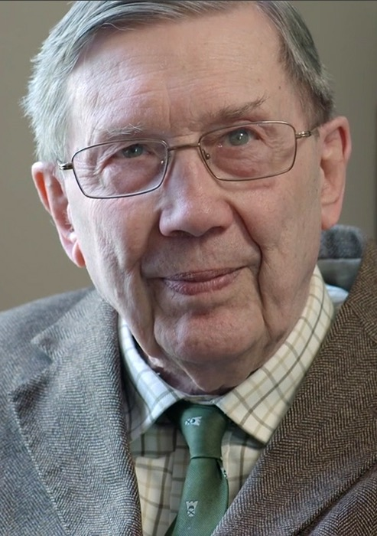
R. C. Lucas Quote

Slide 32
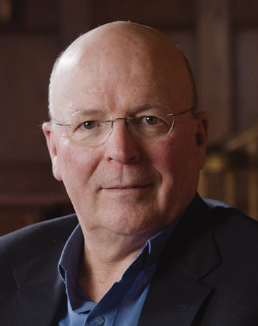
Dr. Scot McKnight Quote

Slide 33
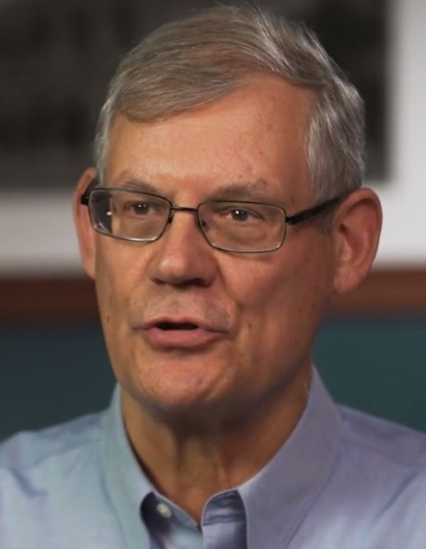
Dr. Douglas J. Moo Quote

Slide 34
Dr. R. Scott Pace & Dr. Daniel L. Akin Quote

Slide 35
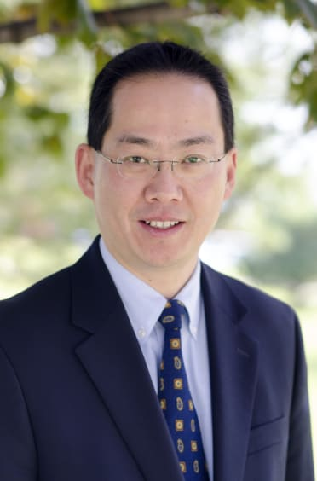
Dr. David W. Pao Quote

Slide 36
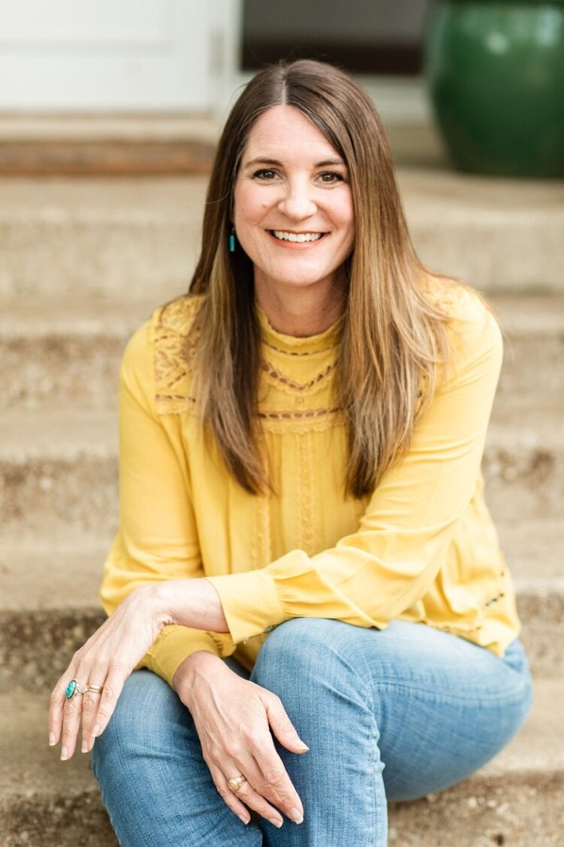
Jen Wilkin Quote

Slide 37
Dr. N. T. Wright Quote

Slide 38
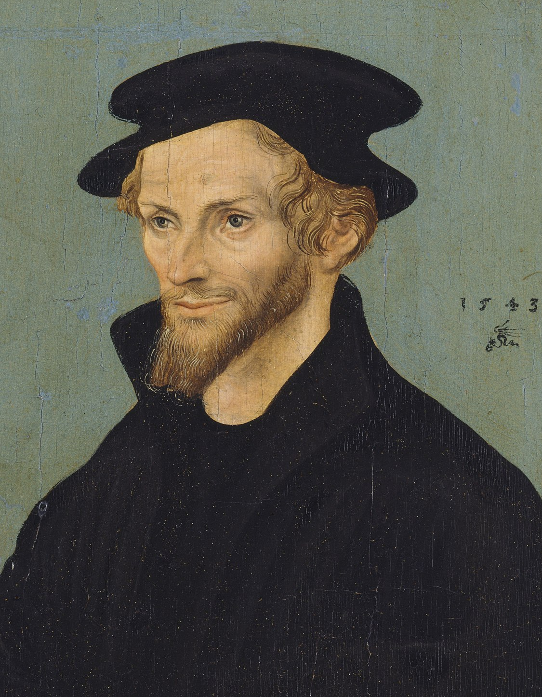
Philip Melanchthon If somebody who had been shipwrecked knew for sure that he could swim to safety, he would not fear for his life but would be cheerful.

