Slide 1
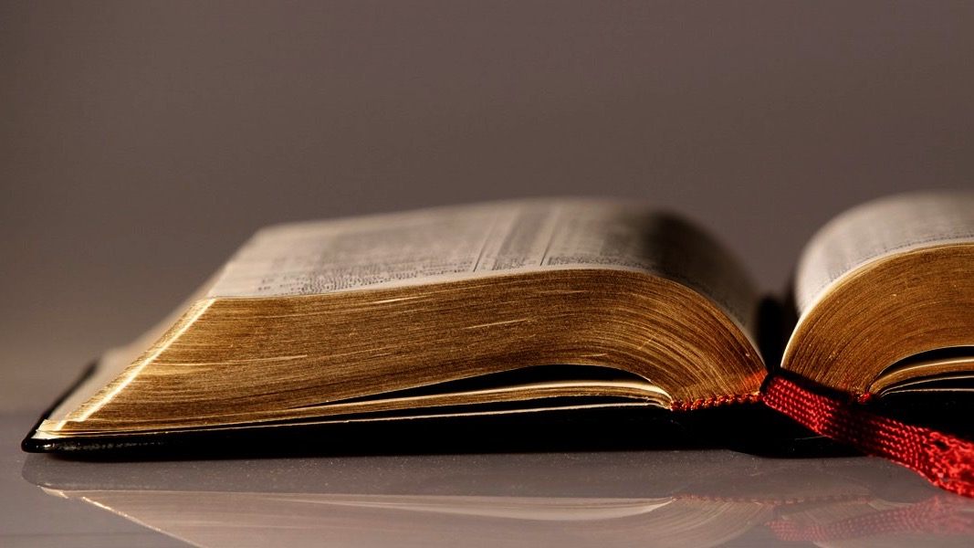
Welcome to
Our Sunday School
We’ll start at 9:07
visit OurSundaySchool.com for more about our class

Slide 2
Colossians: week 5 (pages 33-41)

Slide 3
Colossians 1:6b-8
It is bearing fruit and growing all over the world, just as it has among you since the day you heard it and came to truly appreciate God’s grace. You learned this from Epaphras, our dearly loved fellow servant. He is a faithful minister of Christ on your behalf, and he has told us about your love in the Spirit.

Slide 4
Colossians: week 5 (pages 33-41)

Slide 5
~Creation language in…
Genesis 1:28
Genesis 8:18
Genesis 9:1
Genesis 9:7
Genesis 17:20
Genesis 28:3
Genesis 35:11
Genesis 48:4
Exodus 1:7
Jeremiah 3:16
Jeremiah 23:3

Slide 6
Colossians: week 5 (pages 33-41)

Slide 7
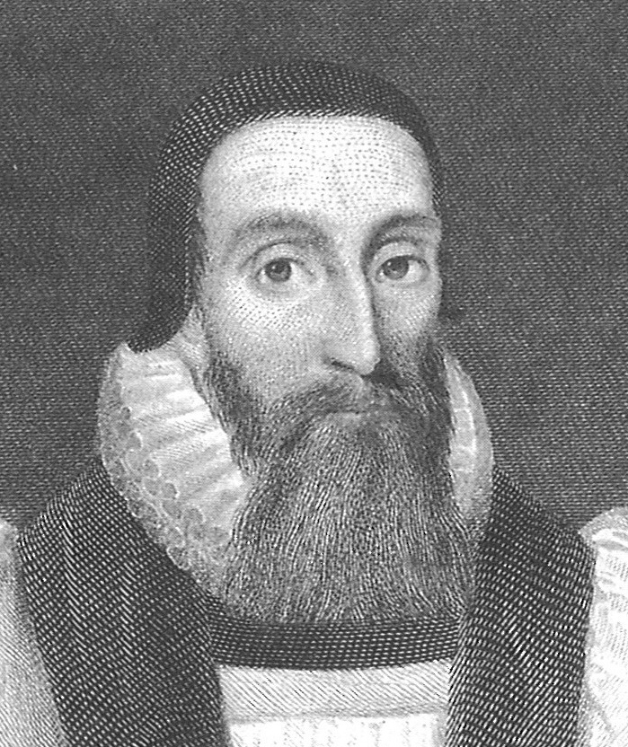
Dr. John Davenant Paul himself preached the Gospel from Jerusalem as far as to Illyricum; Mark, in Egypt; Matthew, in Ethiopia; Thomas, in India; Simon Zelotes, in Britain.

Slide 8
Colossians: week 5 (pages 33-41)

Slide 9
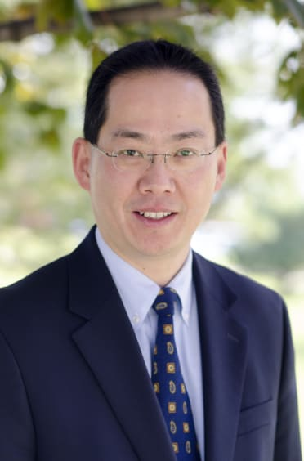
Dr. David W. Pao Paul clearly reminds his readers that one’s relationship with Jesus will affect one’s relationship with others, and one’s behavior reflects one’s belief system.

Slide 10
Dr. David W. Pao To emphasize one without the other is not only misleading; it is to misunderstand the demands of the gospel message.

Slide 11
Colossians: week 5 (pages 33-41)

Slide 12
Dr. David W. Pao To focus on the interrelationship between faith and practice can often be used as an excuse to downplay the… content of the gospel message….

Slide 13
Dr. David W. Pao Paul reminds us that the content of the objective gospel serves as the basis for both “faith” and “love.” It is to be “heard” and “understood.”

Slide 14
Colossians: week 5 (pages 33-41)

Slide 15
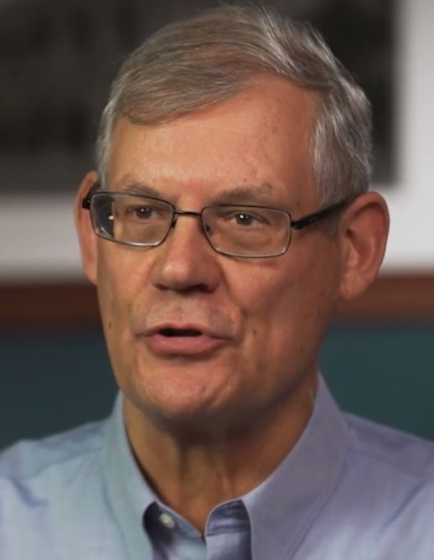
Dr. Douglas J. Moo Paul turns from message to messenger.

Slide 16
Colossians: week 5 (pages 33-41)

Slide 17
Dr. John Davenant It contributes much to the promotion of religion that a people think honorably of their pastors and ministers,

Slide 18
Dr. John Davenant for if the priests of God begin to be despised, religion will soon be despised and the worship of God condemned.

Slide 19
Colossians: week 5 (pages 33-41)

Slide 20
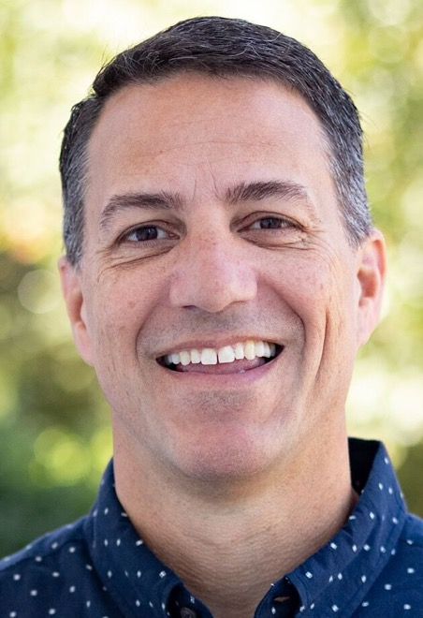
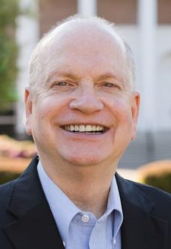
Dr. R. Scott Pace & Dr. Daniel L. Akin Our adoption by the Father should provoke us to praise him with gladness.

Slide 21
Dr. R. Scott Pace & Dr. Daniel L. Akin Our redemption by the Son should motivate us to follow him with gratitude.

Slide 22
Dr. R. Scott Pace & Dr. Daniel L. Akin And our conversion by the Spirit should empower us to obey him by going.

Slide 23
Colossians: week 5 (pages 33-41)

Slide 24
Prayer time
Write down your prayer requests (on the Weekly Update or in the comments
Lean in, engage, and pray for someone not with you
Go worship

Slide 25
Today’s class (page 17)
Preparing for Colossians 1:1-2:3 Pray with others Hear with others Think with others Study with others Share with others Invite others
In class, as a class
In class, as tables
After class

Slide 26
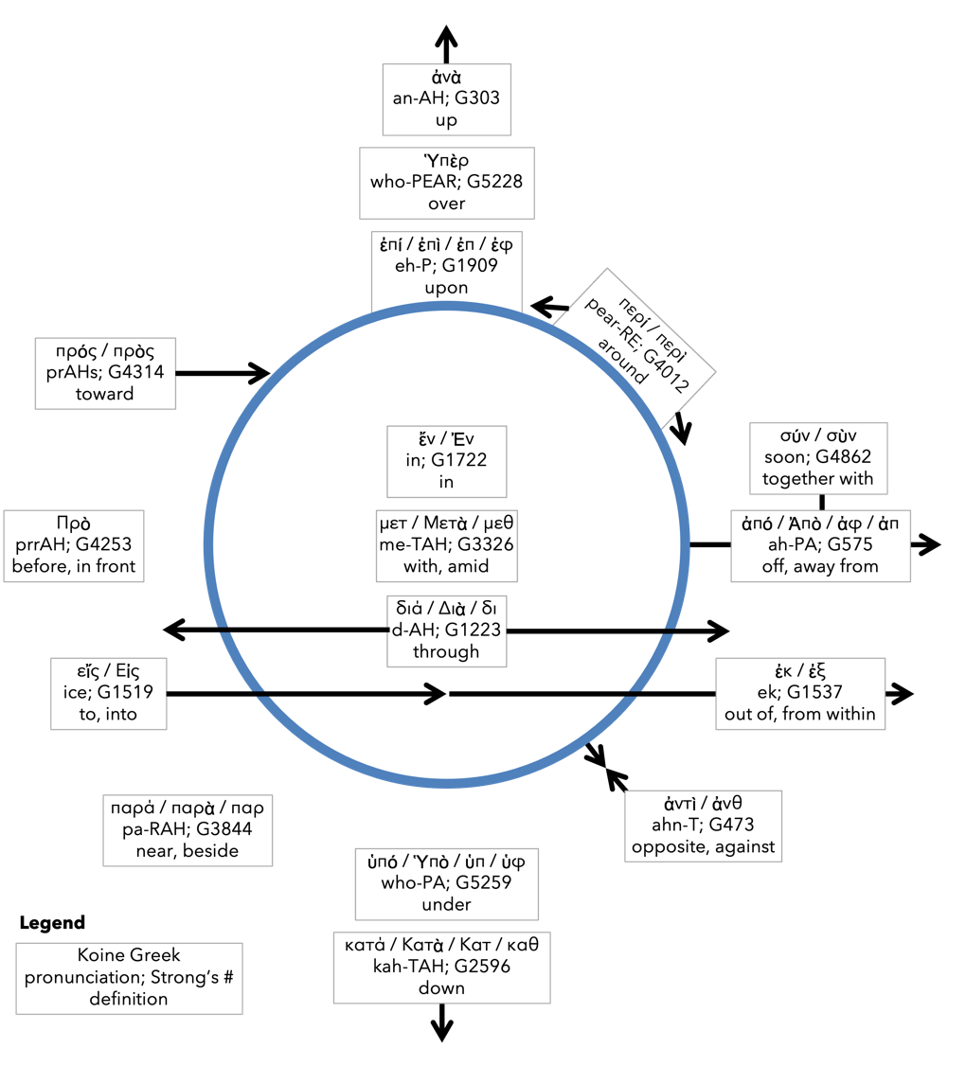
Preposition circle (page 12)

Slide 27
BDAG on morphe (mor-FAY) form, outward appearance, shape

Slide 28
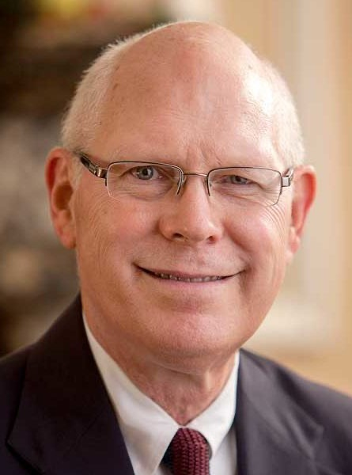
Dr. Gregory K. Beale Quote

Slide 29
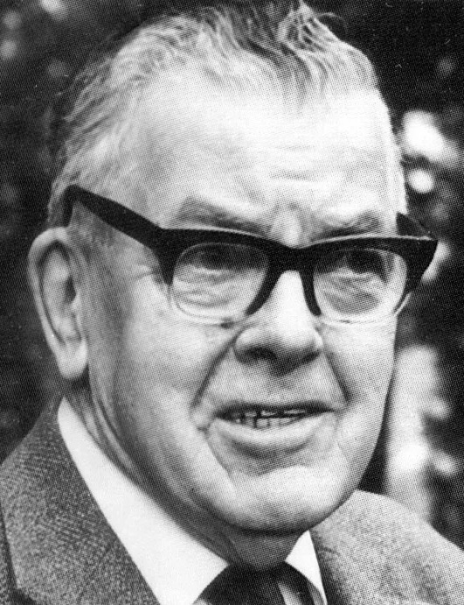
F. F. Bruce Quote

Slide 30
Dr. John Davenant Quote

Slide 31
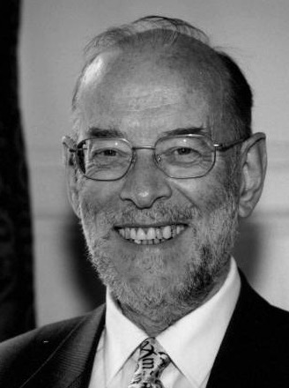
Dr. James D. G. Dunn Quote

Slide 32
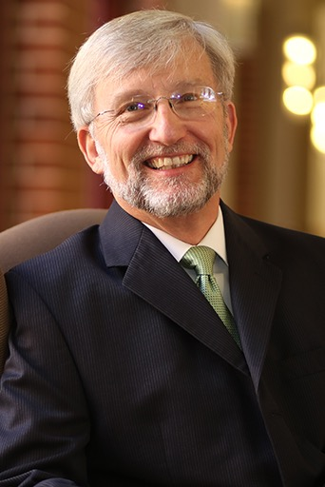
Dr. David Garland Quote

Slide 33
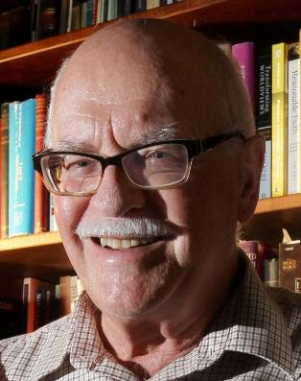
Dr. Murray J. Harris Quote

Slide 34
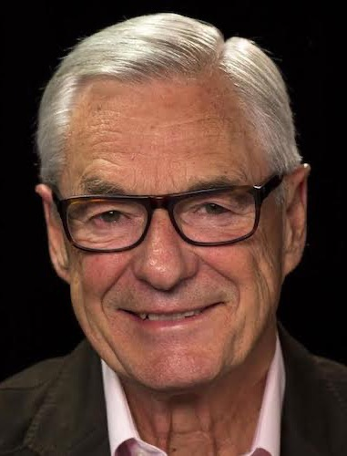
Dr. R. Kent Hughes Quote

Slide 35
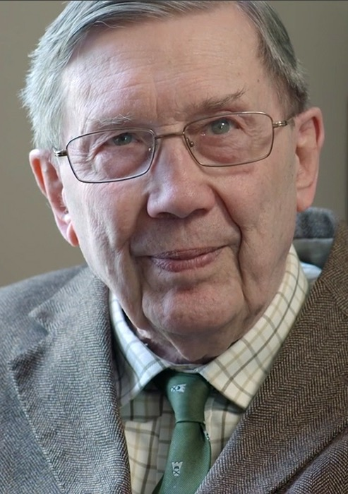
R. C. Lucas Quote

Slide 36
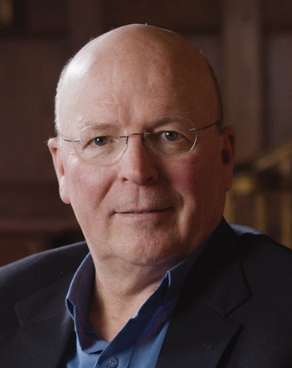
Dr. Scot McKnight Quote

Slide 37
Dr. Douglas J. Moo Quote

Slide 38
Dr. R. Scott Pace & Dr. Daniel L. Akin Quote

Slide 39
Dr. David W. Pao Quote

Slide 40
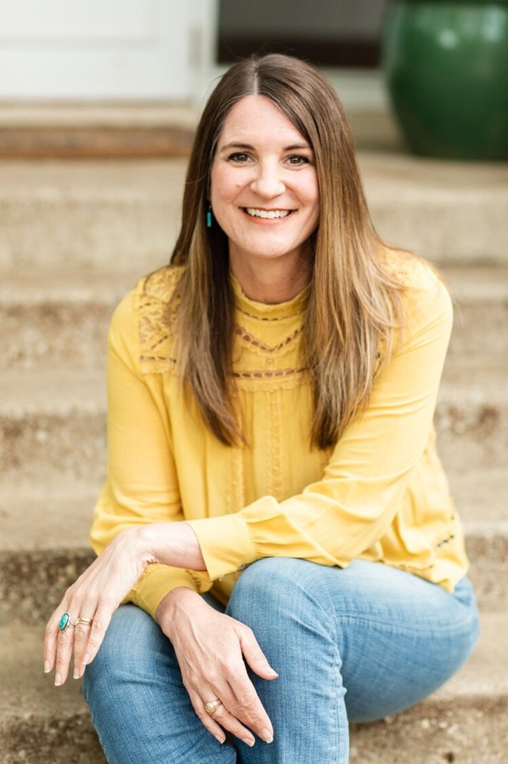
Jen Wilkin Quote

Slide 41
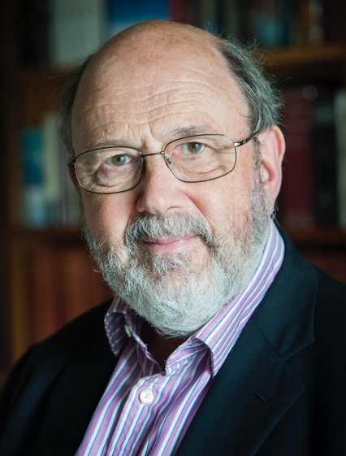
Dr. N. T. Wright Quote

