Slide 1
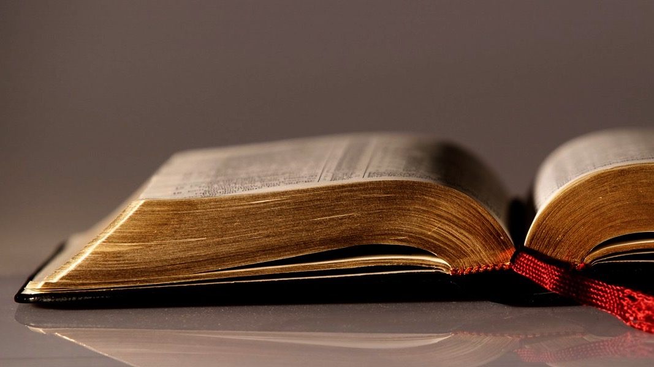
Welcome to
Our Sunday School
We’ll start at 9:07
visit OurSundaySchool.com for more about our class

Slide 2
Colossians: week 4 (pages 24-33)

Slide 3
Colossians 1:3-6a
We always thank God, the Father of our Lord Jesus Christ, when we pray for you, for we have heard of your faith in Christ Jesus and of the love you have for all the saints because of the hope reserved for you in heaven. You have already heard about this hope in the word of truth, the gospel that has come to you.

Slide 4
Colossians: week 4 (pages 24-33)

Slide 5
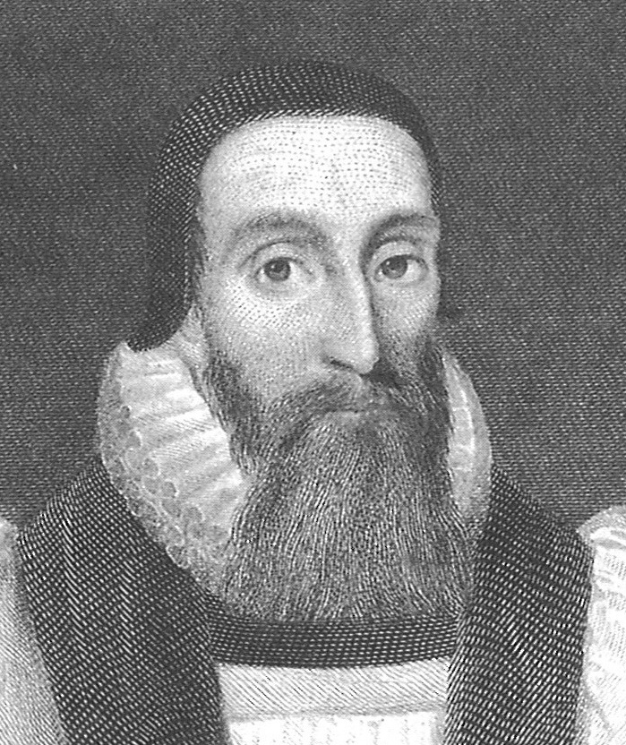
Dr. John Davenant

Slide 6
Colossians: week 4 (pages 24-33)

Slide 7
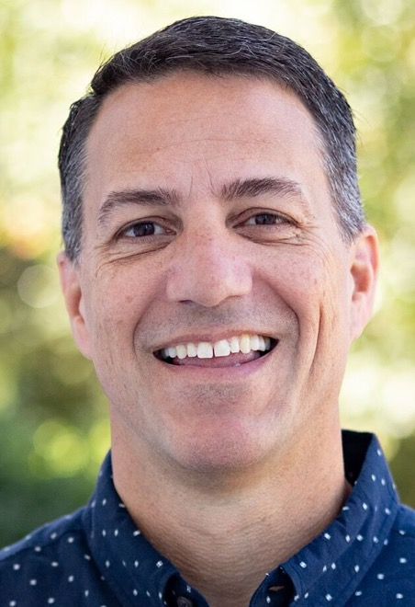
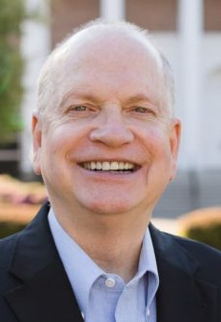
Dr. R. Scott Pace & Dr. Daniel L. Akin Love for others is the evidence of a redeemed heart... and the distinguishing mark of Christ’s followers.

Slide 8
Colossians: week 4 (pages 24-33)

Slide 9
Lancelot Ridley A true and lively faith cannot be hid long, but it will burst up into good works…. for a true faith in God is not idle or dead.

Slide 10
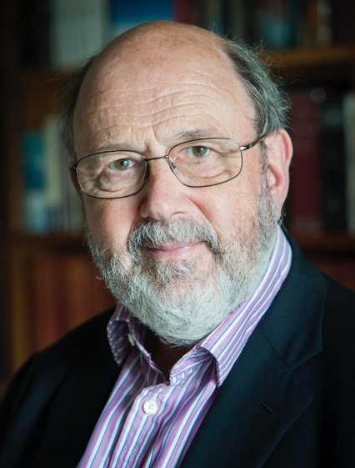
Dr. N. T. Wright For Paul, the sure sign of grace at work was the fact of a loving community created out of nothing:

Slide 11
Dr. N. T. Wright of a love not restricted to those with whom one has a natural affinity, but with which extends to all the saints.

Slide 12
Dr. John Davenant The object of love, specified in this place, the saints; and the extent of the object, all saints.

Slide 13
Colossians: week 4 (pages 24-33)

Slide 14
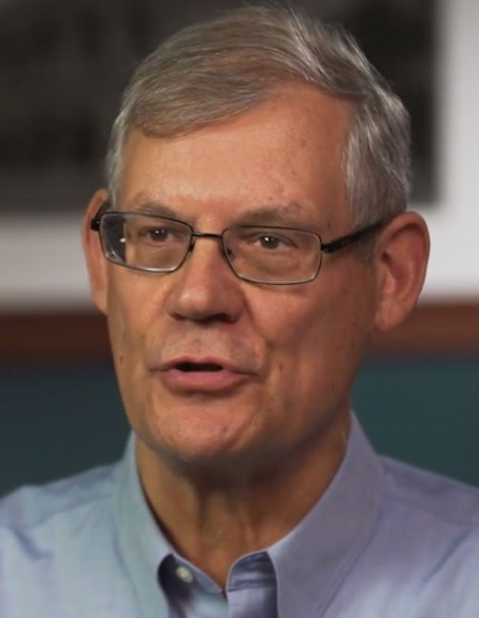
Dr. Douglas J. Moo The gospel, then, Paul implies, is to be contrasted with the false teaching, which cannot offer a reliable basis for hope.

Slide 15
Colossians: week 4 (pages 24-33)

Slide 16
Dr. John Davenant God himself is the reward promised to the faithful.

Slide 17
Colossians: week 4 (pages 24-33)

Slide 18
Dr. John Davenant Since, therefore, Christ is the truth, and the Gospel hath Christ, both as its author and its object, it is most aptly called the word of the truth.

Slide 19
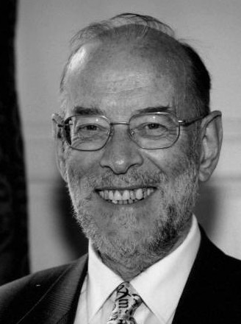
Dr. James D. G. Dunn “Gospel” … was known in wider Greek usage, but almost always in the plural, in the sense of “good tidings” … and the singular is unknown in biblical Greek outside the New Testament.

Slide 20
Colossians: week 4 (pages 24-33)

Slide 21
Dr. John Davenant For the Colossians had not come to the gospel, but the gospel to them.

Slide 22
Dr. John Davenant The sick are wont to seek physicians, and to provide medicines at their own expense;

Slide 23
Dr. John Davenant but the heavenly Physician seeks the sick, freely sends the medicine of the Gospel to them who are neither looking for it, nor thinking of it.

Slide 24
Prayer time
Write down your prayer requests (on the Weekly Update or in the comments
Lean in, engage, and pray for someone not with you
Go worship

Slide 25
Today’s class (page 17)
Preparing for Colossians 1:1-2:3 Pray with others Hear with others Think with others Study with others Share with others Invite others
In class, as a class
In class, as tables
After class

Slide 26
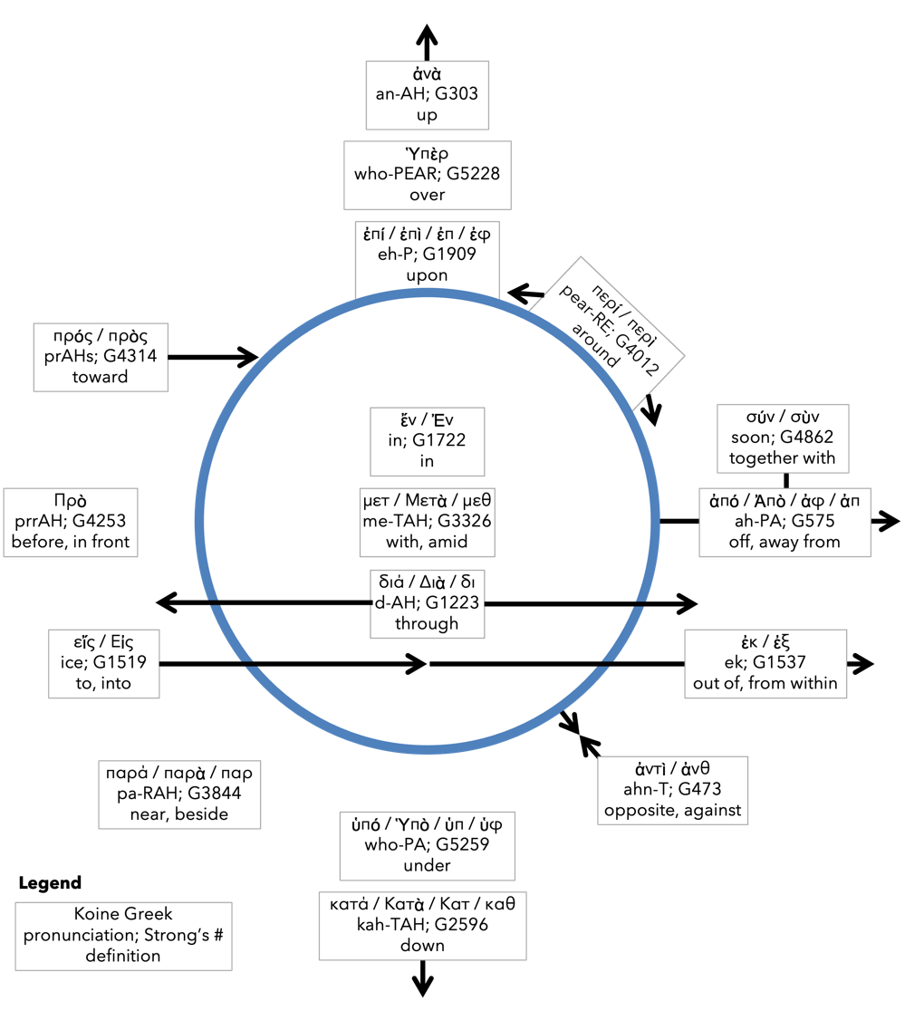
Preposition circle (page 12)

Slide 27
BDAG on morphe (mor-FAY) form, outward appearance, shape

Slide 28
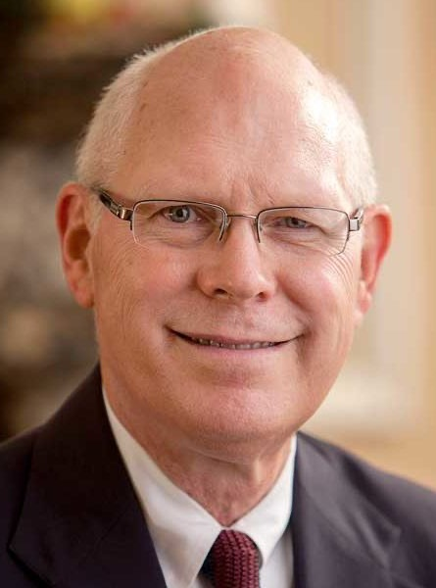
Dr. Gregory K. Beale Quote

Slide 29
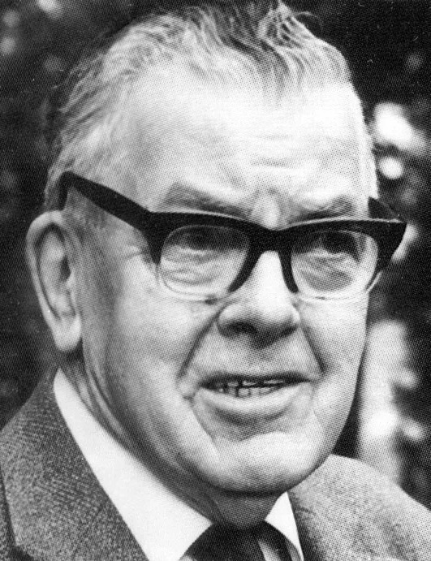
F. F. Bruce Quote

Slide 30
Dr. John Davenant Quote

Slide 31
Dr. James D. G. Dunn Quote

Slide 32
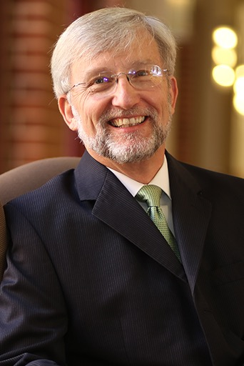
Dr. David Garland Quote

Slide 33
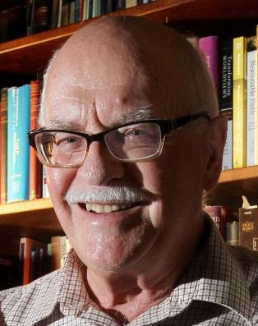
Dr. Murray J. Harris Quote

Slide 34
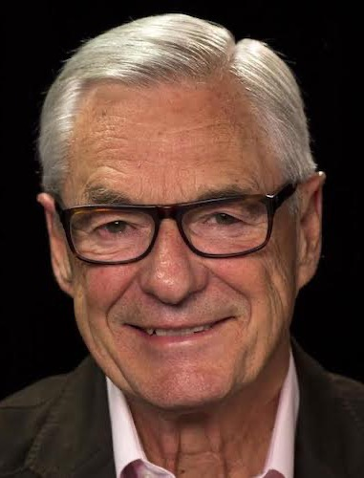
Dr. R. Kent Hughes Quote

Slide 35
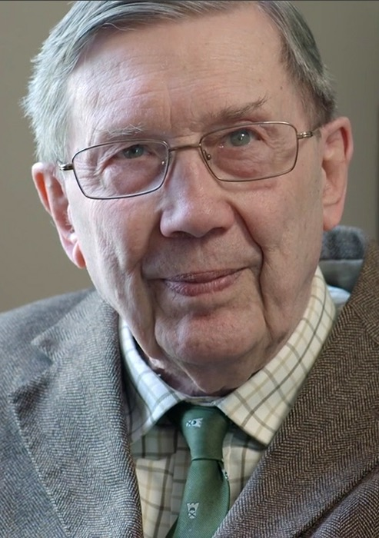
R. C. Lucas Quote

Slide 36
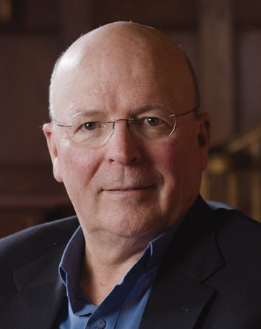
Dr. Scot McKnight Quote

Slide 37
Dr. Douglas J. Moo Quote

Slide 38
Dr. R. Scott Pace & Dr. Daniel L. Akin Quote

Slide 39
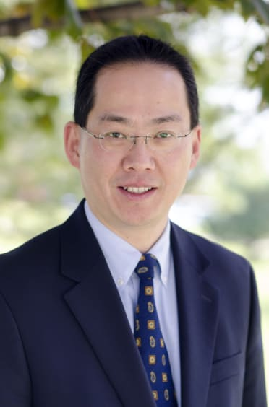
Dr. David W. Pao Quote

Slide 40
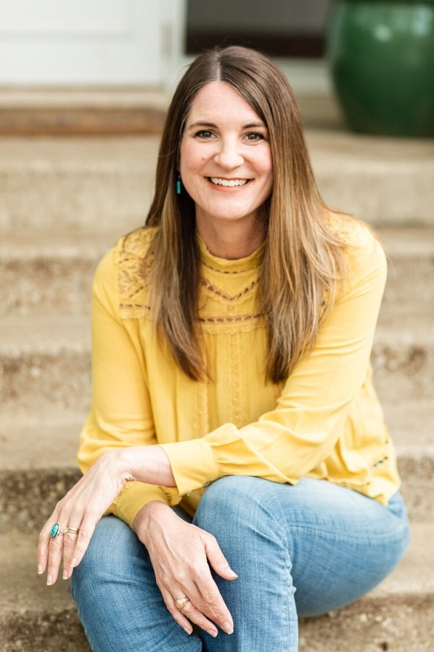
Jen Wilkin Quote

Slide 41
Dr. N. T. Wright Quote

