Slide 1
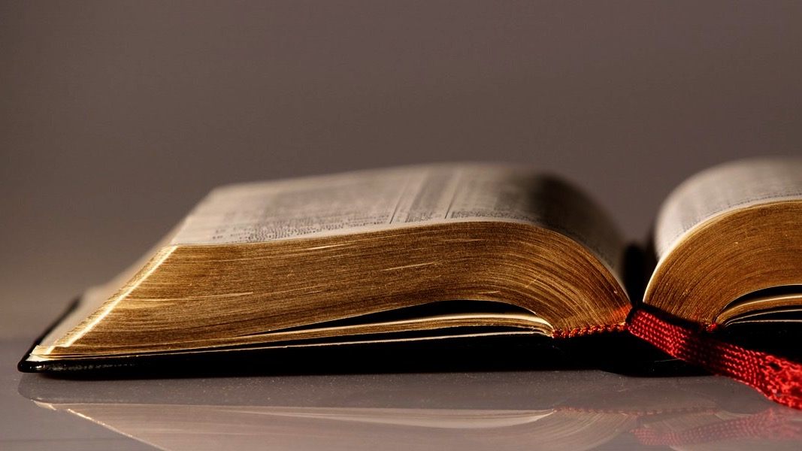
Welcome to
Our Sunday School
We’ll start at 9:07
visit OurSundaySchool.com for more about our class

Slide 2
Colossians: week 3 (pages 18-23)

Slide 3
Colossians 1:1-2
Paul, an apostle of Christ Jesus by God’s will, and Timothy our brother:
To the saints in Christ at Colossae, who are faithful brothers and sisters.
Grace to you and peace from God our Father.

Slide 4
Colossians: week 3 (pages 18-23)

Slide 5
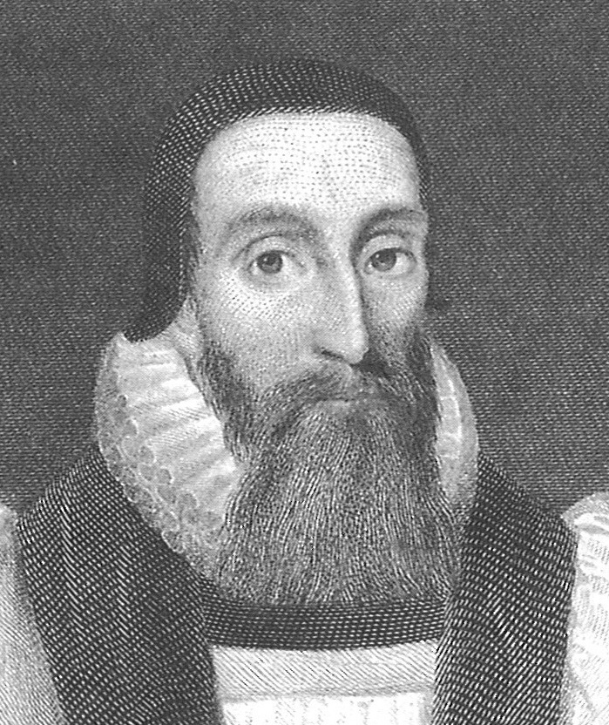
Dr. John Davenant For an Apostle is the ambassador of God, the amanuensis of the Holy Spirit.

Slide 6
Colossians: week 3 (pages 18-23)

Slide 7
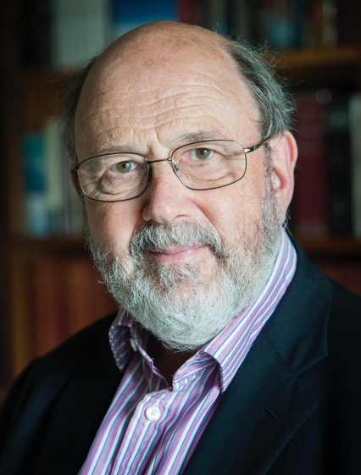
Dr. N. T. Wright Paul often refers to Christians as ‘saints’, indicating thereby not an advanced level of holiness but the fact of being… set apart from the world for God.

Slide 8
Thomas Cartwright They are called saints for two causes, one without themselves in Christ, the other wrought within them by the Spirit of Christ.

Slide 9
Colossians: week 3 (pages 18-23)

Slide 10
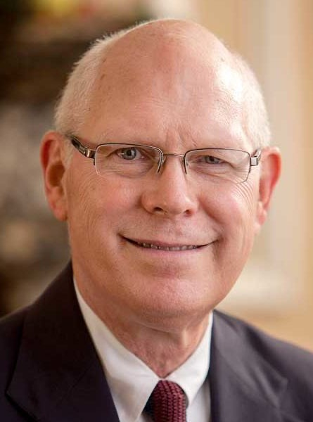
Dr. Gregory K. Beale The evidence from ancient coins found in the area reveals the worship of such deities as Artemis of Ephesus, Zeus, Men of Phrygia, Hygeia, Athena, Boule, Demeter, and Selene, in addition to the Egyptian gods Isis and Serapis.

Slide 11
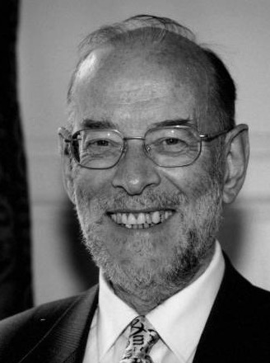
Dr. James D. G. Dunn

Slide 12
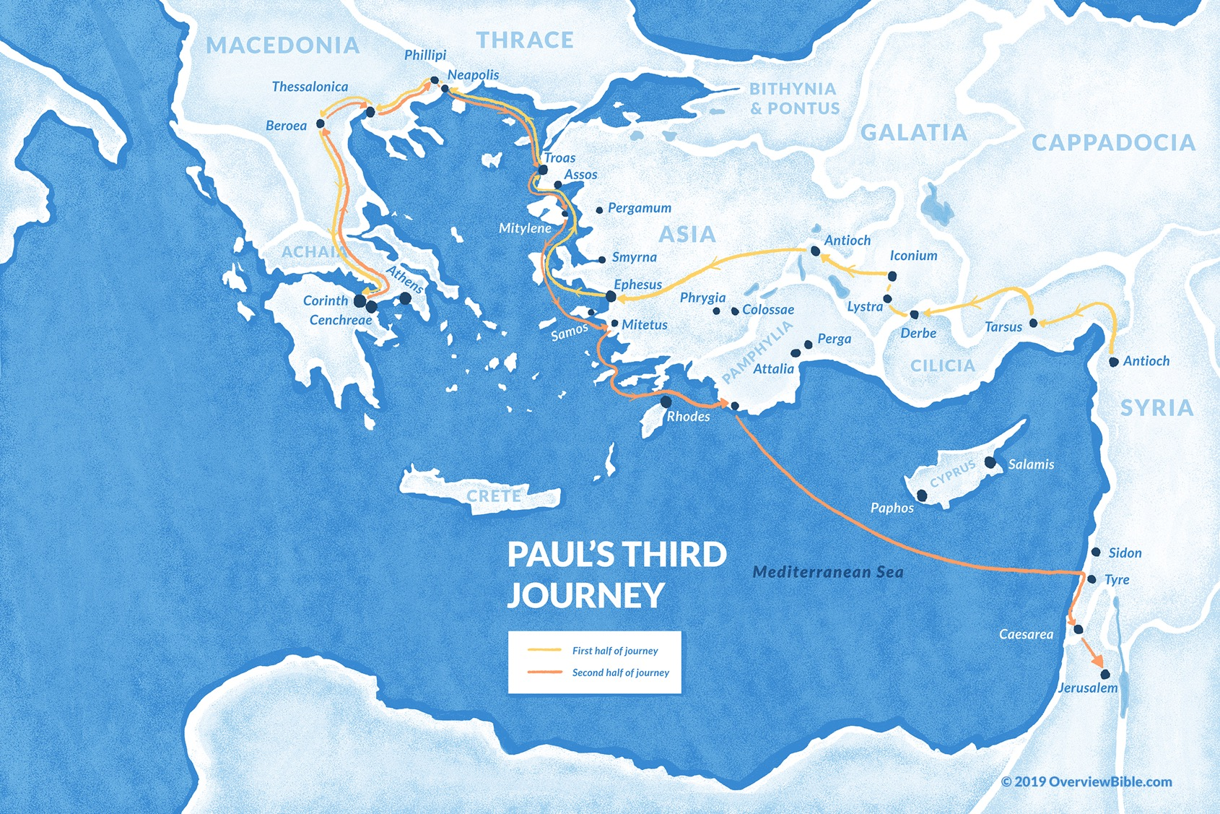
#3
~Acts 18:23-21:15

Slide 13
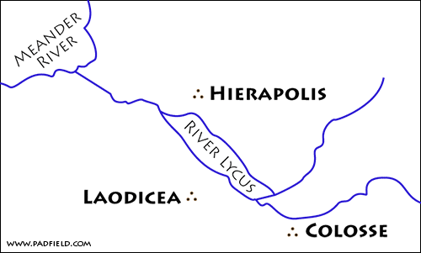

Slide 14
Dr. Gregory K. Beale The parallelism of “in Colossae” and “in Christ” implies that the Christians’ spiritual location “in Christ” should affect how they live in their physical location.

Slide 15
Colossians: week 3 (pages 18-23)

Slide 16
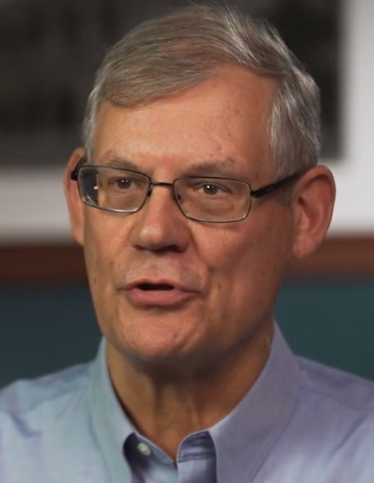
Dr. Douglas J. Moo While calling his readers “holy” is typical for Paul, addressing them as “faithful” is not.

Slide 17
Colossians: week 3 (pages 18-23)

Slide 18
Dr. Douglas J. Moo It reminds us that we are members of the same family and that we should adopt the attitudes and actions necessary to maintain our familial unity.

Slide 19
Colossians: week 3 (pages 18-23)

Slide 20
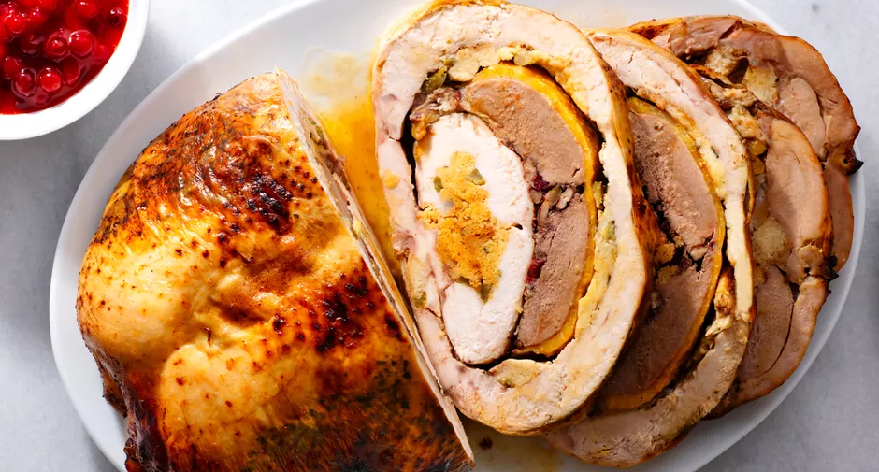
The Spruce / Diana Chistruga

Slide 21
Colossians: week 3 (pages 18-23)

Slide 22
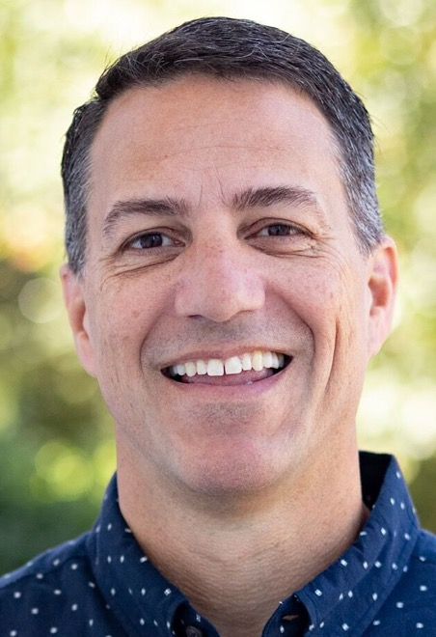
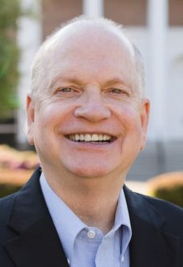
Dr. R. Scott Pace & Dr. Daniel L. Akin One of the most glorious truths about our salvation is the reality of our acceptance into God’s family

Slide 23
Colossians: week 3 (pages 18-23)

Slide 24
Prayer time
Write down your prayer requests (on the Weekly Update or in the comments
Lean in, engage, and pray for someone not with you
Go worship

Slide 25
Today’s class (page 17)
Preparing for Colossians 1:1-2:3 Pray with others Hear with others Think with others Study with others Share with others Invite others
In class, as a class
In class, as tables
After class

Slide 26
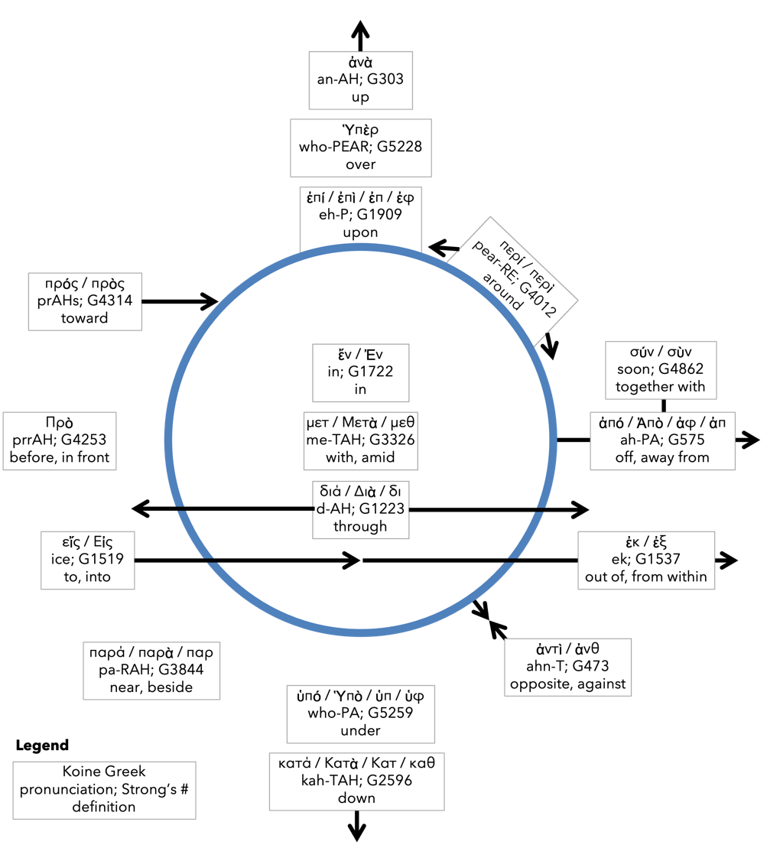
Preposition circle (page 12)

Slide 27
BDAG on morphe (mor-FAY) form, outward appearance, shape

Slide 28
Dr. Gregory K. Beale Quote

Slide 29
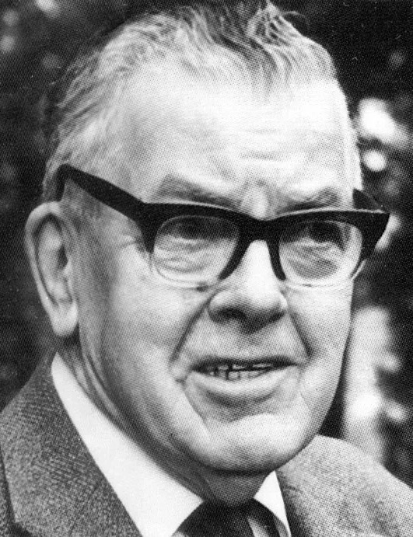
F. F. Bruce Quote

Slide 30
Dr. John Davenant Quote

Slide 31
Dr. James D. G. Dunn Quote

Slide 32
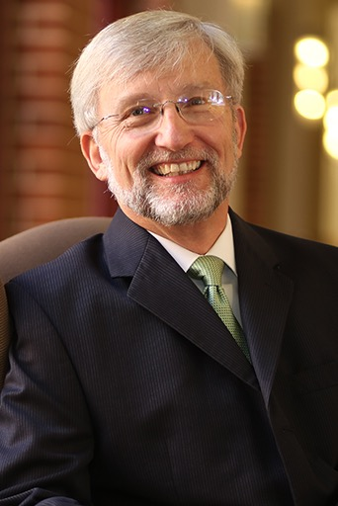
Dr. David Garland Quote

Slide 33
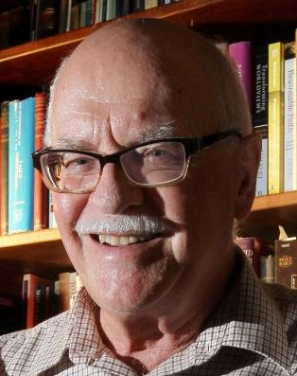
Dr. Murray J. Harris Quote

Slide 34
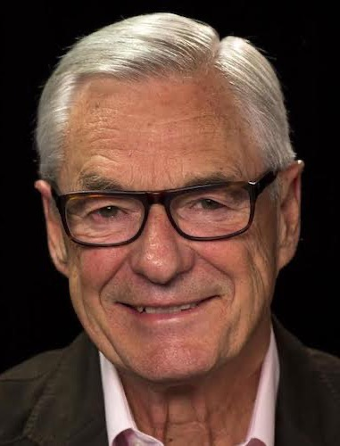
Dr. R. Kent Hughes Quote

Slide 35
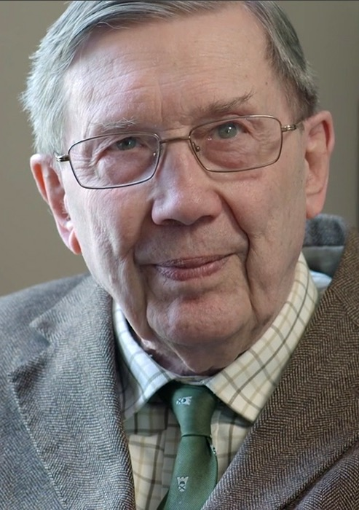
R. C. Lucas Quote

Slide 36
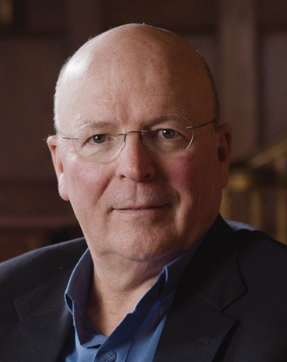
Dr. Scot McKnight Quote

Slide 37
Dr. Douglas J. Moo Quote

Slide 38
Dr. R. Scott Pace & Dr. Daniel L. Akin Quote

Slide 39
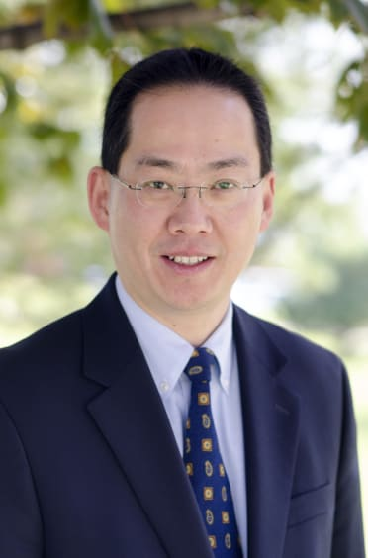
Dr. David W. Pao Quote

Slide 40
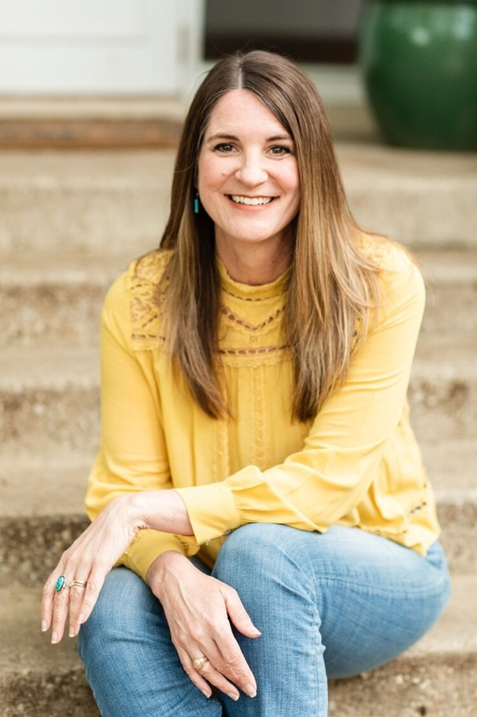
Jen Wilkin Quote

Slide 41
Dr. N. T. Wright Quote

