Slide 1
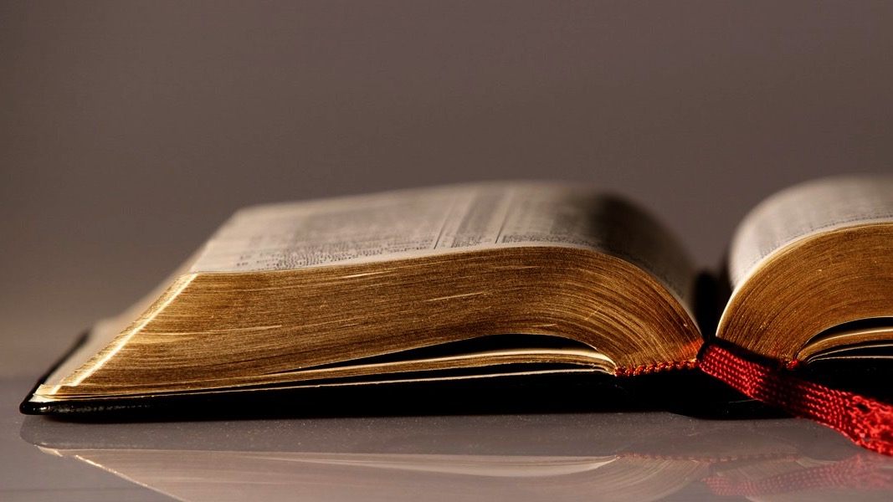
Welcome to
Our Sunday School
We’ll start at 9:07
visit OurSundaySchool.com for more about our class

Slide 2
Colossians: week 2

Slide 3
Last class: Colossians introduction
The “Introduction” of the teal book
History of Colossae
History of the Colossian church
Reading Colossians

Slide 4
Today’s class (page 17)
Preparing for Colossians 1:1-2:3 Pray with others Hear with others Think with others Study with others Share with others Invite others
In class, as a class
In class, as tables
After class

Slide 5
Today’s class (page 17)
Preparing for Colossians 1:1-2:3 Pray with others Hear with others Think with others Study with others Share with others Invite others
In class, as a class
In class, as tables
After class

Slide 6
Today’s class (page 17)
Preparing for Colossians 1:1-2:3 Pray with others Hear with others Think with others Study with others Share with others Invite others
In class, as a class
In class, as tables
After class

Slide 7
Today’s class (page 17)
Preparing for Colossians 1:1-2:3 Pray with others Hear with others Think with others Study with others Share with others Invite others
In class, as a class
In class, as tables
After class

Slide 8
Today’s class (page 17)
Preparing for Colossians 1:1-2:3 Pray with others Hear with others Think with others Study with others Share with others Invite others
In class, as a class
In class, as tables
After class

Slide 9
Today’s class (page 17)
Preparing for Colossians 1:1-2:3 Pray with others Hear with others Think with others Study with others Share with others Invite others
In class, as a class
In class, as tables
After class

Slide 10
Today’s class (page 17)
Preparing for Colossians 1:1-2:3 Pray with others Hear with others Think with others Study with others Share with others Invite others
In class, as a class
In class, as tables
After class

Slide 11
Reminder: commentaries

Slide 12
Prayer time
Write down your prayer requests (on the Weekly Update or in the comments
Lean in, engage, and pray for someone not with you
Go worship

Slide 13
Today’s class (page 17)
Preparing for Colossians 1:1-2:3 Pray with others Hear with others Think with others Study with others Share with others Invite others
In class, as a class
In class, as tables
After class

Slide 14
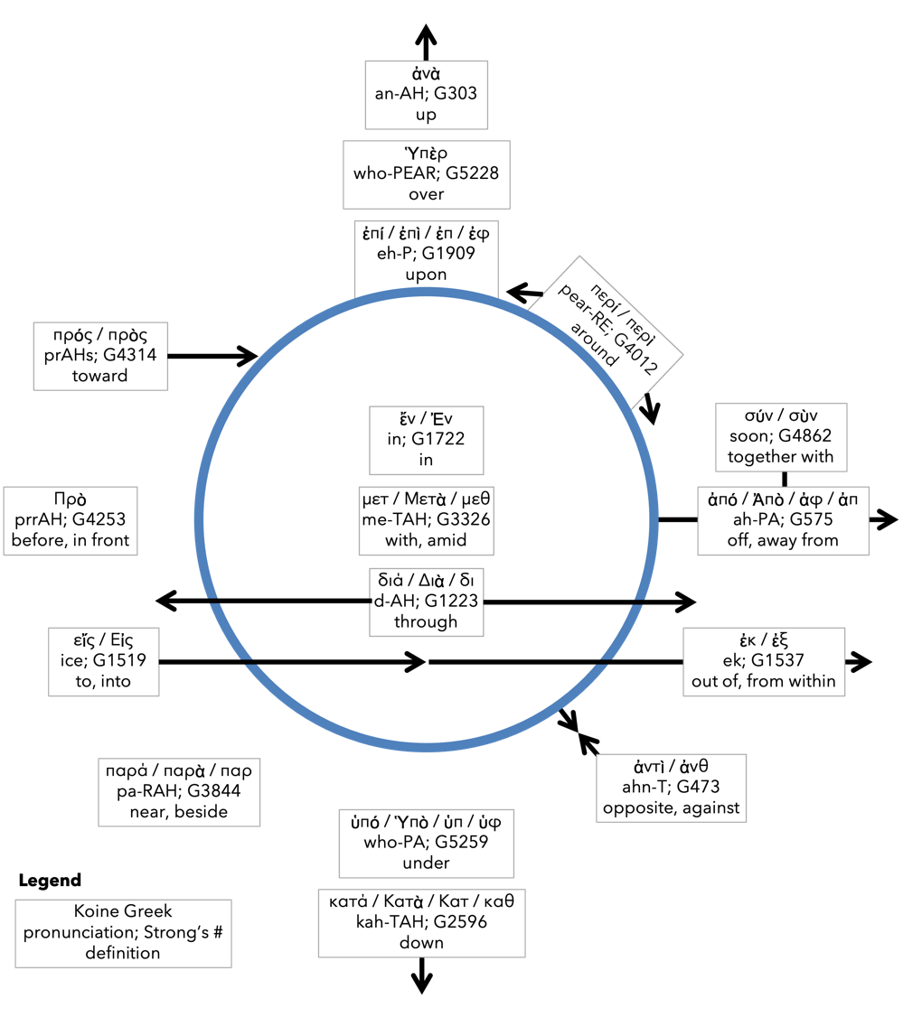
Preposition circle (page 12)

Slide 15
BDAG on morphe (mor-FAY) form, outward appearance, shape

Slide 16
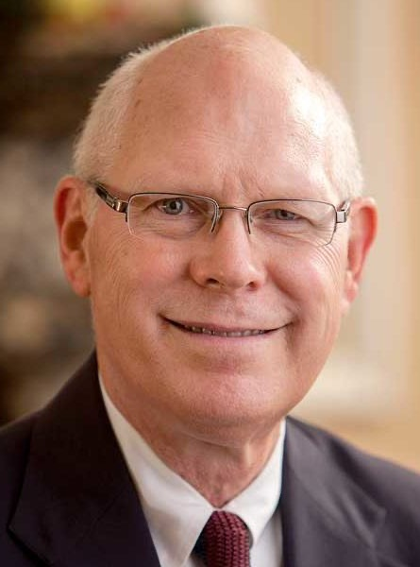
Dr. Gregory K. Beale Quote

Slide 17
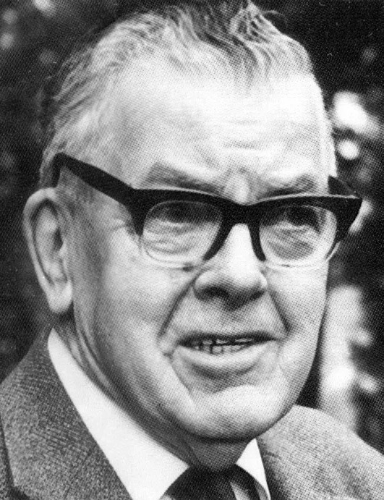
F. F. Bruce Quote

Slide 18
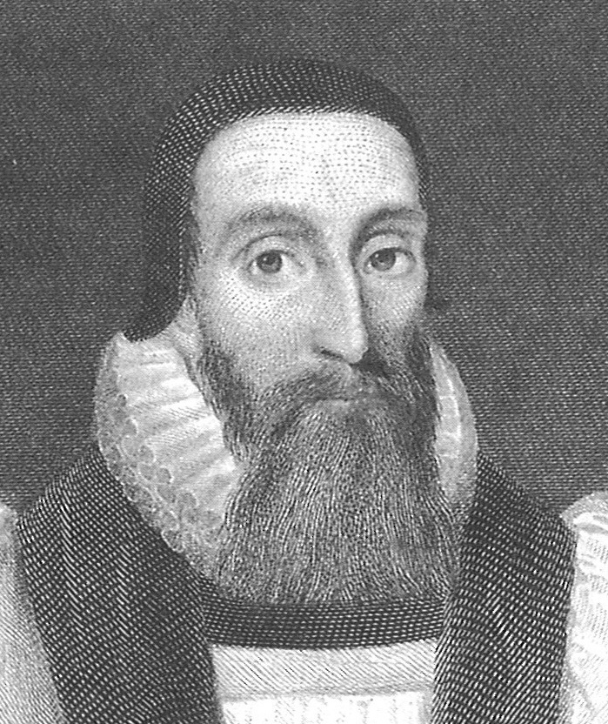
Dr. John Davenant Quote

Slide 19
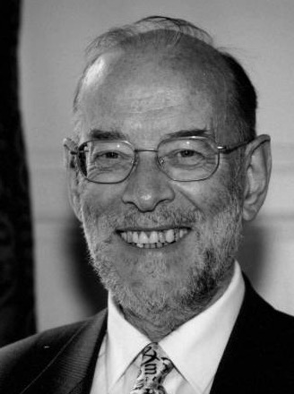
Dr. James D. G. Dunn Quote

Slide 20
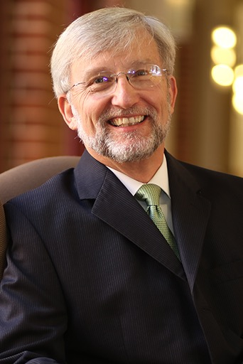
Dr. David Garland Quote

Slide 21
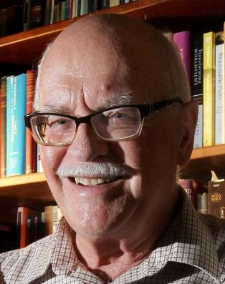
Dr. Murray J. Harris Quote

Slide 22
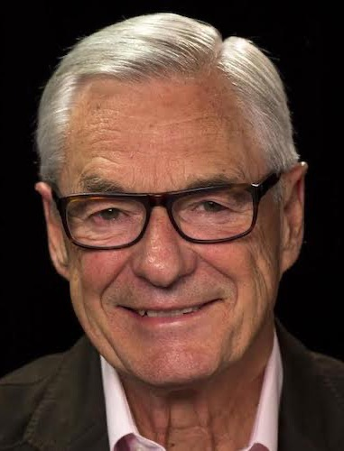
Dr. R. Kent Hughes Quote

Slide 23
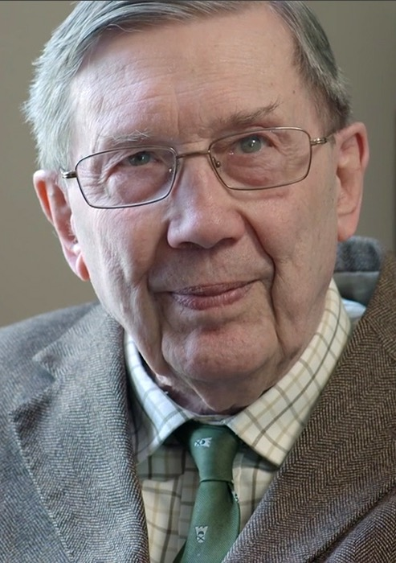
R. C. Lucas Quote

Slide 24
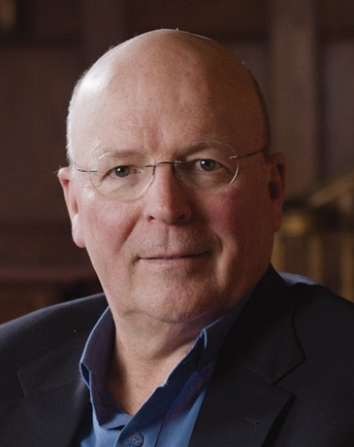
Dr. Scot McKnight Quote

Slide 25
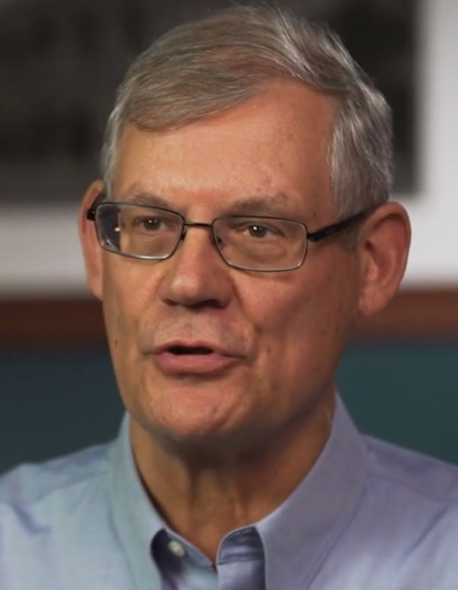
Dr. Douglas J. Moo Quote

Slide 26
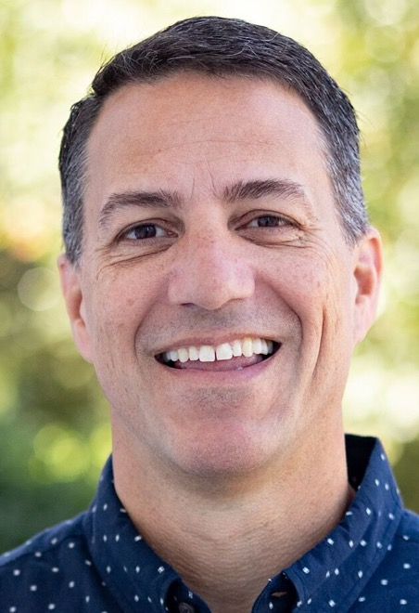
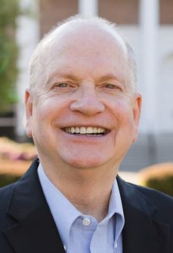
Dr. R. Scott Pace & Dr. Daniel L. Akin Quote

Slide 27
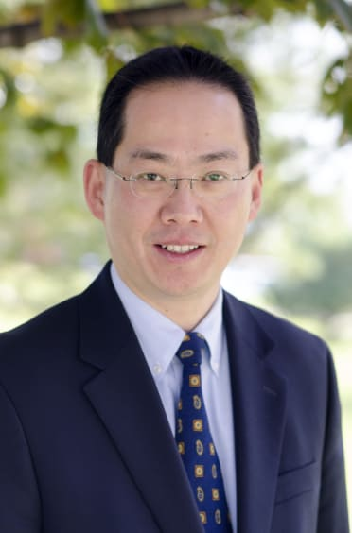
Dr. David W. Pao Quote

Slide 28
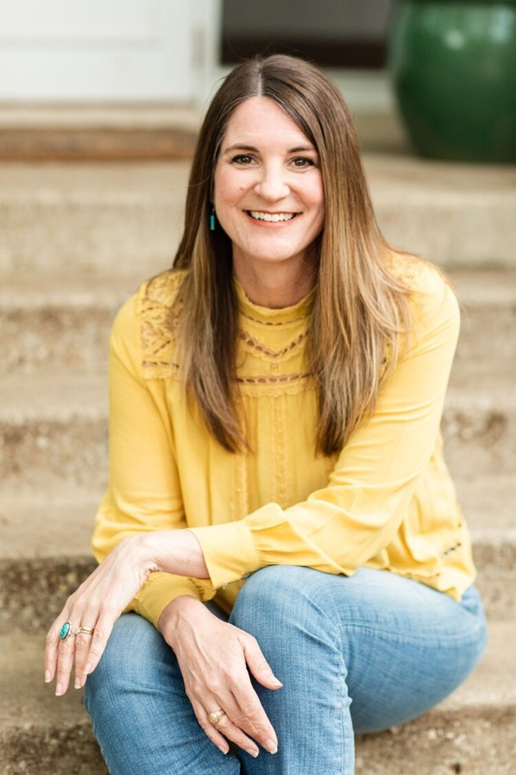
Jen Wilkin Quote

Slide 29
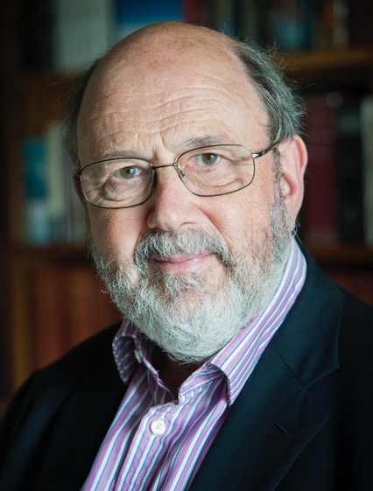
Dr. N. T. Wright Quote

