Slide 1
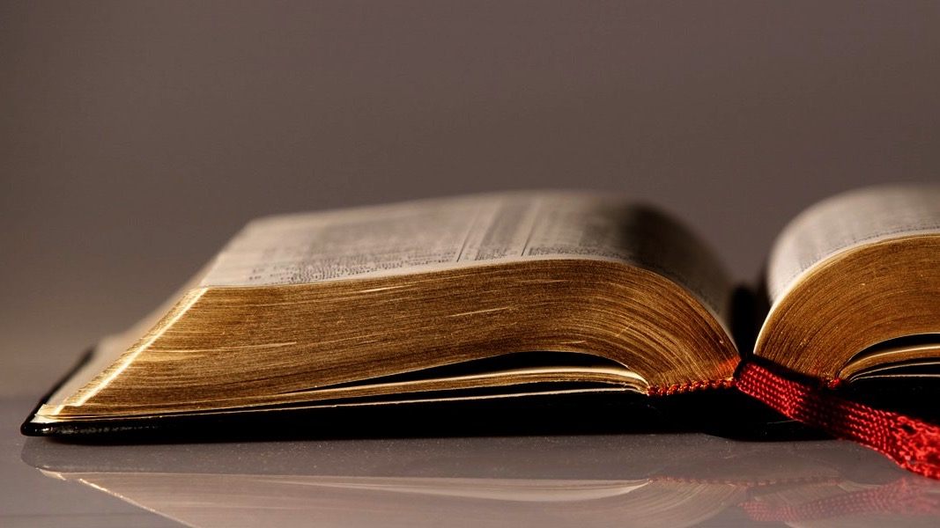
Welcome to
Our Sunday School
We’ll start at 9:07
visit OurSundaySchool.com for more about our class

Slide 2
Today’s class: Colossians introduction
The “Introduction” of the teal book
History of Colossae
History of the Colossian church
Reading Colossians

Slide 3
Today’s class: Colossians introduction
The “Introduction” of the teal book
History of Colossae
History of the Colossian church
Reading Colossians

Slide 5
Page 5: About Our Sunday School

Slide 6
Page 6: About This Resource

Slide 8
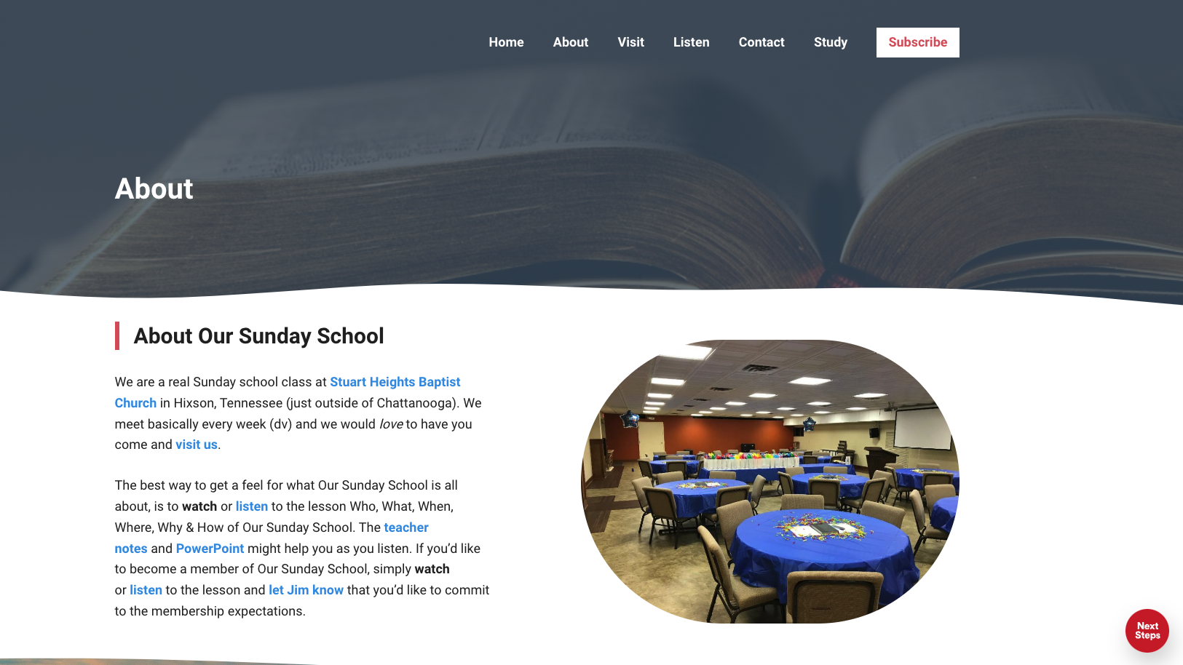

Slide 9
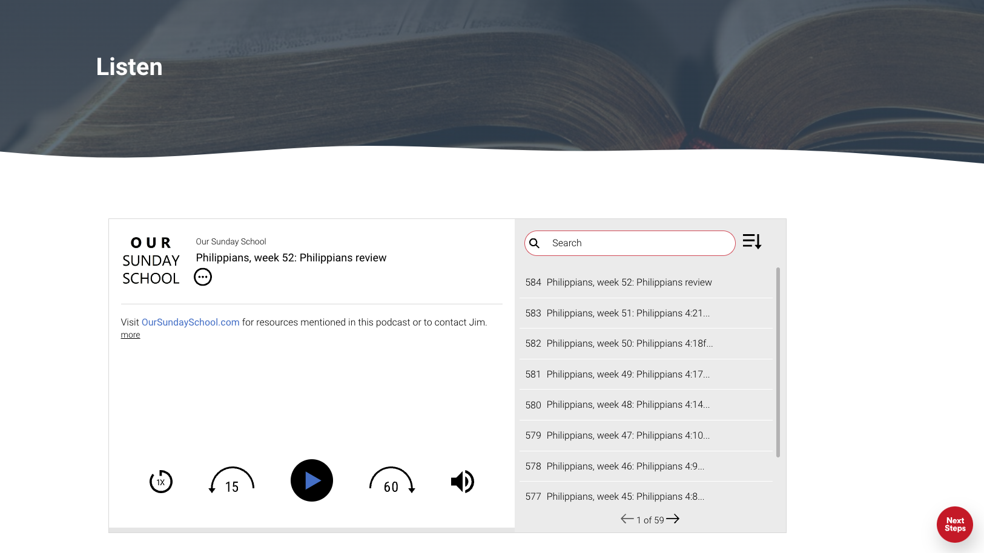

Slide 10
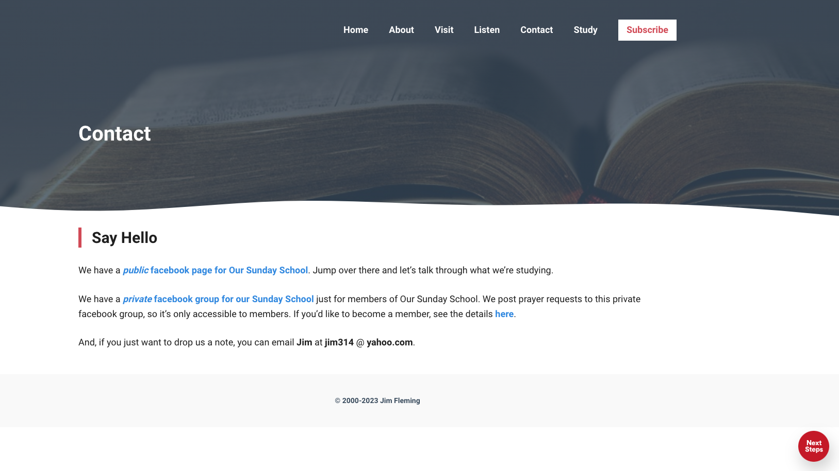

Slide 12
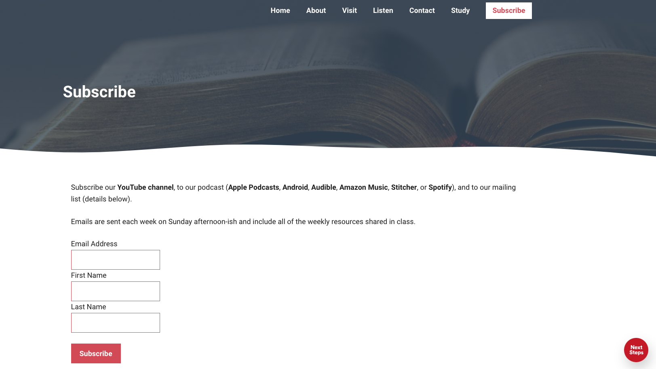

Slide 13
Page 6: About This Resource

Slide 14
Page 7: About This Resource

Slide 15
Pages 7-8: Commentaries

Slide 16
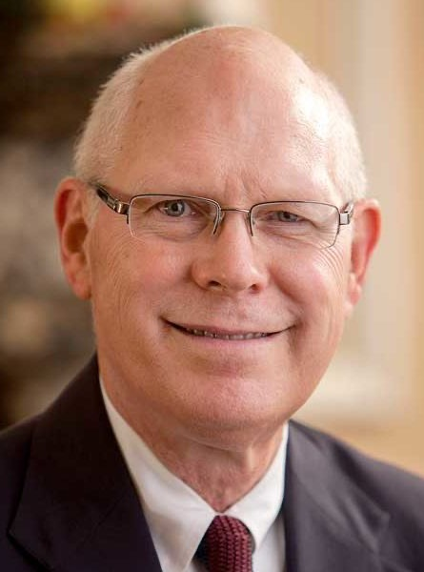
Dr. Gregory K. Beale

Slide 17
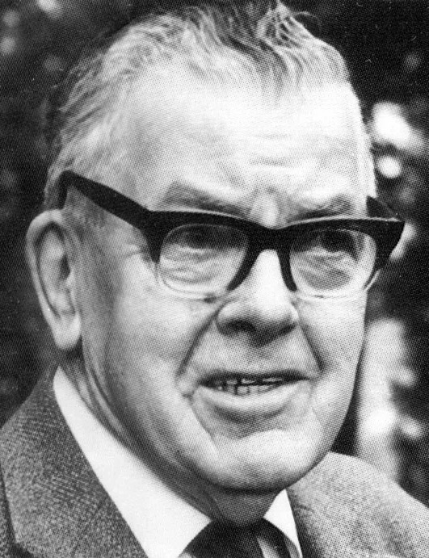
F. F. Bruce

Slide 18
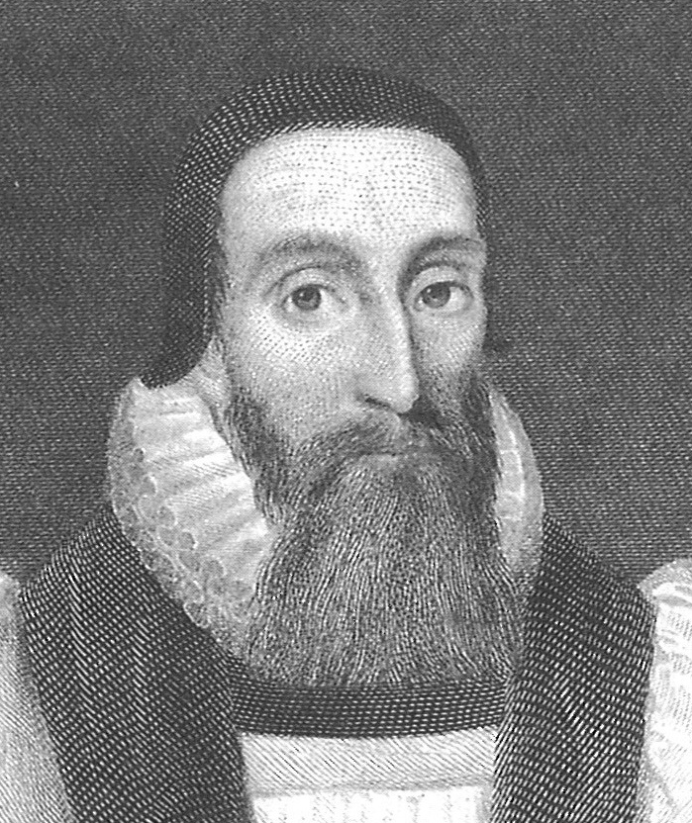
Dr. John Davenant

Slide 19
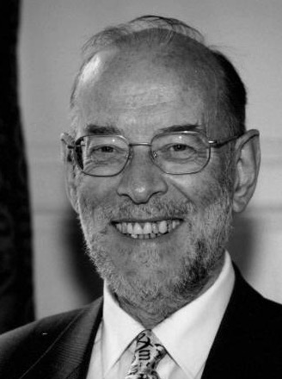
Dr. James D. G. Dunn

Slide 20
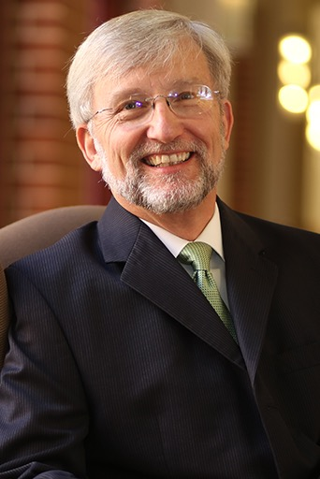
Dr. David Garland

Slide 21
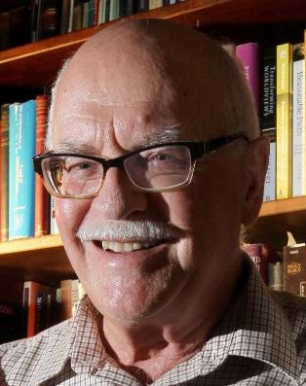
Dr. Murray J. Harris

Slide 22
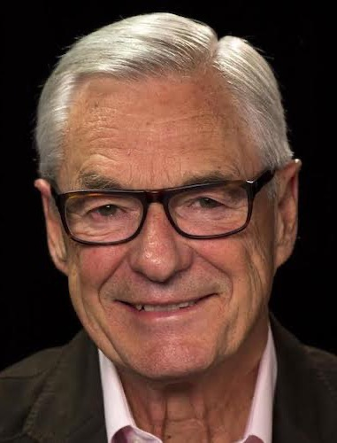
Dr. R. Kent Hughes

Slide 23
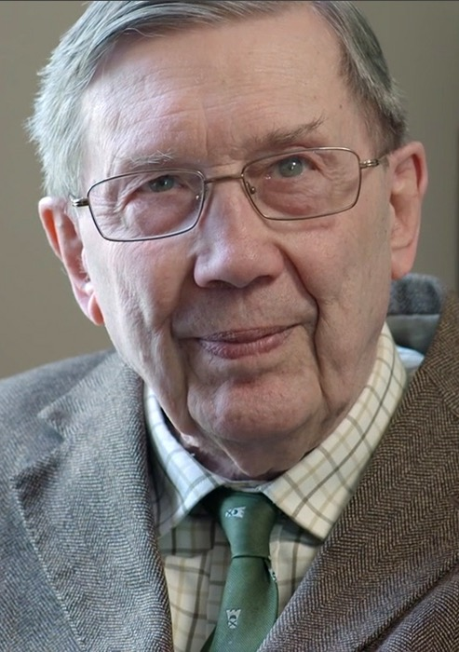
R. C. Lucas

Slide 24
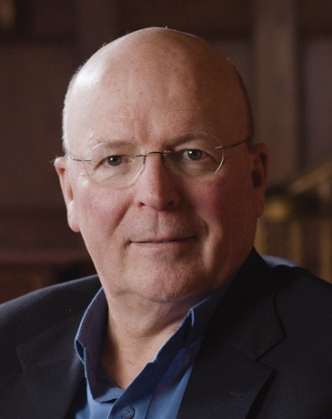
Dr. Scot McKnight

Slide 25
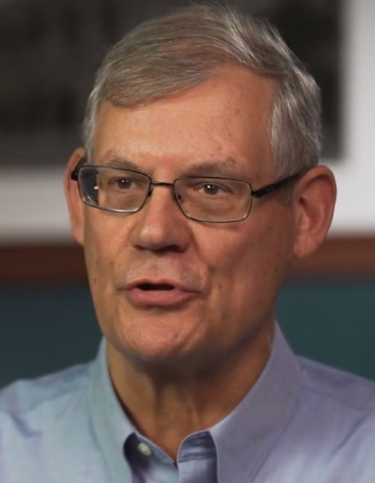
Dr. Douglas J. Moo

Slide 26
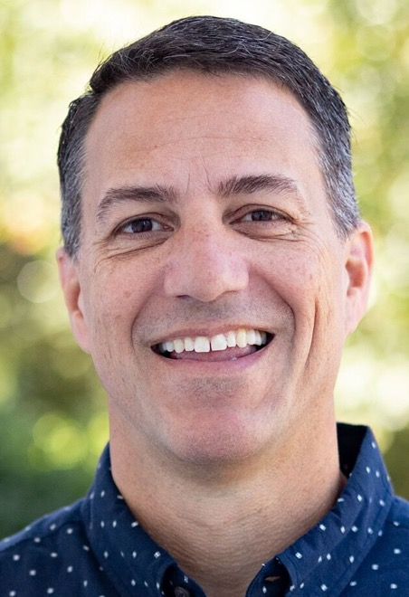
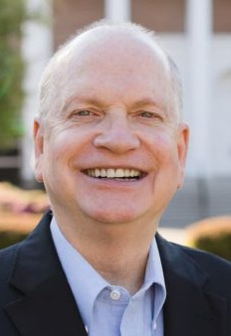
Dr. R. Scott Pace & Dr. Daniel L. Akin

Slide 27
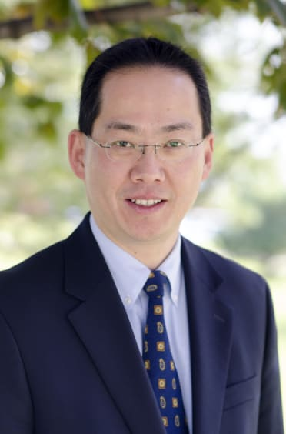
Dr. David W. Pao

Slide 28
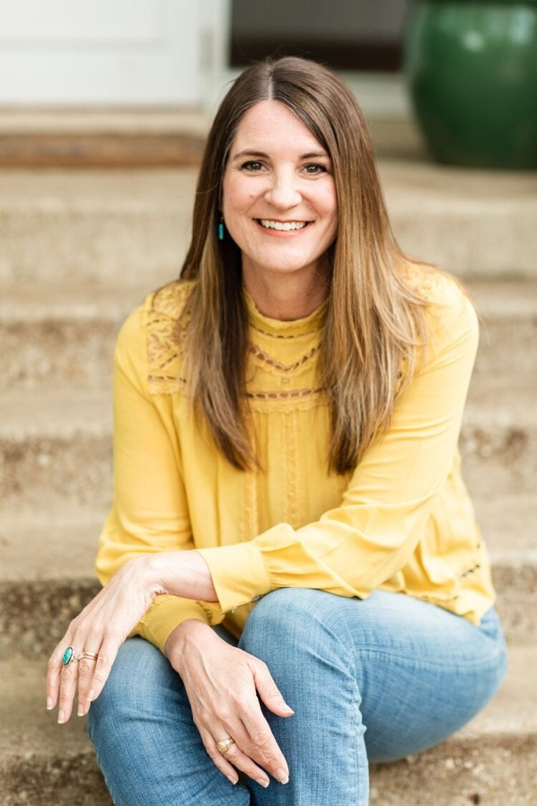
Jen Wilkin

Slide 29
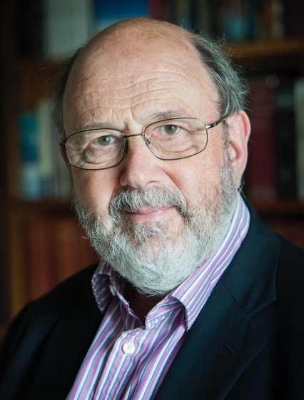
Dr. N. T. Wright

Slide 30
Pages 10-14: Cheat Sheets for Greek

Slide 31
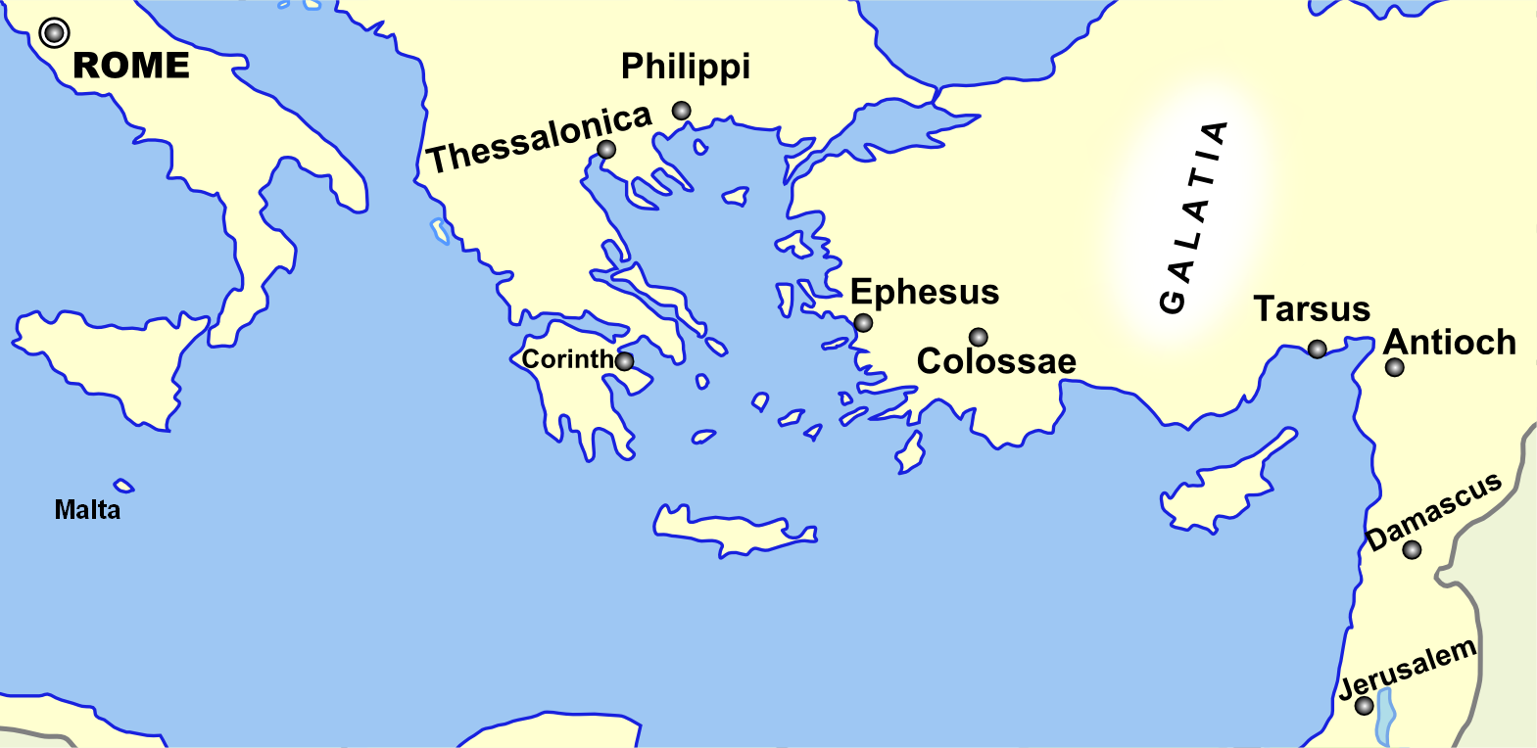
Page 15: Broad Overview of Geography
Monozigote. (2012). Broad Overview of Geography Relevant to Paul of Tarsus [Map]. Wikipedia.

Slide 32
Today’s class: Colossians introduction
The “Introduction” of the teal book
History of Colossae
History of the Colossian church
Reading Colossians

Slide 33
History of Colossae
Was a big deal before the time of Paul
Had dwindled by the time of Paul
“Fusion of religious influences” (Wikipedia)

Slide 34
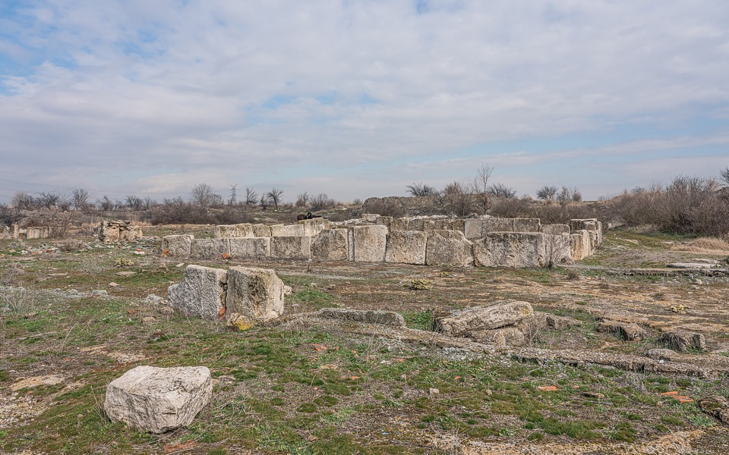
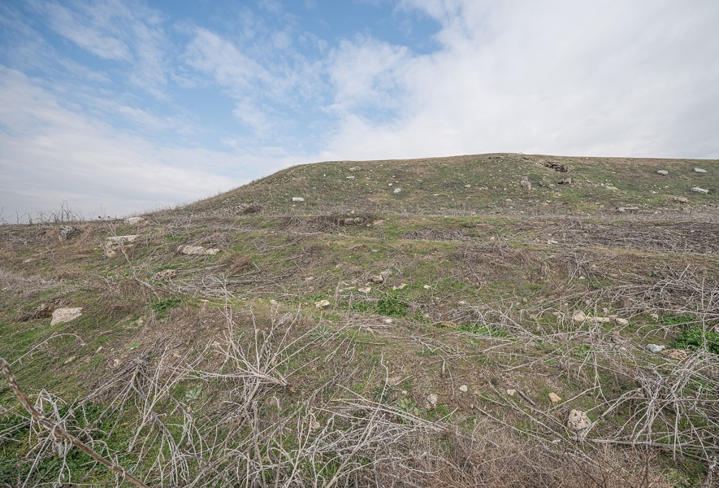
Colossae today
By A.Savin - Own work, FAL, https://commons.wikimedia.org/w/index.php?curid=87546204

Slide 35
Today’s class: Colossians introduction
The “Introduction” of the teal book
History of Colossae
History of the Colossian church
Reading Colossians

Slide 36
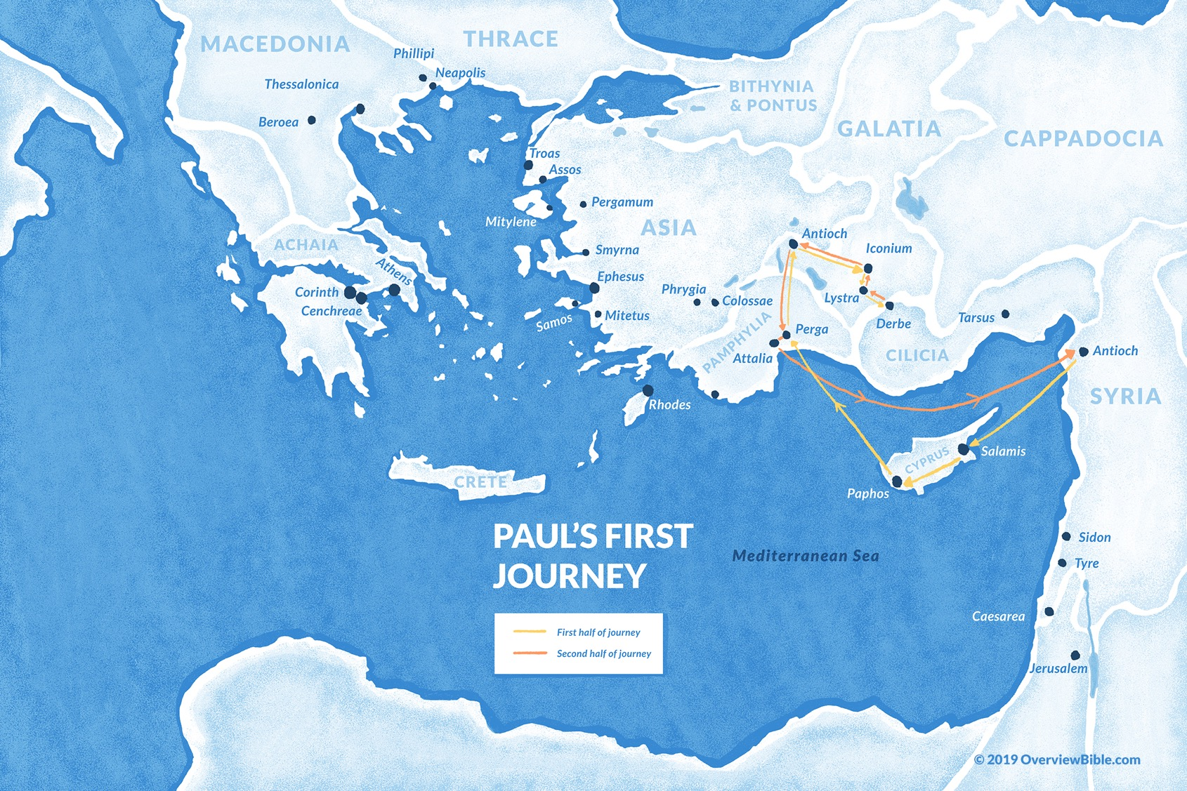
#1
~Acts 13 - 14

Slide 37
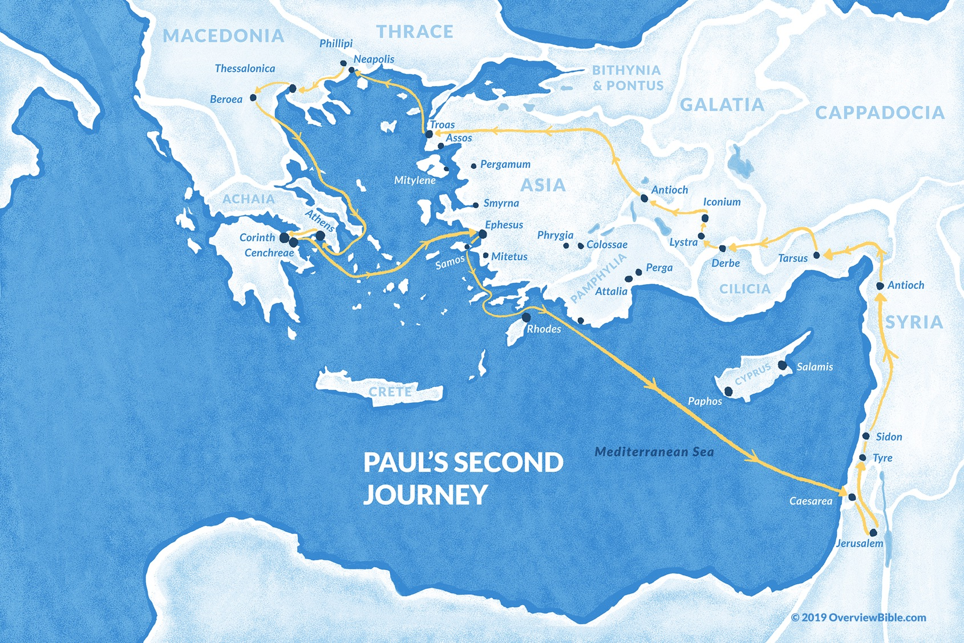
#2
~Acts 15:40- 18:22

Slide 38
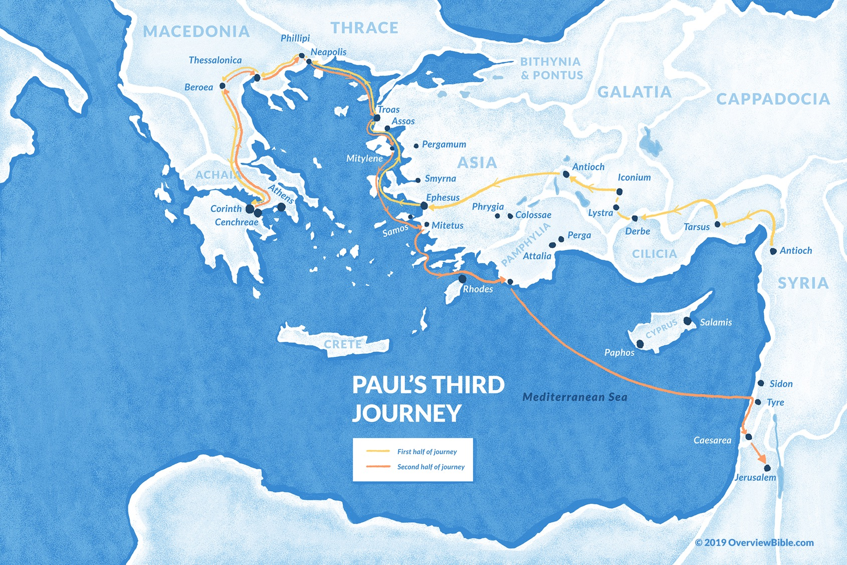
#3
~Acts 18:23-21:15

Slide 39
History of the Colossian church
~Acts 18:23
~Acts 19:1
~Acts 19:8-10

Slide 40
Today’s class: Colossians introduction
The “Introduction” of the teal book
History of Colossae
History of the Colossian church
Reading Colossians

Slide 41
Colossians

Slide 42
Prayer Time
Write down your prayer requests (on the Weekly Update or in the comments
Lean in, engage, and pray for someone not with you
Go worship

Slide 43
Today’s class (page 16)
Preparing for Colossians 1:1-30
Pray with others
Hear with others
Think with others
Study with others In class, as a table
Share with others
Invite others After class
In class, as a class

Slide 44
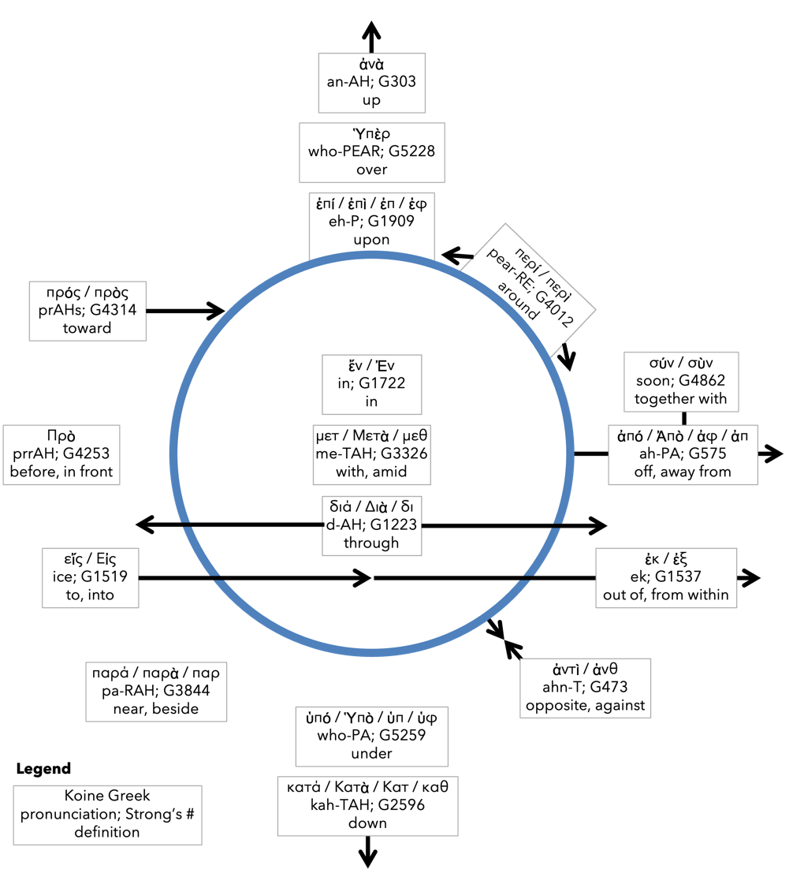
Preposition circle (page 13)

Slide 45
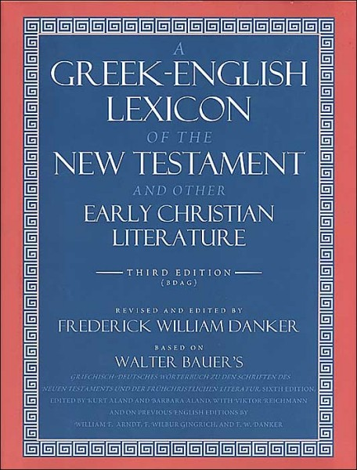
BDAG on morphe (mor-FAY) form, outward appearance, shape

Slide 46
Dr. Gregory K. Beale Quote

Slide 47
F. F. Bruce Quote

Slide 48
Dr. John Davenant Quote

Slide 49
Dr. James D. G. Dunn Quote

Slide 50
Dr. David Garland Quote

Slide 51
Dr. Murray J. Harris Quote

Slide 52
Dr. R. Kent Hughes Quote

Slide 53
R. C. Lucas Quote

Slide 54
Dr. Scot McKnight Quote

Slide 55
Dr. Douglas J. Moo Quote

Slide 56
Dr. R. Scott Pace & Dr. Daniel L. Akin Quote

Slide 57
Dr. David W. Pao Quote

Slide 58
Jen Wilkin Quote

Slide 59
Dr. N. T. Wright Quote

